Slide 1
SignalR Overview

Slide 2
Introduction
Example use cases
  High frequency data updates
  Real-time
  Chat
  Push notifications

Slide 3
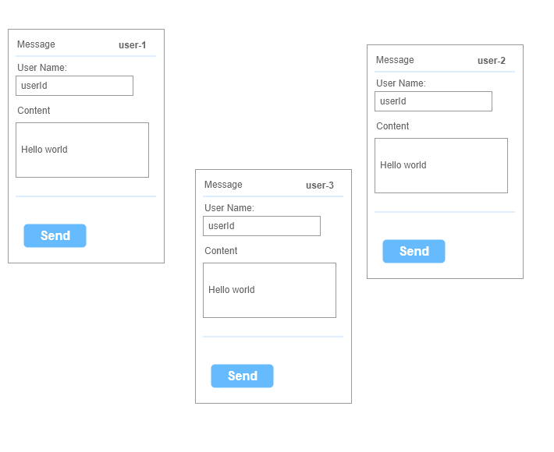
Introduction

Slide 4
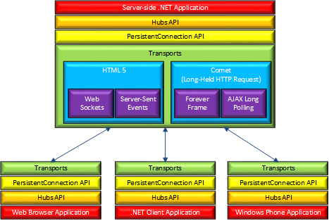
Introduction
SignalR Architecture Diagram

Slide 5
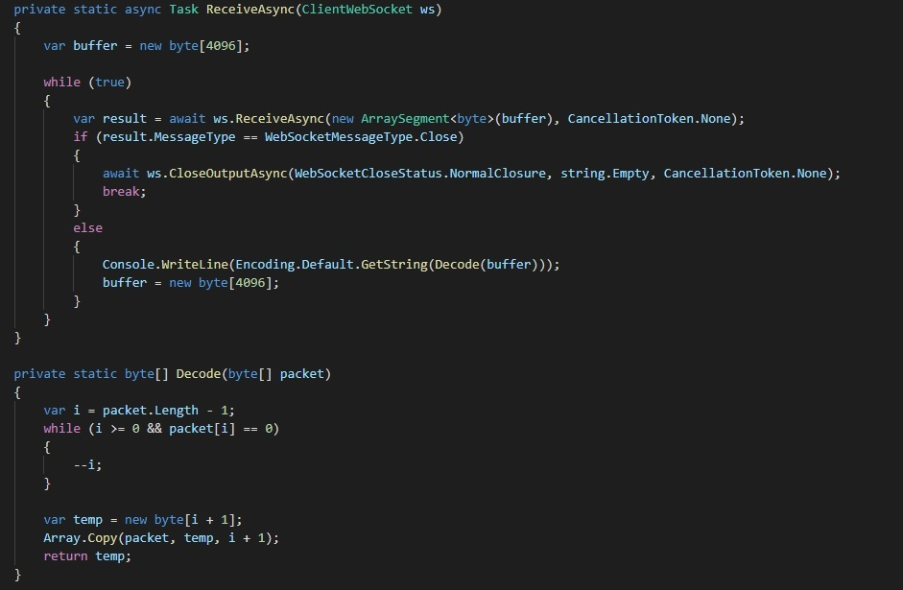


Introduction
What is SignalR
  Server
  Client
WebSocket

Slide 6
External SignalR Client
.Net client
Java Client
Javascript Client

Slide 7
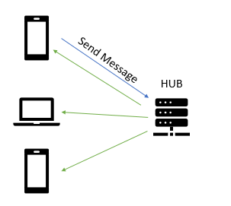
Sending message
To all clients
To specific clients
To clients groups

Slide 8
Streaming
Client streaming
Server streaming

Slide 9
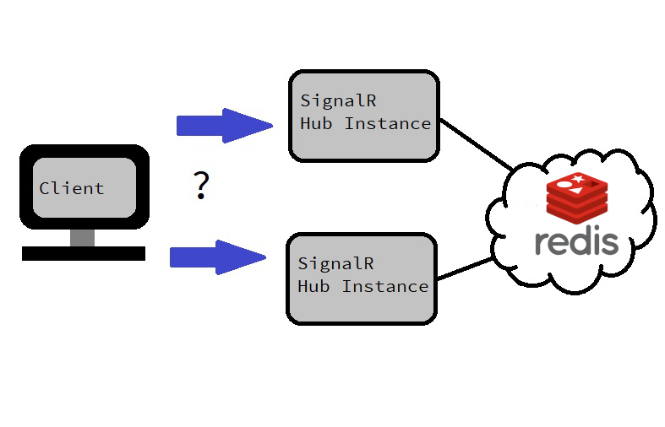
Scaling out SignalR app

Slide 10
Demo & Discussions

