Slide 1

X-RAY VISON: Machine Learning for Fast & Accurate Imaging results
John Jostes, Ronaldo Migliorini,
& Kyna Thorberg

Slide 2
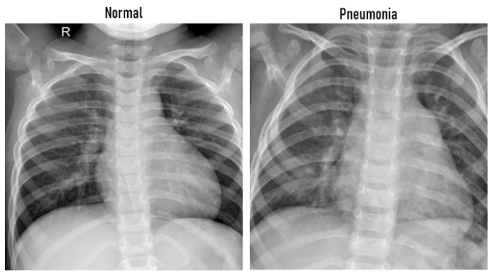
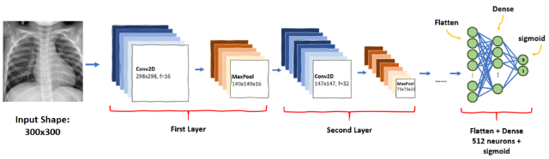

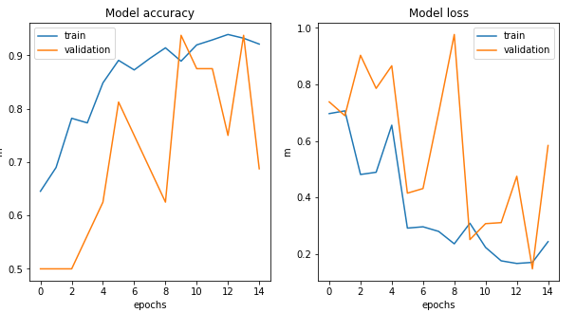
Chest X-rays Pneumonia Detection using Convolutional Neural Network
John josteS, kyna Thorberg, Ronaldo migliorini

Slide 3

THE DATA SET
KAGGLE
Data Set
COVID-19 Radiography Db
https://www.kaggle.com/tawsifurrahman/comments
Database of chest X-ray images for COVID-19 positive cases along with Normal and Viral Pneumonia images. There are 219 COVID-19 positive images, 1341 normal images and 1345 viral pneumonia images. update is regular. Main objective is to researchers can use this database to produce useful and impactful scholarly work on COVID-19, which can help in tackling this pandemic.
219 COVID-19
1341 NORMAL
1345 PNEMONIA

Slide 4
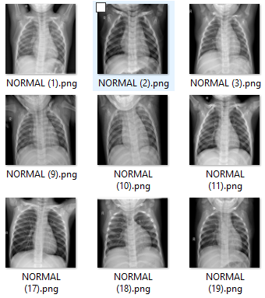
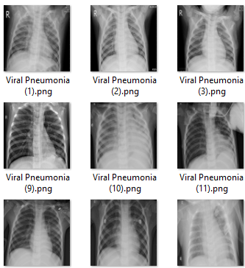
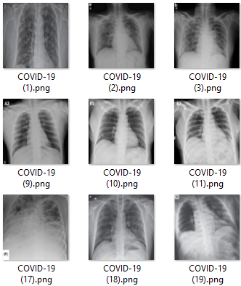
THE DATA SET
1341 NORMAL
1345 PNEMONIA
219 COVID-19

Slide 5
Breaking news – The vision
Millionaires John Jostes, Kyna Thorberg, Ronaldo Migliorini, pioneers on Machine Learning applied to image recognition decided today to associate with Elon Musk to produce smart eyes for self driving cars

Slide 6
What to do if the dataset isn’t ideal: Problems we encountered
In a practical setting, not all data is ideally designed for analysis. Small budgets, limited data availability, and naturally occurring irregularities are a part of dealing with real-world data. Two problems presented especially challenging obstacles to our model:
Unbalanced Data:
Problem: Thankfully, Covid is vastly outnumbered in the data by healthy lungs and those with more familiar patterns of viral pneumonia. However, this leads to a natural imbalance in the data that the model must account for. This is a common problem that naturally occurs in various datasets, like those dealing with fraud detection, spam filtering, and medical diagnoses involving rare diseases.
Potential Pitfall of an Unbalanced Data Set:
Difficulty predicting the smaller set due to the limited number of samples from this class
Potential Solutions:
Identify whether you can collect more data.
Adjust sampling method (over or under-sample)
Adjusting classifying methods (adjust classifications, threshholds; combine methods)

Slide 7
What to do if the dataset isn’t ideal: Problems we encountered
Small Datasets:
Problem: Covid-19 represents a new area of study with limited amounts of available data.
Potential Pitfalls of a Small Dataset:
Bias/Variance Trade-Off (Models w/low bias and high variance tend to overfit data; high bias/low variance tend to underfit).
More likely to see patterns that don’t exist, leading to overfitting.
Potential Solutions:
Use simple models (e.g., logistic regression, simple linear models w/limited weights, regularization techniques).
Remove outliers.
Select relevant features.
Combine models.

Slide 8
Using the Data We Have: Solving the Imperfect Data Problem
Our Solutions:
IMBALANCED DATA:
Simplify data classification into 2 categories: Diseased vs. Normal
Focus research on preliminary goal of training model to identify pneumonia via x-ray. Further research could focus on whether there is a distinction between images of pneumonia caused by more well-known viruses vs. pneumonia caused by COVID-19. This data would still speed the results of chest x-rays and reduce the burden of busy medical staff.
SMALL DATASET:
Augment the existing data (https://blog.keras.io/building-powerful-image-classification-models-using-very-little-data.html)
Performs random transformations, so that the model avoids seeing the exact same pic more than once (prevents overfitting and helps model generalize better)
Uses keras.preprocessing.image.ImageDataGenerator class to:
Create random transformations and normalization operations used on images during training.
Instantiate generators of the augmented images/labels. Generators are then used with keras model methods that accept them as inputs (fit_generator, evaluate_generator and predict_generator).

Slide 9
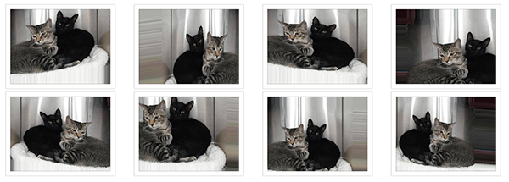
Augmenting Strategy: An example

Slide 10
Using the Data We Have: Alternatives
Other available algorithms/methods:
IMBALANCED DATA:
MNIST
CIFAR-10
Confusion Matrix / F-1 Score
SMOTE
(Synthetic Minority Oversampling
Algorithm)
One-class classification
Cost Sensitive-Learning
SMALL DATASET:
K-nearest neighbors
PCA

Slide 11
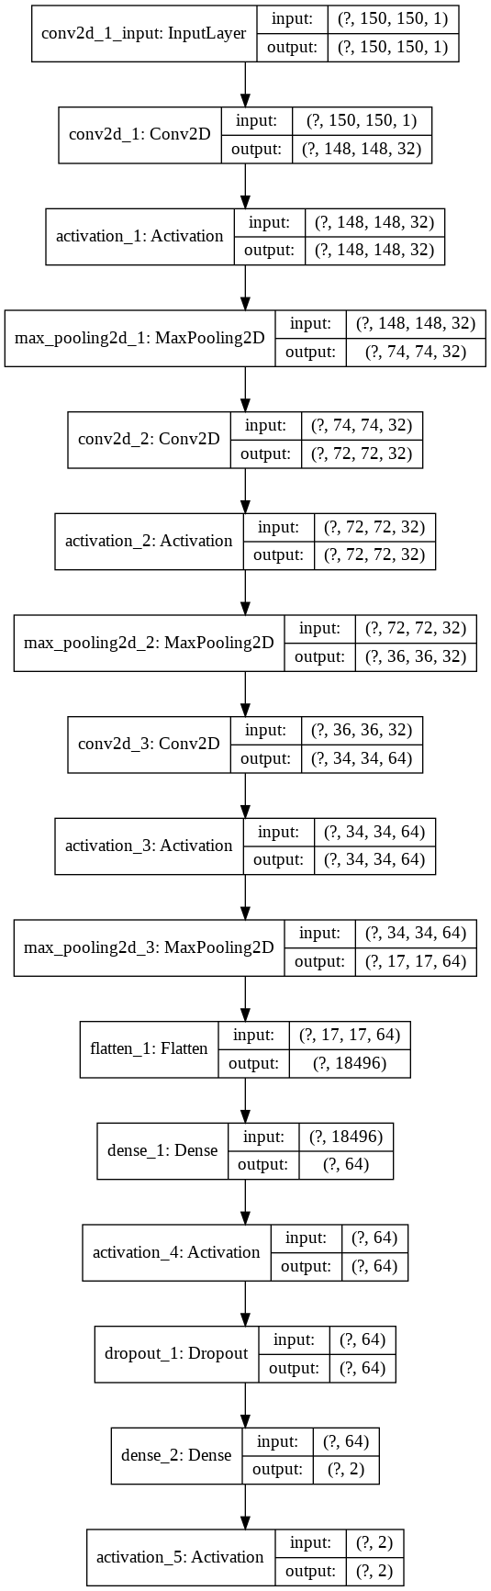
The BIG Picture: Designing a CNN
Convolutional Neural Network (CNN):
CNN uses repeated layers to find features in an image, recognizing increasingly complex features as it goes. This makes it an ideal choice for analyzing images like our x-ray data.
Basic Structure:
Convolutional Layers
ReLU Layers
Pooling Layers
A Fully-Connected Layer

Slide 12
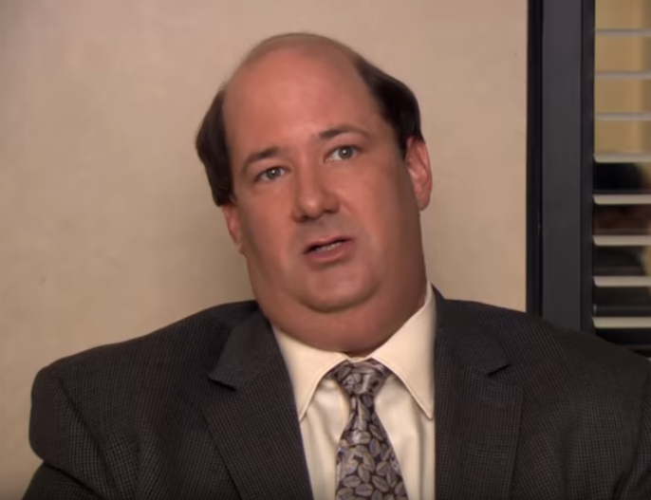
Building the CNN
“Me think, why waste time say lot word when few word do trick”
- Kevin Malone
“lot word waste few word do”

Slide 13
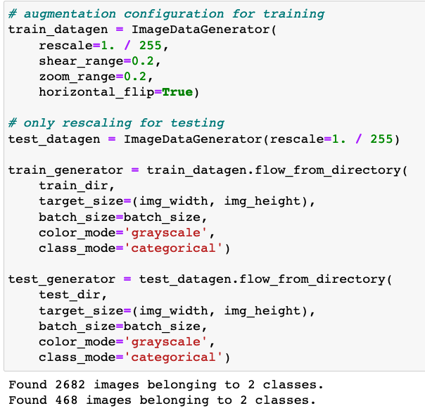
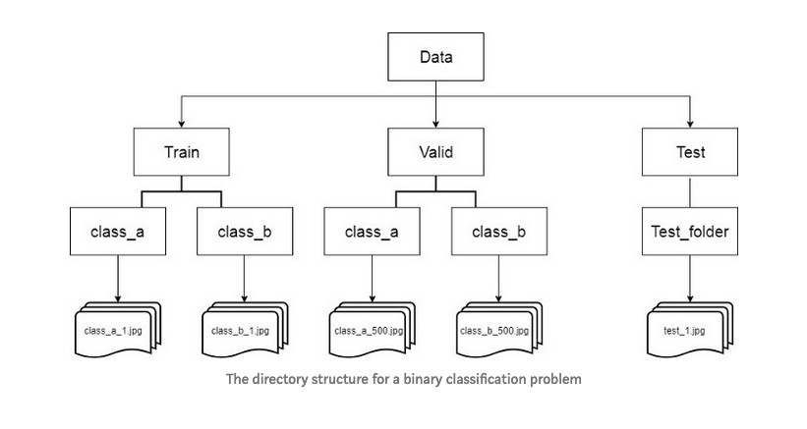
Building the CNN
Importing Data

Slide 14
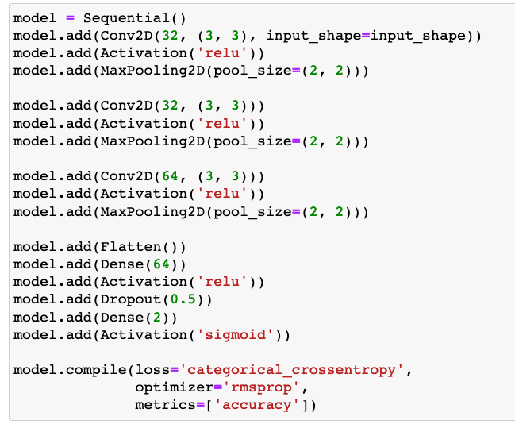
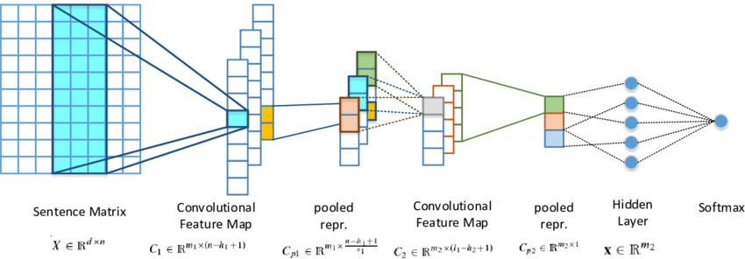
Constructing
Building the CNN

Slide 15
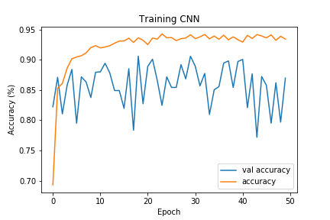
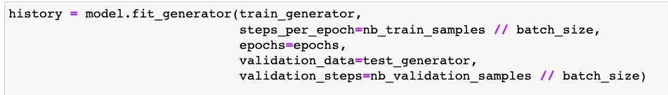
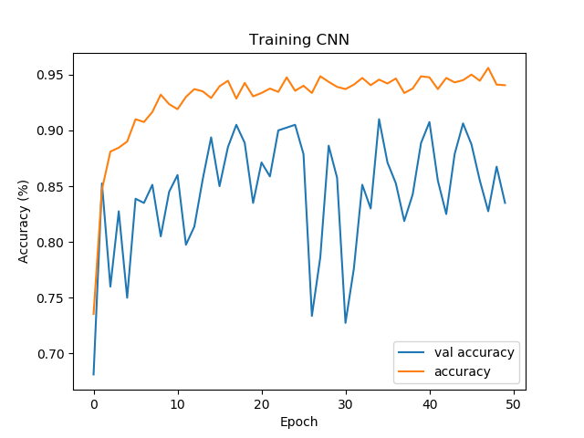
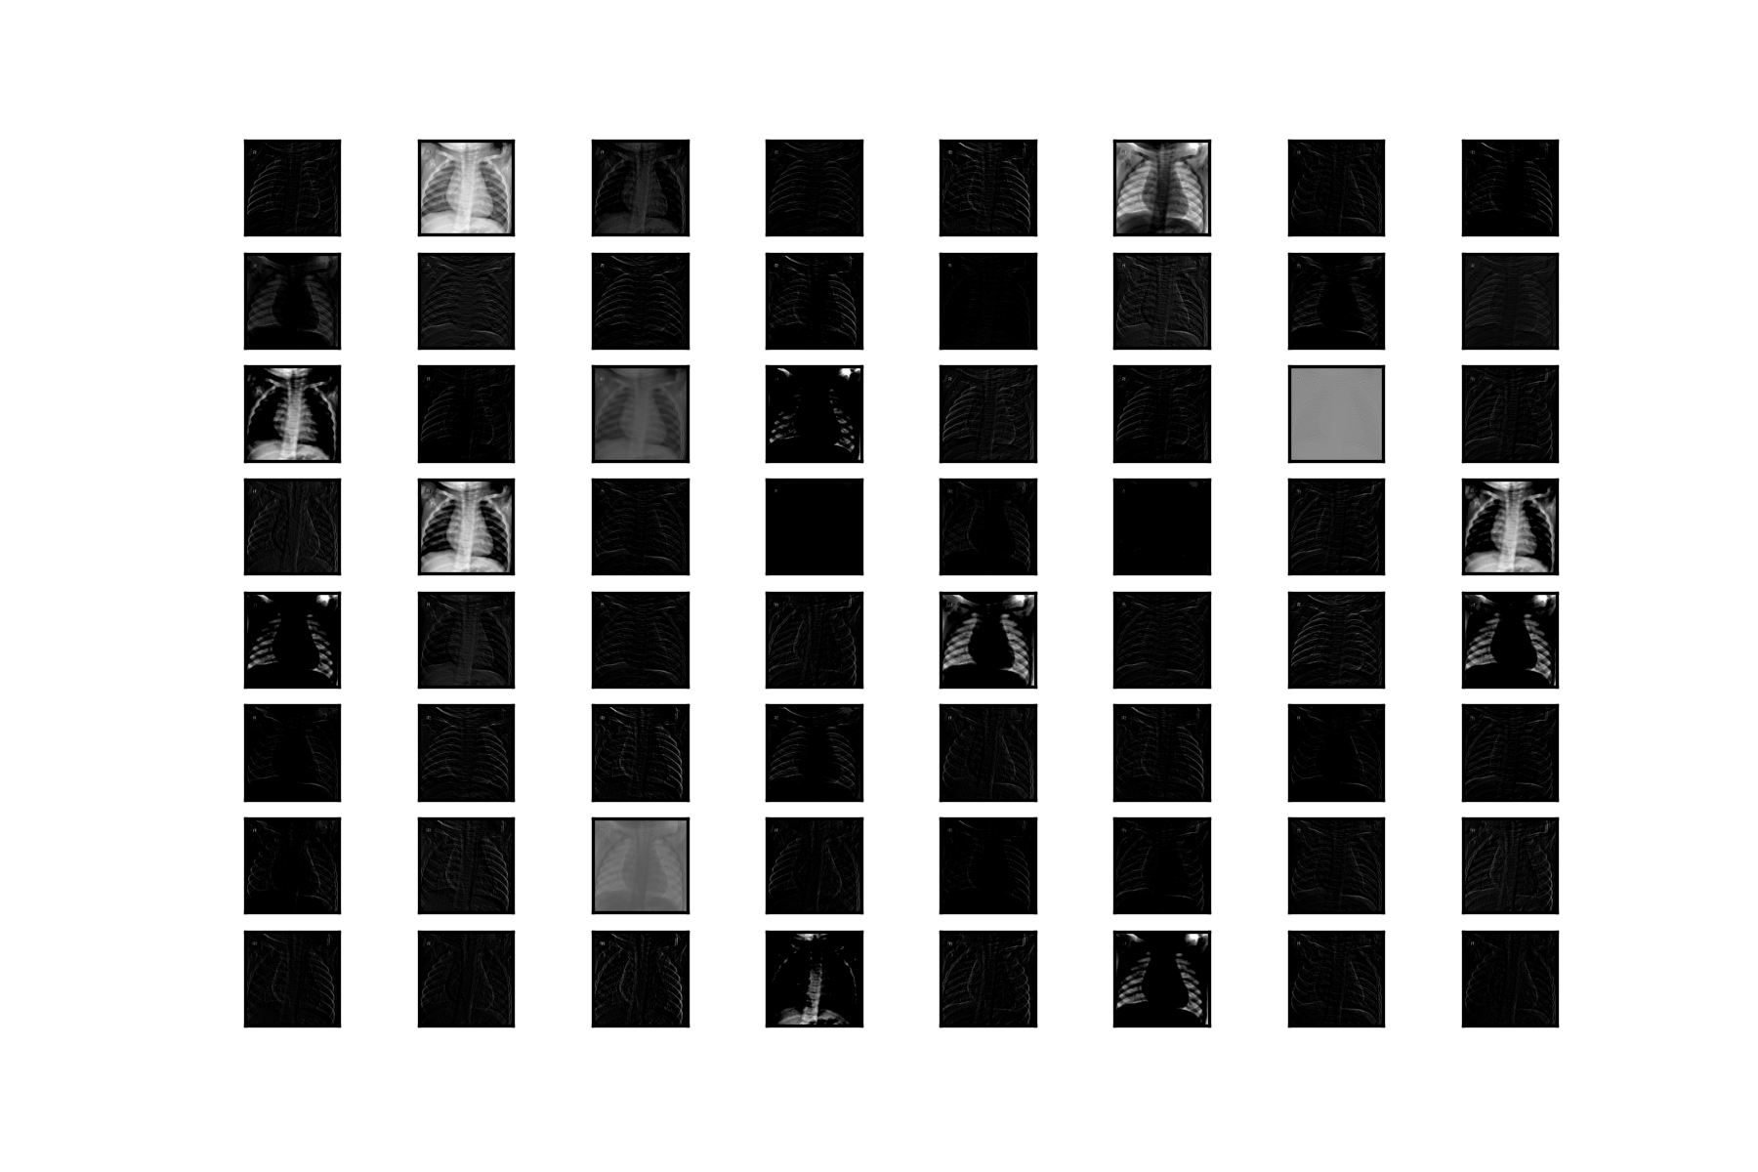
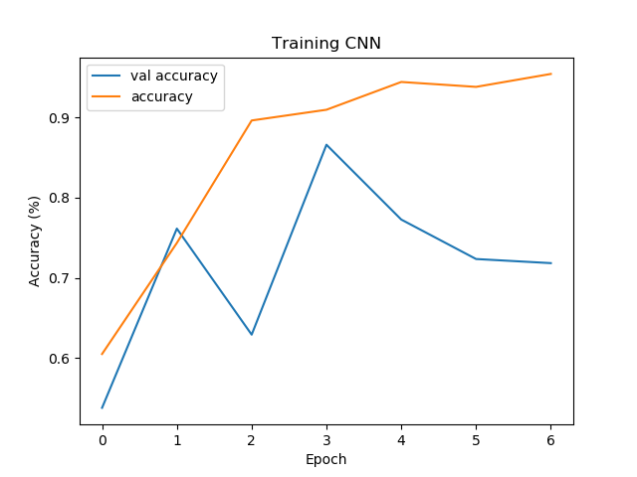
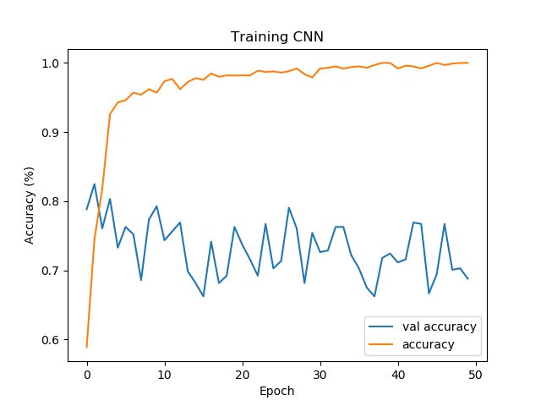
Model.fit( )
Training, Testing Model

Slide 16
Final Thoughts/Questions?

