Slide 1
Estuary Flows - Planning
4/7/26

Slide 2
Milestone
By September 30, 2026, gather and document details necessary (e.g., use case, state of the art, bathymetry, inflow) to motivate and perform a simulation of an estuary flow under conditions for which field measurements exist. Perform high-fidelity simulation of estuary flow to investigate the flow/current structures that are resolved that would inform turbine siting.
Validate the capability against field measurements, and document any advantages compared to a regional-scale model typically used, e.g., FVCOM

Slide 3
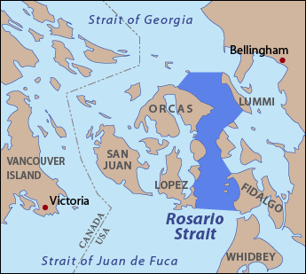
Rosario Straight, WA

Slide 4
Functional Description of Milestone
*With Turbine
AMR-Wind will read in mesoscale flow from precursor FVCOM simulation, informing the velocity and volume fraction (and thereby, density) fields at the boundary.
AMR-Wind will model bathymetry using the existing immersed boundary forcing method (IBFM). The wall effects will be handled using existing LES-compatible wall models.
AMR-Wind will represent the turbine and any associated structures using actuator-based methods, coupled with Kynema to calculate the structural dynamics.
Kynema will calculate the forces on the turbine and any associated structures with its aerodynamics module, which will include added mass effects due to the high density of water.

Slide 5
Task Categories
Implementation of required features
Validation of simpler cases with relevant capabilities
Practicing similar cases to prepare for milestone run
Data gathering and prep for milestone run
Evaluate milestone results

Slide 6
Capabilities that need V&V
Immersed Boundary Forcing Method (IBFM)
  Flat boundary case – laminar
  Non-flat boundary case – laminar
  Flat boundary case – using wall model
  Non-flat boundary case – using wall model
IBFM for underwater flows
  Simple channel – laminar
  Simple channel – using wall model
  Complex channel – using wall model
Current and sea surface rise
Kynema added mass aero

Slide 7
Required capabilities
FVCOM data → boundary condition
  FVCOM data → boundary plane
  Boundary plane refactor, phase-aware and terrain-aware
  FVCOM data → initial condition
Underwater source term for turbulent validation
Kynema added mass aero
Setup of non-turbine bodies through AMR-Wind

Slide 8
Practicing similar case
Need for optimizing domain size, number of cells, pressure solver options:
  Pancake shape of domain
  High aspect ratio cells
  Resolution across liquid-gas interface may be nonuniform

Slide 9
Data gathering and prep
Bathymetry
FVCOM data for input, initial condition
Field measurements for validation
FVCOM data for comparison of advantages, disadvantages
Generic underwater turbine, potentially with additional structures

Slide 10
Evaluate milestone results
Gather information about state of the art to motivate our approach
Identify post-processing needs and inputs for milestone run in order to do analysis and comparison
Analyze flow features, quantities of interest, insights about turbine siting within milestone run
Compare to state-of-the-art modeling options, e.g., FVCOM

Slide 11
April
AMR-Wind features and refactoring
1 basic V&V case
Set up test bed domain
May
Intermediate V&V cases
Get FVCOM data
Start to use test bed
June
Remaining AMR-Wind features
Remaining V&V cases
Demonstrate / test sea level rise
July
Validate sea level rise
Finish any tasks left over from previous months
August
Define details of milestone run
Run coarse-resolution milestone case
Obtain field data for milestone validation
September
Run full-resolution milestone case
Understand state of the art
Analyze milestone results and compare

