Slide 2
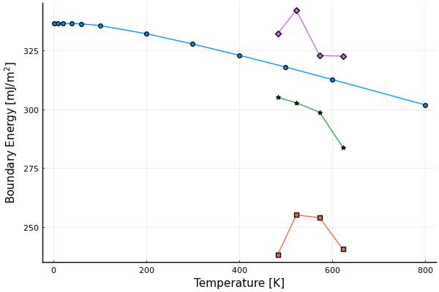
exp. 71.5 deg
This work 36.87 deg
exp. 23.3 deg
exp. 10.3 deg

Slide 3
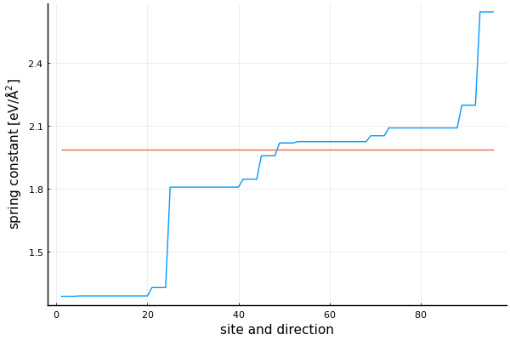
perfect
twist boundary

