Slide 1
Orientation : 2024-2 Maro seminar
2021105280 kyungmin Kwon
2024/11/05

Slide 2
Why We are Hosting this Seminar?
Underclassmen have the opportunity to reflect on what subjects they might study and develop an interest in, by observing the presentations of their seniors.
Upperclassmen have the chance to solidify their knowledge and organize their thoughts by presenting their areas of study.

Slide 3
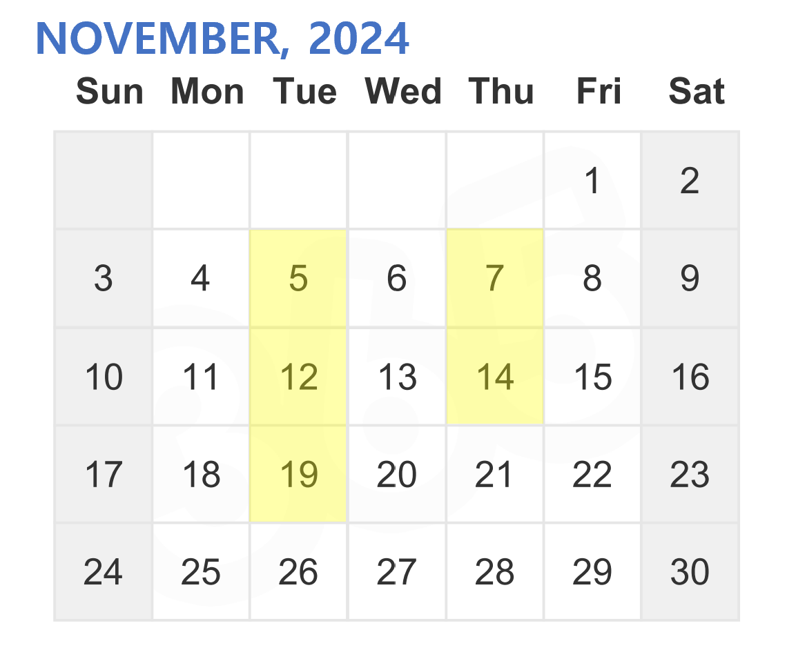
Info. of the Seminar
Time: 19:00 - (likely until 21:00) Location: 전정대 강의실 (subject to change) Announcement: Will be posted the day before Presenters: Please refer to the website for details

Slide 4
Thank you!

