Slide 1
Quantum computer and Quantum Computing Logic Gates: How can they be implemented optically?
2021105280 kyungmin Kwon
2024/11/05

Slide 2
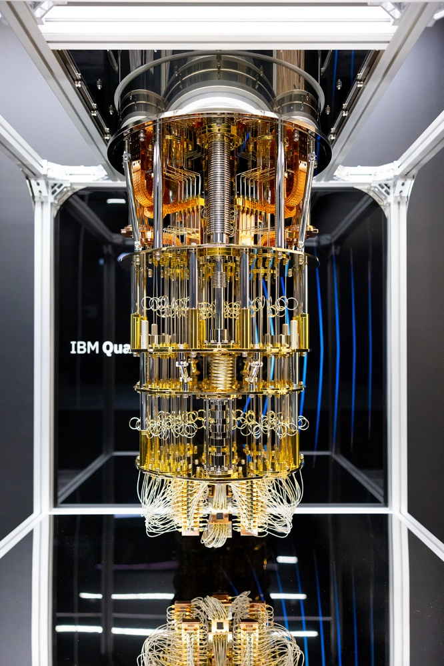



What is Quantum Computer?
Quantum computer harnesses the principles of Quantum Mechanics to solve complex problems that classical computers are unable to resolve in a timely or efficient manner.
The principles of Quantum Mechanics
1. Superposition 3. Decoherence
2. Entanglement 4. Interference
Schrödinger's Cat (A simple way to understand Q.M.)
DEAD
Break down or not
ALIVE
$\text{∣}\text{ψ}\text{⟩=}\frac{1}{\sqrt{2}}\text{∣}\text{decay}\text{⟩}\text{∣}\text{dead}\text{⟩}$+$\frac{1}{\sqrt{2}}\text{∣}\text{no}\text{−}\text{decay}\text{⟩}\text{∣}\text{alive}\text{⟩}$
https://www.japan.go.jp/kizuna/2024/03/100000_qubit_quantum_computer.html

Slide 3
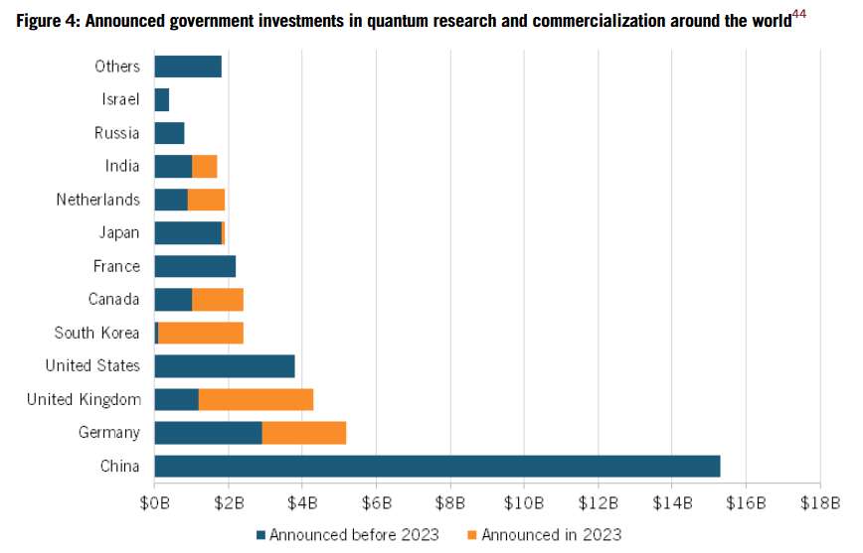
Before we begin,,,
• What is Quantum Computer and why is it important?
• The difference of quantum computer and classical computer. (Bit, Logic gate)
• How logic gates are represented optically and why build optical computer?
https://itif.org/publications/2024/09/09/how-innovative-is-china-in-quantum/

Slide 4
What is Quantum Computer?
Quantum computer harnesses the principles of Quantum Mechanics to solve complex problems that classical computers are unable to resolve in a timely or efficient manner.
The principles of Quantum Mechanics
1. Superposition 3. Decoherence
2. Entanglement 4. Interference
Schrödinger's Cat (A simple way to understand Q.M.)
DEAD
Break down or not
ALIVE
$\text{∣}\text{ψ}\text{⟩=}\frac{1}{\sqrt{2}}\text{∣}\text{decay}\text{⟩}\text{∣}\text{dead}\text{⟩}$+$\frac{1}{\sqrt{2}}\text{∣}\text{no}\text{−}\text{decay}\text{⟩}\text{∣}\text{alive}\text{⟩}$
https://www.japan.go.jp/kizuna/2024/03/100000_qubit_quantum_computer.html

Slide 5
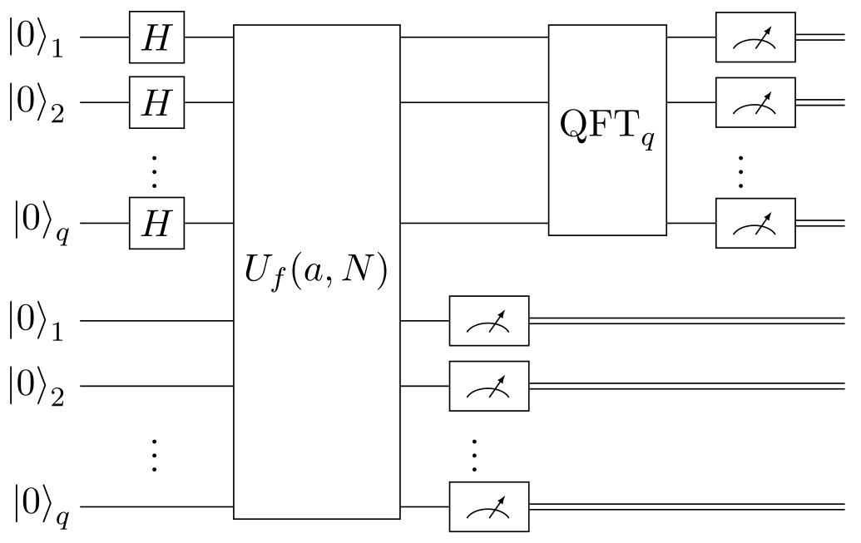
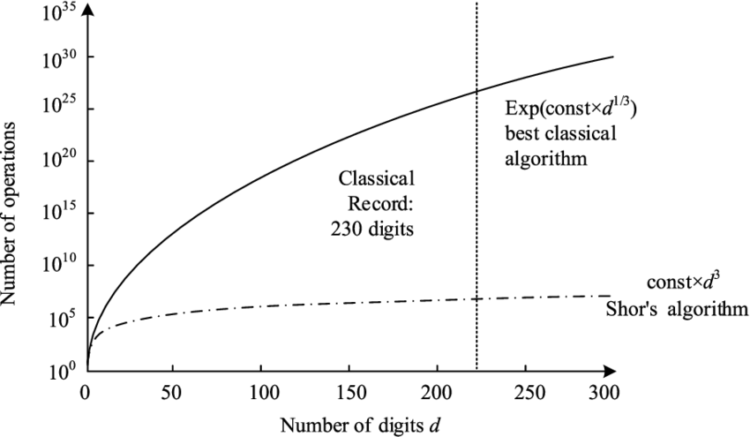
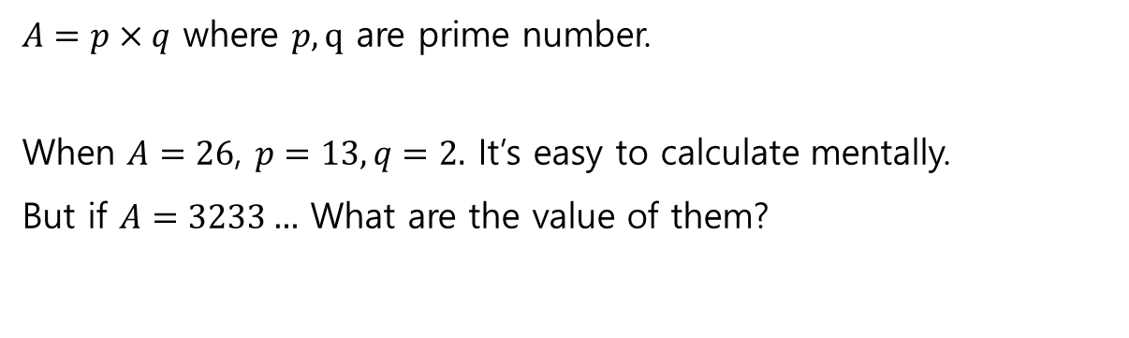
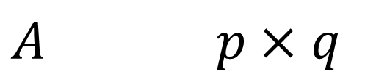
Why is the quantum computer important? (Aspects of Factorization)
Financial cryptographic system
In encryption methods like RSA, a number generated by multiplying two large prime numbers is created and used as a private key to decrypt messages.
Let’s factorize the following.
$A=p×q$ where $p, q$ are prime number.
When $A=26$, $p=13, q=2.$ It’s easy to calculate mentally.
But if $A=3233…$ What are the value of them?
Easy
$A p×q$
Hard
Shor Algorithm
If quantum computers advance further,
the existing RSA system will be broken.
What are the value of them?

Slide 6

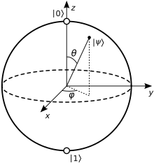
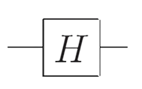
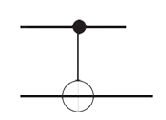
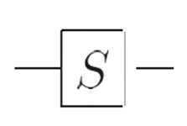
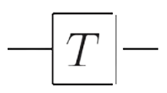





How does quantum computing work?
0
$$…$$
Classical Bit
1
• The bit must be 0 or 1. it is deterministic.
• Universal gate : Only NAND gate
$$\text{∣}\text{0⟩}$$
$$…$$
Qubit
Bloch sphere
$$\text{∣}\text{1}\text{⟩}$$
• The bit must be 0 or 1. it is probabilistic.
• Universal gate : Hadamard gate, CNOT gate, Phase gate and T(8/π) gate.
$\text{∣}\text{ψ}\text{⟩}\text{=}c_{0}\text{∣}\text{0⟩}$+$c_{1}\text{∣}\text{1}\text{⟩}$ , the bit is superposition state!

Slide 7
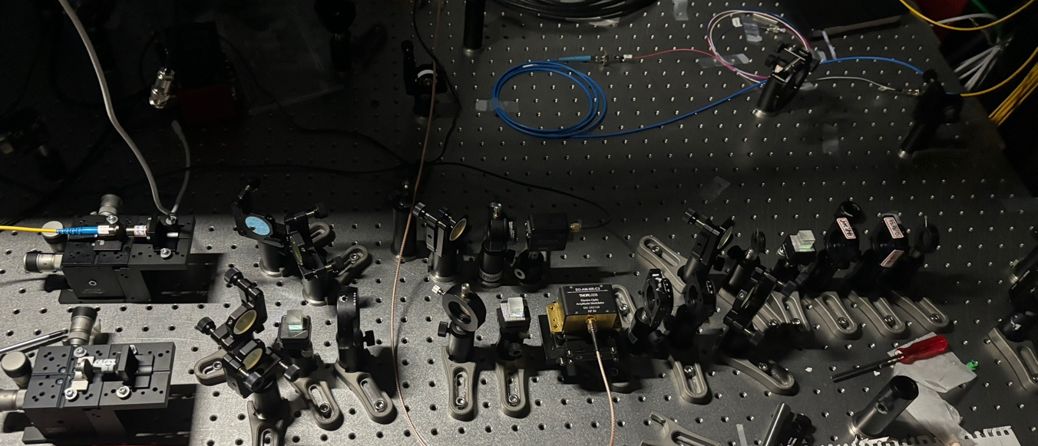





A qubit can be created using the light!
For coherent light (laser),
1550nm
laser
Intensity of light, $I=\frac{1}{2}cɛ_{0}{\left|E\right|}^{2}$
In Quantum Mechanics, $I∝n$ (photon number)
Single photon = 1 qubit
Many photons (classical optics),
$${\frac{1}{2}I}_{0}$$
Intensity ratio$\left(\frac{I}{I_{0}}\right)$ : $\frac{1}{2}$
$$I_{0}$$
$${\frac{1}{2}I}_{0}$$
50:50 Beam Splitter(BS)
Single photon (Quantum optics),
Probability : $\frac{1}{2}$
or
My photon subtraction experiment for single photon (2024.08.23)
50:50 Beam Splitter(BS)

Slide 8
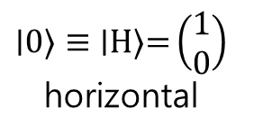









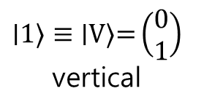
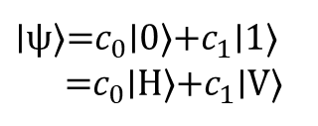
How will the states 0 and 1 be determined?
Polarization mode = which state of qubit
Bloch sphere
$$\hat{y}$$
$\text{∣}\text{ψ}\text{⟩=}c_{0}\text{∣}\text{0}\text{⟩}$+$c_{1}\text{∣}\text{1}\text{⟩}$
=$c_{0}\text{∣}\text{H}\text{⟩}$+$c_{1}\text{∣}\text{V}\text{⟩}$
$$\text{∣}\text{0}\text{⟩}≡\text{∣}\text{H}\text{⟩}\text{=}\left(\begin{matrix}1 \\ 0\end{matrix}\right)$$
horizontal
$$\hat{x}$$
$$\hat{z}$$
$$\hat{y}$$
$$\text{∣}\text{1}\text{⟩}≡\text{∣}\text{V}\text{⟩}\text{=}\left(\begin{matrix}0 \\ 1\end{matrix}\right)$$
vertical
$$θ$$
$$\text{∣}\text{H}\text{⟩}$$
$$e^{−iθ}\text{∣}\text{H}\text{⟩}$$
$$\hat{x}$$
$$\hat{z}$$
Components that change the phase of light
The polarization of light and qubits share similar mathematical representations!

Slide 9
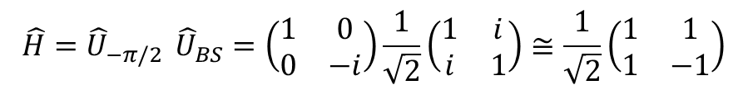

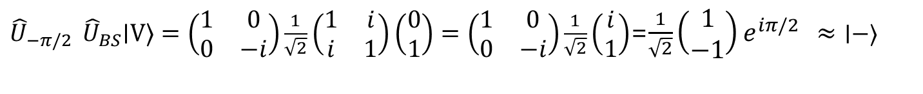
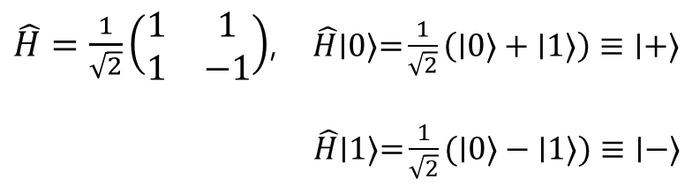





Universal Quantum Logic Gate : implemented optically
1. Hadamard gate
$\hat{H}=\frac{1}{\sqrt{2}}\left(\begin{matrix}1 & 1 \\ 1 & −1\end{matrix}\right)$, $\hat{H}\text{∣}\text{0}\text{⟩}\text{=}\frac{1}{\sqrt{2}}\left(\text{∣}\text{0}\text{⟩}+\text{∣}\text{1}\text{⟩}\right)≡\text{∣}\text{+}\text{⟩}$
$\hat{H}\text{∣}\text{1}\text{⟩}\text{=}\frac{1}{\sqrt{2}}(\text{∣}\text{0}\text{⟩}−\text{∣}\text{1}\text{⟩})≡\text{∣}\text{−}\text{⟩}$
Using “Symmetric” Beam splitter (ignoring global phase difference; it’s not important variable.)
$$\text{∣}\text{1′}\text{⟩}$$
$$\hat{H}={\hat{U}}_{−π/2 }{\hat{U}}_{BS}=\left(\begin{matrix}1 & 0 \\ 0 & −i\end{matrix}\right)\frac{1}{\sqrt{2}}\left(\begin{matrix}1 & i \\ i & 1\end{matrix}\right)≅\frac{1}{\sqrt{2}}\left(\begin{matrix}1 & 1 \\ 1 & −1\end{matrix}\right)$$
$$−π/2$$
${\hat{U}}_{−π/2 }{\hat{U}}_{BS}\text{∣}\text{H}\text{⟩}=\left(\begin{matrix}1 & 0 \\ 0 & −i\end{matrix}\right)\frac{1}{\sqrt{2}}\left(\begin{matrix}1 & i \\ i & 1\end{matrix}\right)\left(\begin{matrix}1 \\ 0\end{matrix}\right)=\left(\begin{matrix}1 & 0 \\ 0 & −i\end{matrix}\right)\frac{1}{\sqrt{2}}\left(\begin{matrix}1 \\ i\end{matrix}\right)$=$\left(\begin{matrix}1 & 0 \\ 0 & −i\end{matrix}\right)\frac{1}{\sqrt{2}}\left(\begin{matrix}1 \\ i\end{matrix}\right)$ =$\text{∣}\text{+}\text{⟩}$
$$\text{∣}\text{0}\text{⟩}$$
$$\text{∣}\text{0′}\text{⟩}$$
$$−π/2$$
${\hat{U}}_{−π/2 }{\hat{U}}_{BS}\text{∣}\text{V}\text{⟩}=\left(\begin{matrix}1 & 0 \\ 0 & −i\end{matrix}\right)\frac{1}{\sqrt{2}}\left(\begin{matrix}1 & i \\ i & 1\end{matrix}\right)\left(\begin{matrix}0 \\ 1\end{matrix}\right)=\left(\begin{matrix}1 & 0 \\ 0 & −i\end{matrix}\right)\frac{1}{\sqrt{2}}\left(\begin{matrix}i \\ 1\end{matrix}\right)$=$\frac{1}{\sqrt{2}}\left(\begin{matrix}1 \\ −1\end{matrix}\right)e^{iπ/2 }≈\text{∣}\text{−⟩}$
$$\text{∣}\text{1}\text{⟩}$$
We can make superposition of state. (it’s cannot make it in classical computer.)

Slide 10
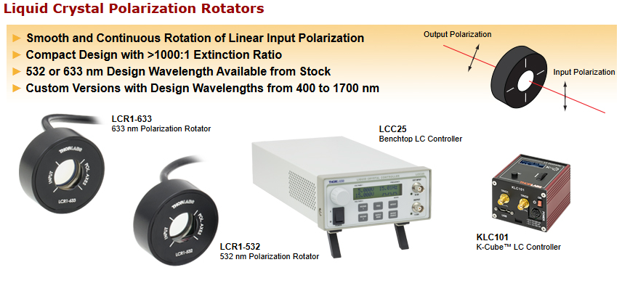
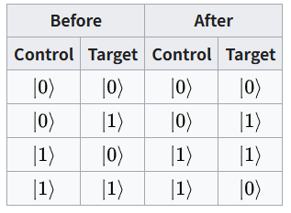
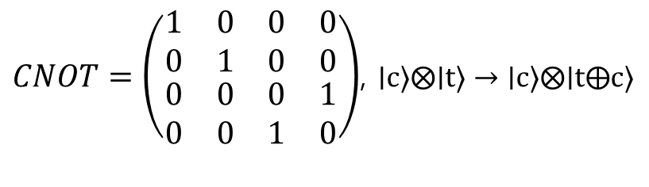


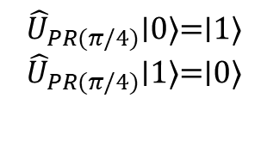
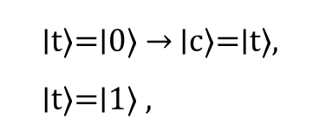





Universal Quantum Logic Gate : implemented optically
2. Controlled NOT(CNOT) gate
$CNOT=\left(\begin{matrix}\begin{matrix}1 & 0 \\ 0 & 1\end{matrix} & \begin{matrix}0 & 0 \\ 0 & 0\end{matrix} \\ \begin{matrix}0 & 0 \\ 0 & 0\end{matrix} & \begin{matrix}0 & 1 \\ 1 & 0\end{matrix}\end{matrix}\right)$, $\text{∣}\text{c}\text{⟩}⨂\text{∣}\text{t}\text{⟩}→\text{∣}\text{c}\text{⟩}⨂\text{∣}\text{t}⨁\text{c}\text{⟩}$
$$\text{∣}\text{t}\text{⟩}\text{=}\text{∣}\text{0}\text{⟩} \text{→} \text{∣}\text{c}\text{⟩}\text{=}\text{∣}\text{t}\text{⟩}\text{,}$$
$\text{∣}\text{t}\text{⟩}\text{=}\text{∣}\text{1}\text{⟩}\text{ , }$
copy the state!
$$\text{∣}\text{c}\text{⟩}$$
$$\text{∣}\text{t}\text{⟩}$$
flip the state!
Polarization rotator
$$\text{∣}\text{1′}\text{⟩}$$
$$π/4$$
$$\text{∣}\text{0}\text{⟩}$$
$$\text{∣}\text{0′}\text{⟩}$$
thorlab
$$\text{∣}\text{1}\text{⟩}$$
$${\hat{U}}_{PR(π/4)}=\left(\begin{matrix}\cos{2θ} & \sin{2θ} \\ \sin{2θ} & −\cos{2θ}\end{matrix}\right)\underset{→}{θ=π/4}\left(\begin{matrix}0 & 1 \\ 1 & 0\end{matrix}\right)$$
$${\hat{U}}_{PR(π/4)}\text{∣}\text{0}\text{⟩}\text{=}\text{∣}\text{1}\text{⟩}$$
$${\hat{U}}_{PR(π/4)}\text{∣}\text{1}\text{⟩}\text{=}\text{∣}\text{0}\text{⟩}$$
The CNOT gate is similar to a conditional XOR operation in classical computing.

Slide 11
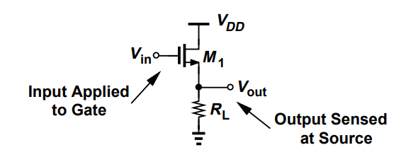
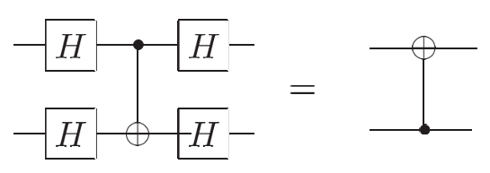












Universal Quantum Logic Gate : implemented optically
2. Controlled NOT(CNOT) gate (target and control are changed)
Source Follower (Voltage Buffer)
$$\text{∣}\text{t}\text{⟩}$$
$$\text{∣}\text{c}\text{⟩}$$
Unlike ideal classical gates, ideal quantum gates do not have ‘high-impedance’ inputs.
$c_{1}\text{∣}\text{V}\text{⟩}$
$$↑$$
Polarization Beam Splitter(PBS)
$$\text{∣}\text{1′}\text{⟩}$$
$\text{∣}\text{ψ}\text{⟩}\text{=}c_{0}\text{∣}\text{H}\text{⟩}$+$c_{1}\text{∣}\text{V}\text{⟩}$
$c_{0}\text{∣}\text{H}\text{⟩}$
$$\text{∣}\text{0}\text{⟩}$$
$$\text{∣}\text{0′}\text{⟩}$$
$$→$$
$$→$$
PBS
The role of ‘control’ and ‘target’ are arbitrary.
They depend on what basis you think of device as operating in.
$$\text{∣}\text{1}\text{⟩}$$

Slide 12





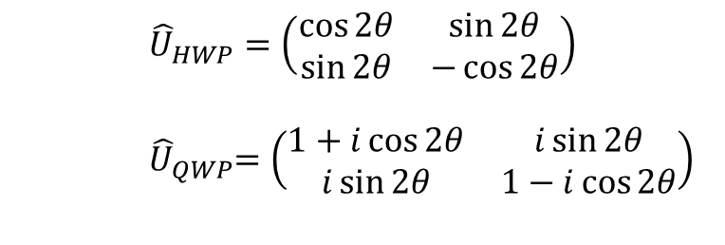
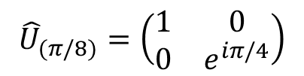



Universal Quantum Logic Gate : implemented optically
3. Phase gate (S gate, T gate)
$${\hat{U}}_{(π/4)}=\left(\begin{matrix}1 & 0 \\ 0 & i\end{matrix}\right)$$
For arbitrary transformation,
$$\hat{U}(θ)\text{∣}\text{0}\text{⟩}\text{=}\text{∣}\text{0}\text{⟩}$$
$$\hat{U}(θ)\text{∣}\text{1}\text{⟩}\text{=}e^{−iθ}\text{∣}\text{1}\text{⟩}$$
$${\hat{U}}_{(π/8)}=\left(\begin{matrix}1 & 0 \\ 0 & e^{iπ/4}\end{matrix}\right)$$
$$\hat{U}(θ)=\left(\begin{matrix}1 & 0 \\ 0 & e^{−iθ}\end{matrix}\right)$$
Half Wave Plate(HWP)
Quarter Wave Plate(QWP)
$${\hat{U}}_{HWP}=\left(\begin{matrix}\cos{2θ} & \sin{2θ} \\ \sin{2θ} & −\cos{2θ}\end{matrix}\right)$$
$${ \hat{U}}_{QWP}=\left(\begin{matrix}1+i\cos{2θ} & i\sin{2θ} \\ i\sin{2θ} & 1−i\cos{2θ}\end{matrix}\right)$$
$$\text{∣}\text{1′}\text{⟩}$$
QWP
HWP
QWP
$$\text{∣}\text{0}\text{⟩}$$
$$\text{∣}\text{0′}\text{⟩}$$
$$\hat{U}(θ)={\hat{U}}_{QWP}(θ_{3}){\hat{U}}_{HWP}(θ_{2}){\hat{U}}_{QWP}(θ_{1})$$
$$\text{∣}\text{1}\text{⟩}$$

Slide 13
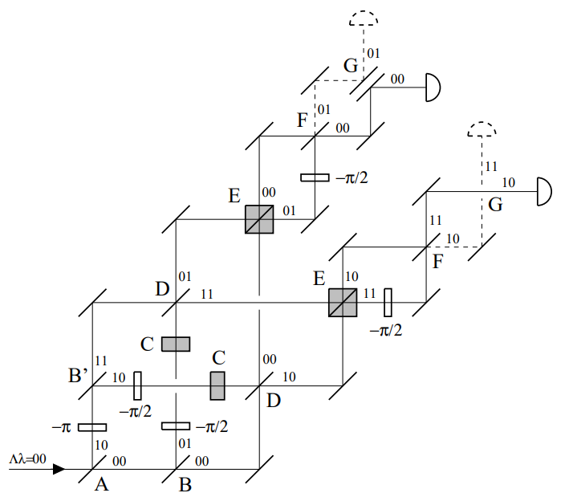
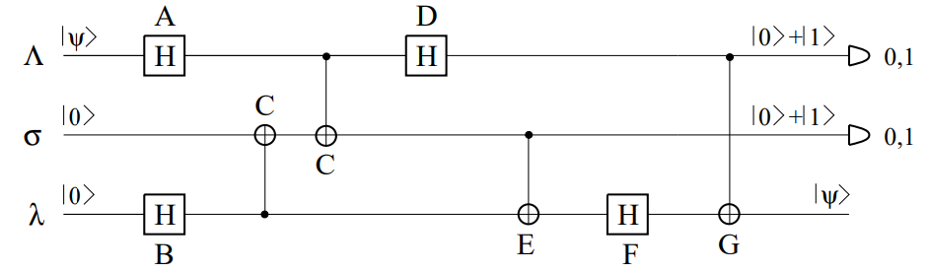
Example : Quantum Teleportation

Slide 14
The advantage of Optical Computer
• It can be implemented at room temperature and atmospheric pressure.
• The optical quantum system is highly compatible with telecommunication
• It is more suitable when considering scalability.

Slide 15
Reference
• Asavanant, W., & Furusawa, A. (2022). Optical Quantum Computers: A Route to Practical Continuous Variable Quantum Information Processing. AIP Publishing LLC. https://doi.org/10.1063/9780735424074
• Nielsen, M. A., & Chuang, I. L. (2010). Quantum computation and quantum information (10th anniversary ed.). Massachusetts Institute of Technology.
• Razavi, B. (2014). Microelectronics. Wiley.
• Cerf, N. J., Adami, C., & Kwiat, P. G. (1997). Optical simulation of quantum logic. Physical Review Letters, 78(15), 4291–4294. https://doi.org/10.1103/PhysRevLett.78.4291
• Barz, S. (2014). Quantum computing with photons: Introduction to the circuit model, the one-way quantum computer, and the fundamental principles of photonic experiments.
• O'Brien, J. L. (2008). Optical quantum computing. arXiv preprint arXiv:0803.1554. https://doi.org/10.48550/arXiv.0803.1554

Slide 16
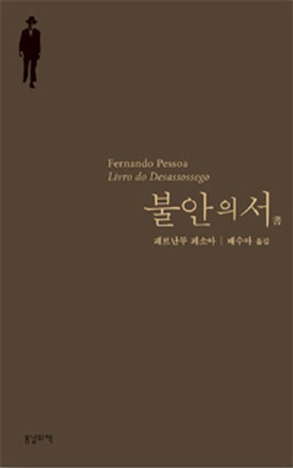
Thank you
꿈꾸기 혹은 행동하기.
나는 둘 중 하나를 선택해야 한다. 선택이란 끔찍하다.
내 이성은 꿈꾸기를 혐오하고, 내 감수성은 행동하기를 역겨워한다.
행동하기란 내가 부여받지 못한 천성이며, 꿈꾸기란 그 누구도 부여받지 못한 운명이다.
나는 이 두 가지를 모두 끔찍하게 싫어하므로 그중 하나를 선택할 수가 없다.
그런데 나는 종종 꿈을 꾸거나 아니면 행동을 해야만 하는 입장이므로,
한 가지를 다른 한 가지 속에 뒤섞어버린다.

