Slide 1
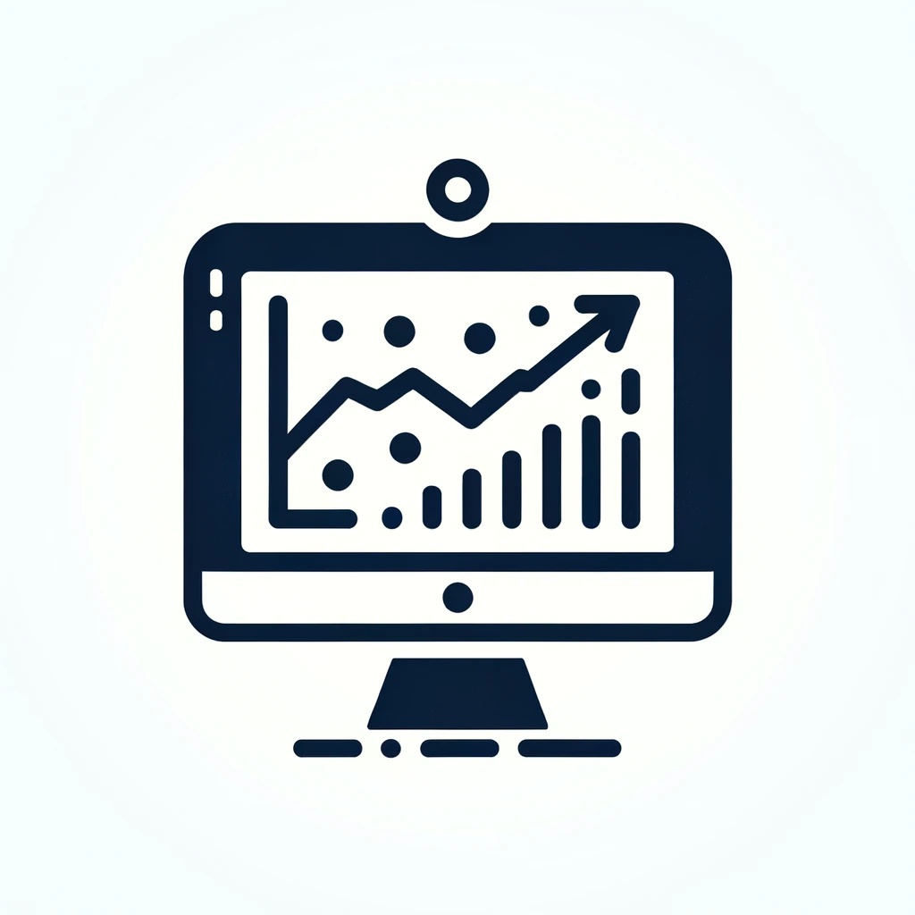
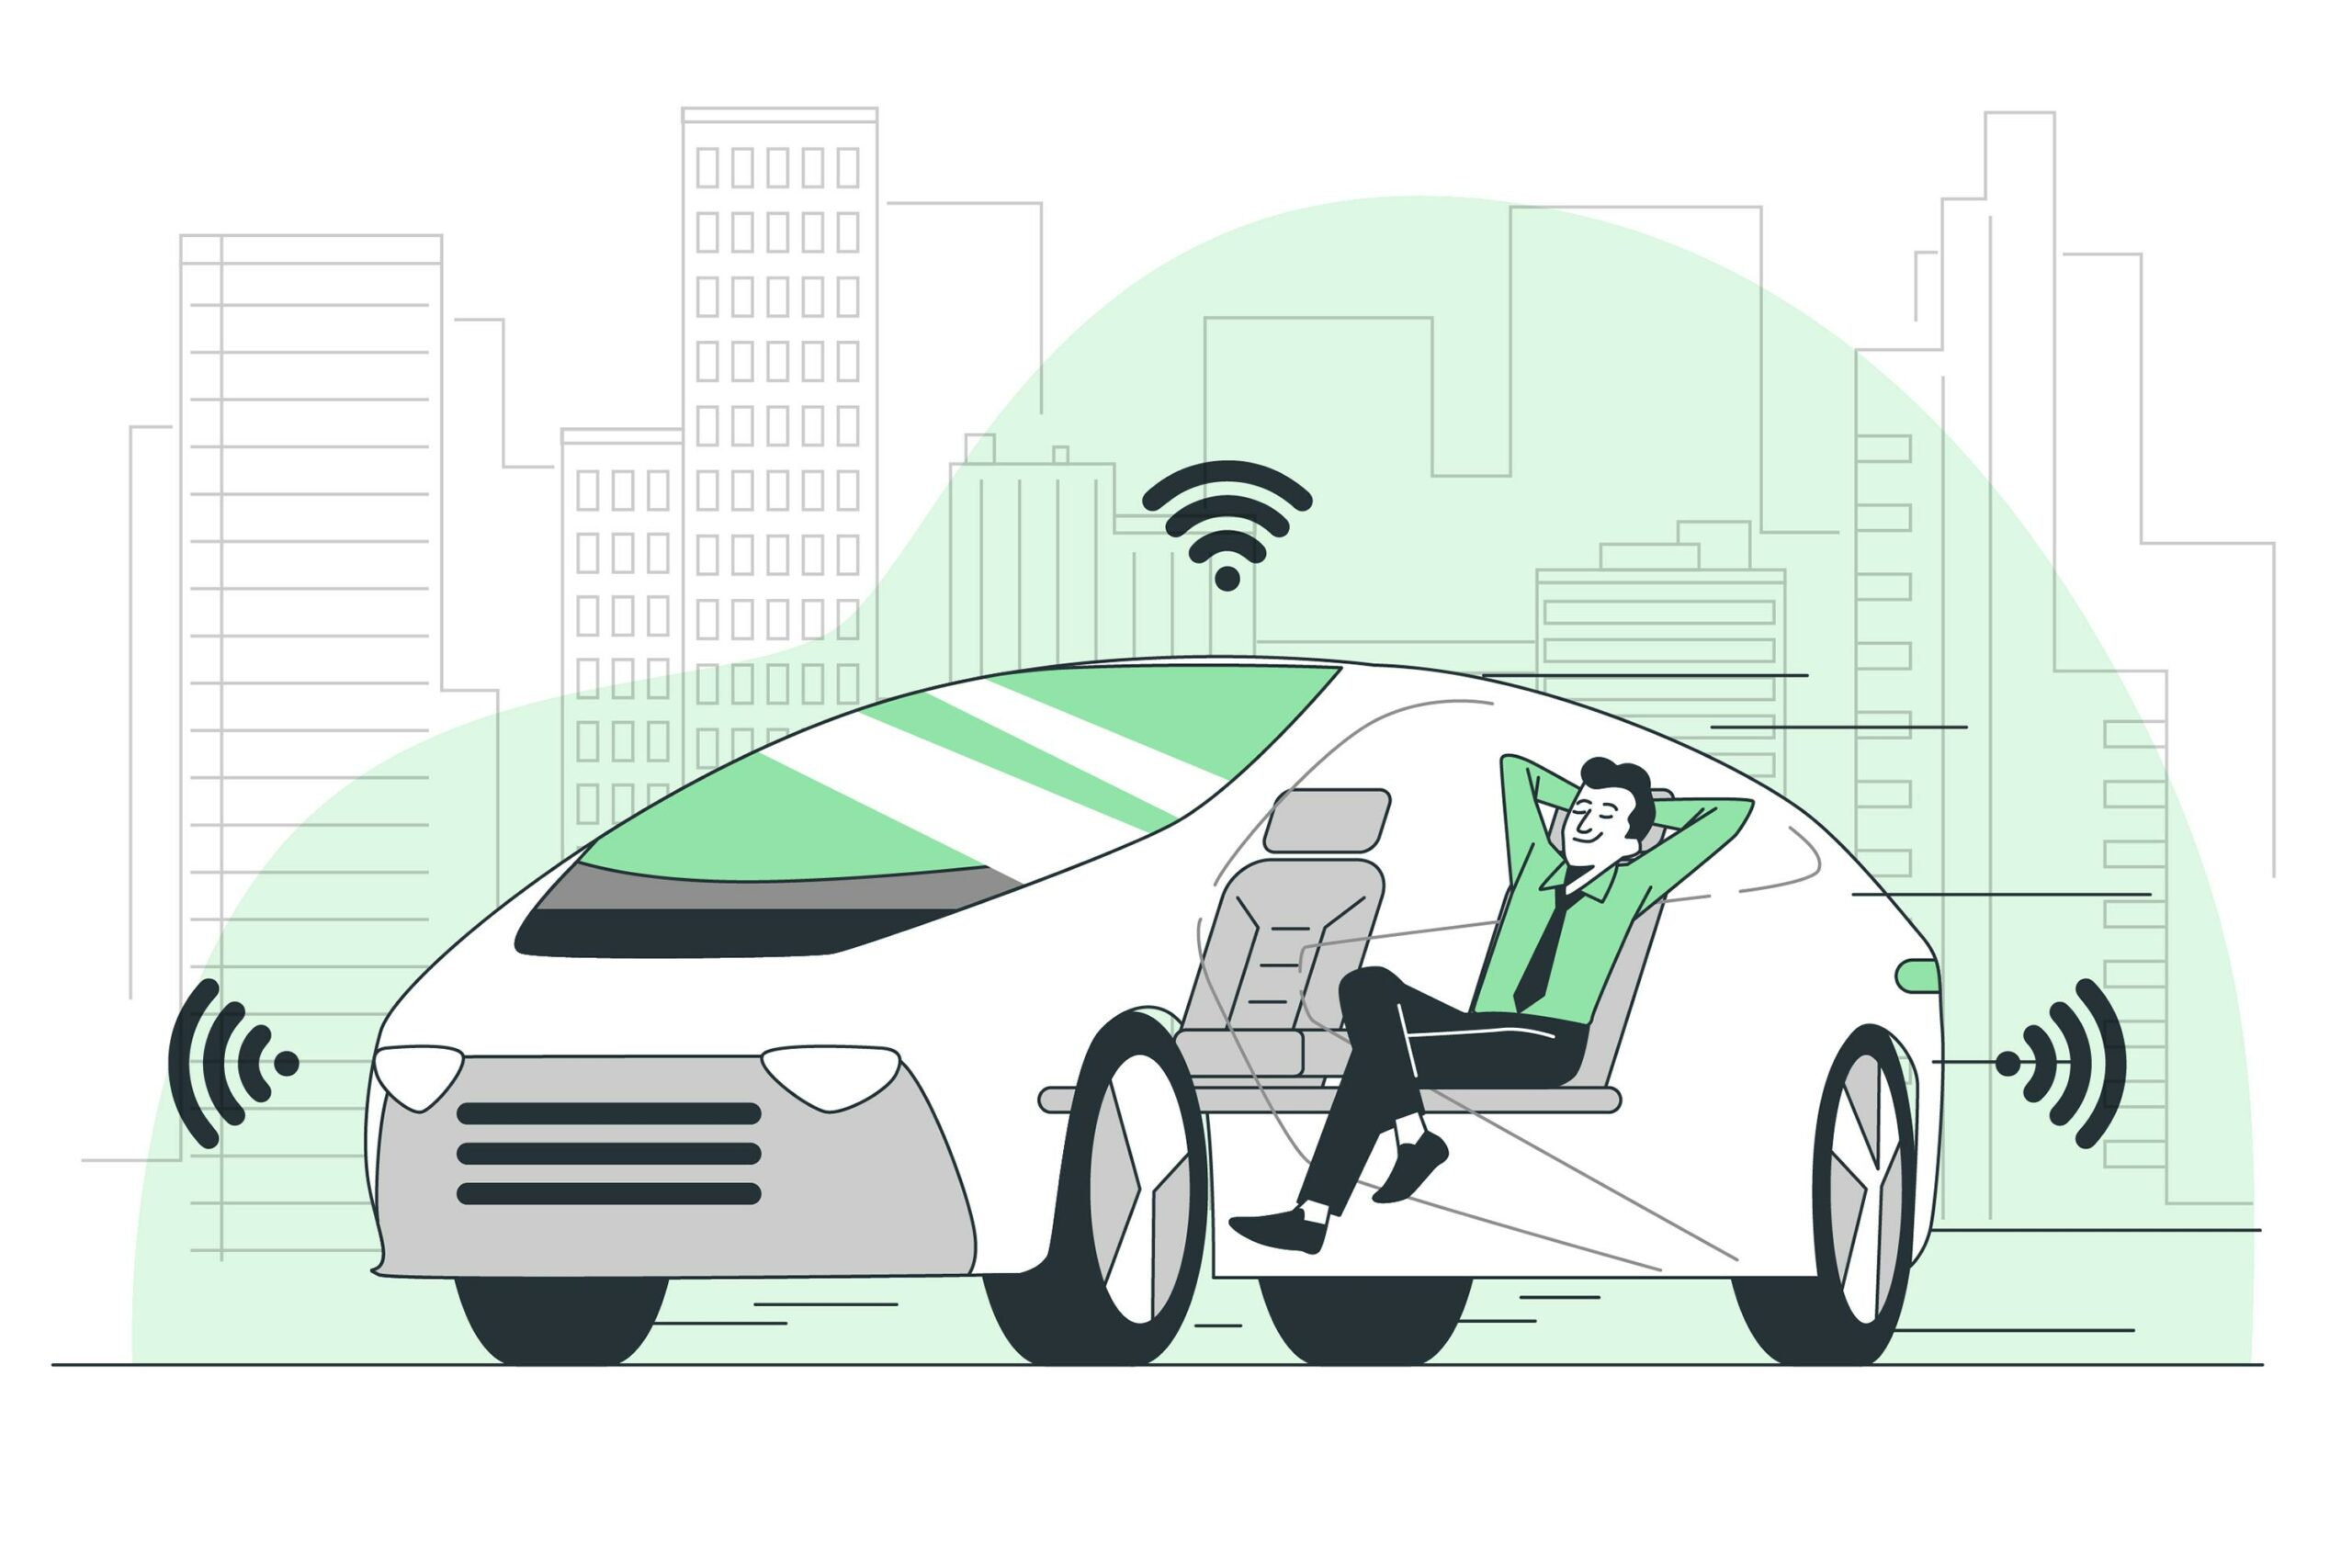
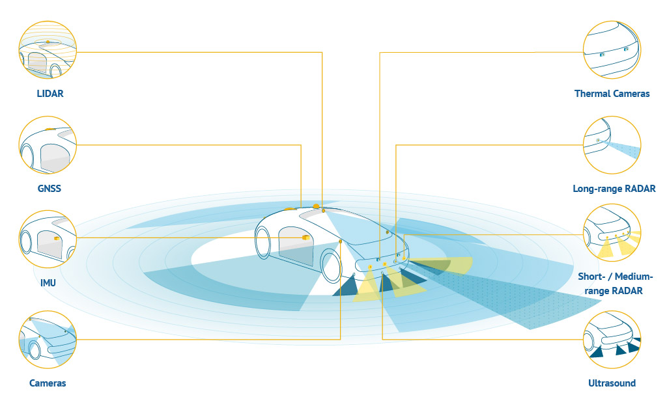
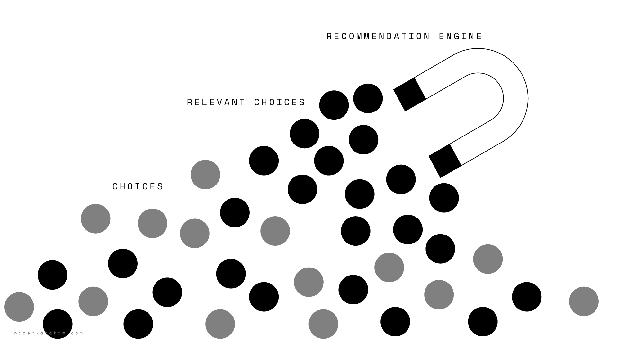
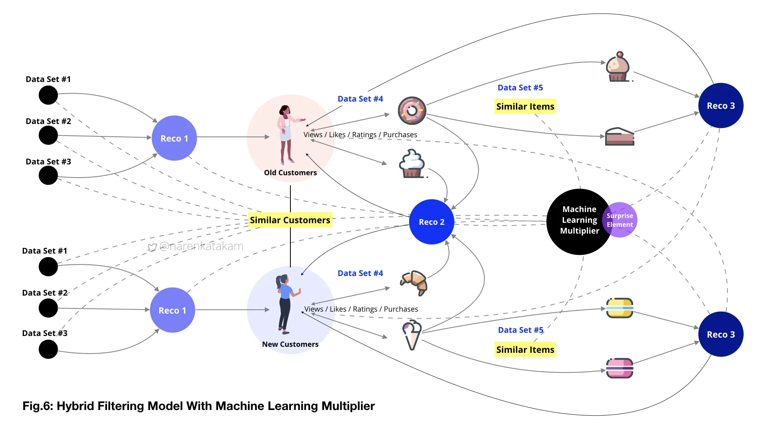
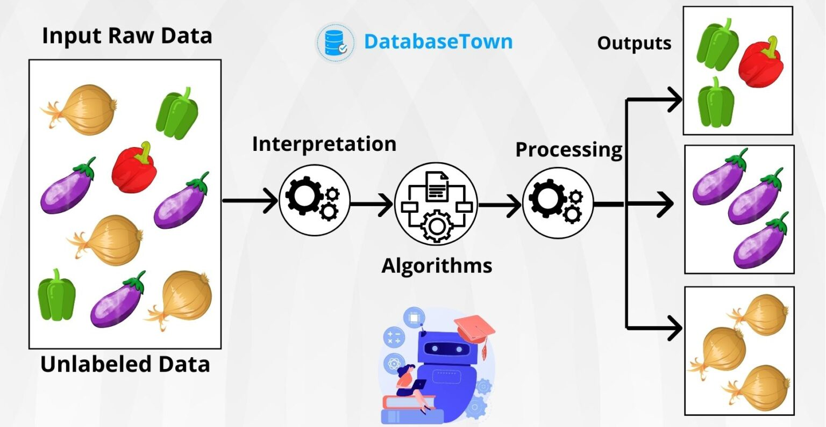

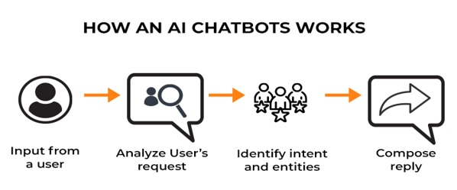
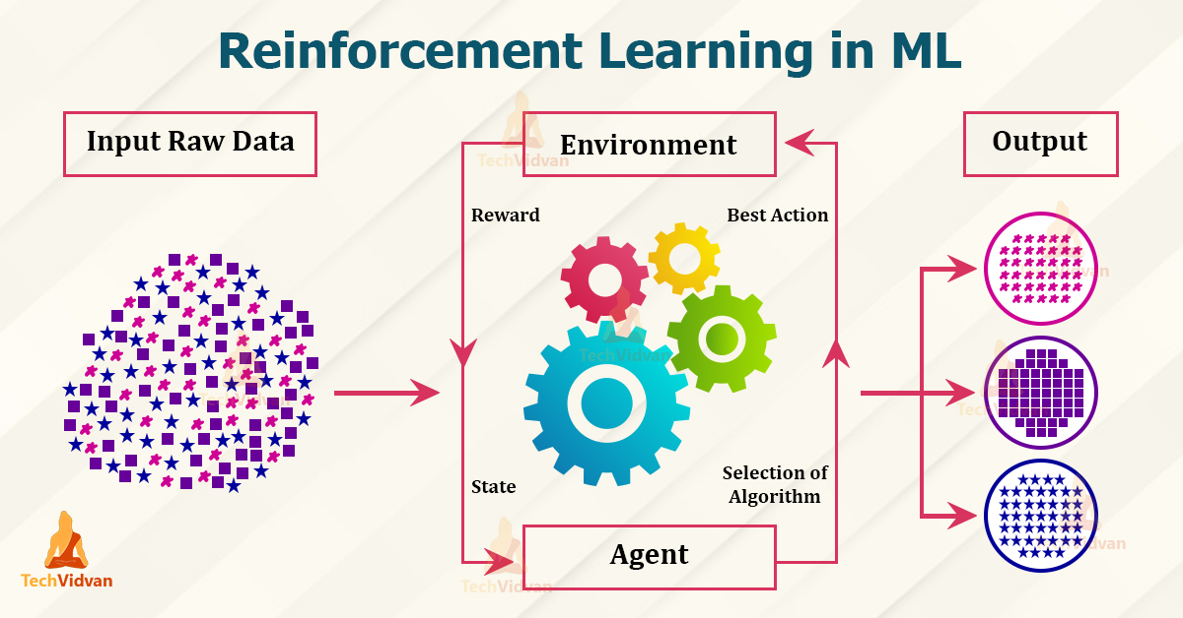
Target audience: A-level students
Machine Learning
-- The future language
Group 2 : Zhao Jianqiao ; Shen Shihan ; Fan Ruilin ; Hei Xiaoping ; Huang Zheyuan
1. Definition
3. Application
Machine learning allows computers to learn on their own by analyzing data without our step-by-step guidance, and it enables computers to recognize patterns, make decisions and predictions as if they were gaining experience.
1.Autonomous Driving
Autonomous driving technology employs machine learning algorithms to analyze environmental data collected by sensors, enabling vehicles to achieve autonomous navigation, decision-making, and safe driving.
Machine learning algorithms enable computers to improve themselves over time by analysing data without human guidance.
2. What you will learn ?
2.Intelligent Recommendation
An intelligent recommendation system analyses user behaviours and preferences by using machine learning algorithms to suggest or recommend additional products to consumers.
In this machine learning lecture,you can learn its main categories—supervised, unsupervised, semi-supervised, and reinforcement learning.
Supervised Learning
Linear Regression: Predicts continuous
values and so on.
Unsupervised Learning
K-Means Clustering: Divides data into K clusters and so on.
3.Chatbot
Chatbots, such as ChatGPT and Siri, are based on natural language processing models that can understand and generate human language to interact and engage in dialogue with users across a diverse range of topics and domains.
Semi-Supervised and Reinforcement Learning
1.Semi-Supervised Learning: Combines labeled and unlabeled data.
2.Reinforcement Learning: Learns via rewards and punishments, used in gaming and robotics.
The applications of machine learning technology are extensive, covering various aspects from daily life to industrial fields.
4. Future outlook
As one of the core drivers of contemporary and future technological progress, machine learning is crucial to the innovation and development of various fields. As machine learning algorithms demonstrate their unique advantages in a wide range of application scenarios, there is a huge demand for people with relevant professional skills, which in turn leads to the growth of opportunities in the job market. In view of this, mastering machine learning techniques is not only a necessity, but also offers learners the opportunity to work across multiple industries.

