Slide 1
Shared, Dynamically Updating, No Code IoT-Data-Generator

Slide 2
The Problem
We need to create simulated data for demonstrations, development and testing.
We often satisfy this need by either writing our own simple but fit for purpose script or app or perhaps we copy a script or app from the Internet or from one of our many excellent workshops.
The problems with this are:
We are repeating the task but not building on previous efforts.
We spend time developing and testing new code that just creates the data for our demo – it doesn’t add value to the demo itself.

Slide 3
What We Need
We want one data generator that can be used by all.
We want to write the framework code once that will handle the data generation and publishing.
We want to be able to dynamically add, remove, enable, disable, adjust or otherwise modify our data sources without having to write or modify any code.
The IoT-Data-Generator solves these problems

Slide 4
A Solution
The IoT-Data-Generator provides a framework where all you have to do is add or remove data source definitions - even while the simulator is running.
The basic principles are:
One *.json configuration file per simulator data source
The simulator runs continuously
The simulator monitors data source files for changes (e.g. additions or enabled --> disabled or frequency changes or topic changes, etc)
Data source files can be added or removed or edited while the simulator is running and changes will take effect on the next scan (as defined in lib/simulator_config.py:scan_interval)

Slide 5
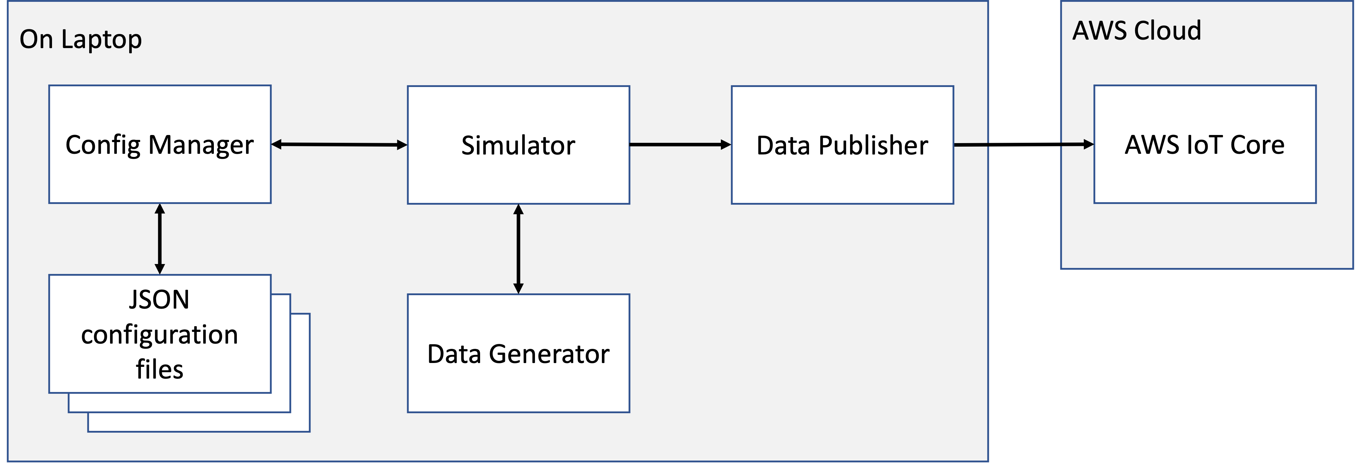
or EC2
The Simulator orchestrates the following:
1. Read data source files and create generator records for each
2. Process generator records to determine whether or not to publish
3. Publish enabled and scheduled generated data to AWS IoT Core
4. Update generator records with the last published time
5. Loop 1 to 4 indefinitely

Slide 6
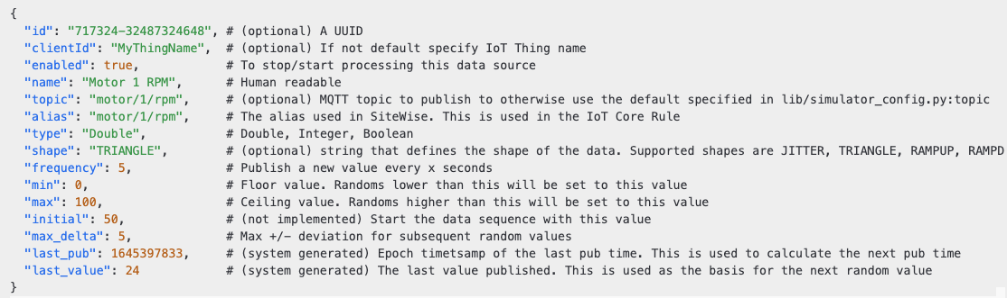
An example data source file
You can copy and paste data source *.json files from the samples directory to the data_sources directory at any time to add or remove data sources or create your own data source *.json file.

Slide 7
Install, Configure, Run, Contribute.
Install
git clone https://gitlab.aws.dev/greenzcg/iot-data-generator.git
Configure
Ensure you have created at least one AWS Iot Core Thing and copied the Thing certificates to the certs directory
Edit global configuration and defaults in the lib/simulator_config.py file
Update/add/remove *.json config files in the data_sources directory
Run
Start the simulator with python3 simulator.py
Observe data arriving in AWS IoT Core using the console MQTT Test Client
Create IoT Core Rules to direct the traffic to downstream resources
Contribute
Create your own branch and submit a pull request here https://gitlab.aws.dev/greenzcg/iot-data-generator.git

