Slide 1



Forecasting accelerator 2.0 Scope
Opportunity (Why)
Goals
(What)
Target Persona
(Whom)
Leverage ISD’s experience in a wide range of sectors/industries to (1) understand fundamental and common challenges (2) standardize and scale forecasting solutions
Share industry knowledge: use-cases, challenges, data requirements
Create code template to analyze time series data applicable to any industry and provide recommendations on best approach
Add-ons for specific challenges
Data scientist / Consultants
Data&AI practitioners searching for industry specifics use-cases

Slide 2
ds-toolkit:: Forecasting accelerator 2.0
Background
We focus on updating existing forecasting repository to generate our deliverables more quickly.
Completeness of forecasting algorithms is not practical:
There exist many public algorithms for forecasting.
Forecasting AutoML in Azure ML is already published.
Opportunity
MCS opportunity is to leverage the project exposure to a wide range of sectors to share the experience of industry specificities (finance, manufacturing, energy, etc).
The value are (1) demonstrate delivery experience during customer talks (2) acceleration of delivery through focused discussion and data requirements
Proposed approach for 2.0 (draft)
The forecasting 2.0 template would contain the following parts:
Data schema (how to organize data ingestion flow) and data pre-processing scripts -> Target: Architects / Consultants
Time-series profiling scripts (understand type of series and recommend models) -> Target: Data scientists
Documentation on industries specificities/requirements -> Target: Digital Advisor, Consultants, Data scientists, ...
Add-ons for specific scenarios (many-models, forecasting in finance, sol-acc, etc) -> Target: Data scientists
When to use
When dealing with 1 or many time series, you may want to quickly characterize time-series the data (continuous 0 values, high variances, etc.) We provide some indicators to seize such characteristics and assign best approach in generating forecasting models.
When you want to quickly gain insights of a specific sector
When you want to explore an alternative approach to Azure AutoML which tries to generate models by brute-force manners.

Slide 3
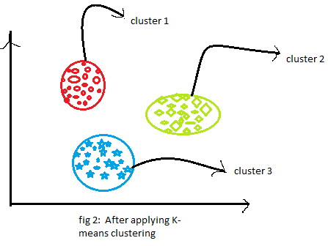
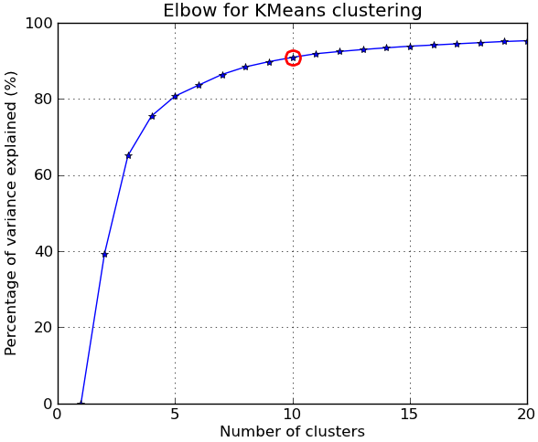
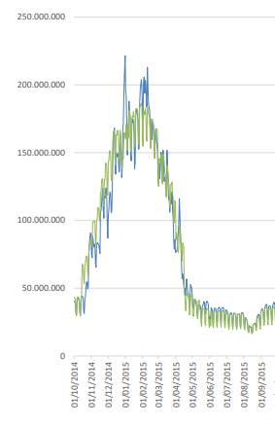
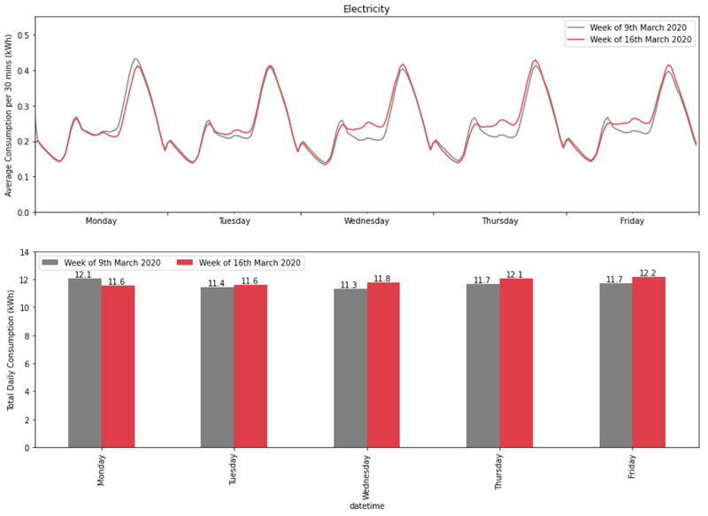
ds-toolkit:: Forecasting accelerator 2.0
Additional features to be implemented
Profiling (clustering) Time Series:
Goal: identify consumption patterns that are similar to each other in order to assign the optimal model in terms of min of MAE or MSE
How to: identify those series that are classified as “intermittent” with respect to those “smooth”
Expected output:
Label each time series as intermittent with respect to smooth
Methods to forecast smooth time series:
Clustering profiles
Clustering smooth time series using K-Means flat or hierarchical
Choose the optimal number of clusters
As a method to choose the optimal number of cluster, use max explained variance at the minimum number of cluster -> Elbow Method
Check weather identified profiles have a business meaning
Assign best model
with respect to the type of smooth profile identified
Cluster 1: thermal consumption, use temperatures
Cluster 2: industrial consumption, use calendar variables

Slide 4

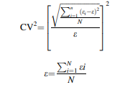
ds-toolkit:: Forecasting accelerator 2.0
Identifying intermittent time series:
Definition of intermittent time series: intermittent time series or demand comes about when a product or a time series experiences several periods of zero demand. Often in these situation, when demand occurs it is small, and sometimes highly variable in size
How to identify intermittent time series:
Compute 2 indicators such as
Average Inter-demand Interval (ADI), this parameter is period based which is calculated as average interval time between two demand occurrences
Coefficient of Variation Squared (CV2), This statistical parameter is calculated as standard deviation of the *For correspondence demand divided by the average demand for non-zero demand periods. The squared coefficient of variation represents variability of demand size.
SD Inter-demand Interval (optional)
Based on their values, it is possible to identify intermittent, lumpy, erratic and smooth (regular) time series
Methods to forecast smooth time series: treat those series with traditional methods (regressions, arima, prophet, etc)
References:
Lancaster Centre For Marketing Analytics and Forecasting
Methods for Intermittent Demand Forecasting
Methods to forecast intermittent time series:
Croston’s method
Adjusted Croston methods
Model-based forecasting methods
ARMA models
DARMA models -> Discrete ARMA
INARMA models -> Integer-valued ARMA (INARMA)

Slide 5
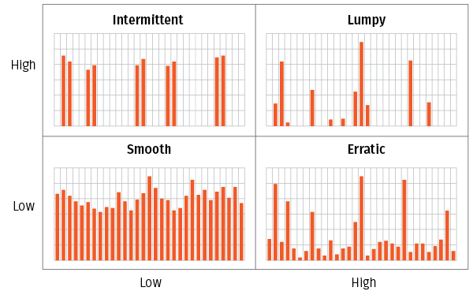
ds-toolkit:: Forecasting accelerator 2.0
SDDI
ADI
Spikes
Lumpy
Unforecastable time
Threshold ADI
Regular
Erratic
Unforecastable quantity
Constant
Threshold
CV2
CV2
Constant at zero

Slide 6
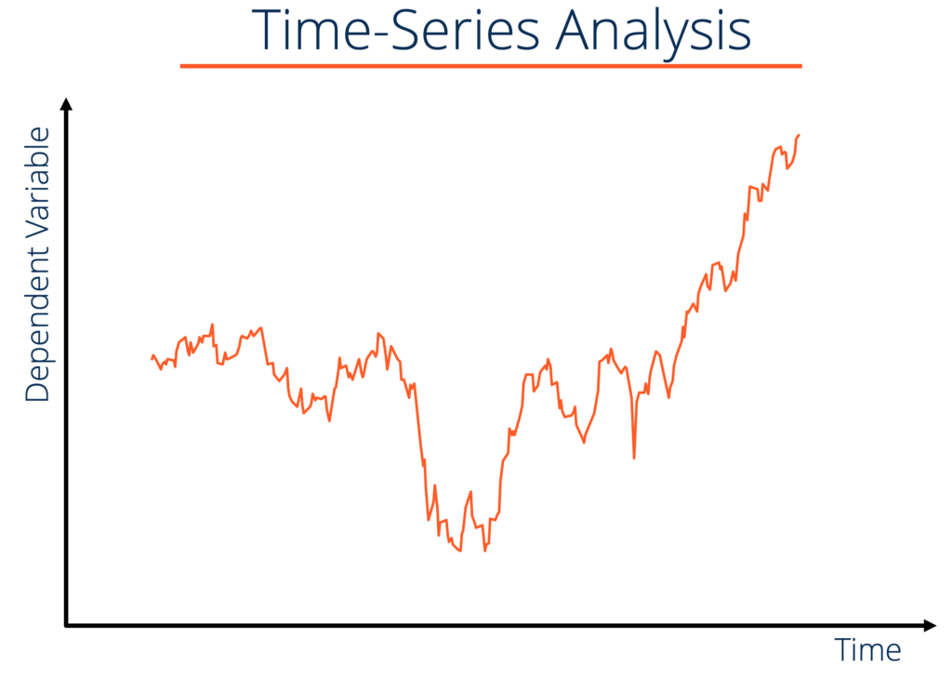
Conceptual process flow in generating forecasting models
Collect time-series data
Time series profiling
Time series clustering
Decide optimal approach
ADI, CV2 indicators values determine intermittent vs smooth time series
Smooth time series
3.0
2.1
Cluster 2
Industrial consumption. Use calendar variables
#1
#2
4.0
0.1
Cluster 1
thermal consumption, use temperatures
:
:
:
:
#N
3.2
1.9
Cluster 2
Industrial consumption. Use calendar variables
We identify optimal approach for generating forecasting models for each cluster
1 observation = 1 time-series

Slide 8
Double click to edit:

Slide 9
Double click to edit:
Data Prep
Profiler
Industry Insights
Architecture Design
(Exog vs Endog ingestion)
Data splitting for holdout testing
Profiler
2 steps for profiling
Requirements
Documentation for specific industry
Util files / demos (databricks many model + profiler)
Profiler recommendation

Slide 10
ds-toolkit:: Forecasting accelerator 2.0
Template Example
Readme.md
Guidance.md
Base_template (TBD simply show how to use AML)
aml_pipeline.ipynb
Preprocessing.py
Train.py
Score.py
Use-cases
(Example) Finance forecasting
Documenation.md
Dataschema.md
Preprocessing.py
Train.py/Forecasting.py
(Example) Retail Forecasting
Documenation.md
Dataschema.md
Preprocessing.py
Train.py/Forecasting.py
Background
We focus on updating existing forecasting repository to generate our deliverables more quickly.
Completeness of forecasting algorithms is not practical:
There exist many public algorithms for forecasting.
Forecasting AutoML in Azure ML is already published.
Proposed approach for 2.0 (draft):
MCS opportunity is to leverage wide range of sectors exposure to share the sector’s specificity (finance, manufacturing, energy, etc).
The benefits are (1) prove of experience during customer talks (2) acceleration of delivery through focused discussion and data requirements
The forecasting 2.0 template would contain the following parts (draft):
Documentation on industries specificity and common stakeholders' requirements
For specific scenarios (many-models, forecasting in finance): link to existing SAs (Solution Accelerators)
Data schema relevant to industry, feature engineering (if required), and data sample
Basic model training and forecasting script containing 1 type of model (TBD)
For specific scenarios (many-model, forecasting in finance), basic implementation of SA with any potential add-on (many-models with databricks, i.e Demand Forecasting 1.0)

Slide 11
ds-toolkit:: Forecasting accelerator 2.0
Background
We focus on updating existing forecasting repository to generate our deliverables more quickly.
Completeness of forecasting algorithms is not practical:
There exist many public algorithms for forecasting.
Forecasting AutoML in Azure ML is already published.
(draft) Basic features to be implemented:
Forecasting model generation
Data schema standardization for forecasting
Forecasting algorithm requires us to prepare.
Ex.) Timestamp, (time-series) values, exogeneous variables (if any)
model training & model selection
Call some representative API like statsmodel, prophet, etc
Suggest how to implement additional models, if needed
Predict
Predict function with generated model
Integrate with Azure ML with compute target
Implement for Azure resources for Azure Synapse/Databricks, etc..?

