Slide 1
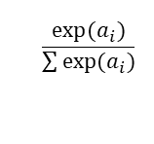
$$\frac{exp⁡(a_{i})}{\sum{exp(a_{i})}}$$
Linear1
Sigmoid
Linear2
Softmax
x
y
100 nodes
100 nodes

