Slide 1
GlassFish Cluster & mod_jk
High Availability & LoadBalance

Slide 2
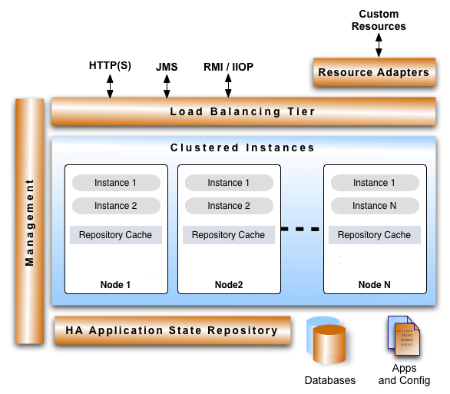
GlassFish Cluster
High-Reliability
High Availability
Session Layer HA
http session, EJB session, JMS, RMI-IIOP
High Scalability
Horizontal
Vertical

Slide 3
重要名詞解釋
DAS - Domain Administration Server
用來管理 GlassFish Domain 中的所有
Cluster, Nodes, Instances, Resources, Configurations.
Node:
A node is a configuration of the GlassFish software
Config Node (Local Node) & SSH Node
Cluster – A cluster is a logical entity that determines the configuration of the server instances that make up the cluster.

Slide 4
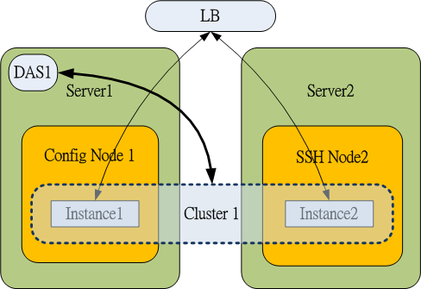
系統架構簡圖

Slide 5

模擬環境準備
VM (vmware、CentOS6.2)
JDK (1.7)
GlassFish (3.1.2.2)
SSH ( and SFTP)
Apache Web Server (2.2.15)
mod_jk (tomcat-connectors-1.2.37)

Slide 6
Build GlassFish Cluster
制定架構圖、確認命名
Enable SSH (and SFTP)
SSH key configuration
ssh-keygen -t rsa
Firewall Setting
-A INPUT -m state --state NEW -m tcp -p tcp --dport 22 -j ACCEPT
Validate SSH
ssh root@192.168.1.121
Copying the ssh keys to the servers
# in 192.168.1.120
cat /root/.ssh/id_rsa.pub | ssh root@192.168.1.121 'cat >> .ssh/authorized_keys'
# in 192.168.1.121
cat /root/.ssh/id_rsa.pub | ssh root@192.168.1.120 'cat >> .ssh/authorized_keys'

Slide 7
Build GlassFish Cluster
Install GlassFish
每一台實體機器或VM 都需安裝
變更 admin 密碼
Start DAS
cd /ap/glassfish-3.1.2.2/bin
./asadmin start-domain domain1
Enabling remote access on the glassfish servers
./asadmin change-admin-password
./asadmin enable-secure-admin
./asadmin restart-domain domain1

Slide 8
Build GlassFish Cluster
Creating the cluster nodes
# in 192.168.1.120
./asadmin create-node-config node1
./asadmin --passwordfile sshpwd create-node-ssh --nodehost 192.168.1.121 --sshuser root node2
Creating the cluster
./asadmin create-cluster cluster1
Creating the cluster instances
./asadmin create-instance --cluster cluster1 --node node1 instance1
./asadmin create-instance --cluster cluster1 --node node2 instance2

Slide 9
Start Cluster
Start Cluster
./asadmin start-cluster cluster1
查看結果
./asadmin list-clusters
./asadmin list-nodes
./asadmin list-instances -l
./asadmin get-health cluster1
Firewall Setting
vi /etc/sysconfig/iptables # 修改防火牆規則
-A INPUT -m state --state NEW -m tcp -p tcp --dport 4848 -j ACCEPT
….
service iptables restart

Slide 10
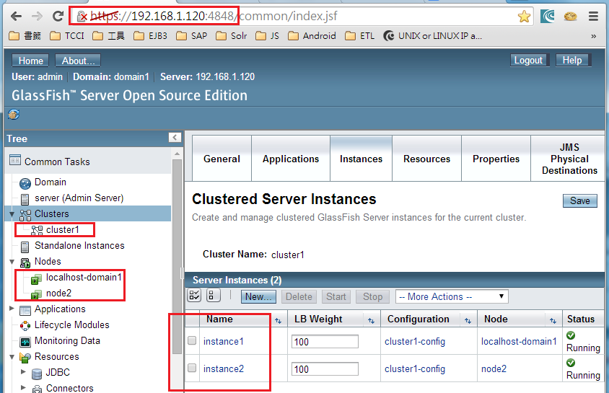
DAS Admin Console

Slide 11
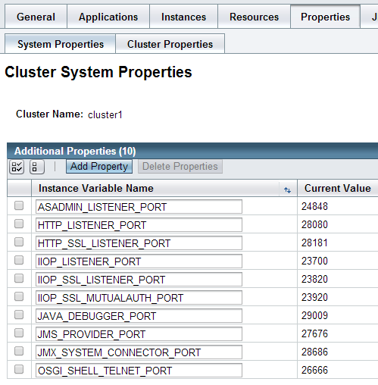
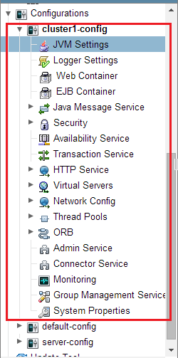
DAS Admin Console

Slide 12
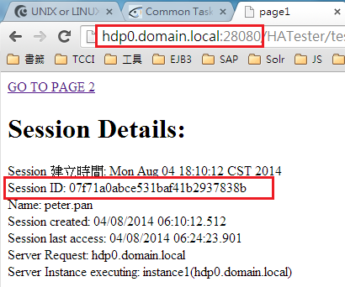
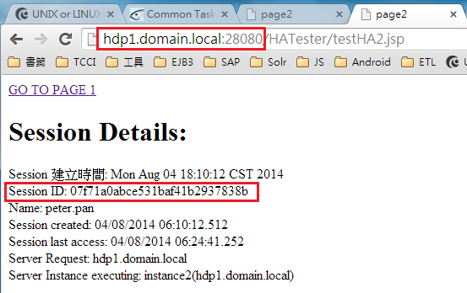
Before Load Balance
Verify Session Replication
GMS - Group Management Service
Shoal , Grizzly
in memory session replication
UDP multicast between that instance and the DAS
./asadmin validate-multicast

Slide 13
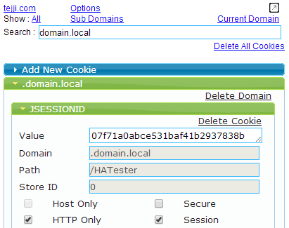
Deploy Test AP
web.xml
<distributable/>
glassfish-web.xml
<cookie-properties>
<property name="cookieDomain" value="domain.local" />
</cookie-properties>

Slide 14
Setup Load Balance
HAProxy、Nginx…
Apache Web Server + mod_jk
建立 GlassFish 與 mod_jk 通訊管道
./asadmin create-network-listener --protocol http-listener-1 --listenerport 28009 --jkenabled true --target cluster1 jk-connector
安裝 module jk 至 Apache Web Server
cp mod_jk.so /usr/lib64/httpd/modules/
設定 /etc/httpd/conf/workers.properties
設定 /etc/httpd/conf/uriworkermap.properties
設定 /etc/httpd/conf/httpd.conf

Slide 15
worker.properties
# list the workers by name
worker.list=instance1, instance2, LBC, jkstatus
# server 1
worker.instance1.port=28009
worker.instance1.host=hdp0.domain.local
worker.instance1.type=ajp13
worker.instance1.lbfactor=1
# server 2
worker.instance2.port=28009
worker.instance2.host=hdp1.domain.local
worker.instance2.type=ajp13
worker.instance2.lbfactor=1
worker.LBC.type=lb
worker.LBC.balance_workers=instance1, instance2
#worker.LBC.sticky_session=1
worker.retries=2
worker.jkstatus.type=status

Slide 16
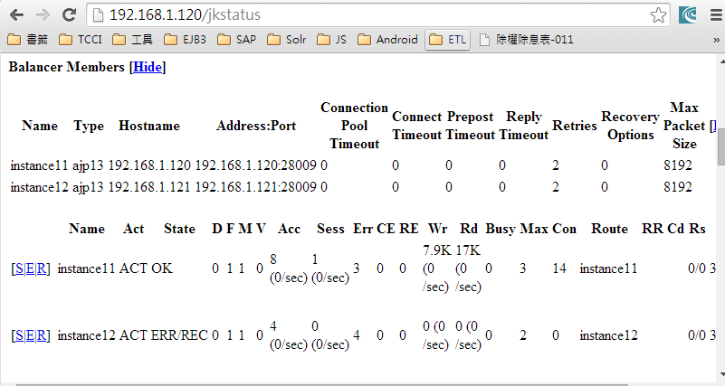
uriworkermap.properties
/*.jsp=LBC
/*.xhtml=LBC
/cas/*=LBC
/pmis/*=LBC
/jkstatus=jkstatus

Slide 17
httpd.conf
…
LoadModule jk_module modules/mod_jk.so
# Configure mod_jk
JkWorkersFile conf/workers.properties
JkMountFile conf/uriworkermap.properties
JkLogFile logs/mod_jk.log
JkLogLevel warn
# Should mod_jk send SSL information to Tomcat (default is On)
JkExtractSSL On
# What is the indicator for SSL (default is HTTPS)
JkHTTPSIndicator HTTPS
# What is the indicator for SSL session (default is SSL_SESSION_ID)
JkSESSIONIndicator SSL_SESSION_ID
# What is the indicator for client SSL cipher suit (default is SSL_CIPHER)
JkCIPHERIndicator SSL_CIPHER
# What is the indicator for the client SSL certificated (default is SSL_CLIENT_CERT)
JkCERTSIndicator SSL_CLIENT_CERT
…

Slide 18
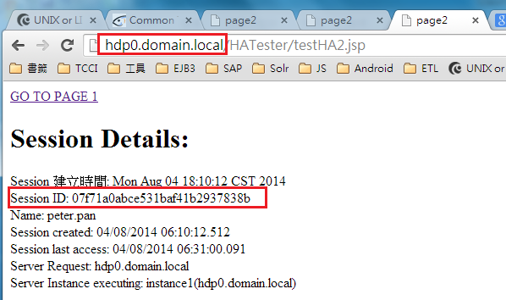
Test LB with GlassFish Cluster
Restart Apache Web Server
/etc/init.d/httpd restart

Slide 19

Validation List …
Service Failover
Session Persistence
Centralized Administration
Resource
Configuration
Shared Libraries
??? 理所當然???
Application Clustering
Stress Testing
Recovery

Slide 20
Thank You !

