Slide 1
UML CASE Tools
Jackson Lee
2014/3/13

Slide 2
Agenda
Recap -UML
Choosing UML CASE tools
Commercial CASE tools
Open Source UML CASE tools
  1. StarUML
  2. Astah (from JUDE)
  3. ArgoUML

Slide 3
What is UML?
The Unified Modeling Language (UML) is a language for specifying, constructing, visualizing, and documenting the artifacts of a software-intensive system.
軟體設計工具 vs 畫圖工具
溝通工具
  一張”好的”圖勝過千言萬語
-Source - SoftwareEngineeringReferences.com
Notes:
intensive 加強的；密集的

Slide 4
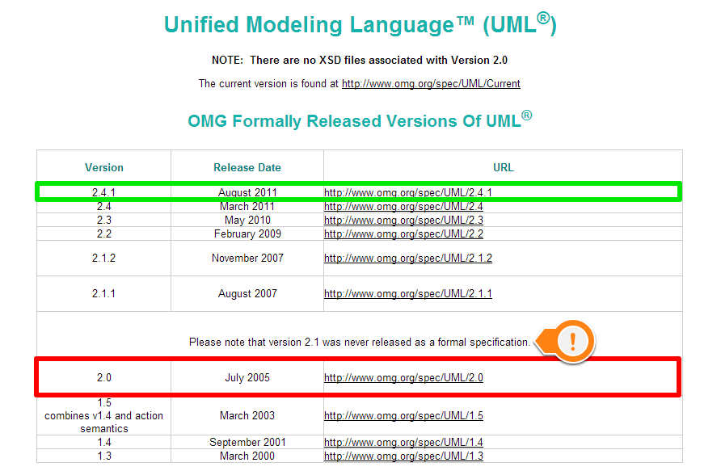
UML SPEC
http://www.omg.org/spec/UML/

Slide 5
Choosing UML tools
Tool should support most UML analysis diagrams (class, use-case, collaboration, sequence, and activity).
It be easy to use, reliable, scalable.
It be free or almost free
Source: SoftwareEngineeringReferences.com

Slide 6

Commercial Tools
  IBM Rational Rose
  Enterprise Architect
  Sybase Power Designer
  Microsoft Visio
  Astah (from Jude)
  Poseidon for UML
  SmartDraw
  Borland Together

Slide 7
IBM Rational Rose
Rational Rose[rational] is often considered the definitive UML tool because the founders of the Rational company also include the creators of UML.
perhaps the best known UML tool; free to universities (if you ask)
Notes:
Early versions of Umbrello described it as an equivalent of Rational Rose and screenshots indicate that it has a similar user interface layout

Slide 8
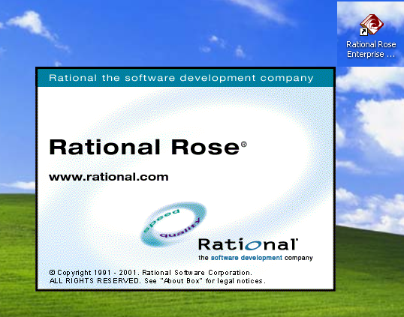

Slide 9
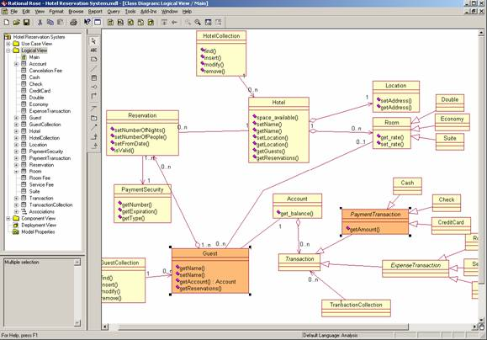
Hotel Reservation System in Rational Rose

Slide 10
Microsoft Visio
Instead of static pictures, create data-connected Visio diagrams that display data, are easy to refresh, and dramatically increase your productivity.
Use the wide variety of diagrams in Office Visio 2007 to understand, act on, and share information about organizational systems, resources, and processes throughout your enterprise.
Source: http://office.microsoft.com/en-us/visio/HA101656401033.aspx

Slide 11
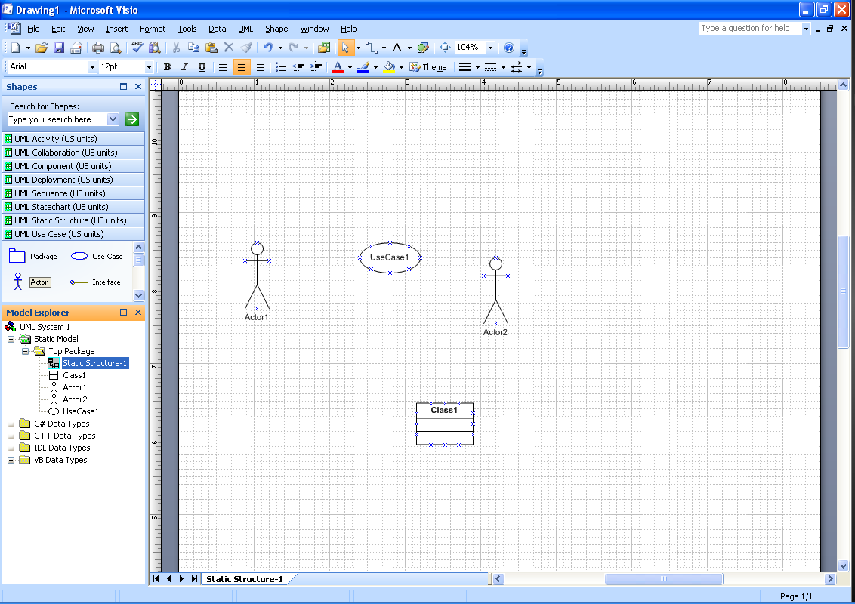
w

Slide 12

Choosing the popular tools…
Are we going to look at all these 513 tools?
  Let’s filter by downloads ☺

Slide 13

1. StarUML - 781,246 downloads
  StarUML is an open source project to develop fast, flexible, extensible, featureful, and freely-available UML/MDA platform running on Win32 platform.
  The goal is a compelling replacement of commercial UML tools such as RationalRose, Together and so on.

Slide 14
1. StarUML - 781,246 downloads
  User Interface: Win32 (MS Windows)
  Translations: English
  License: GNU General Public License (GPL)
  Latest Version: Stable 5.0 2005-12-30
  Support UML Version: 2.0
  Feature :
    Support for Specific Processes: UML Components, RUP, Catalysis, XP, ...
    Support Reverse Engineering…(java older version)
    More Documents, meterials…

Slide 15
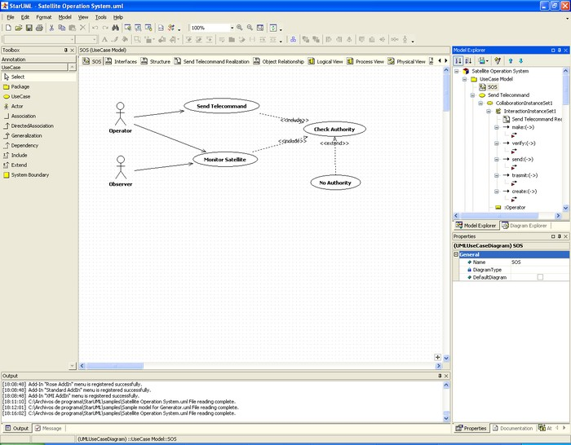
1. starUML screenshots

Slide 16
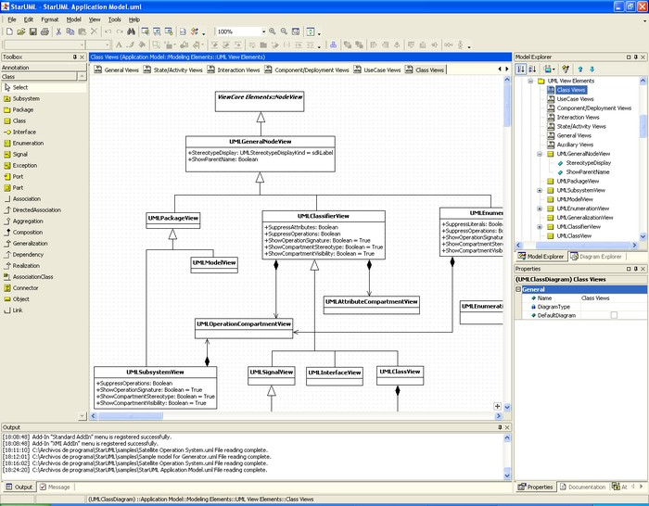
1. starUML screenshots

Slide 17


2. Astah (from JUDE)
  Astah Community is an add-on tool for your UML that is ready to use the instant you download it, allowing your UML to be quickly and easily enhanced, and refining your development process with Astah's innovative modeling approach. (from Japan)
  http://astah.net/editions/community
  Latest Version: Stable 6.8 2014-1-16
  Support UML 2.x
  Feature :
    beautiful
    A lot of [Paid] function

Slide 18
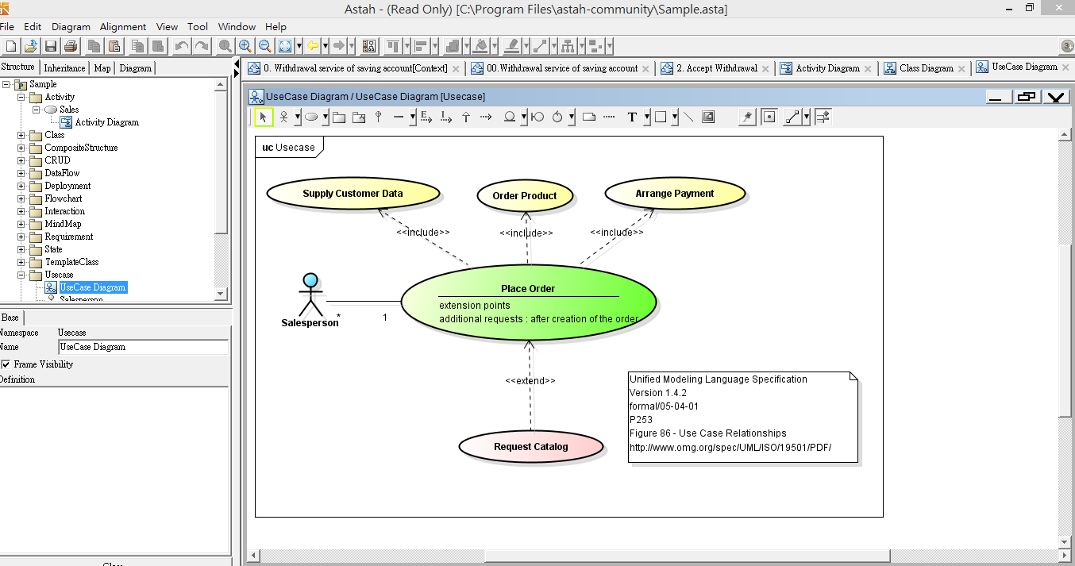

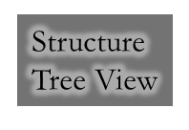


Astah – Use Case diagram

Slide 19
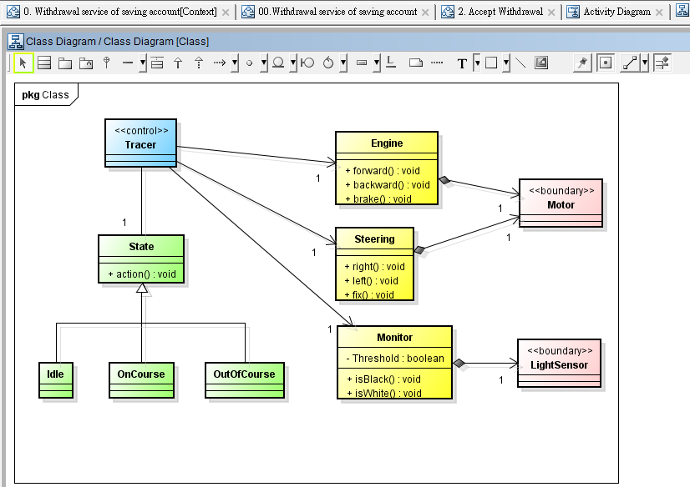
Astah – Class diagram

Slide 20
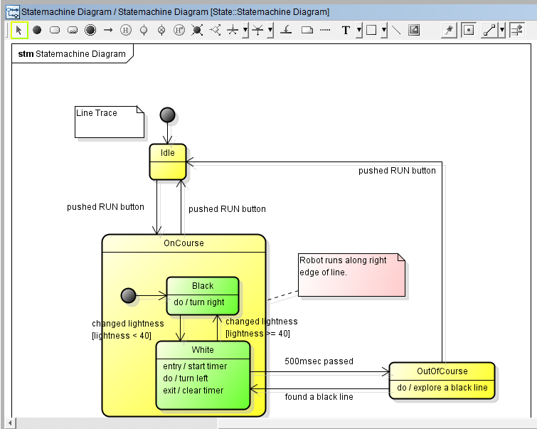
Astah – State Chart Diagram

Slide 21
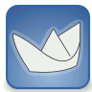
3. ArgoUML
ArgoUML is a powerful yet easy-to-use interactive Java based graphical software design environment that supports the design, development and documentation of object-oriented software applications.
A free research modelling tool; fairly fully featured; the main goal is to have a Really Useful user interface, unlike almost all existing CASE tools;

Slide 22
The users of ArgoUML are software designers & architects, software developers, business analysts, systems analysts and other professionals involved in the analysis, design and development of software applications.
Commercial version: Poseidon by Gentleware; they offer a free community edition as well as fancier editions that cost real money.

Slide 23
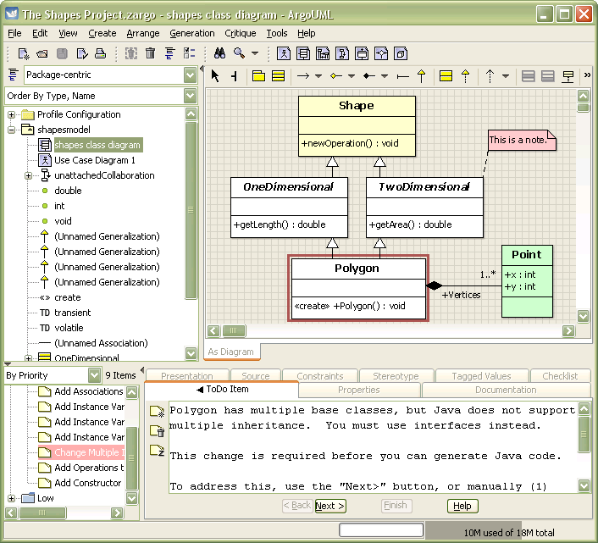

Slide 24
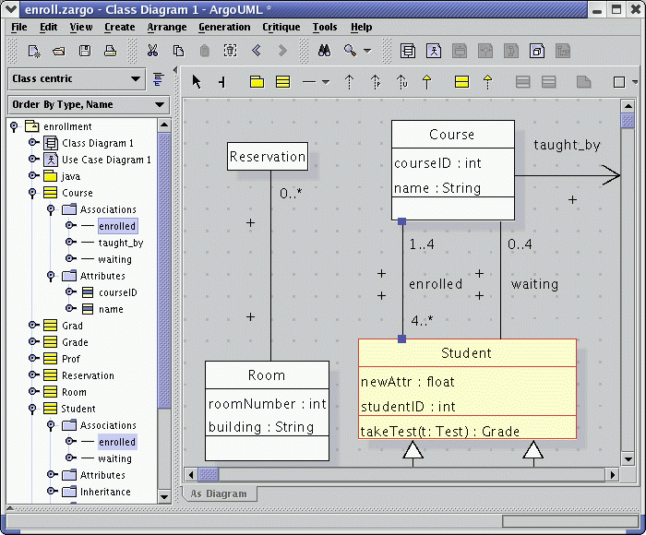
ArgoUML – class diagram

Slide 25
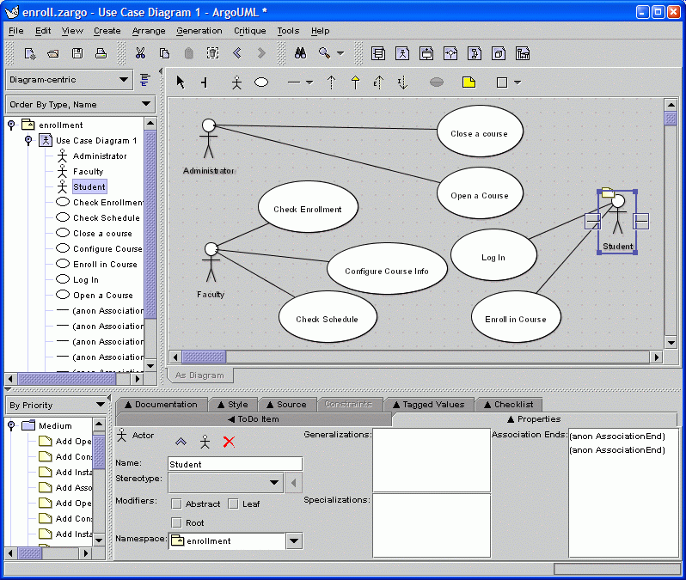
Argo UML – Use Case Diagram

Slide 26
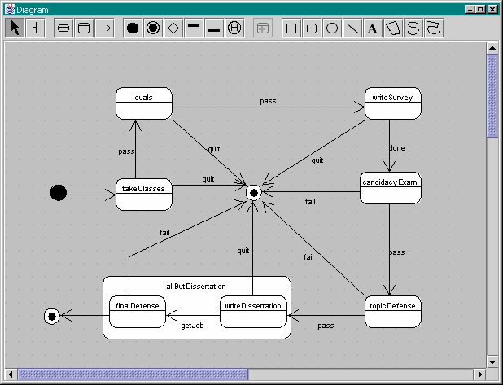
Argo UML – State Chart Diagram

Slide 27

Other CASE Tools
  AndroMDA
  DIA
  Umbrello
  BOUML
  Coral
  Gaphor
  Astade
  FUJABA
  Coral
  Violet
  UMLet

Slide 28
LIVE ＤＥＭＯ
StarUML & Astah Community

Slide 29
Conclusion
Use the tools that make us most productive
Efficiency is the key!

Slide 30
References
http://www.slideshare.net/curiousEngine/uml-case-tools?qid=38e4d791-76eb-4d97-95c5-9e624184b59d&v=qf1&b=&from_search=2

Slide 31

Other CASE Tools
  Oracle JDeveloper
  MetaUML
  Agent UML Tool
  Delphia Object Modeler
  Magic Draw
  Borland Together
  OmniGraffle (Macintosh)
  Eclipse UML
  Visual Paradigm for the Unified Modeling Language
  Visual UML
  iLogix Rhapshody
  gModeler
  And the list goes on!

