Slide 1
RWD簽核頁面設計
Bryant Yu 2019年03月

Slide 2

primefaces-6.2.14
omega-menu-1.1.4
RWD

Slide 3
primefaces-6.2.14
DataExporter無法下載Excel：Apache POI 3.15
https://stackoverflow.com/questions/49147668/primefaces-error-on-exporting-data-xls-java-lang-nosuchmethoderror-poi-cel
中文下載檔名亂碼 : DefaultStreamedContent 檔名不用再轉UTF-8
PickList NullPointerException : escape="true"
https://github.com/primefaces/primefaces/issues/4413
DataTable <p:column headerText="&lt;br/>" >斷行符號
<f:facet name="header">
<h:outputText value ="&lt;br/>"
escape="false" style="white-space:pre-line;" />
</f:facet>
https://stackoverflow.com/questions/11495137/primefaces-how-to-put-a-linebreak-inside-column-header/11501479
6.2 deprecated
https://www.primefaces.org/docs/api/6.2/deprecated-list.html

Slide 4
omega-menu-1.1.4
Omega layout depends on the Omega theme of PrimeFaces that is available since 6.0
https://www.primefaces.org/omega/panel.xhtml
Copy omega-menu-1.1.4.jar
Copy the omega-layout folder to your %WEB-APP-FOLDER%/resources folder
sass src/main/webapp/resources/sass/layout.scss https://sass-lang.com/install src/main/webapp/resources/omega-layout/css/layout.css
Omega provides a main template.xhtml and additional topbar, sidebar and footer fragments for the base layout.
MENU MenuModel
SubMenu
MenuItem
<po:menu model="#{functionMenuController.menuModel}">
</po:menu>

Slide 5
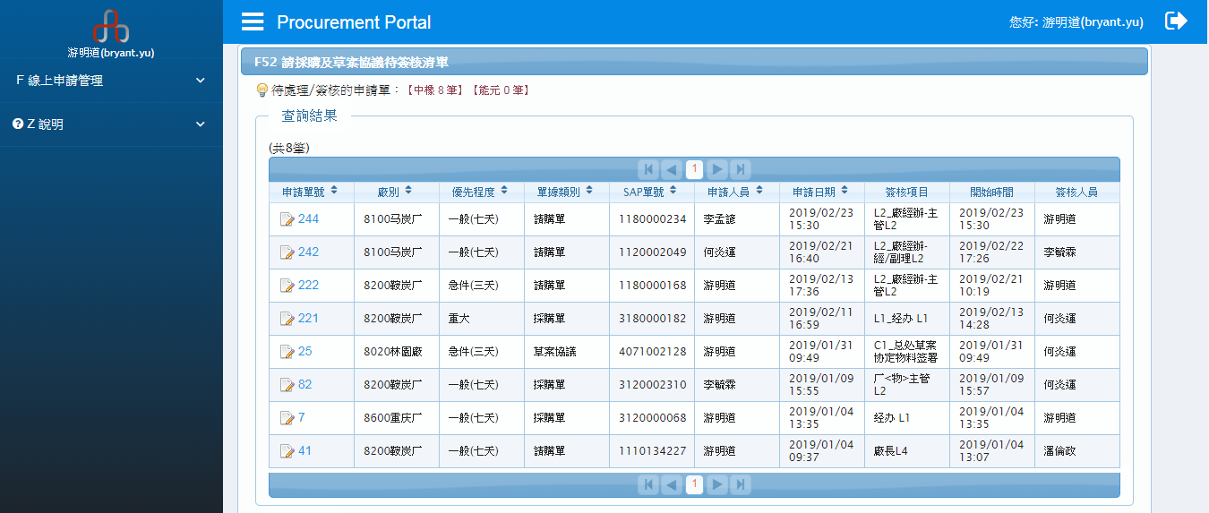
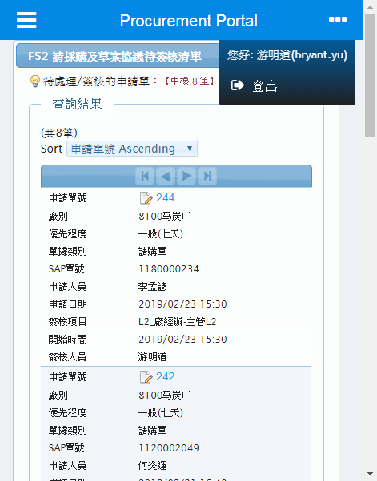
omega-menu-1.1.4

Slide 6
RWD
官方範例
https://www.primefaces.org/showcase/ui/misc/responsive.xhtml
刪除固定寬度改為<div class="ui-fluid"></div>
<p:dialog header="Login" widgetVar="dlg" resizable="false" draggable="false" responsive="true" >
<p:dataTable var="car" value="#{dtBasicView.cars}" reflow="true" style="margin-top:20px">
<p:panelGrid columns="4" columnClasses="ui-grid-col-2,ui-grid-col-4,ui-grid-col-2,ui-grid-col-4" layout="grid" styleClass="ui-panelgrid-blank ui-fluid">
<div class="ui-g"><div class="ui-g-12 ui-md-6 ui-lg-3"></div></div>
JS的alert和confirm改為confirmDialog
https://blog.user.today/solve-blocking-alert-window/
判斷是否為手機頁面 http://detectmobilebrowsers.com/

Slide 7
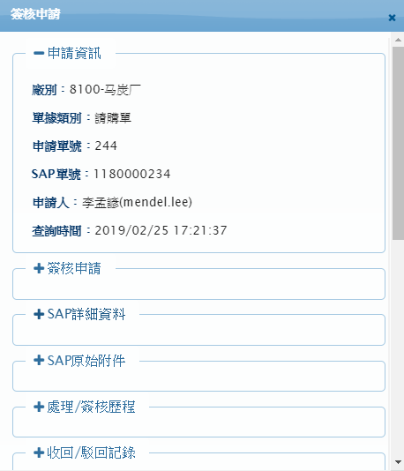
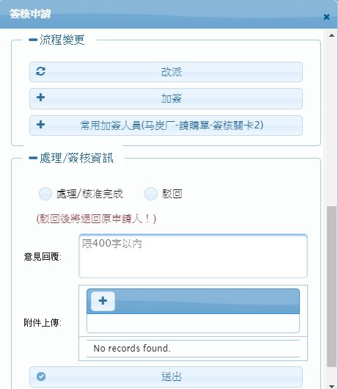
RWD

Slide 8

謝謝

