Slide 1
tcc-bpm-model introduction
embedded workflow engine

Slide 2
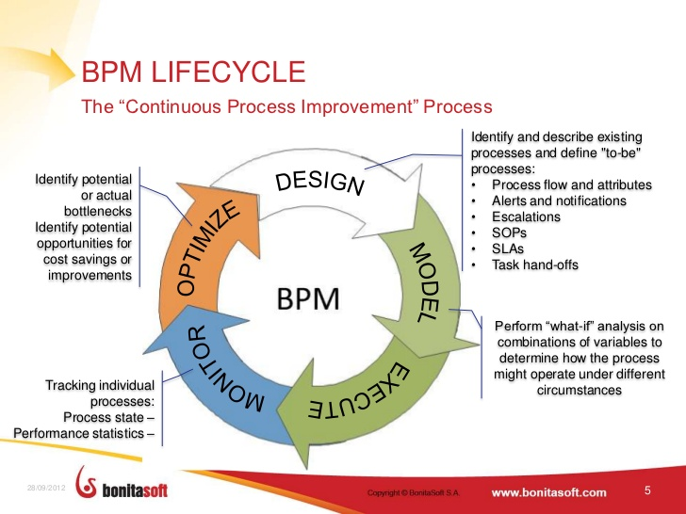
Business Process Management
tcc-bpm-model
is here

Slide 3
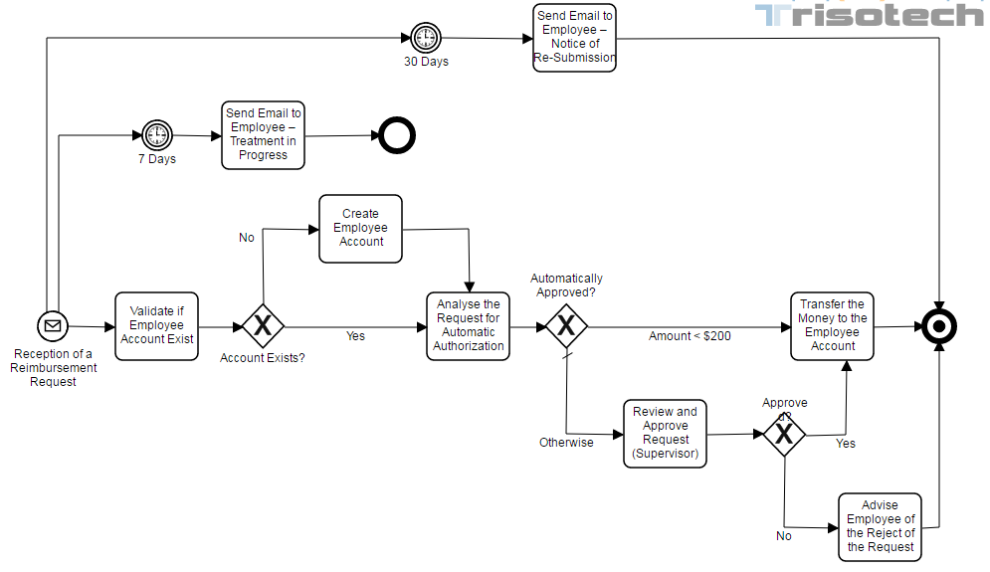
BPM Example: 員工費用報銷申請

Slide 4
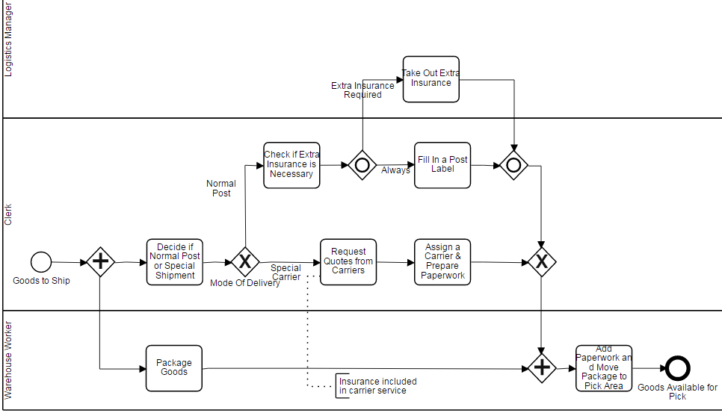
BPM Example: 出貨流程

Slide 5
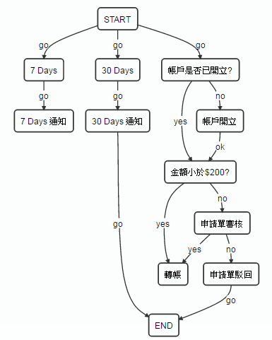
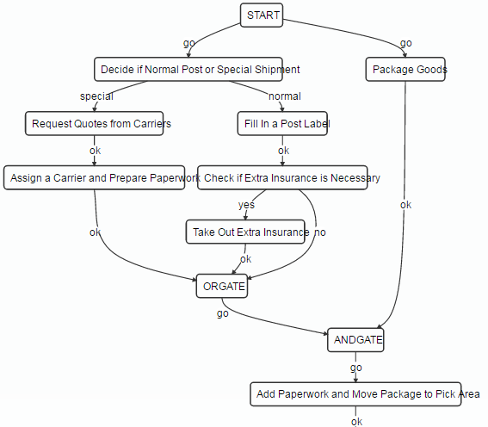
tcc-bpm-model examples

Slide 6
tcc-bpm-model terminology
Process: 流程
Activity: 流程中的步驟或特殊節點
type: TASK(人員工作)，EXPRESSION_ROBOT(程式), START, END, AND_GATE, OR_GATE
role: 執行TASK的角色
options: 是否必簽、全部人或任一人簽、已簽過人是否PASS
Activityroute: activity與activity之間的有向連結
tally(得分): 被選到的次數
Role: 一個(群)人，可執行特定的Activity
Workitem: 實際執行activity的人
ballot(投票):投票(執行/選擇)的項目
route: 實際選的activityroute name
Signature: workitem的執行記錄(when, ballot, comment)

Slide 7
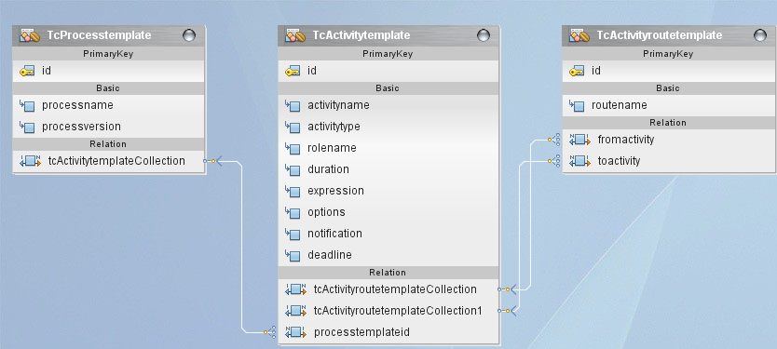
Entity Model

Slide 8
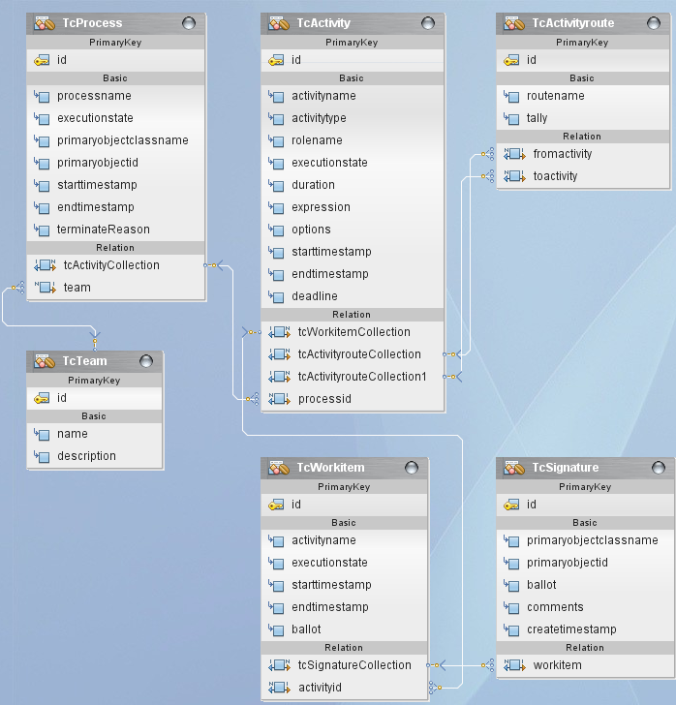

Slide 9
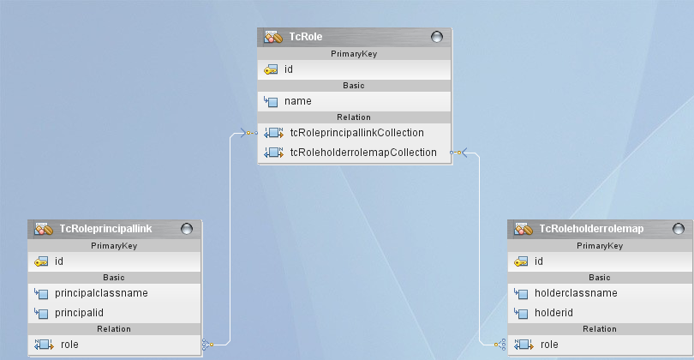

Slide 10
Quick Start
svn export http://tcci-svn/svn/src/tcc-fc/tcc-fc-view/branches/pf5.1/bpmadmin bpmadmin
copy bpmadmin\* to project\
Libraries修改
修改 web\WEB-INFO\faces-config.xml:
修改 web\WEB-INFO\web.xml:
修改 web\jsff\menu.xhtml:
修改 src\conf\persistence.xml:
DB setup: exec db-schema\install_bpm.sql
Deploy & Run

Slide 11
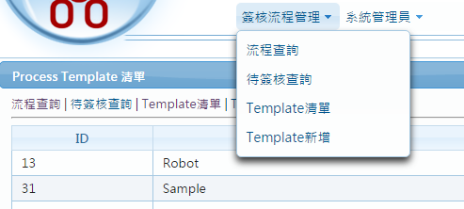
簽核流程管理

Slide 12
Next steps…
Design form(business) entity (require implements Persistable)
Design workflow
directed graph (from START to END) to Excel template
Vertex -> Activity, Edge -> route

Slide 13
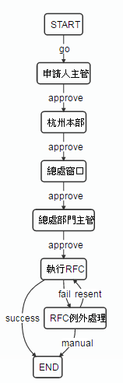
Workflow template sample
ACTIVITY名稱 | ACTIVITY類型 | 角色名稱 | bit 0: 0:選簽, 1:必簽 bit 1: 0:全部簽, 1:任一簽 bit 2: 0:每次都簽, 1:簽過則PASS | DURATION | EXPRESSION
activityname | activitytype | rolename | options | duration | expression
START | START
申請人主管 | TASK | SUPERVISOR | 1
杭州本部 | TASK | HZ-MANAGER | 2
總處窗口 | TASK | HQ-CONTACT | 3
總處部門主管 | TASK | HQ-MANAGER | 3
執行RFC | EXPRESSION_ROBOT |  |  |  | execRFC
RFC例外處理 | TASK | RFC-OPERATOR | 3
END | END
FROMACTIVITY | TOACTIVITY | ROUTENAME
fromactivity | toactivity | routename
START | 申請人主管 | go
申請人主管 | 杭州本部 | approve
杭州本部 | 總處窗口 | approve
總處窗口 | 總處部門主管 | approve
總處部門主管 | 執行RFC | approve
執行RFC | END | success
執行RFC | RFC例外處理 | fail
RFC例外處理 | 執行RFC | resent
RFC例外處理 | END | manual
當activity是PASS時，系統會走 approve route，沒有時此activity會變 WAITING

Slide 14
Implement BpmEngineEx callback
// 當workitem啟動時, app可實作通知owner有一筆待簽核項目
public void onWorkitemStartNotification(TcWorkitem workitem)
// 當執行 EXPRESSION_ROBOT activity, 回傳next routename
public String onExecuteExpressionRobot(TcActivity activity)
// 當activity進入WAITING狀態時會被呼叫
// 必簽的activity沒有人
// onExecuteExpressionRobot發生exception
// next routename不存在
public void onWaitingActivity(TcActivity activity)

Slide 15
BpmEngineEx callback cont.
// 流程執行到END
public void onCompleteProcess(TcProcess process)
// Workitem簽核時中止流程 (routename是TERMINATE or reject)
// 直接呼叫terminateProcess
public void onTerminateProcess(TcProcess process)
// Workitem簽核
// ballot:使用者簽核的項目(如approve, partialApprove)
// routeName: 實際要走的activityroute
// allowAgent: false時 operator必需與workitem owner相同,否則會exception
public void completeWorkitem(TcWorkitem workitem, String ballot, String routeName, String comments, TcUser operator, boolean allowAgent)

Slide 16
BpmEngineEx callback cont.
// 批次通知待簽事項
public void onBatchNotifyRunningWorkitems(TcUser owner, List<TcWorkitem> workitems)
PS: AP需自行設定排程並呼叫batchNotifyRunningWorkitems, sample如下:
@Schedule(dayOfWeek = "Mon,Tue,Wed,Thu,Fri", hour = "06", minute = "00", persistent=false)
public void notifySignWaitingBatch() {
try {
bpmEngine.batchNotifyRunningWorkitems();
} catch (Exception ex) {
logger.error("notifyRunningWorkitems", ex);
}
}

Slide 17
其它可實作的callback
public void onStartActivity(TcActivity activity)
public void onCompleteActivity(TcActivity activity, String nextRoute)
public String onNextActivtyRoute(TcActivity activity)

Slide 18
Flow Actions (請參考com.tcci.fc.controller.bpmadmin package)
建立流程: createProcess
結束流程: terminateProcess
簽核: completeWorkitem
改派: reassign
加簽(先會): addActivitiesBefore
加簽(後會): addActivitiesAfter
加簽(同一個activity): addActivityWorkitem
退回上一關: returnToPrevious

Slide 19
Issue
退回上一關: AND_GATE?
退回上一關: OR_GATE?
並簽時退回上一關?

