Slide 1
Valorant capstone project
Kyoungho brian kim

Slide 2

ABOUT VALORANT
Notes:
Valorant is a first person shooter game from Riot Games that was released June 2, 2020. In less than 2 years, Valorant grabbed professional players from all over first person shooting games such as Overwatch and CS:GO and now it has over 14 million monthly average players. It is rapidly gaining its popularity. Although the game hasn’t been out to public for a long time, the stats are gathered in a way that we can perform both SQL and Python for my project.

Slide 3
Problem statement
As the world of Esports rises and more viewers are tuning into video game streamers, there is a major need for a fantasy league for professional gamers. What would the data model and design look like and how can we solve deep questions to predict upcoming Valorant competitions?

Slide 4
Goals
Create a fantasy football style environment for the Valorant community
Create more involvement and engagement within the Valorant community
Initiate more awareness and increase resources as only a few of these exist

Slide 5
sources
Valorant made its APIS public in the website:
https://www.riotgames.com/en/DevRel/valorant-api-launch
In here we are able to see how the Riot Games developers gather data and how one table links with another.

Slide 6
Entity relationship diagram (erd)
An ERD is a type of flowchart that illustrates how features such as people, items, and prices relate to each other within a system.
Lucid Chart
Click this Link for the diagram

Slide 7
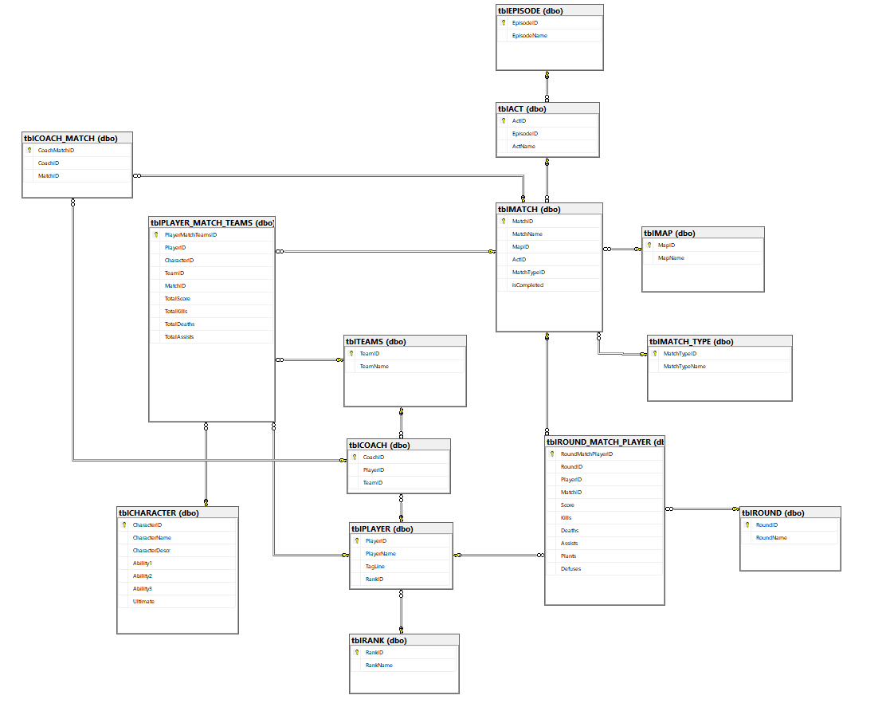
First ERD
Taking from the Valorant API page, I was able to use Lucid Chart for the first draft of the ERD.
Working with SQL requires visualizations like this to see how to link one table to another.

Slide 8
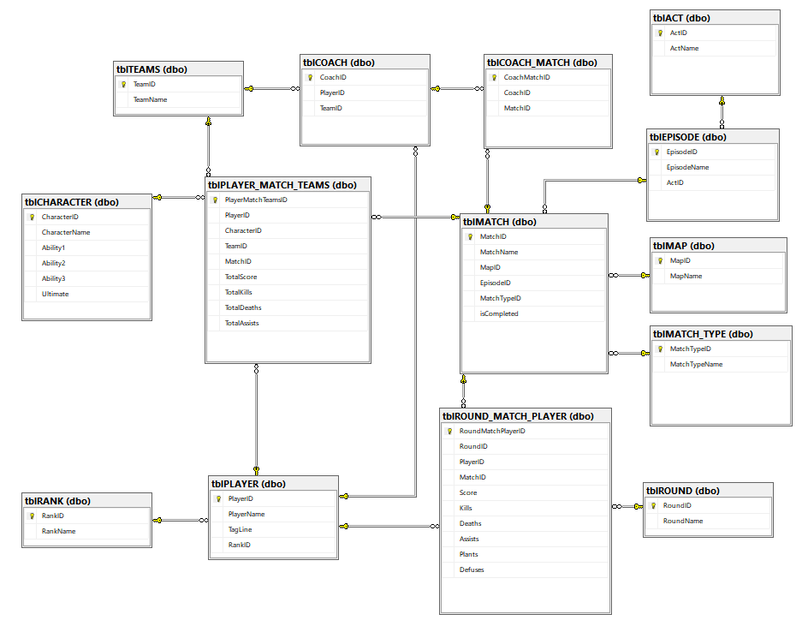
second ERD
Transferring the csv files from Excel to Azure Data Studio, I was able to see that some of the entities are unnecessary to implement to my overall project.
Relationships are mostly similar but some entities are changed

Slide 9
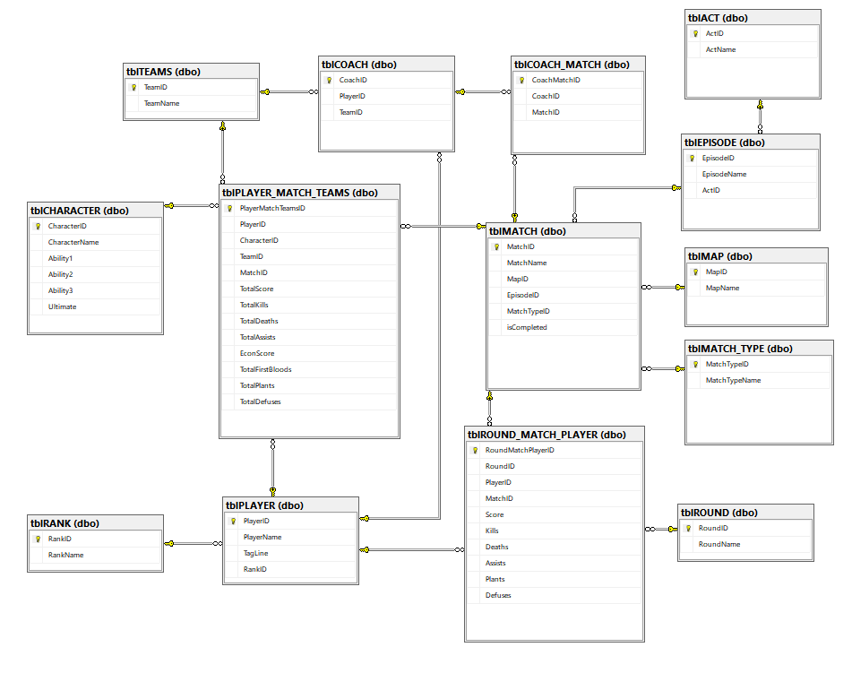
Final ERD
The final Erd change was very small. Some entities were found that were useful in the tblPLAYER_MATCH_TEAMS column that made the overall data structure flow smoother and findings easier to relate

Slide 10
Collecting Data
Since professional Valorant APIs were inaccessible, I organized a group of 20 people to perform in our tournament to use for our data.

Slide 11
Visualizations power BI
Power BI Desktop to create Individual and team performances
Here, I was able to visually see the application of SQL and Entity Relationship Diagram.

Slide 12
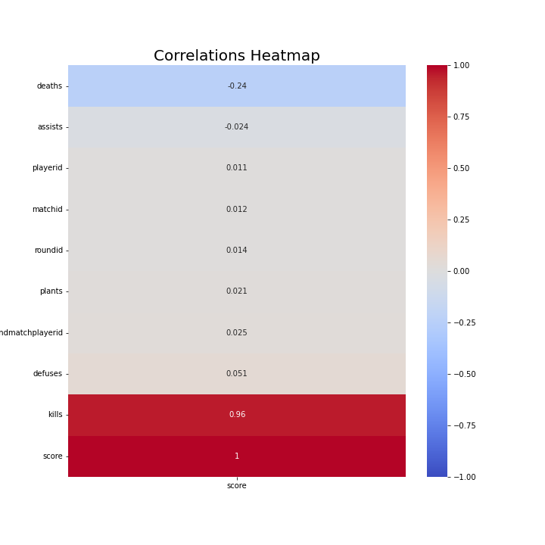
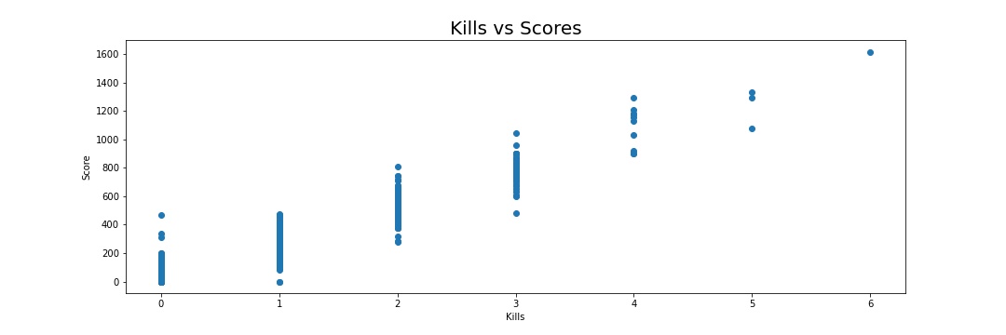
Visualizations python

Slide 13
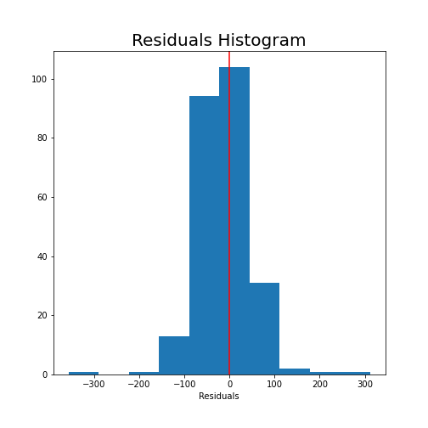
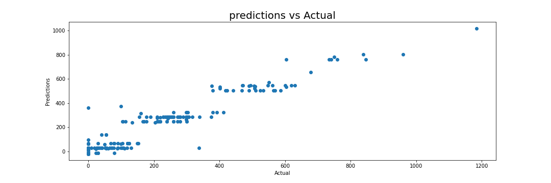
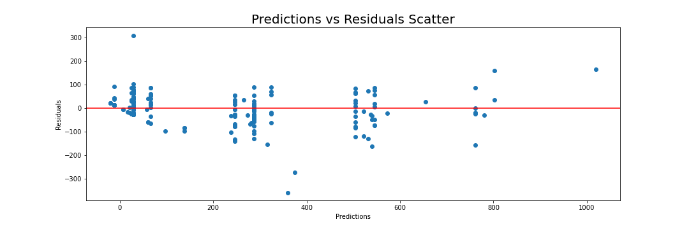
Visualizations python

Slide 14
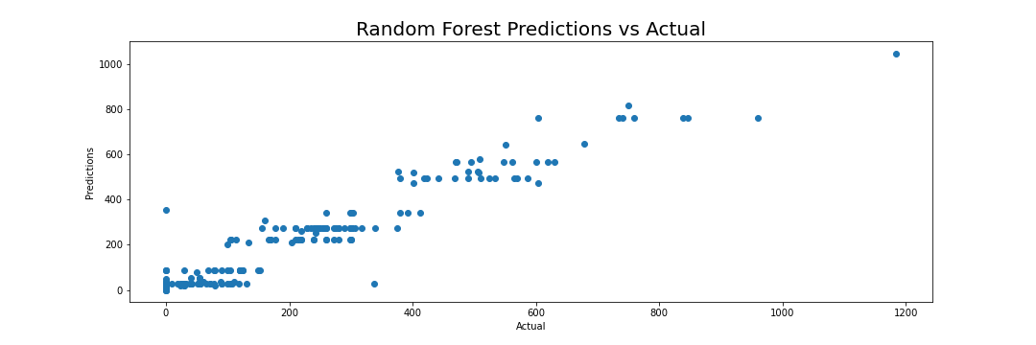
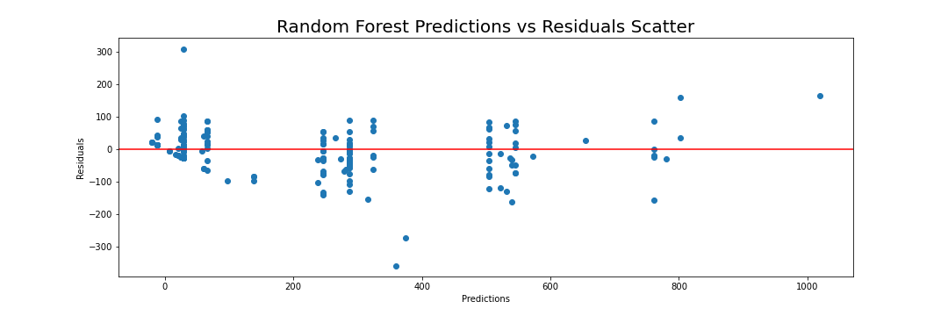
Visualizations python

Slide 15

Thank you!

