Slide 1
Image Processing
September 6, 2013

Slide 2
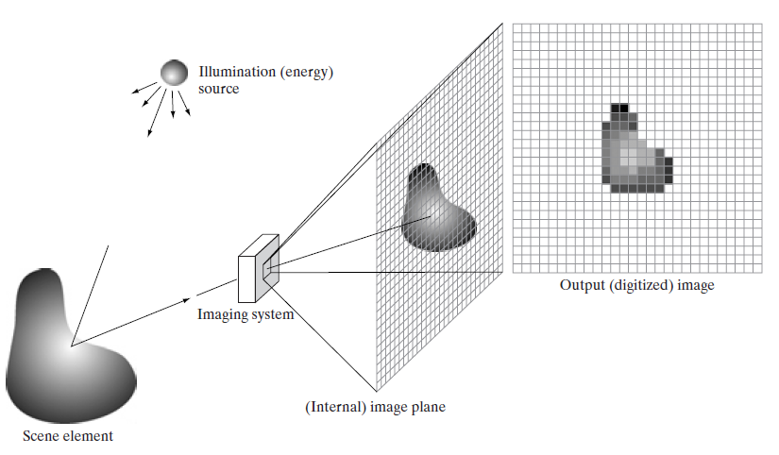
An example of the digital image acquisition process.

Slide 3
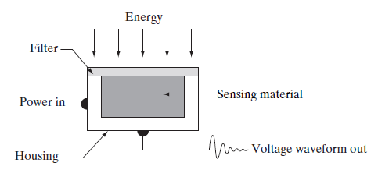
Sensing element

Slide 4
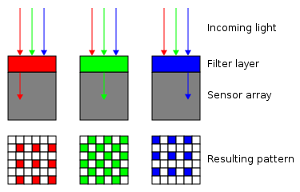
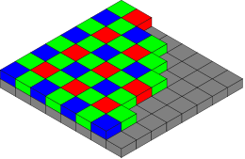
Buyer mosaic

Slide 5
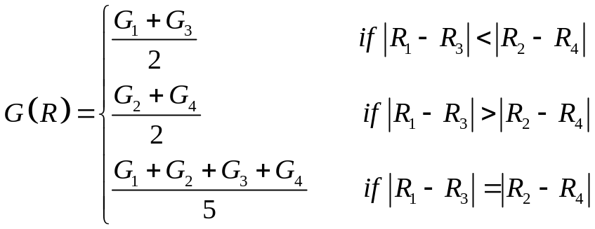
Buyer mosaic interpolation
(Linear interpolation taking correlation into consideration)
R₁
G₁
R₄
G₄
R
G₂
R₂
G₃
R₃
T. Sakamoto, C. Nakanishi and T. Hase, “Software pixel interpolation for digital still cameras suitable for a 32-bit MCU,” IEEE Trans. Consumer Electronics, vol. 44, no. 4, November 1998.

Slide 6

Buyer mosaic interpolation
(Linear interpolation taking correlation into consideration)
B₁
G₁
B₄
G₄
B
G₂
B₂
G₃
B₃
T. Sakamoto, C. Nakanishi and T. Hase, “Software pixel interpolation for digital still cameras suitable for a 32-bit MCU,” IEEE Trans. Consumer Electronics, vol. 44, no. 4, November 1998.

Slide 7
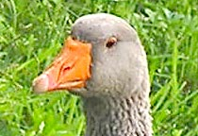



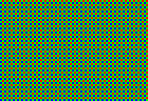
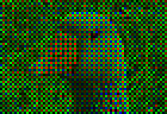

Buyer mosaic
Scene
Measured data
Direct combination
RGB mosaic
Interpolation result

Slide 8
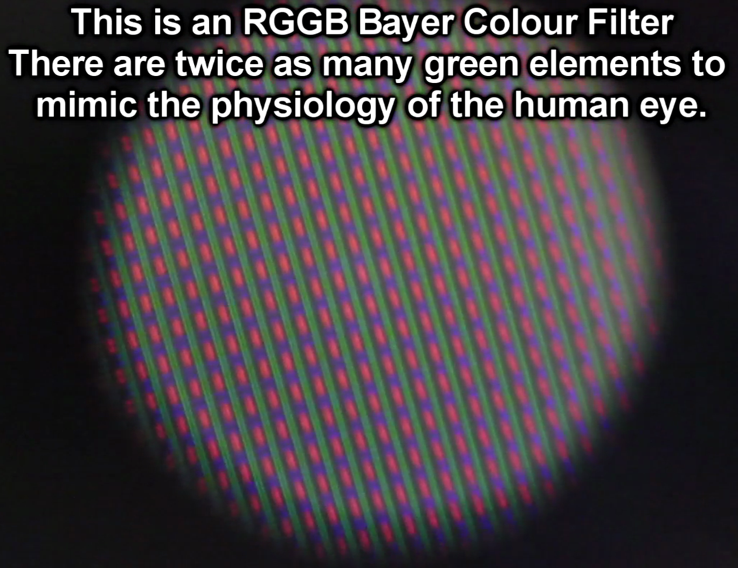
Buyer mosaic
x80 microscope view of an RGGB Bayer filter on a 240 line Sony CCD PAL Camcorder CCD sensor

Slide 9
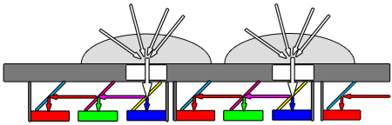
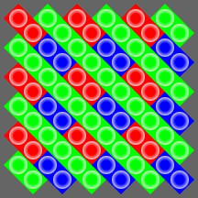
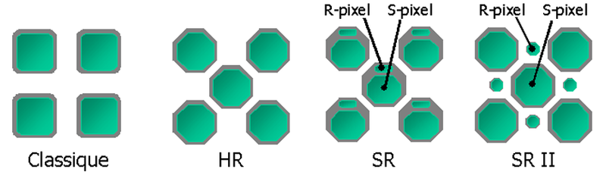
Other methods
Nikon's full-color RGB sensor patent (Dec, 2003)
SCCD sensor (Fuji)
EXR sensor (Fuji)

Slide 10
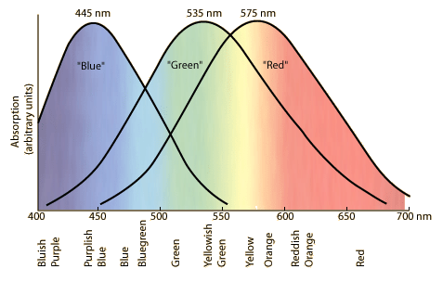
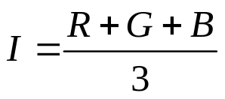

Human eye color-sensitivity

Slide 11
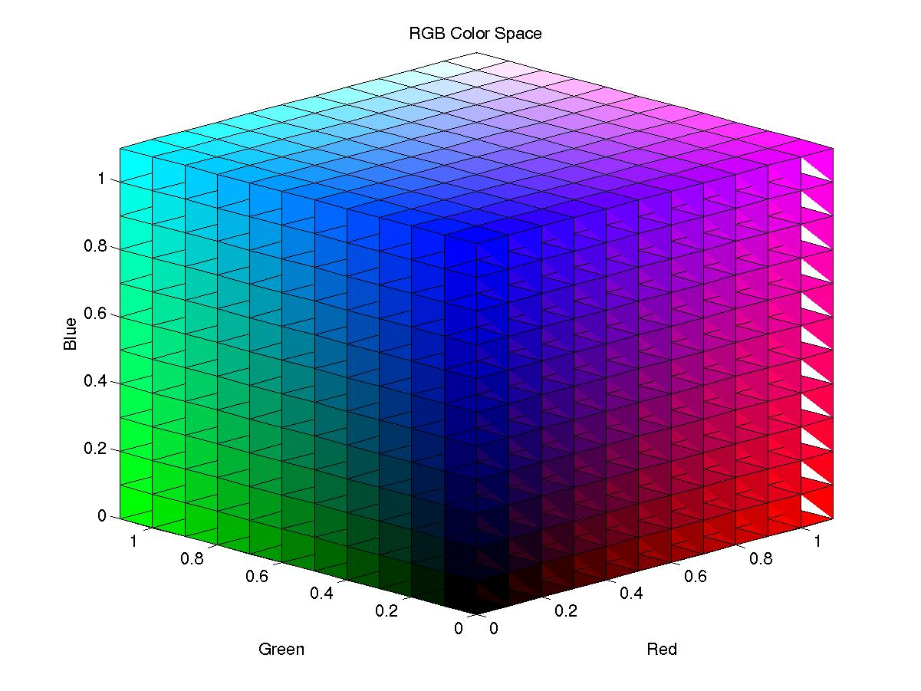
RGB color space

Slide 12
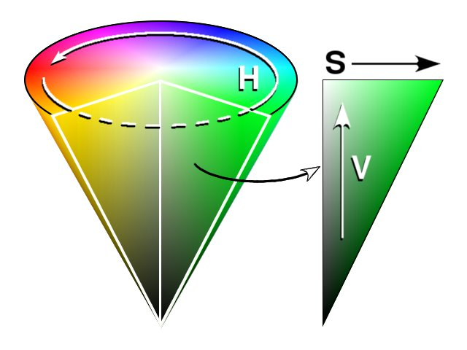
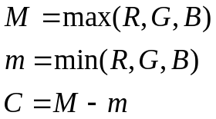
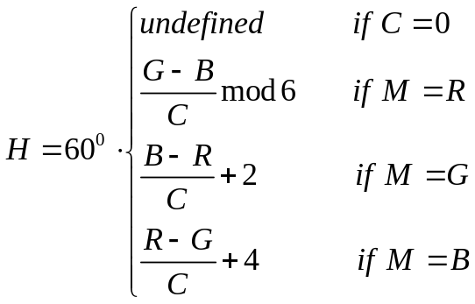
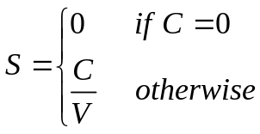
HSV color space
HUE, Saturation, Value
RGB to HSV

