Slide 1

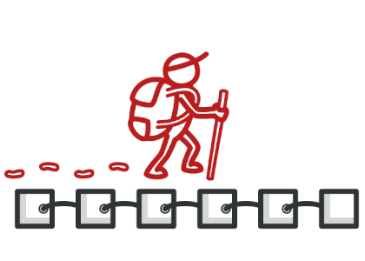
ITERATOR
Gerardo Mitsuy Fukazawa
CIS 476/566 Software Architecture and Design Patterns
Image: https://refactoring.guru/images/patterns/cards/iterator-mini-2x.png?id=7d28f66a487066774a74

Slide 2
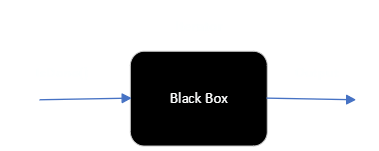
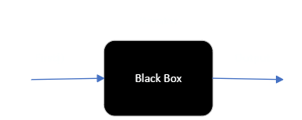

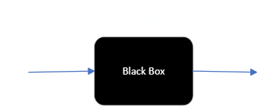
Intent
Iterator is a behavioral design pattern that provides a way to access elements of a collection without exposing its underlying representation.

Slide 3
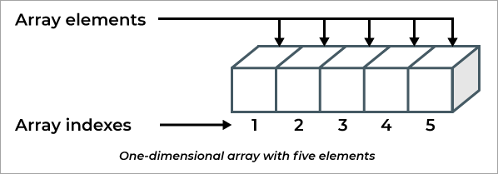
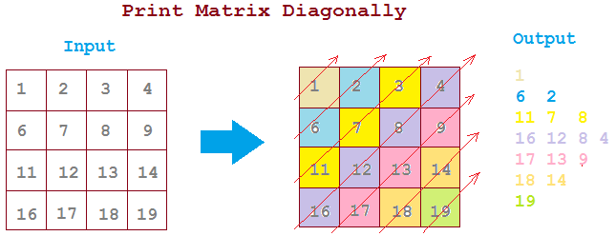
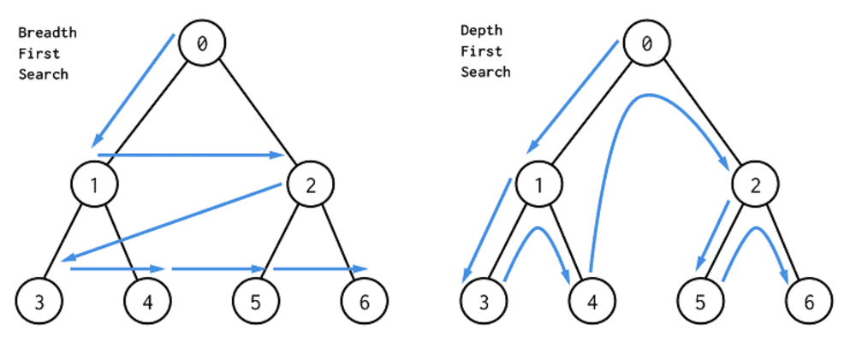
Motivation
The main idea of the Iterator pattern is to extract the traversal behavior of a collection into a separate object called an iterator
Separating the traversal mechanism from the List object lets us define iterators for different traversal policies without enumerating them in the List interface.
Image 1: https://www.softwaretestinghelp.com/wp-content/qa/uploads/2019/10/graphical-representation-of-a-one-dimensional-array.png
Image 2: https://2.bp.blogspot.com/-ppKyeaNtLWU/WE1vF6hYLMI/AAAAAAAABjY/SU5D7NNluGkS9RdoBYhrLoHkkGAoJwfwQCLcB/s640/diagonal-order-of-matrix.png Image 3: https://www.freelancinggig.com/blog/wp-content/uploads/2019/02/BFS-and-DFS-Algorithms.png

Slide 4
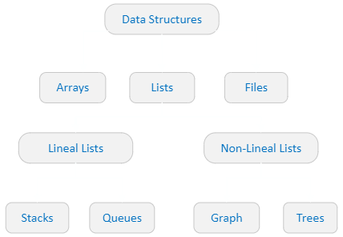
Applicability
To access an aggregate object’s contents without exposing its internal representation
To support multiple traversals of aggregate objects
To provide a uniform interface for traversing different aggregate structures

Slide 5
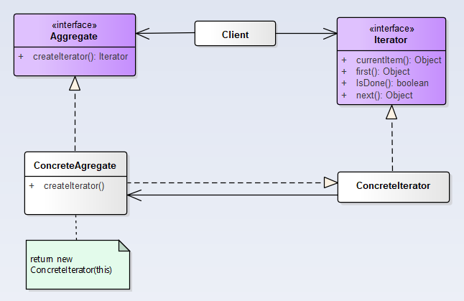
Participants
Iterator
Defines an interface for accessing and traversing elements.
ConcreteIterator
Implements the Iterator interface.
Keeps track of the current position in the traversal of the aggregate.
Aggregate
Defines an interface for creating an Iterator object
ConcreteAggregate
Implements the Iterator creation interface to return an instance of the proper ConcreteIterator
Generalized Class Diagram

Slide 6
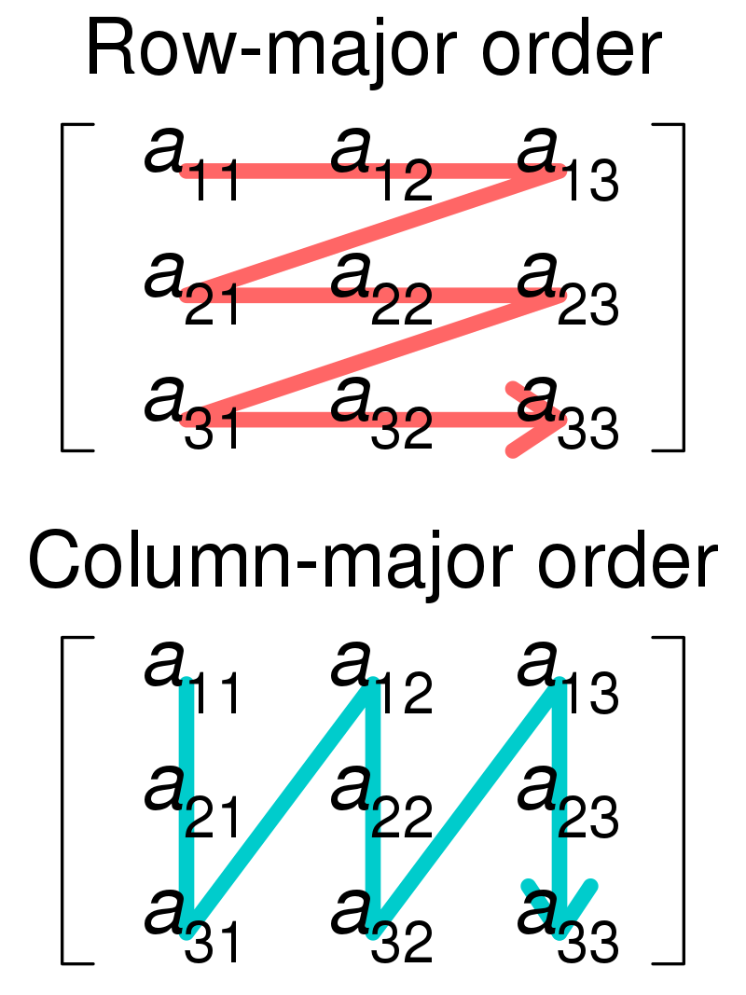
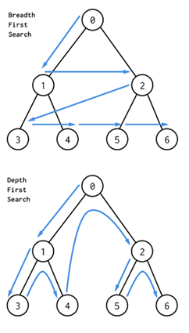
Consequences
It supports variations in the traversal of an aggregate. For example, it makes it easy to change the matrix traversal algorithm from Row-wise to Column-wise (Image1) or tree traversal algorithm from BFS to DFS (Image2) by replacing the iterator instance.
Iterators simplify the Aggregate interface. All the functionality related to access and traversal is removed from the aggregate interface, thereby keeping it simple.
More than one traversal can be pending on an aggregate. An iterator keeps track of its own traversal. Therefore, you can have more than one traversal in progress at once.
Image 1
Image 2
Image 1: https://upload.wikimedia.org/wikipedia/commons/thumb/4/4d/Row_and_column_major_order.svg/1920px-Row_and_column_major_order.svg.png Image 2: https://www.freelancinggig.com/blog/wp-content/uploads/2019/02/BFS-and-DFS-Algorithms.png

Slide 7
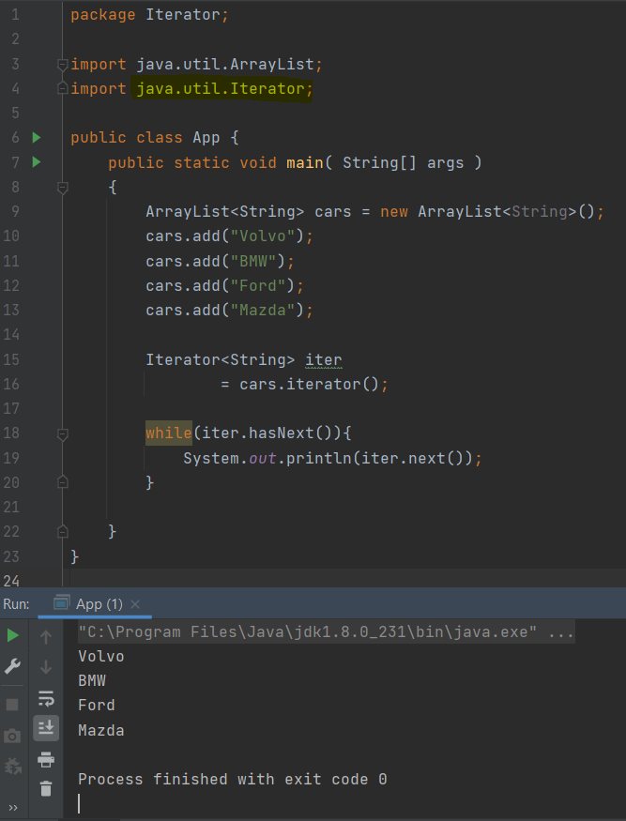
Known Uses
Image 1
Iterator are common in object-oriented systems. Most collection class libraries offer iterators in one form or other.
Java class ‘java.util.Iterator’ is an example I’m using to Iterate an ArrayList<String> (Image 1)

Slide 8
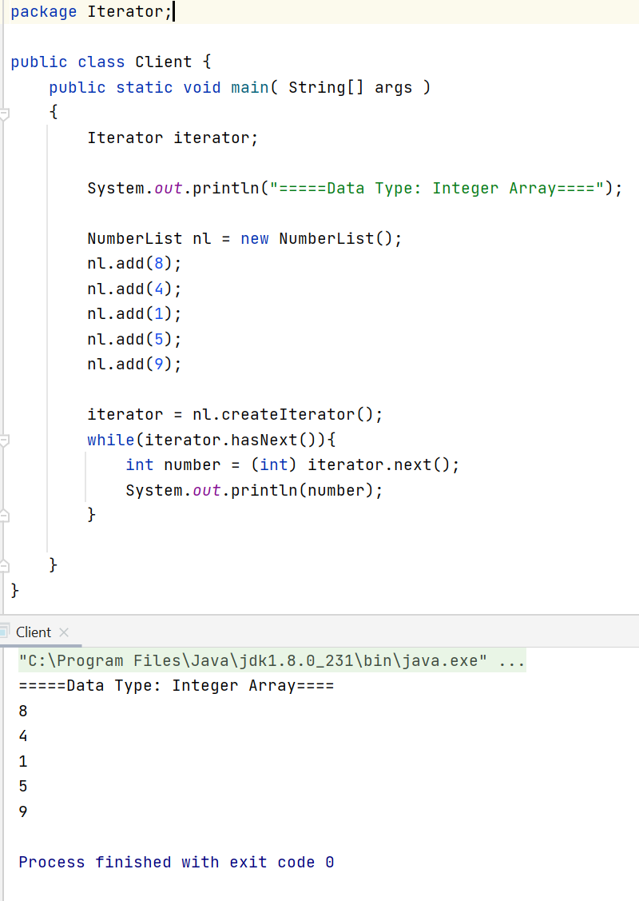

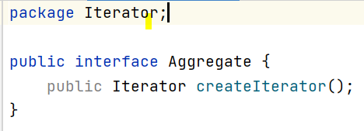
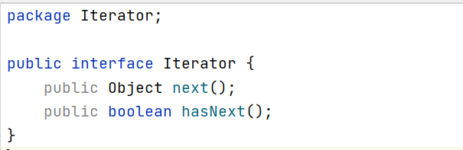
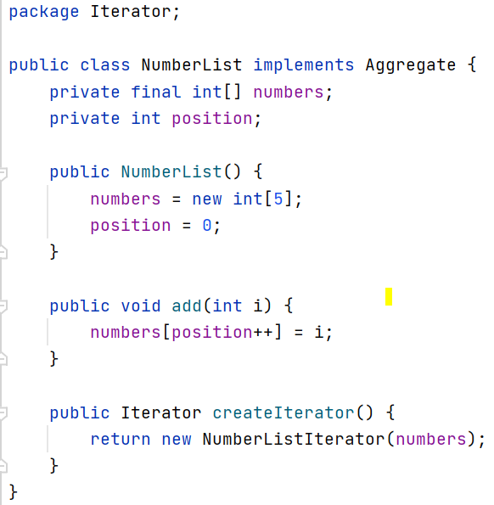
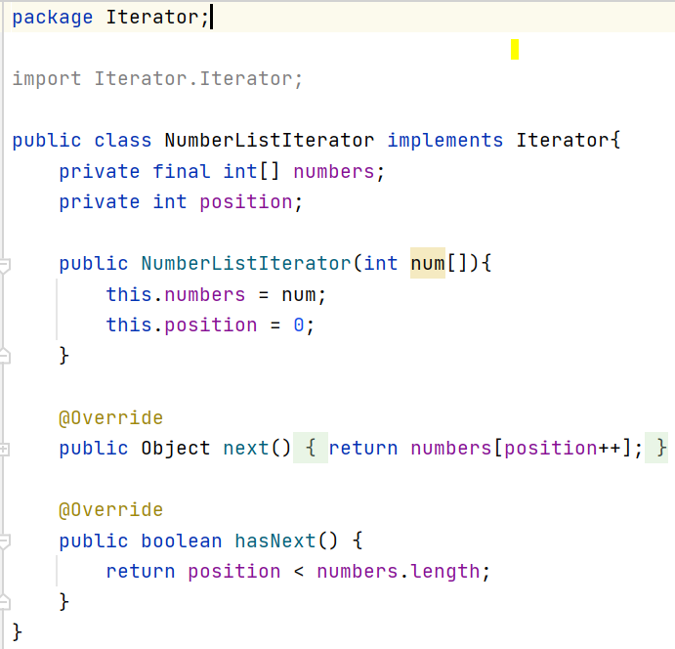
Example 1: Integer array

Slide 9
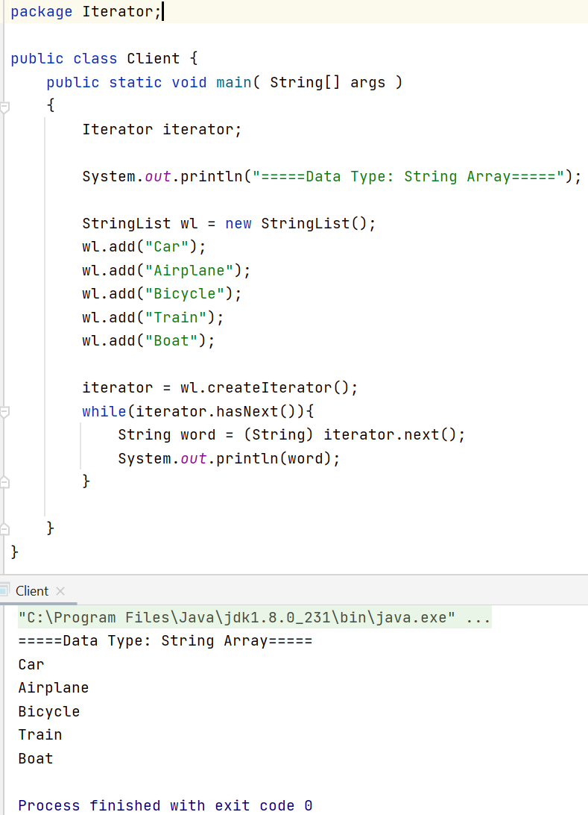
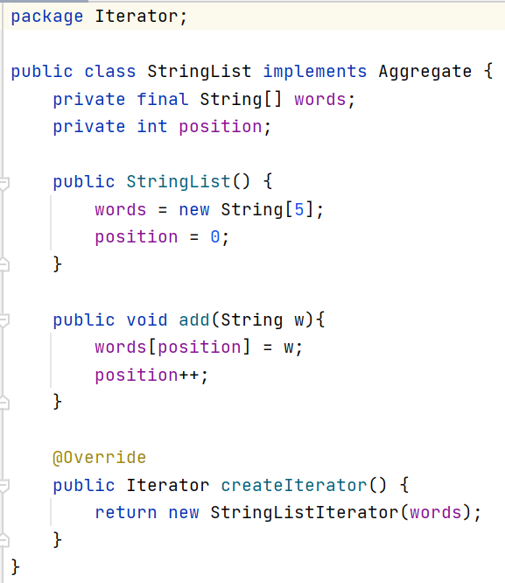
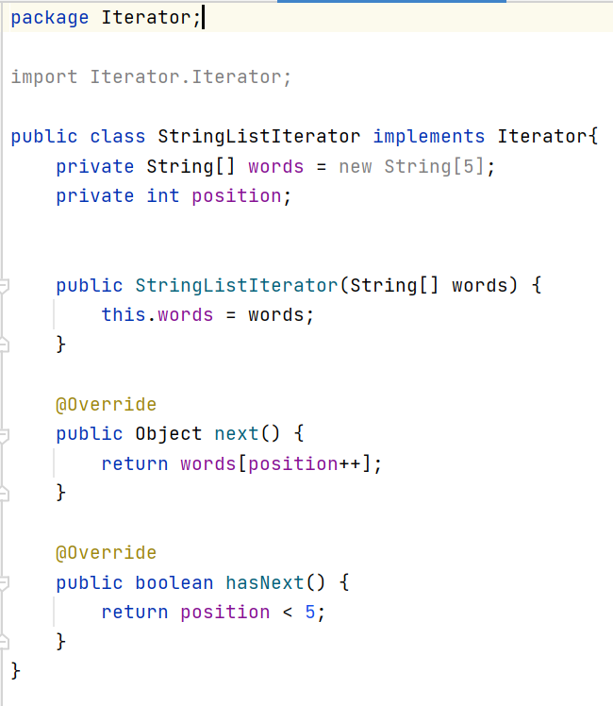
Example 1: String array

Slide 10
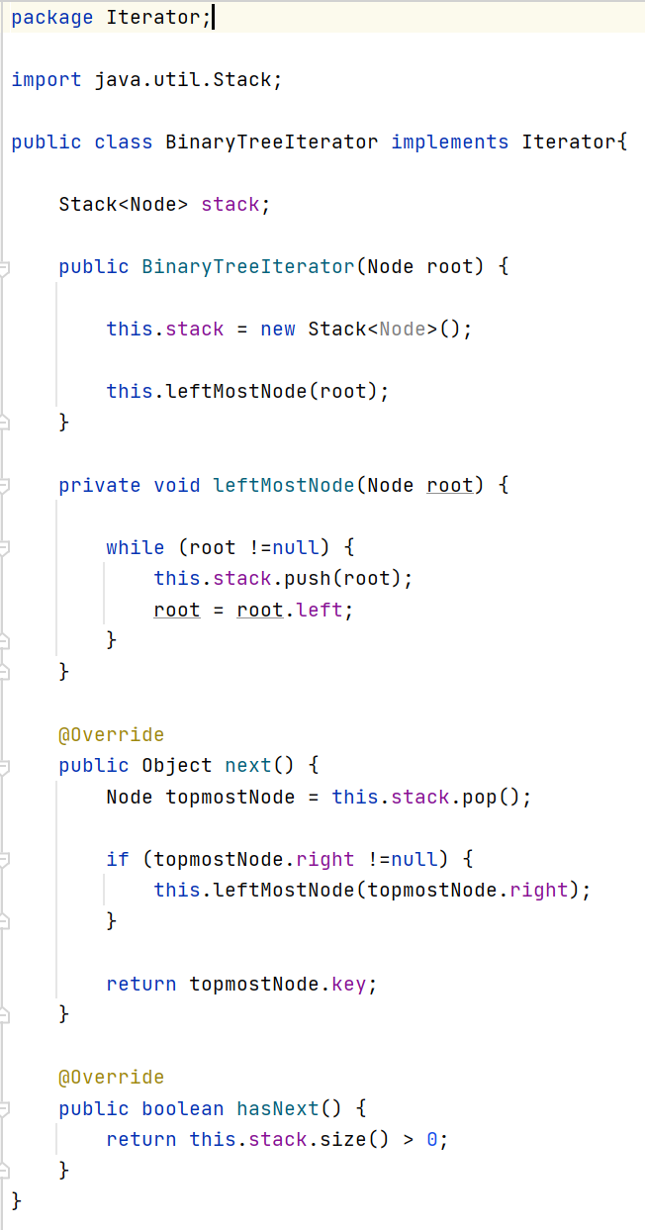
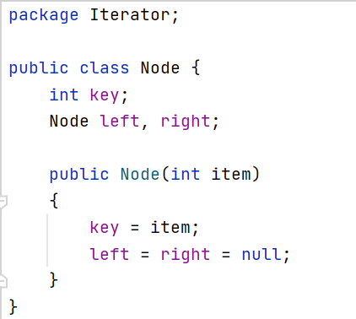
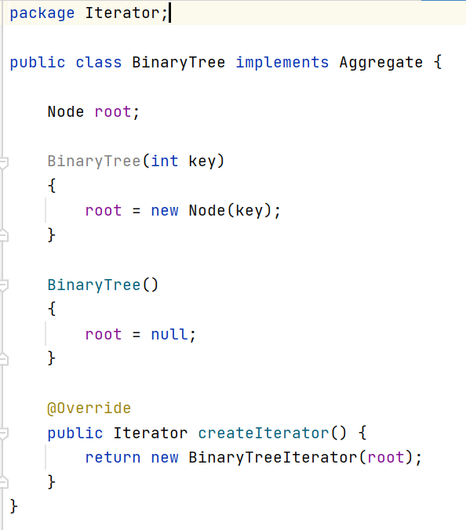
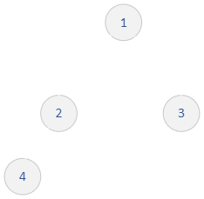
Example 1: Binary Tree

Slide 11
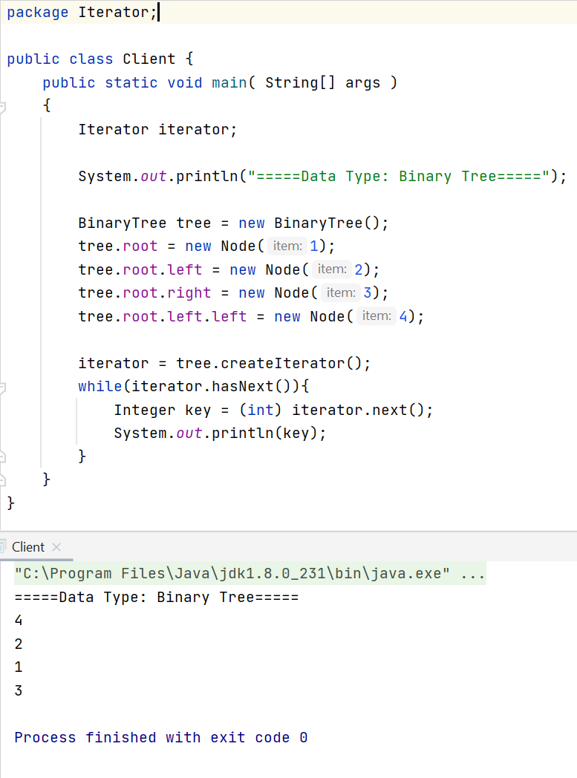
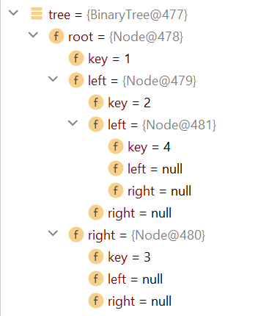
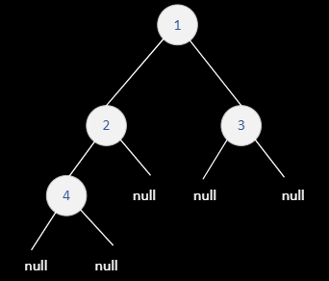
Example 1: Binary Tree

Slide 12
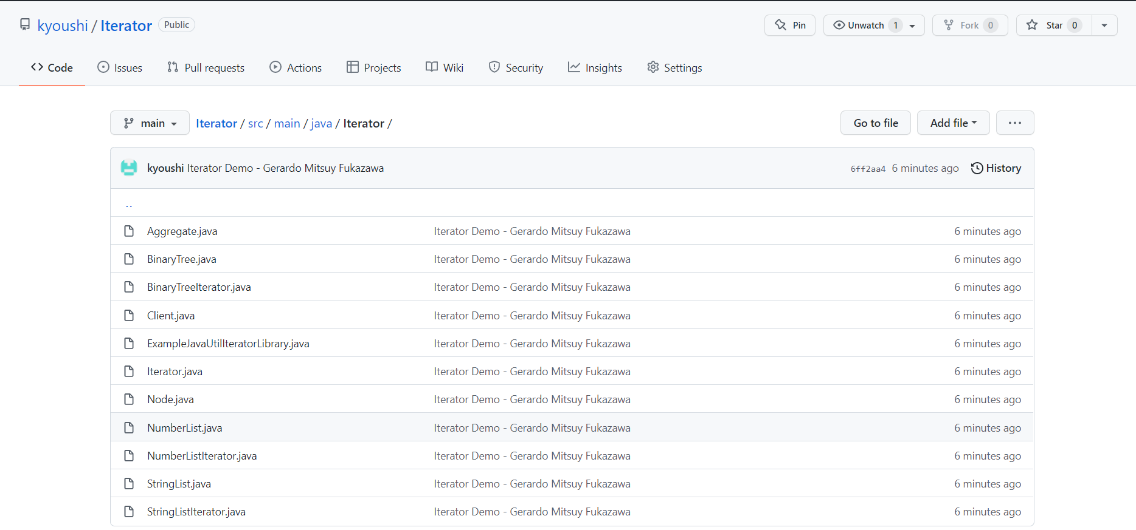
Source Code
https://github.com/kyoushi/Iterator.git

Slide 13
References
Gamma, E., R. Helm, et al. (1995). Design Patterns - Elements of Reusable Object Oriented Software. Reading, MA, Addison-Wesley, p 257-271
https://refactoring.guru/design-patterns/iterator

Slide 14
Thank You

