Slide 1
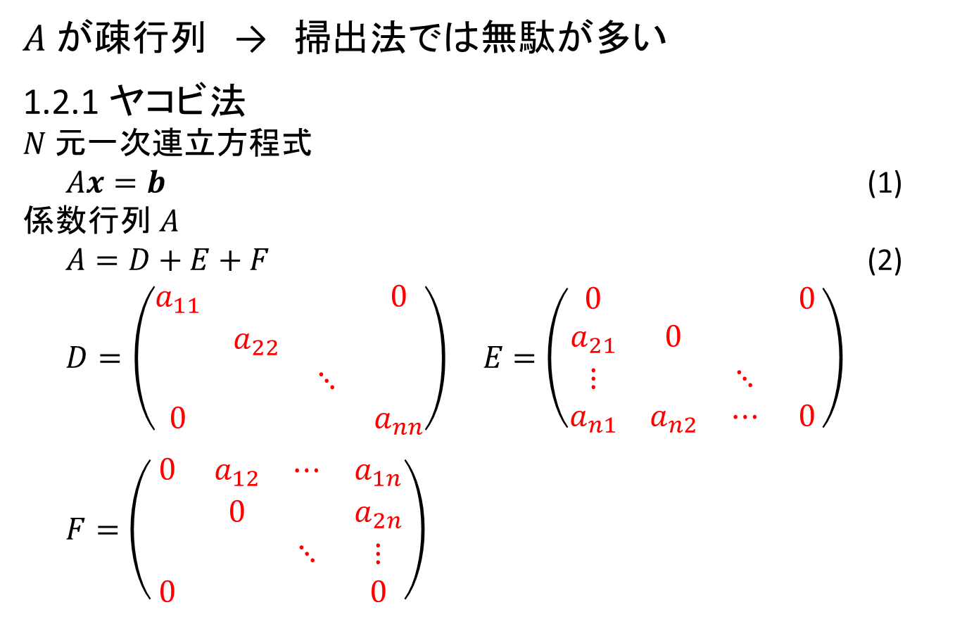
1.2 反復法
$A$ が疎行列 → 掃出法では無駄が多い
1.2.1 ヤコビ法
$N$元一次連立方程式
$Ax=b$ (1)
係数行列$A$
$A=D+E+F$ (2)
$D=\left(\begin{matrix}a_{11} & & & 0 \\ & a_{22} & & \\ & & ⋱ & \\ 0 & & & a_{nn}\end{matrix}\right) E=\left(\begin{matrix}0 & & & 0 \\ a_{21} & 0 & & \\ ⋮ & & ⋱ & \\ a_{n1} & a_{n2} & ⋯ & 0\end{matrix}\right)$
$F=\left(\begin{matrix}0 & a_{12} & ⋯ & a_{1n} \\ & 0 & & a_{2n} \\ & & ⋱ & ⋮ \\ 0 & & & 0\end{matrix}\right)$

Slide 2
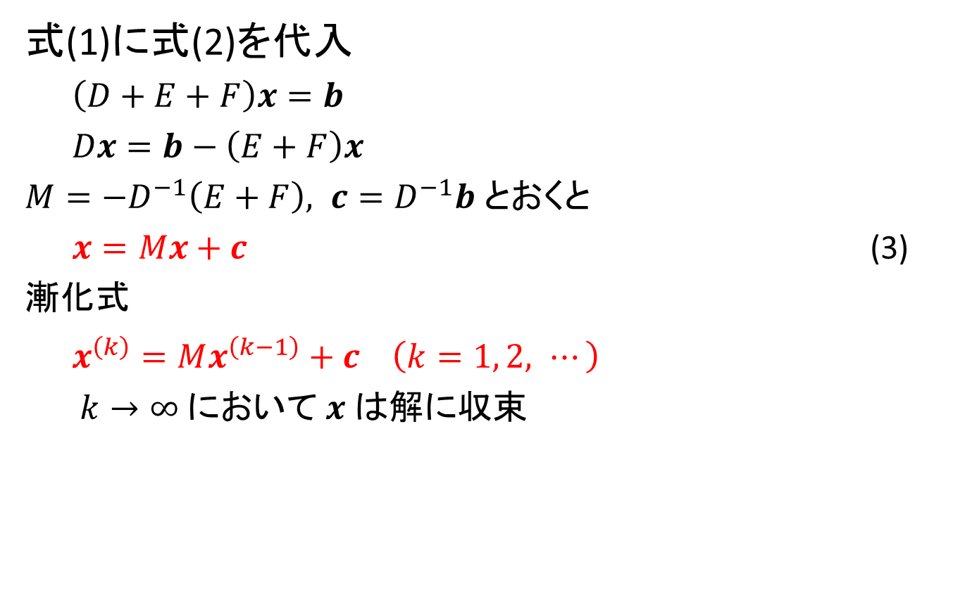
1.2.1 ヤコビ法
式(1)に式(2)を代入
$\left(D+E+F\right)x=b$
$Dx=b−\left(E+F\right)x$
$M={−D}^{−1}\left(E+F\right), c=D^{−1}b$とおくと
$x=Mx+c$ (3)
漸化式
$x^{\left(k\right)}=Mx^{\left(k−1\right)}+c \left(k=1, 2, ⋯\right)$
$k→∞$において$x$は解に収束

Slide 3
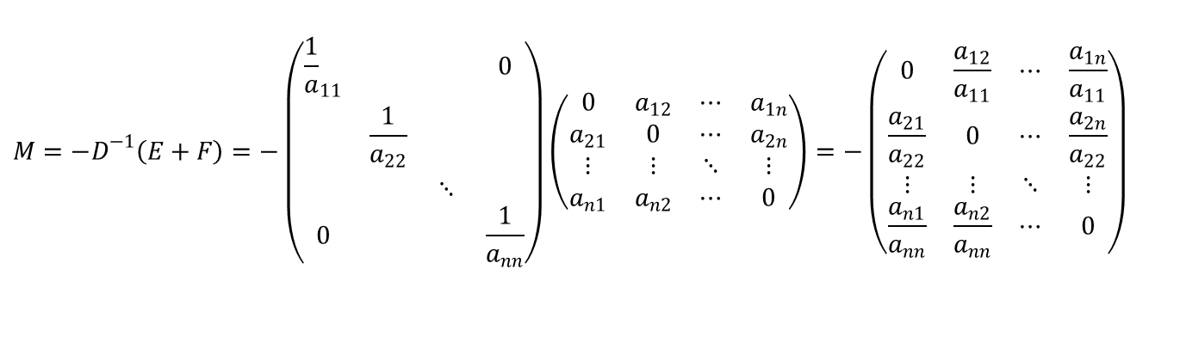
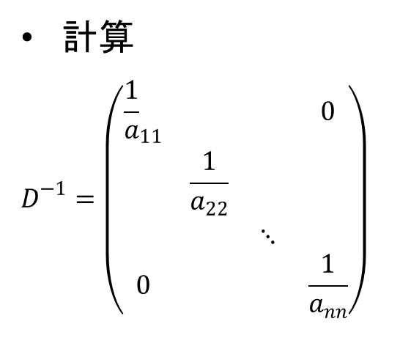

1.2.1 ヤコビ法
計算
$$D^{−1}=\left(\begin{matrix}{\frac{1}{a}}_{11} & & & 0 \\ & \frac{1}{a_{22}} & & \\ & & ⋱ & \\ 0 & & & \frac{1}{a_{nn}}\end{matrix}\right)$$
$$c=D^{−1}b=\left(\begin{matrix}\frac{b_{1}}{a_{11}} \\ \frac{b_{2}}{a_{22}} \\ ⋮ \\ \frac{b_{n}}{a_{nn}}\end{matrix}\right)$$
$$M=−D^{−1}\left(E+F\right)=−\left(\begin{matrix}{\frac{1}{a}}_{11} & & & 0 \\ & \frac{1}{a_{22}} & & \\ & & ⋱ & \\ 0 & & & \frac{1}{a_{nn}}\end{matrix}\right)\left(\begin{matrix}0 & a_{12} & ⋯ & a_{1n} \\ a_{21} & 0 & ⋯ & a_{2n} \\ ⋮ & ⋮ & ⋱ & ⋮ \\ a_{n1} & a_{n2} & ⋯ & 0\end{matrix}\right)=−\left(\begin{matrix}0 & \frac{a_{12}}{a_{11}} & ⋯ & \frac{a_{1n}}{a_{11}} \\ \frac{a_{21}}{a_{22}} & 0 & ⋯ & \frac{a_{2n}}{a_{22}} \\ ⋮ & ⋮ & ⋱ & ⋮ \\ \frac{a_{n1}}{a_{nn}} & \frac{a_{n2}}{a_{nn}} & ⋯ & 0\end{matrix}\right)$$

Slide 4
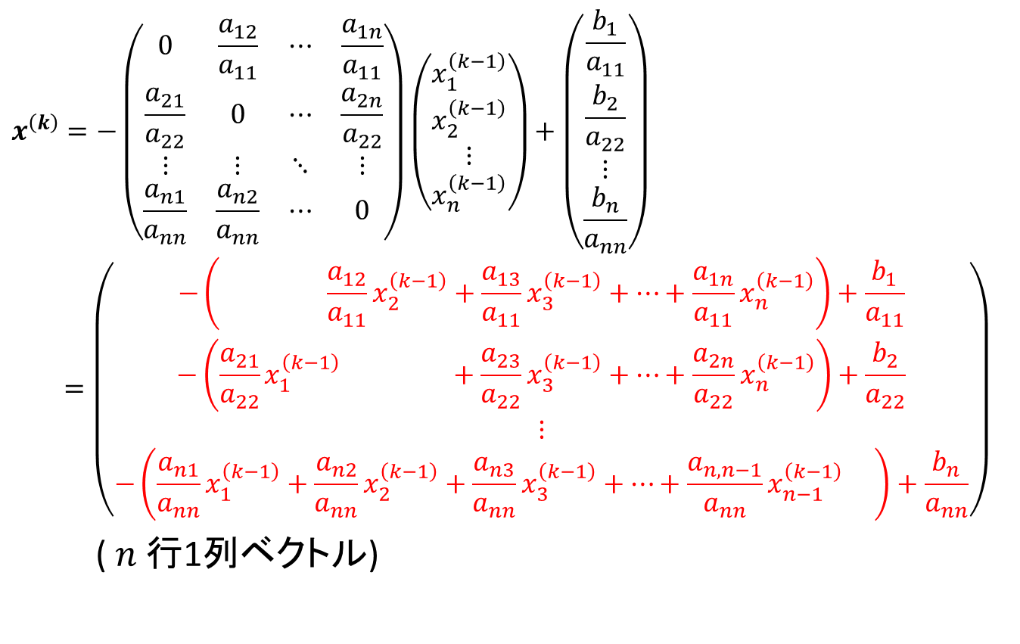
1.2.1 ヤコビ法
$$x^{\left(k\right)}=−\left(\begin{matrix}0 & \frac{a_{12}}{a_{11}} & ⋯ & \frac{a_{1n}}{a_{11}} \\ \frac{a_{21}}{a_{22}} & 0 & ⋯ & \frac{a_{2n}}{a_{22}} \\ ⋮ & ⋮ & ⋱ & ⋮ \\ \frac{a_{n1}}{a_{nn}} & \frac{a_{n2}}{a_{nn}} & ⋯ & 0\end{matrix}\right)\left(\begin{matrix}x_{1}^{\left(k−1\right)} \\ x_{2}^{\left(k−1\right)} \\ ⋮ \\ x_{n}^{\left(k−1\right)}\end{matrix}\right)+\left(\begin{matrix}\frac{b_{1}}{a_{11}} \\ \frac{b_{2}}{a_{22}} \\ ⋮ \\ \frac{b_{n}}{a_{nn}}\end{matrix}\right)$$
$$=\left(\begin{matrix}−\left( \frac{a_{12}}{a_{11}}x_{2}^{\left(k−1\right)}+\frac{a_{13}}{a_{11}}x_{3}^{\left(k−1\right)}+⋯+\frac{a_{1n}}{a_{11}}x_{n}^{\left(k−1\right)}\right)+\frac{b_{1}}{a_{11}} \\ −\left(\frac{a_{21}}{a_{22}}x_{1}^{\left(k−1\right)} +\frac{a_{23}}{a_{22}}x_{3}^{\left(k−1\right)}+⋯+\frac{a_{2n}}{a_{22}}x_{n}^{\left(k−1\right)}\right)+\frac{b_{2}}{a_{22}} \\ ⋮ \\ −\left(\frac{a_{n1}}{a_{nn}}x_{1}^{\left(k−1\right)}+\frac{a_{n2}}{a_{nn}}x_{2}^{\left(k−1\right)}+\frac{a_{n3}}{a_{nn}}x_{3}^{\left(k−1\right)}+⋯+\frac{a_{n,n−1}}{a_{nn}}x_{n−1}^{\left(k−1\right)} \right)+\frac{b_{n}}{a_{nn}}\end{matrix}\right)$$
($n$行1列ベクトル)

Slide 5
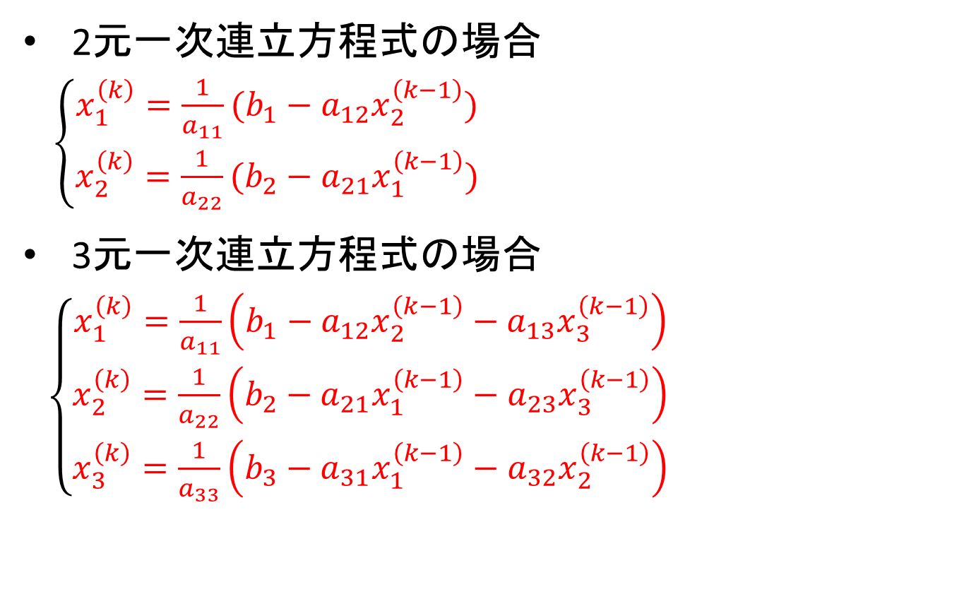
1.2.1 ヤコビ法
2元一次連立方程式の場合
$\left\{\begin{aligned}x_{1}^{\left(k\right)}=\frac{1}{a_{11}}(b_{1}−a_{12}x_{2}^{\left(k−1\right)}) \\ x_{2}^{\left(k\right)}=\frac{1}{a_{22}}(b_{2}−a_{21}x_{1}^{\left(k−1\right)})\end{aligned}\right.$
3元一次連立方程式の場合
$\left\{\begin{aligned}x_{1}^{\left(k\right)}=\frac{1}{a_{11}}\left(b_{1}−a_{12}x_{2}^{\left(k−1\right)}−a_{13}x_{3}^{\left(k−1\right)}\right) \\ x_{2}^{\left(k\right)}=\frac{1}{a_{22}}\left(b_{2}−a_{21}x_{1}^{\left(k−1\right)}−a_{23}x_{3}^{\left(k−1\right)}\right) \\ x_{3}^{\left(k\right)}=\frac{1}{a_{33}}\left(b_{3}−a_{31}x_{1}^{\left(k−1\right)}−a_{32}x_{2}^{\left(k−1\right)}\right)\end{aligned}\right.$

Slide 6

1.2.1 ヤコビ法
(例)
$\left\{\begin{aligned}5x_{1}−4x_{2}=4 \\ −x_{1}+2x_{2}=1\end{aligned}\right.$ 初期値 $\left(\begin{matrix}x_{1}^{\left(0\right)} \\ x_{2}^{\left(0\right)}\end{matrix}\right)=\left(\begin{matrix}0 \\ 0\end{matrix}\right)$
漸化式
$\left\{\begin{aligned}x_{1}^{\left(k\right)}=\frac{1}{5}(4+4x_{2}^{\left(k−1\right)}) \\ x_{2}^{\left(k\right)}=\frac{1}{2}(1+x_{1}^{\left(k−1\right)})\end{aligned}\right.$

Slide 7
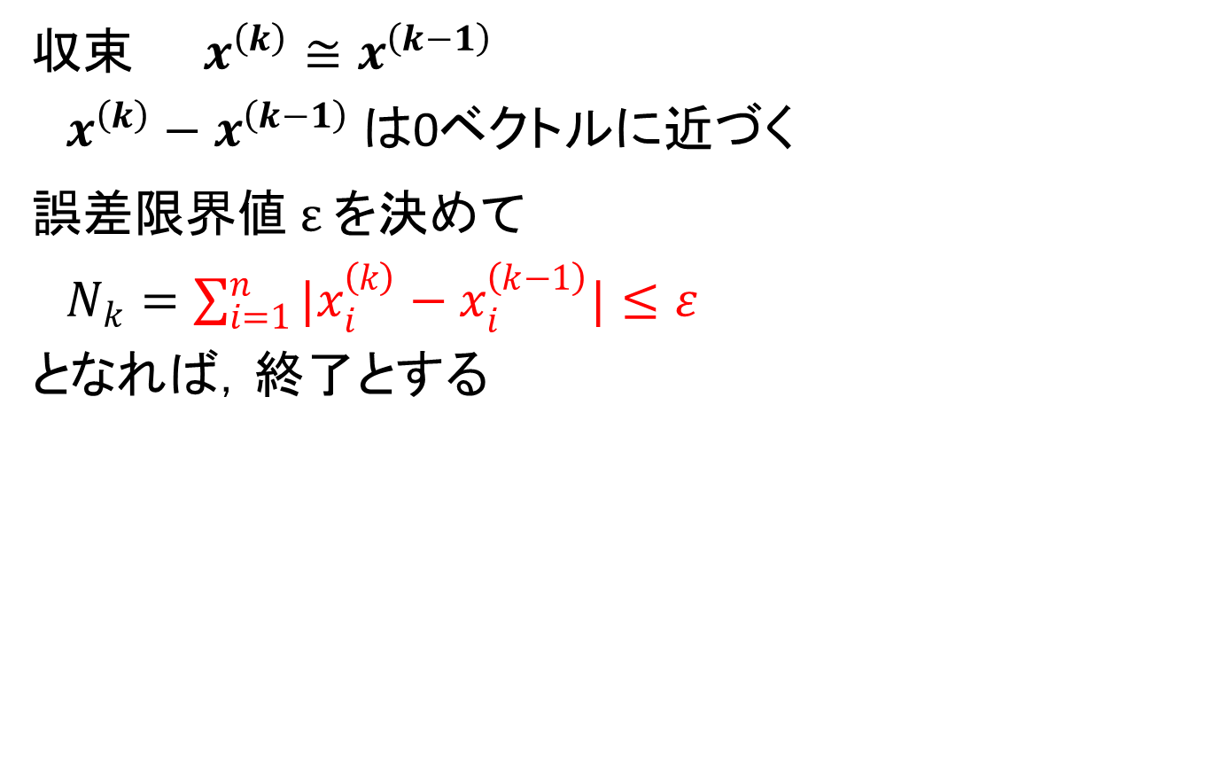
収束判定
収束 $x^{\left(k\right)}≅x^{\left(k−1\right)}$
$x_{}^{\left(k\right)}−x_{}^{\left(k−1\right)}$は0ベクトルに近づく
誤差限界値$ε$を決めて
$N_{k}=\sum_{i=1}^{n}{|x_{i}^{\left(k\right)}−x_{i}^{\left(k−1\right)}|≤ε}$
となれば，終了とする

Slide 8

1.2.2 ガウス・ザイデル法
$\left(D+E+F\right)x=b$ より
$\left(D+E\right)x=b−Fx$ (1)
$x=−{\left(D+E\right)}^{−1}Fx+{\left(D+E\right)}^{−1}b$
$x^{\left(k\right)}=−{\left(D+E\right)}^{−1}Fx^{\left(k−1\right)}+{\left(D+E\right)}^{−1}b$ (2)
→ ガウス・ザイデル法
$$D+E=\left(\begin{matrix}a_{11} & & & 0 \\ a_{21} & a_{22} & & \\ ⋮ & & ⋱ & \\ a_{n1} & a_{n2} & ⋯ & a_{nn}\end{matrix}\right)$$

Slide 9
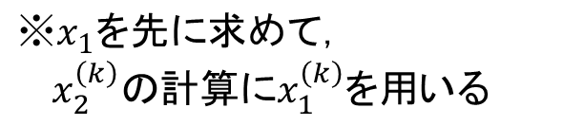
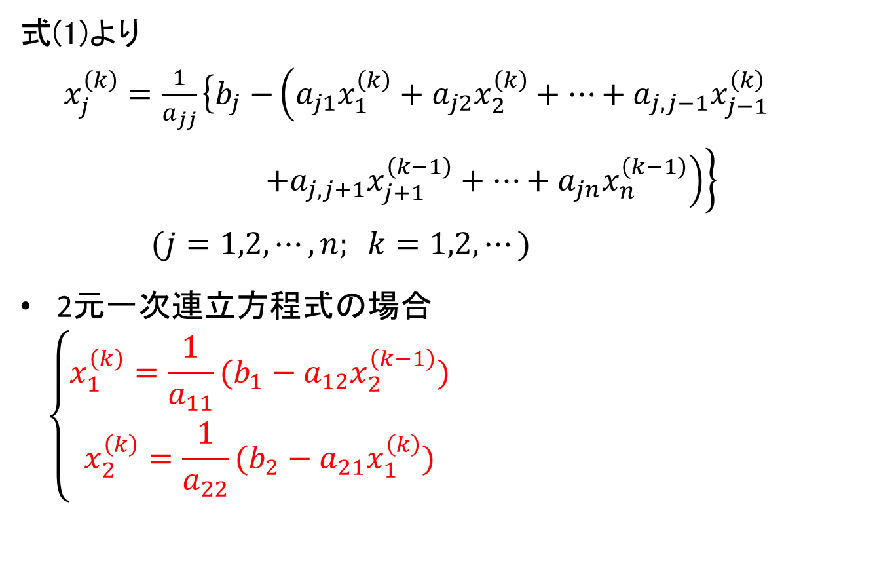
1.2.2 ガウス・ザイデル法
式(1)より
$x_{j}^{\left(k\right)}=\frac{1}{a_{jj}}\left\{b_{j}−\right.\left(a_{j1}x_{1}^{\left(k\right)}+a_{j2}x_{2}^{\left(k\right)}+⋯+a_{j,j−1}x_{j−1}^{\left(k\right)}\right.$
$\left.\left.+a_{j,j+1}x_{j+1}^{\left(k−1\right)}+⋯+a_{jn}x_{n}^{\left(k−1\right)}\right)\right\}$
$(j=1,2,⋯,n; k=1,2,⋯)$
2元一次連立方程式の場合
$$\left\{\begin{aligned}x_{1}^{\left(k\right)}=\frac{1}{a_{11}}(b_{1}−a_{12}x_{2}^{\left(k−1\right)}) \\ x_{2}^{\left(k\right)}=\frac{1}{a_{22}}(b_{2}−a_{21}x_{1}^{\left(k\right)})\end{aligned}\right.$$
$$※x_{1}を先に求めて，$$
$x_{2}^{\left(k\right)}の計算にx_{1}^{\left(k\right)}を用いる$

Slide 10

1.2.2 ガウス・ザイデル法
3元一次連立方程式の場合
$\left\{\begin{aligned}x_{1}^{\left(k\right)}=\frac{1}{a_{11}}\left(b_{1}−a_{12}x_{2}^{\left(k−1\right)}−a_{13}x_{3}^{\left(k−1\right)}\right) \\ x_{2}^{\left(k\right)}=\frac{1}{a_{22}}\left(b_{2}−a_{21}x_{1}^{\left(k\right)}−a_{23}x_{3}^{\left(k−1\right)}\right) \\ x_{3}^{\left(k\right)}=\frac{1}{a_{33}}\left(b_{3}−a_{31}x_{1}^{\left(k\right)}−a_{32}x_{2}^{\left(k\right)}\right)\end{aligned}\right.$

Slide 11
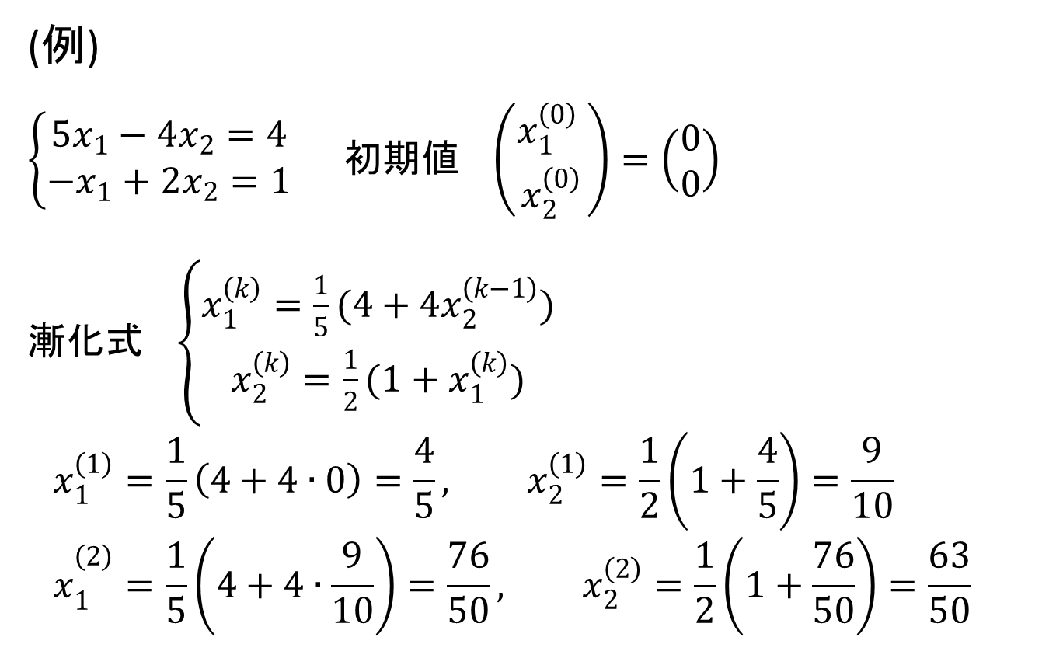
1.2.2 ガウス・ザイデル法
(例)
$\left\{\begin{aligned}5x_{1}−4x_{2}=4 \\ −x_{1}+2x_{2}=1\end{aligned}\right.$ $\text{初期値} \left(\begin{matrix}x_{1}^{\left(0\right)} \\ x_{2}^{\left(0\right)}\end{matrix}\right)=\left(\begin{matrix}0 \\ 0\end{matrix}\right)$
漸化式$\left\{\begin{aligned}x_{1}^{\left(k\right)}=\frac{1}{5}(4+4x_{2}^{\left(k−1\right)}) \\ x_{2}^{\left(k\right)}=\frac{1}{2}(1+x_{1}^{\left(k\right)})\end{aligned}\right.$
$$x_{1}^{\left(1\right)}=\frac{1}{5}\left(4+4∙0\right)=\frac{4}{5}, x_{2}^{\left(1\right)}=\frac{1}{2}\left(1+\frac{4}{5}\right)=\frac{9}{10}$$
$${ x}_{1}^{\left(2\right)}=\frac{1}{5}\left(4+4∙\frac{9}{10}\right)=\frac{76}{50}, x_{2}^{\left(2\right)}=\frac{1}{2}\left(1+\frac{76}{50}\right)=\frac{63}{50}$$

Slide 12
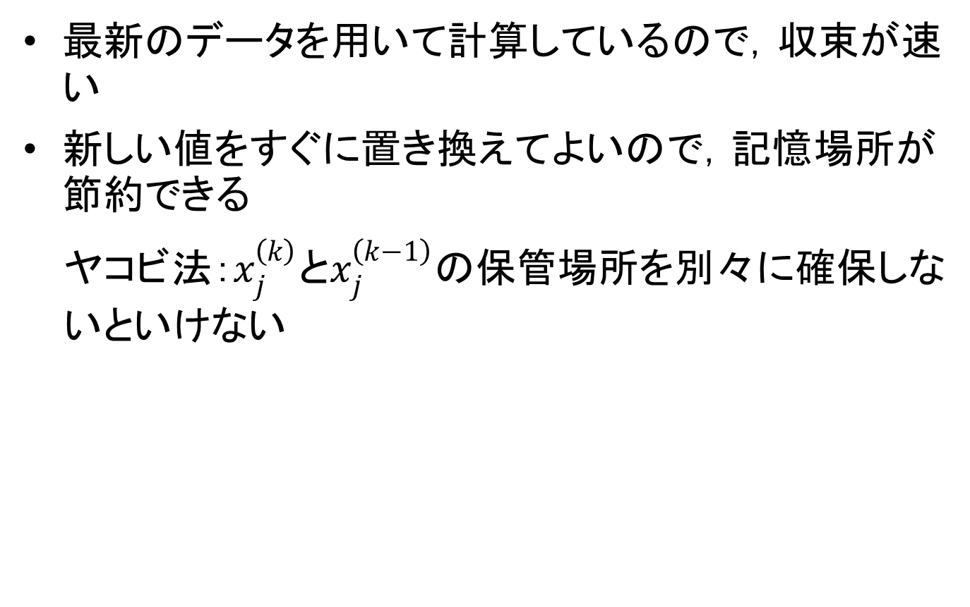
ヤコビ法とガウス・ザイデル法の比較
最新のデータを用いて計算しているので，収束が速い
新しい値をすぐに置き換えてよいので，記憶場所が節約できる
ヤコビ法：$x_{j}^{\left(k\right)}とx_{j}^{\left(k−1\right)}$の保管場所を別々に確保しないといけない

