Slide 1
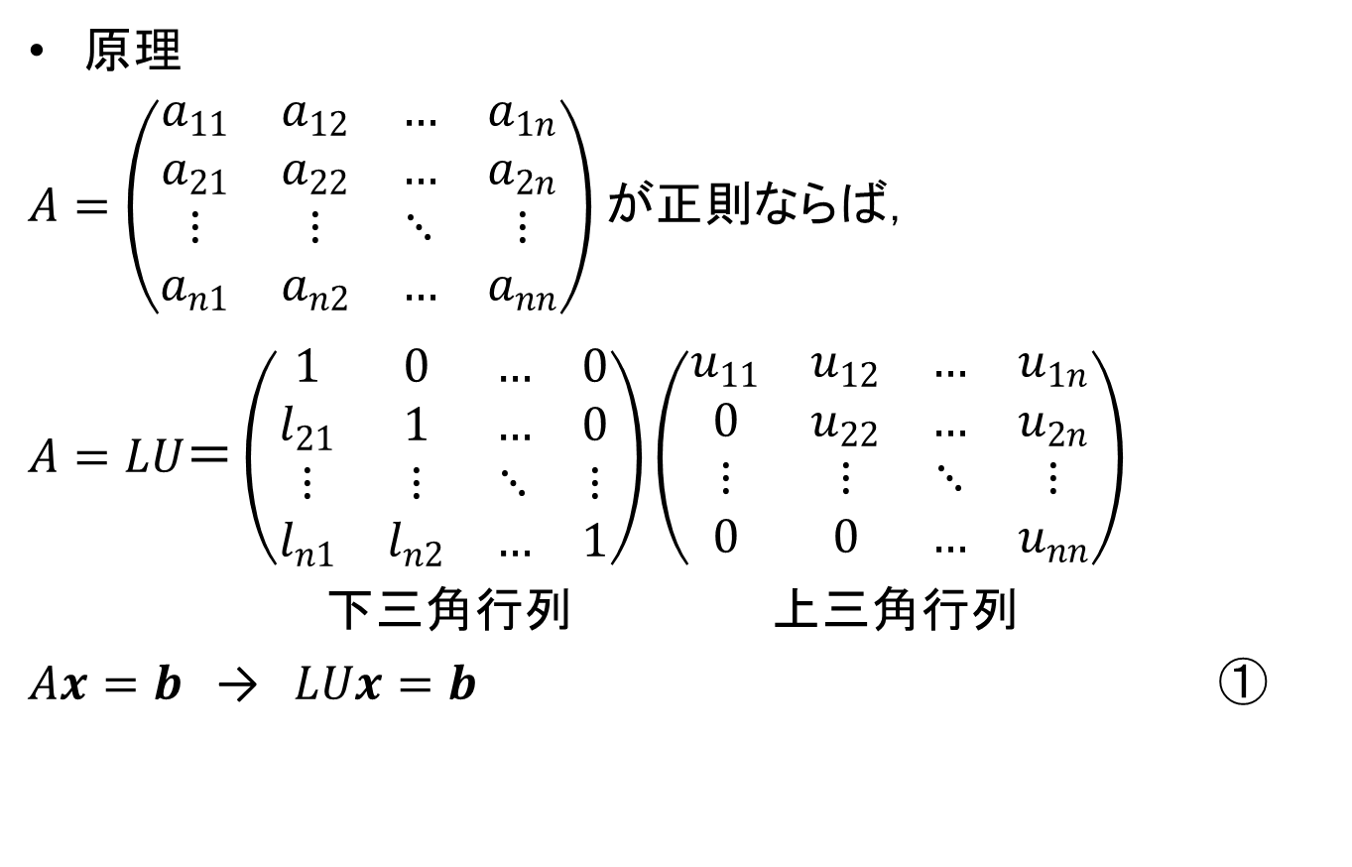
LU分解
原理
$A=\left(\begin{matrix}a_{11} & a_{12} & … & a_{1n} \\ a_{21} & a_{22} & … & a_{2n} \\ ⋮ & ⋮ & ⋱ & ⋮ \\ a_{n1} & a_{n2} & … & a_{nn}\end{matrix}\right)$が正則ならば，
$$A=LU＝\left(\begin{matrix}1 & 0 & … & 0 \\ l_{21} & 1 & … & 0 \\ ⋮ & ⋮ & ⋱ & ⋮ \\ l_{n1} & l_{n2} & … & 1\end{matrix}\right)\left(\begin{matrix}u_{11} & u_{12} & … & u_{1n} \\ 0 & u_{22} & … & u_{2n} \\ ⋮ & ⋮ & ⋱ & ⋮ \\ 0 & 0 & … & u_{nn}\end{matrix}\right)$$
下三角行列 上三角行列
$Ax=b$ → $LUx=b$ $①$

Slide 2

LU分解
$Ux=y$とおくと，①式は
$$Ly=b$$
$$Ly=\left(\begin{matrix}1 & 0 & … & 0 \\ l_{21} & 1 & … & 0 \\ ⋮ & ⋮ & ⋱ & ⋮ \\ l_{n1} & l_{n2} & … & 1\end{matrix}\right)\left(\begin{matrix}y_{1} \\ y_{2} \\ ⋮ \\ y_{n}\end{matrix}\right)$$
$=\left(\begin{matrix}y_{1} \\ l_{21}y_{1}+y_{2} \\ ⋮ \\ l_{n1}y_{1}+{l_{n2}y_{2}+…+y}_{n}\end{matrix}\right)=\left(\begin{matrix}b_{1} \\ b_{2} \\ ⋮ \\ b_{n}\end{matrix}\right)$
$$y_{1}=b_{1}, {y_{2}=b}_{2}−l_{21}y_{1}, ⋯$$

Slide 3
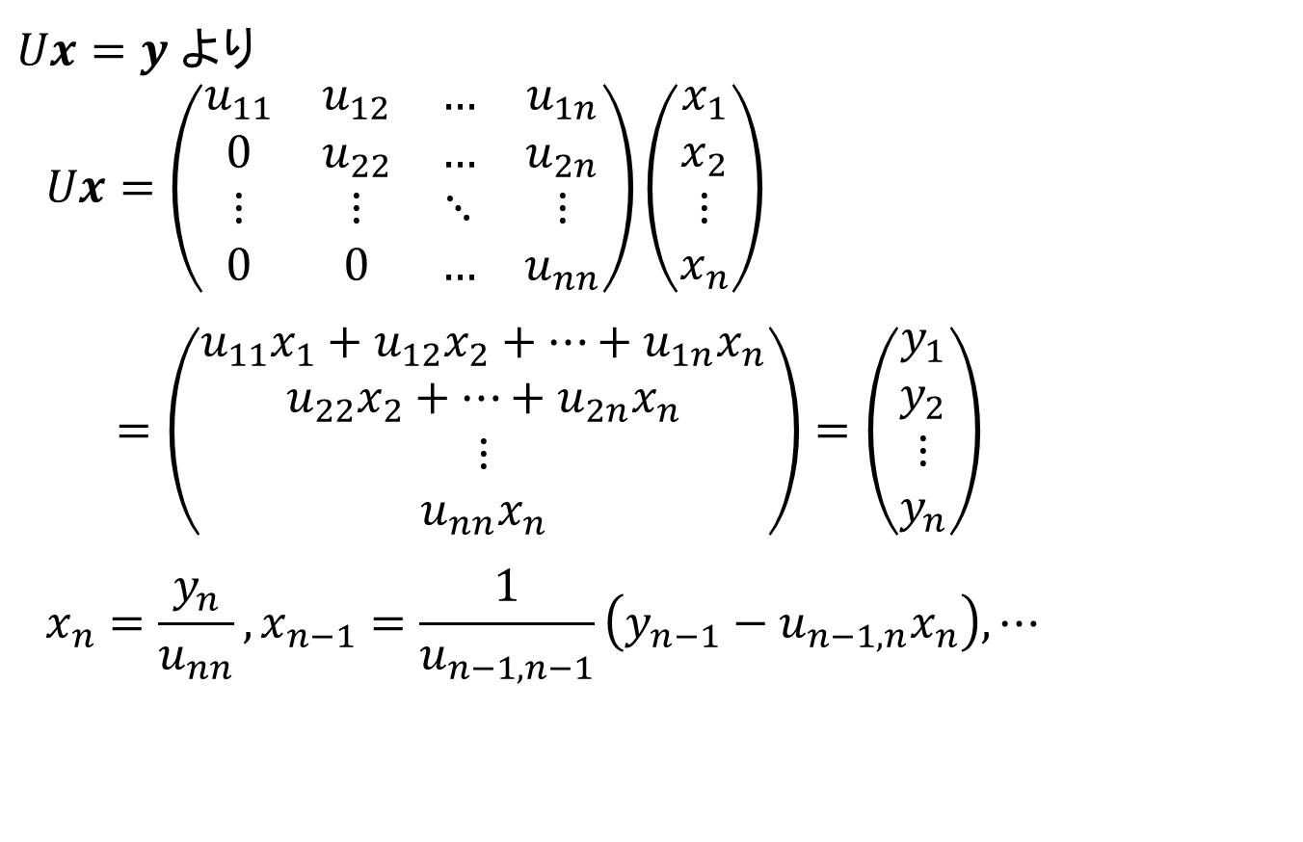
LU分解
$Ux=y$より
$$Ux=\left(\begin{matrix}u_{11} & u_{12} & … & u_{1n} \\ 0 & u_{22} & … & u_{2n} \\ ⋮ & ⋮ & ⋱ & ⋮ \\ 0 & 0 & … & u_{nn}\end{matrix}\right)\left(\begin{matrix}x_{1} \\ x_{2} \\ ⋮ \\ x_{n}\end{matrix}\right)$$
$$=\left(\begin{matrix}{u_{11}x}_{1}+u_{12}x_{2}+…+u_{1n}x_{n} \\ u_{22}x_{2}+…+u_{2n}x_{n} \\ ⋮ \\ u_{nn}x_{n}\end{matrix}\right)=\left(\begin{matrix}y_{1} \\ y_{2} \\ ⋮ \\ y_{n}\end{matrix}\right)$$
$$x_{n}=\frac{y_{n}}{u_{nn}}, x_{n−1}=\frac{1}{u_{n−1,n−1}}\left(y_{n−1}−u_{n−1,n}x_{n}\right), ⋯$$

Slide 4
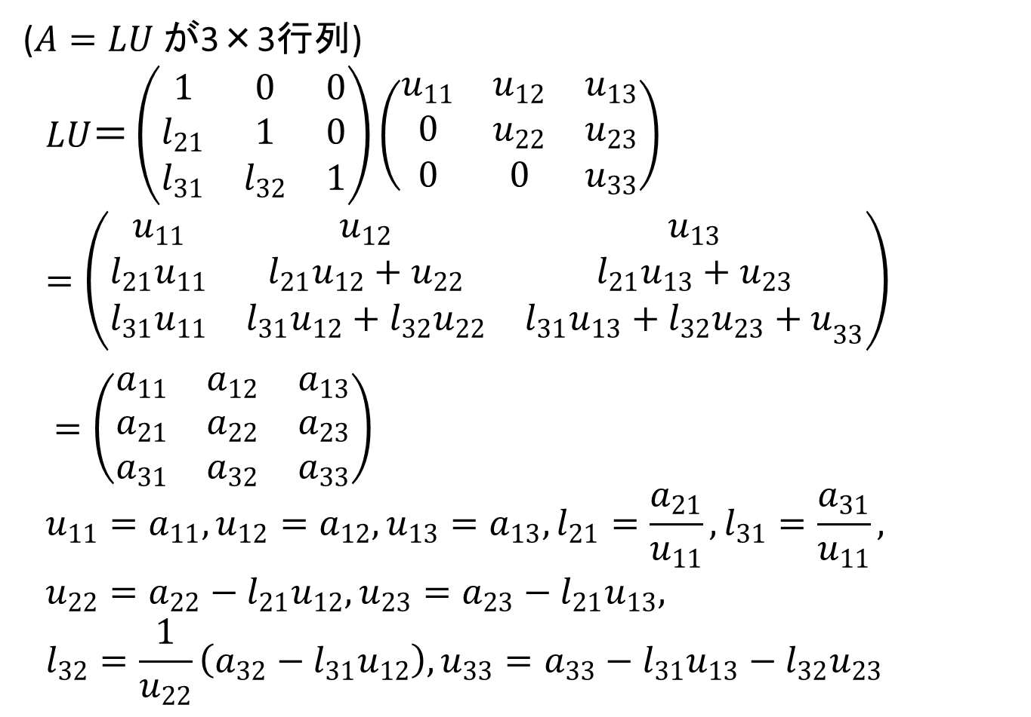
LUの求め方
($A=LU$が3×3行列)
$$LU＝\left(\begin{matrix}1 & 0 & 0 \\ l_{21} & 1 & 0 \\ l_{31} & l_{32} & 1\end{matrix}\right)\left(\begin{matrix}u_{11} & u_{12} & u_{13} \\ 0 & u_{22} & u_{23} \\ 0 & 0 & u_{33}\end{matrix}\right)$$
$$=\left(\begin{matrix}u_{11} & u_{12} & u_{13} \\ l_{21}u_{11} & l_{21}u_{12}+u_{22} & l_{21}u_{13}+u_{23} \\ l_{31}u_{11} & l_{31}u_{12}+l_{32}u_{22} & {l_{31}u_{13}+l_{32}u_{23}+u}_{33}\end{matrix}\right)$$
$=\left(\begin{matrix}a_{11} & a_{12} & a_{13} \\ a_{21} & a_{22} & a_{23} \\ a_{31} & a_{32} & a_{33}\end{matrix}\right)$
$$u_{11}=a_{11}, u_{12}=a_{12}, u_{13}=a_{13},l_{21}=\frac{a_{21}}{u_{11}}, l_{31}=\frac{a_{31}}{u_{11}},$$
$$u_{22}=a_{22}−l_{21}u_{12}, u_{23}=a_{23}−l_{21}u_{13},$$
$$l_{32}=\frac{1}{u_{22}}\left(a_{32}−l_{31}u_{12}\right), u_{33}=a_{33}−l_{31}u_{13}−l_{32}u_{23}$$

Slide 5

LUの求め方
($A=LU が n$×$n$ 行列)
$$l_{ij}=\frac{1}{u_{jj}}\left(a_{ij}−\sum_{k=1}^{j−1}{l_{ik}u_{kj}}\right) i≥j,$$
$$u_{ij}=a_{ij}− \sum_{k=1}^{i−1}{l_{ik}u_{kj}} i≤j$$

Slide 6

2 非線形方程式
代数方程式
$a_{0}x^{n}+a_{1}x^{n−1}+⋯a_{n−1}x+a_{n}=0$ ${(a}_{0}≠0)$ (1)
$f\left(x\right)=a_{0}x^{n}+a_{1}x^{n−1}+⋯a_{n−1}x+a_{n}$とおくと
$f\left(x\right)=0$ (2)

Slide 7
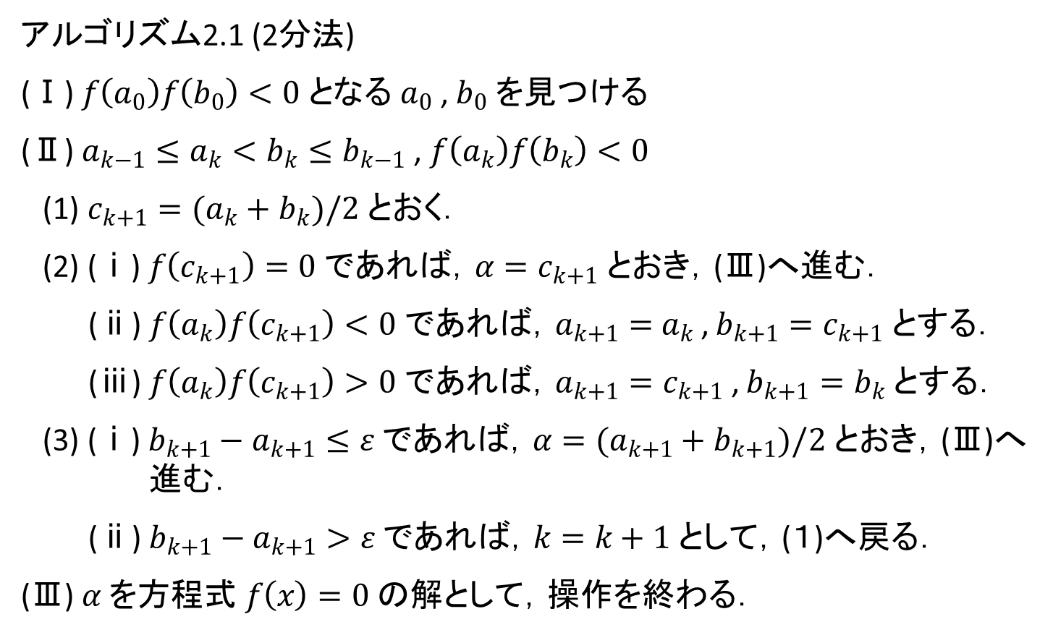
2.2.1 2分法
アルゴリズム2.1 (2分法)
(Ⅰ) $f\left(a_{0}\right)f\left(b_{0}\right)<0$となる$a_{0}$, $b_{0}$を見つける
(Ⅱ) $a_{k−1}≤a_{k}<b_{k}≤b_{k−1}$, $f\left(a_{k}\right)f\left(b_{k}\right)<0$
(1) $c_{k+1}=(a_{k}+b_{k})/2$とおく．
(2) (ⅰ) $f\left(c_{k+1}\right)=0$であれば，$α=c_{k+1}$とおき，(Ⅲ)へ進む．
(ⅱ) $f\left(a_{k}\right)f\left(c_{k+1}\right)<0$であれば，$a_{k+1}={ a}_{k}$, $b_{k+1}=c_{k+1}$とする．
(ⅲ) $f\left(a_{k}\right)f\left(c_{k+1}\right)>0$であれば，$a_{k+1}=c_{k+1}$, $b_{k+1}=b_{k}$とする．
(3) (ⅰ) $b_{k+1}−a_{k+1}≤ε$であれば，$α=(a_{k+1}+b_{k+1})/2$とおき，(Ⅲ)へ進む．
(ⅱ) $b_{k+1}−a_{k+1}>ε$であれば，$k=k+1$として，(１)へ戻る．
(Ⅲ) $α$を方程式$f\left(x\right)=0$の解として，操作を終わる．

Slide 8














$$f\left(x\right)$$
$$a_{2}$$
$$a_{1}$$
$$a_{0}$$
$$c_{1}$$
$$α$$
$$0$$
$$c_{2}$$
$$b_{0}$$
$$x$$
$$\left(1\right) f\left(a_{0}\right)f\left(c_{1}\right)>0$$
$$b_{2}$$
$$b_{1}$$
$$\left(2\right) f\left(a_{1}\right)f\left(c_{2}\right)<0$$

Slide 9
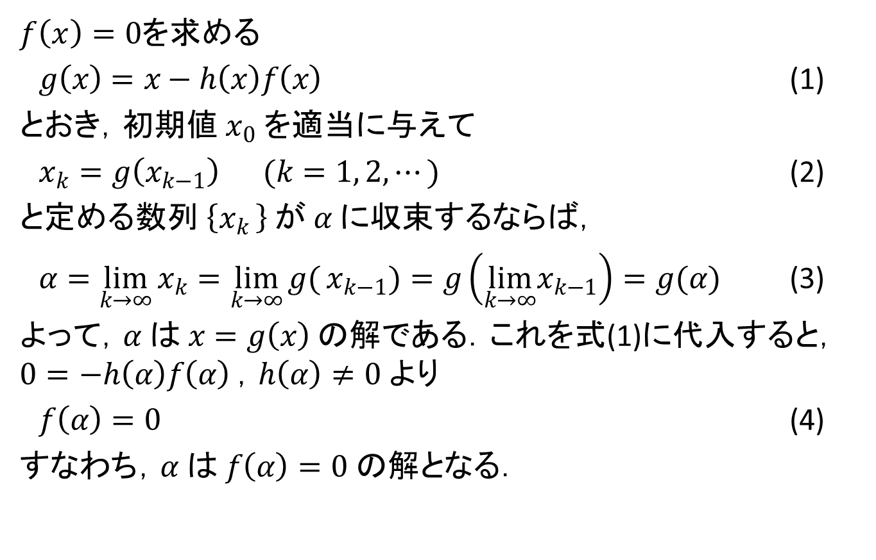
2.3 反復法
$f\left(x\right)=0$を求める
$g\left(x\right)=x−h\left(x\right)f\left(x\right)$ (1)
とおき，初期値$x_{0}$を適当に与えて
$x_{k}=g\left(x_{k−1}\right)$ $(k=1, 2, ⋯)$ (2)
と定める数列$\left\{x_{k }\right\}$が$α$に収束するならば，
$α=\lim_{k→∞}{x_{k}}=\lim_{k→∞}{g(}x_{k−1})=g\left(\lim_{k→∞}x_{k−1}\right)=g(α)$ (3)
よって，$α$は$x=g\left(x\right)$の解である．これを式(1)に代入すると，$0=−h\left(α\right)f\left(α\right)$，$h\left(α\right)≠0$より
$f\left(α\right)=0$ (4)
すなわち，$α$は$f\left(α\right)=0$の解となる．

Slide 10





$$f\left(x\right)$$
$$α$$
$$0$$
$$x_{3}$$
$$x_{2}$$
$$x_{1}$$
$$x_{0}$$
$$x$$

