Slide 1

3.2 補間法
点${ x}_{0}, x_{1}, ⋯, x_{n}$における$f\left(x_{0}\right)$, $f\left(x_{1}\right)$, $⋯$, $f\left(x_{n}\right)$
$g\left(x_{j}\right)=f_{j} (j=0, 1, ⋯, n)$ ($f_{j}=f\left(x_{j}\right)$)
を満たす
$g\left(x\right) ： f\left(x\right)$の補間関数

Slide 2
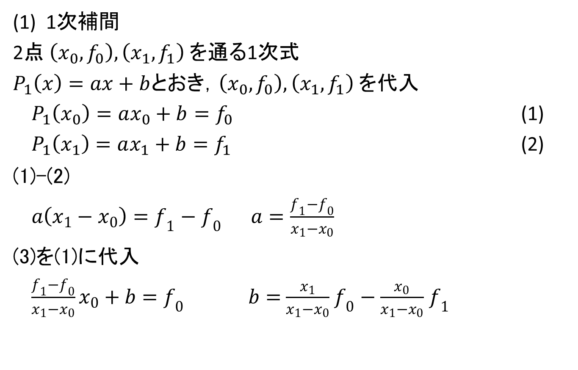
3.2.1 ラグランジュの補間公式
(1) 1次補間
2点$\left(x_{0},f_{0}\right), \left(x_{1},f_{1}\right)$を通る1次式
$P_{1}\left(x\right)=ax+b$とおき，$\left(x_{0},f_{0}\right), \left(x_{1},f_{1}\right)$を代入
$P_{1}\left(x_{0}\right)=ax_{0}+b=f_{0}$ (1)
$P_{1}\left(x_{1}\right)=ax_{1}+b=f_{1}$ (2)
(1)-(2)
$a\left(x_{1}−x_{0}\right)=f_{1}−f_{0}$ $a=\frac{f_{1}−f_{0}}{x_{1}−x_{0}}$
(3)を(1)に代入
$\frac{f_{1}−f_{0}}{x_{1}−x_{0}}x_{0}+b=f_{0}$ $b=$ $\frac{x_{1}}{x_{1}−x_{0}}$ $f_{0}$ $−$ $\frac{x_{0}}{x_{1}−x_{0}}$ $f_{1}$

Slide 3

(1) 1次補間
$$P_{1}\left(x\right)=\frac{f_{1}−f_{0}}{x_{1}−x_{0}}x+\frac{x_{1}}{x_{1}−x_{0}}f_{0}−\frac{x_{0}}{x_{1}−x_{0}}f_{1}$$
$$= \frac{x−x_{1}}{x_{0}−x_{1}}f_{0}+\frac{x−x_{0}}{x_{1}−x_{0}}f_{1}$$

Slide 4
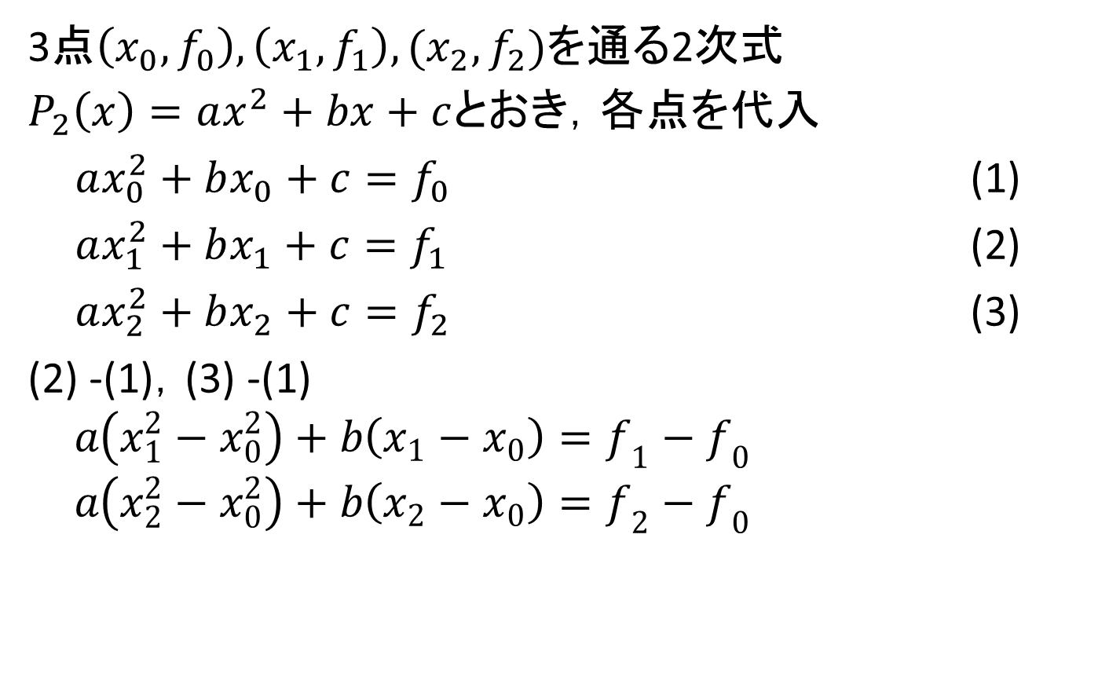
(2) 2次補間
3点$\left(x_{0},f_{0}\right), \left(x_{1},f_{1}\right), (x_{2},f_{2})$を通る2次式
$P_{2}\left(x\right)=ax^{2}+bx+c$とおき，各点を代入
$ax_{0}^{2}+bx_{0}+c=f_{0}$ (1)
$ax_{1}^{2}+bx_{1}+c=f_{1}$ (2)
$ax_{2}^{2}+bx_{2}+c=f_{2}$ (3)
(2) -(1)，(3) -(1)
$$a\left(x_{1}^{2}−x_{0}^{2}\right)+b\left(x_{1}−x_{0}\right)=f_{1}−f_{0}$$
$$a\left(x_{2}^{2}−x_{0}^{2}\right)+b\left(x_{2}−x_{0}\right)=f_{2}−f_{0}$$

Slide 5
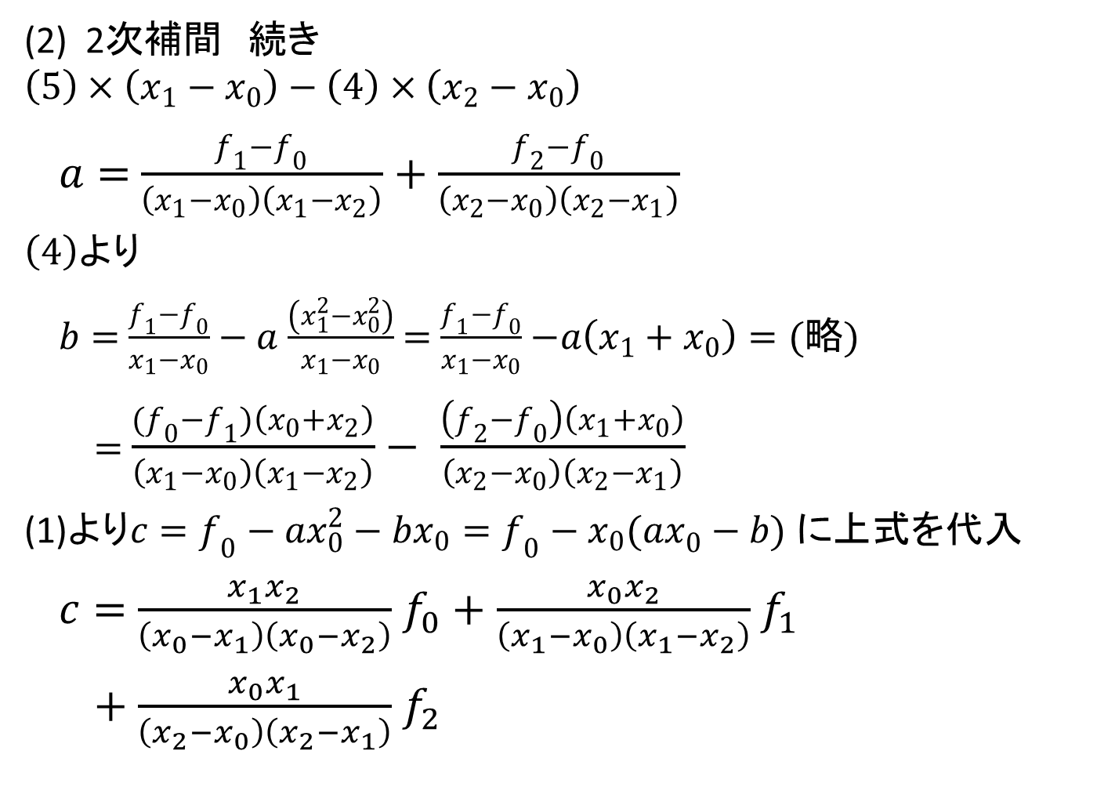
(2) 2次補間 続き
$$\left(5\right)×\left(x_{1}−x_{0}\right)−\left(4\right)×\left(x_{2}−x_{0}\right)$$
$a=$ $\frac{f_{1}−f_{0}}{\left(x_{1}−x_{0}\right)\left(x_{1}−x_{2}\right)}$ $+$ $\frac{f_{2}−f_{0}}{\left(x_{2}−x_{0}\right)\left(x_{2}−x_{1}\right)}$
$\left(4\right)$より
$b=$ $\frac{f_{1}−f_{0}}{x_{1}−x_{0}}$ $− a$ $\frac{\left(x_{1}^{2}−x_{0}^{2}\right)}{x_{1}−x_{0}}$ $=$ $\frac{f_{1}−f_{0}}{x_{1}−x_{0}}$ $−a\left(x_{1}+x_{0}\right)=(略)$
$=$ $\frac{{(f}_{0}−f_{1})\left(x_{0}+x_{2}\right)}{\left(x_{1}−x_{0}\right)\left(x_{1}−x_{2}\right)}$ $−$ $\frac{\left(f_{2}−f_{0}\right)\left(x_{1}+x_{0}\right)}{\left(x_{2}−x_{0}\right)\left(x_{2}−x_{1}\right)}$
(1)より$c=f_{0}−{ax}_{0}^{2}−bx_{0}=f_{0}−x_{0}({ax}_{0}^{}−b)$ に上式を代入
$c=$ $\frac{x_{1}x_{2}}{\left(x_{0}−x_{1}\right)\left(x_{0}−x_{2}\right)}$ $f_{0}+$ $\frac{x_{0}x_{2}}{\left(x_{1}−x_{0}\right)\left(x_{1}−x_{2}\right)}$ $f_{1}$
$+$ $\frac{x_{0}x_{1}}{\left(x_{2}−x_{0}\right)\left(x_{2}−x_{1}\right)}$ $f_{2}$

Slide 6
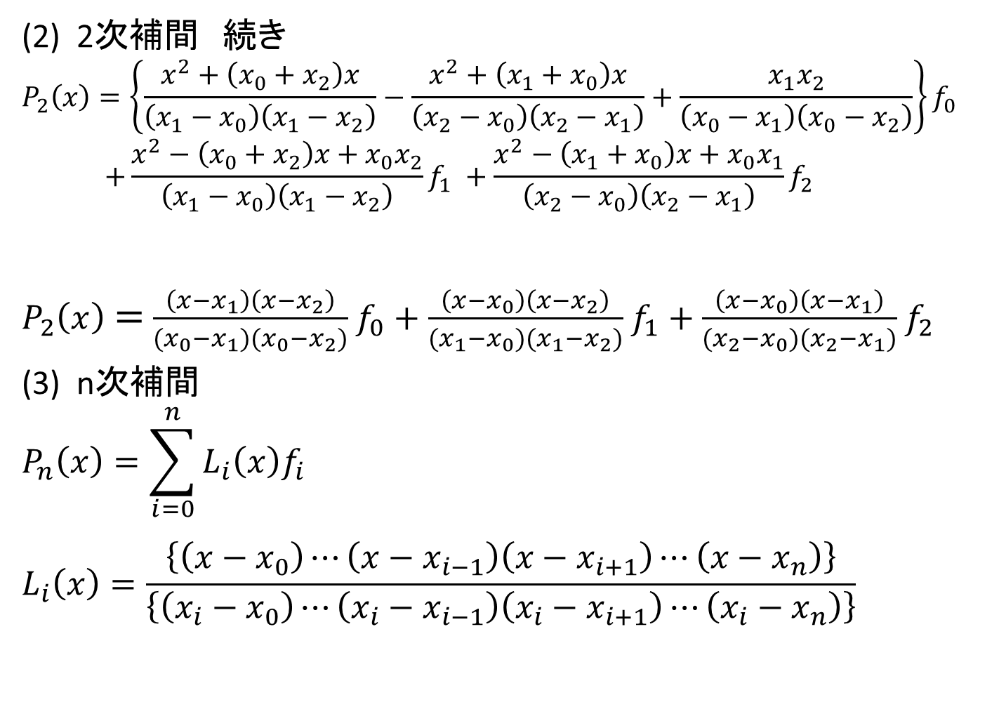
(2) 2次補間 続き
$$P_{2}\left(x\right)=\left\{\frac{x^{2}+\left(x_{0}+x_{2}\right)x}{\left(x_{1}−x_{0}\right)\left(x_{1}−x_{2}\right)}−\frac{x^{2}+\left(x_{1}+x_{0}\right)x}{\left(x_{2}−x_{0}\right)\left(x_{2}−x_{1}\right)}+\frac{x_{1}x_{2}}{\left(x_{0}−x_{1}\right)\left(x_{0}−x_{2}\right)}\right\}f_{0}$$
$$+\frac{{x^{2}−\left(x_{0}+x_{2}\right)x+x}_{0}x_{2}}{\left(x_{1}−x_{0}\right)\left(x_{1}−x_{2}\right)}f_{1} +\frac{{x^{2}−\left(x_{1}+x_{0}\right)x+x}_{0}x_{1}}{\left(x_{2}−x_{0}\right)\left(x_{2}−x_{1}\right)}f_{2}$$
$P_{2}\left(x\right)=$ $\frac{\left(x−x_{1}\right)\left(x−x_{2}\right)}{{(x}_{0}−x_{1})(x_{0}−x_{2})}$ $f_{0}+$ $\frac{\left(x−x_{0}\right)\left(x−x_{2}\right)}{{(x}_{1}−x_{0})(x_{1}−x_{2})}$ $f_{1}+$ $\frac{\left(x−x_{0}\right)\left(x−x_{1}\right)}{{(x}_{2}−x_{0})(x_{2}−x_{1})}$ $f_{2}$
(3) n次補間
$$P_{n}\left(x\right)=\sum_{i=0}^{n}{L_{i}\left(x\right)f_{i}}$$
$$L_{i}\left(x\right)=\frac{\left\{\left(x−x_{0}\right)⋯\left(x−x_{i−1}\right)\left(x−x_{i+1}\right)⋯\left(x−x_{n}\right)\right\}}{\left\{\left(x_{i}−x_{0}\right)⋯\left(x_{i}−x_{i−1}\right)\left(x_{i}−x_{i+1}\right)⋯\left(x_{i}−x_{n}\right)\right\}}$$

Slide 7
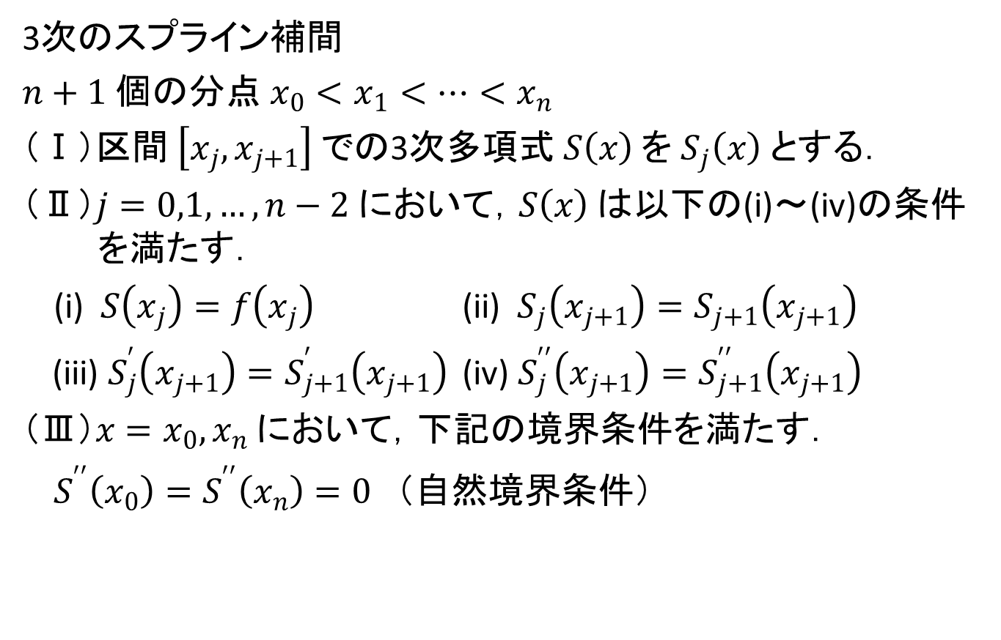
スプライン補間
3次のスプライン補間
$n+1$個の分点$x_{0}<x_{1}<…<x_{n}$
（Ⅰ）区間$\left[x_{j},x_{j+1}\right]$での3次多項式$S\left(x\right)$を$S_{j}\left(x\right)$とする．
（Ⅱ）$j=0,1,…,n−2$において，$S\left(x\right)$は以下の(i)～(iv)の条件を満たす．
(i) $S\left(x_{j}\right)=f\left(x_{j}\right)$ (ii) ${ S}_{j}\left(x_{j+1}\right)=S_{j+1}\left(x_{j+1}\right)$
(iii) $S_{j}^{′}\left(x_{j+1}\right)=S_{j+1}^{′}\left(x_{j+1}\right)$ (iv) $S_{j}^{′′}\left(x_{j+1}\right)=S_{j+1}^{′′}\left(x_{j+1}\right)$
（Ⅲ）$x=x_{0}, x_{n}$において，下記の境界条件を満たす．
$S^{′′}\left(x_{0}\right)=S^{′′}\left(x_{n}\right)=0$ （自然境界条件）

Slide 8
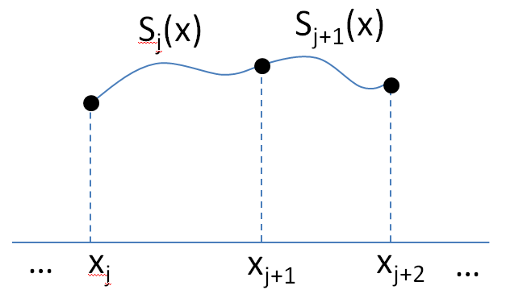
スプライン補間

