Slide 1
Funny uml diagrams
Ky Perrone
11/14/2023

Slide 2
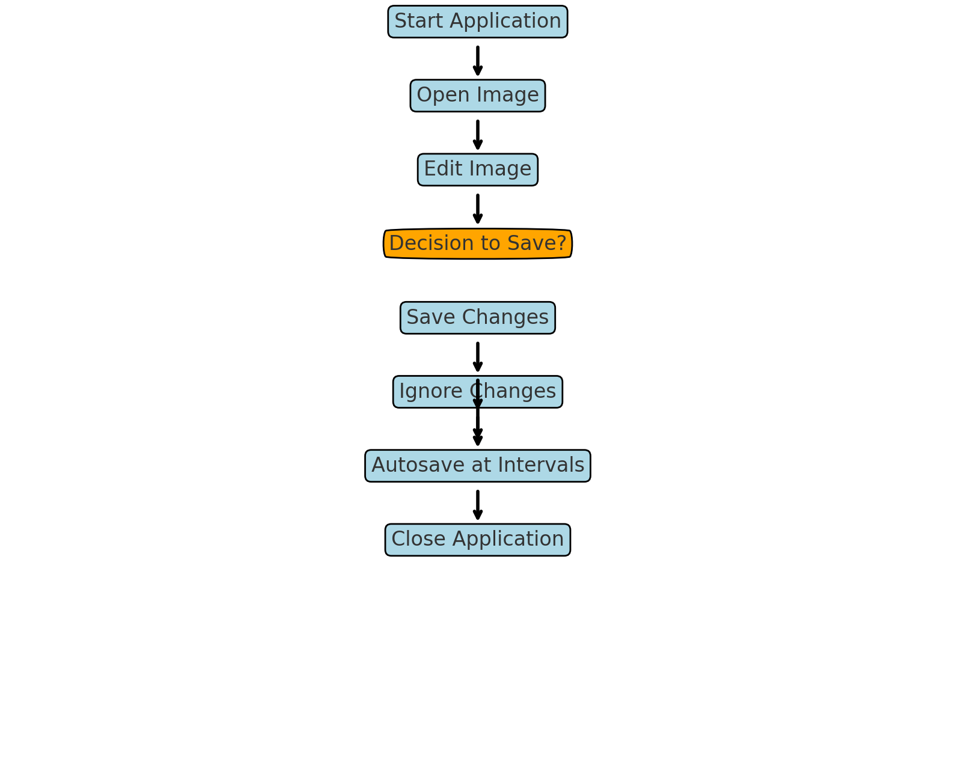
Very cool activity diagram

Slide 3
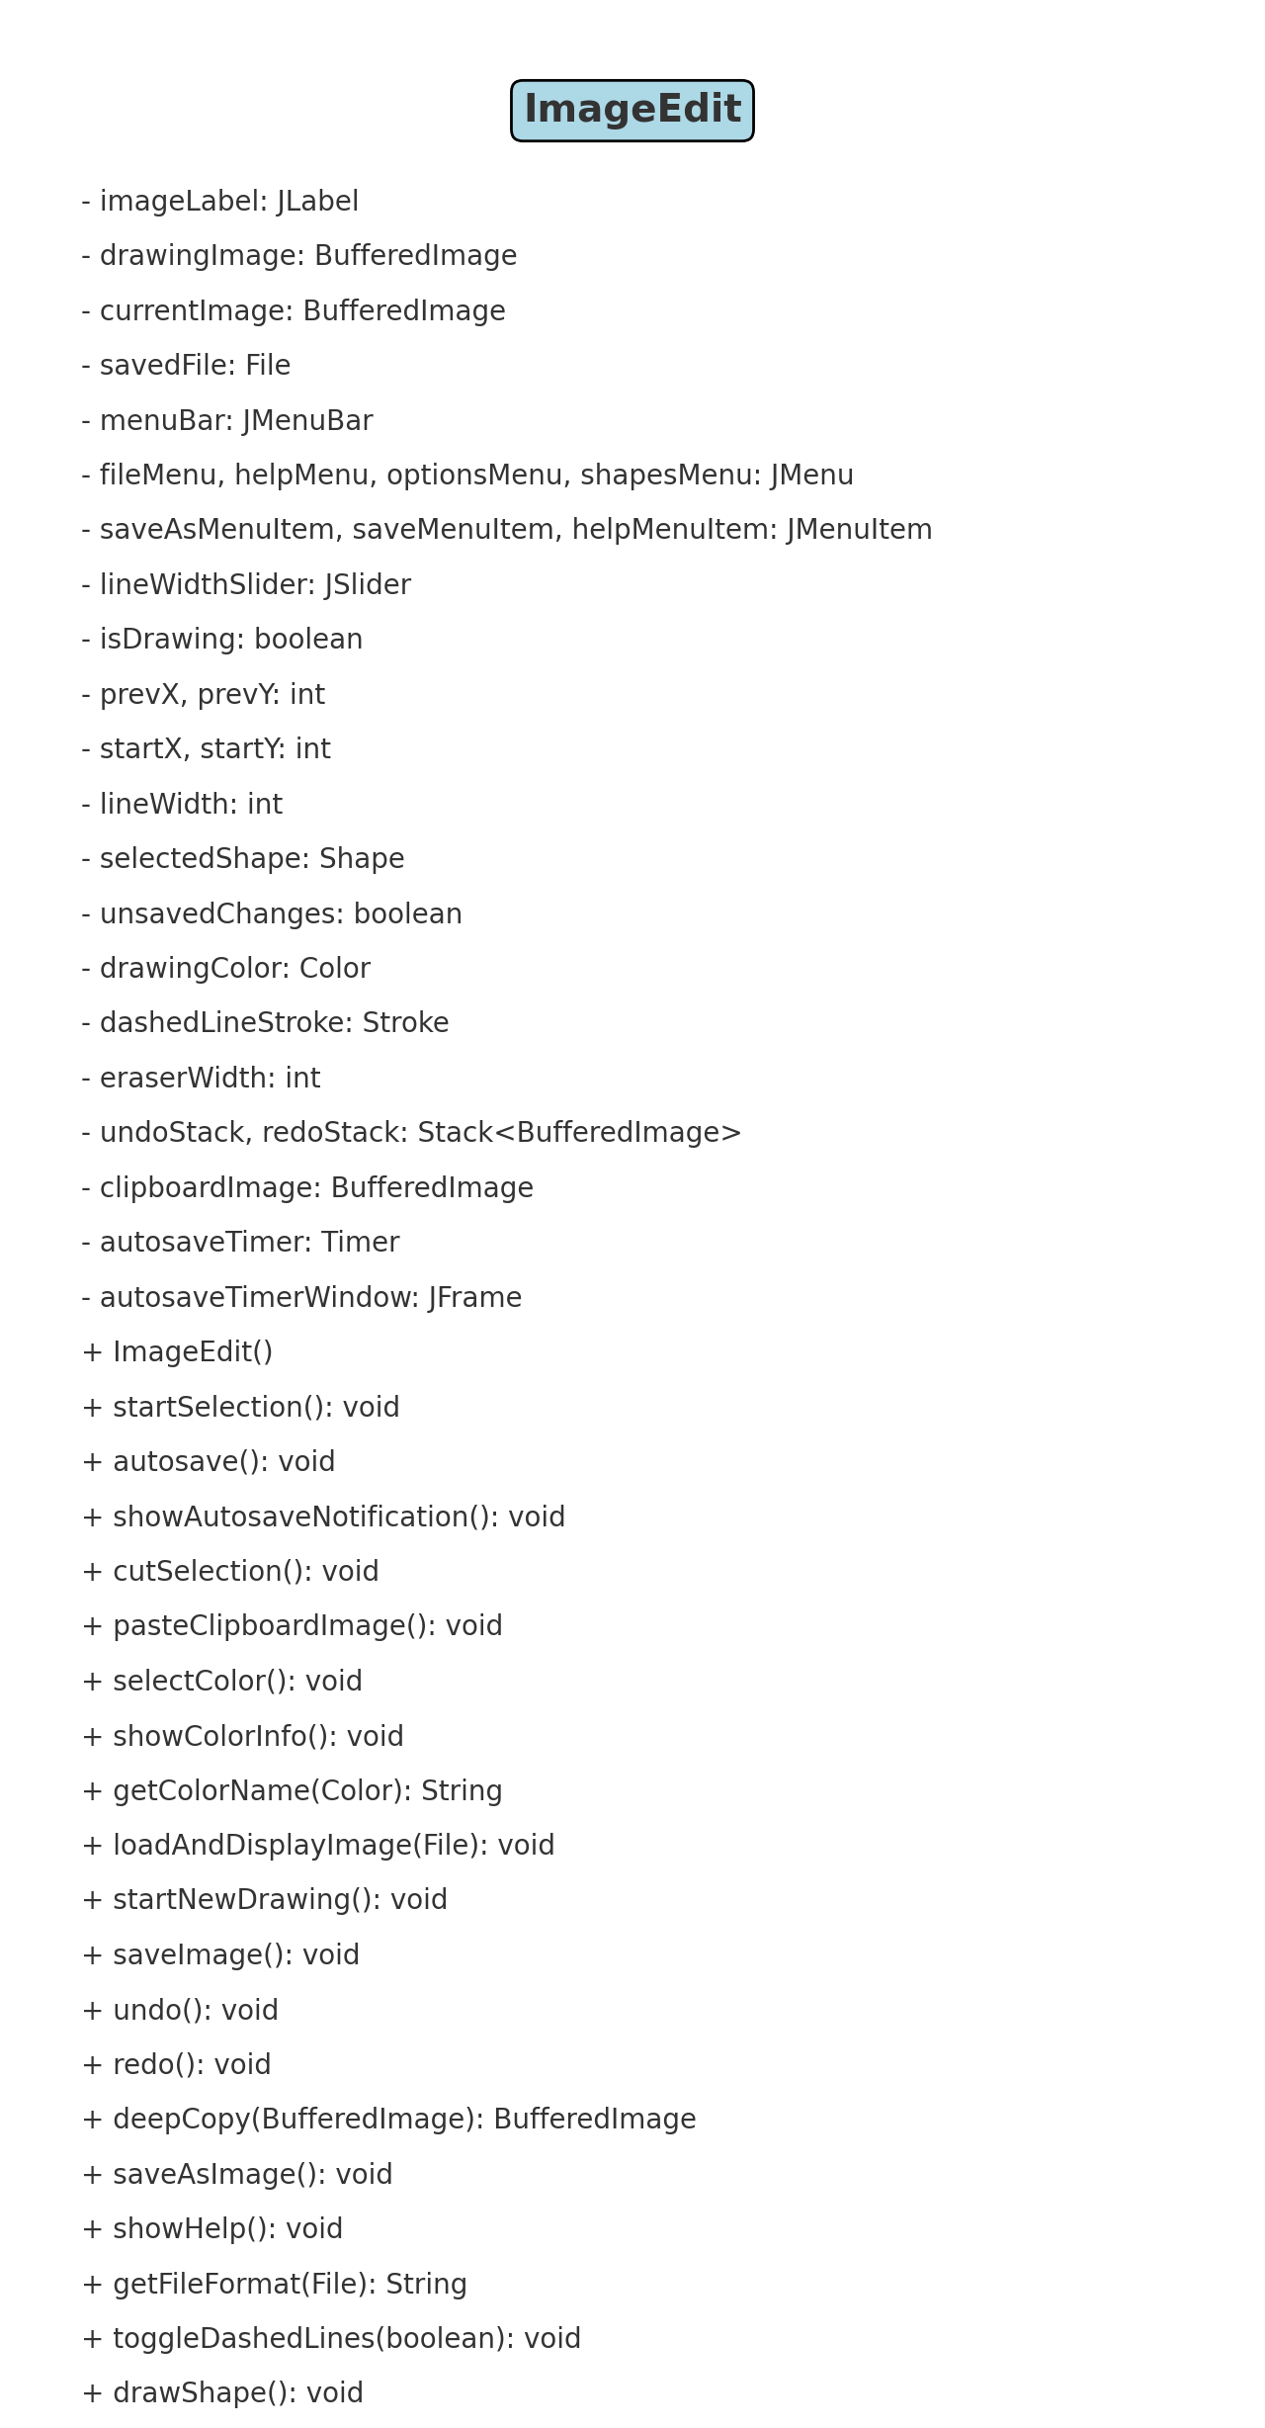
Neat class diagram

Slide 4
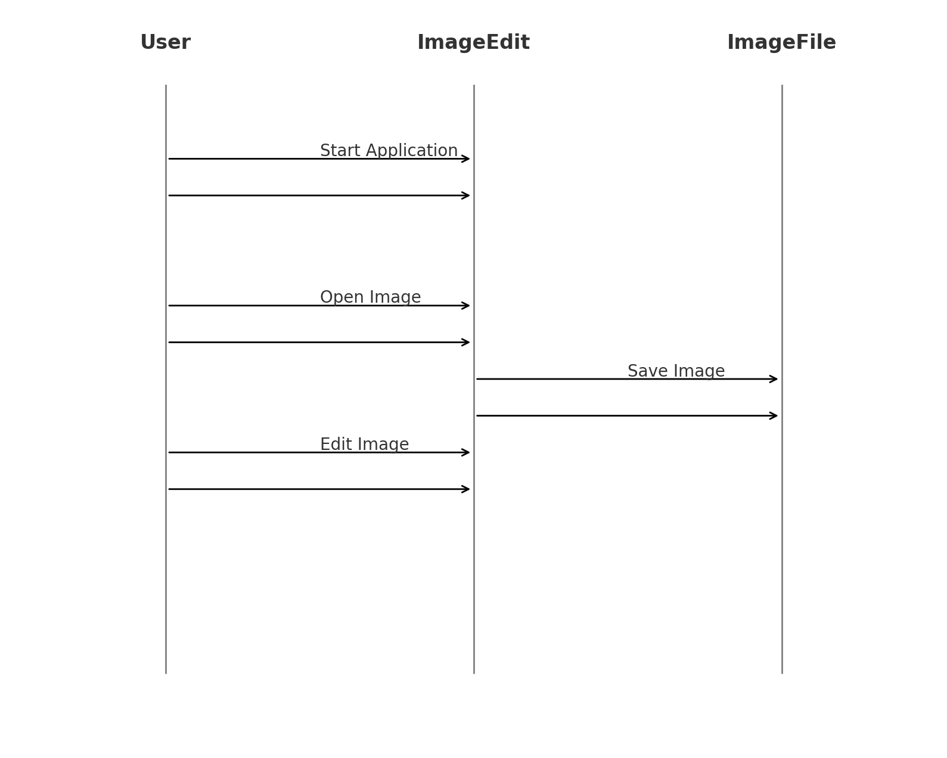
Epic Sequence Diagram

Slide 5
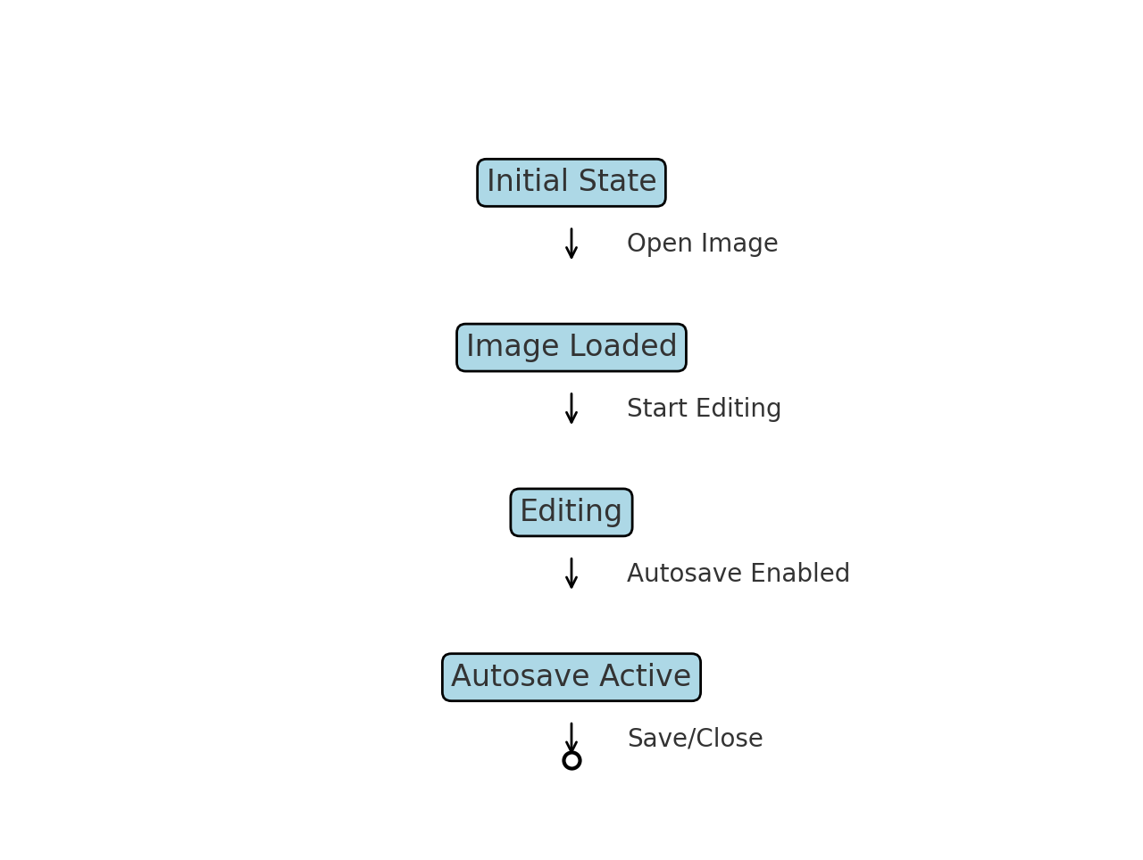
Breathtaking state diagram

Slide 6
THANK YOU
Ky Perrone
Ky.perrone@valpo.edu

