Slide 1

Concrete Remaining Life Prediction(CRLP) program
Yi-Leng Chen
March 1 , 2024

Slide 2
CONTENTS
Introduction
Code demonstration
Goal statement
Risks
Prototype demonstration

Slide 3
1
Introduction
This project aims to develop a system that implements theories introduced by a United States laboratory[1] in 1992. Their work emphasized the importance of estimating remaining service life to enable property owners to plan for repairs or demolitions proactively.
[1] Building and fire research laboratory. (1992). Methods for Predicting Remaining Life of Concrete in Structures.https://nvlpubs.nist.gov/nistpubs/Legacy/IR/nistir4954.pdf

Slide 4
2
Project Goal
1
This project aims to develop a program that implements the theories, with the goal of predicting the remaining service life of concrete structures.

Slide 5
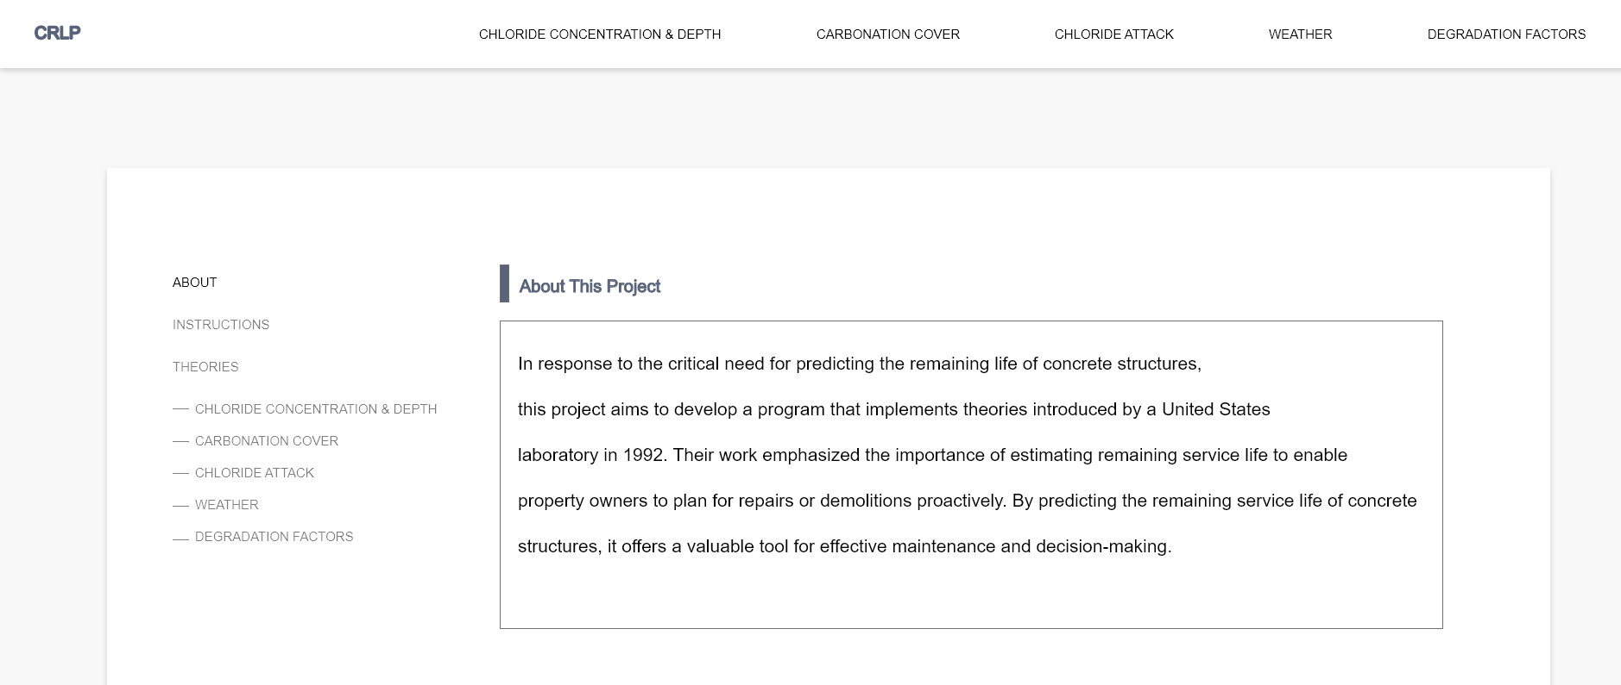
Prototype demonstration
3
User Interface Prototype

Slide 6
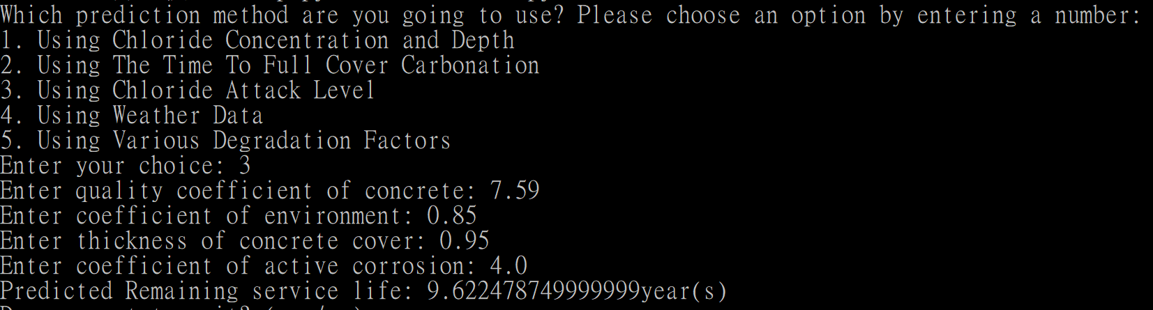
Code demonstration
4

Slide 7
Challenge
4
Weather Test Data: Among all the prediction methods, only the weather data method has real-life information available on the Canadian government's website [2]. Other methods lack real-life data for testing. However, the data on the website sometimes lacks completeness.
[1] Hourly Data Report for November 17, 2015. (2015, November). Government of Canada. https://climate.weather.gc.ca/climate_data/hourly_data_e.html?hlyRange=2014-10-15%7C20151117&dlyRange=%7C&mlyRange=%7C&StationID=52641&Prov=ON&urlExtension=_e.html&searchType=stnName&optLimit=yearRange&StartYear=1840&EndYear=2024&selRowPerPage=25&Line=0&searchMethod=contains&Month=11&Day=17&txtStationName=toronto&timeframe=1&Year=2015

Slide 8
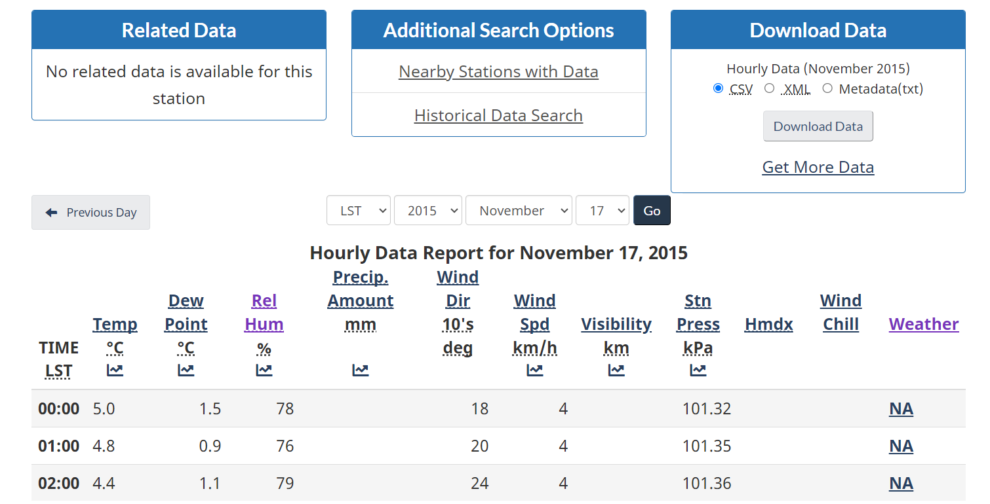
Challenge
4

Slide 9
Risks
5
Input quality: The system primarily handles calculations related to corrosion. The detection of carbonation, the thickness of concrete, and other input values come from external instruments. Therefore, the accuracy of these inputs cannot be verified.
Notes:
Carbonation, sulfate attack

Slide 10
Questions or Feedback

