Slide 1



Slide 2
simply
sorted

Slide 4
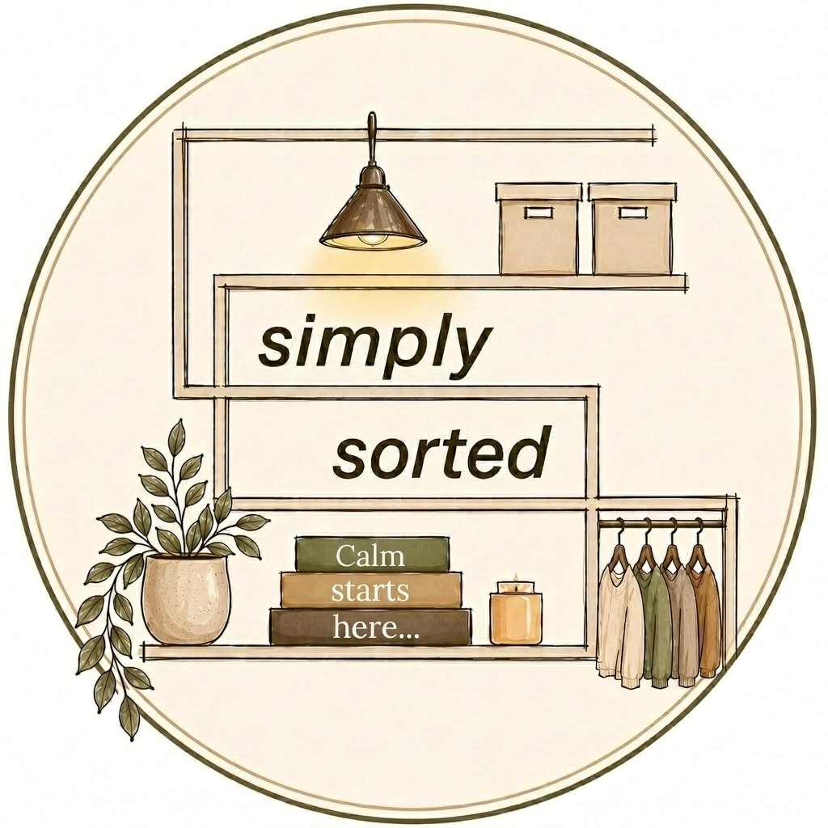

Slide 5


