Slide 1


Slide 2
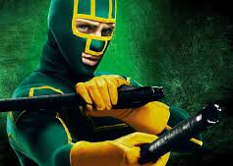
What Superhero is the Worst
Sales data vs popular opinion

Slide 3
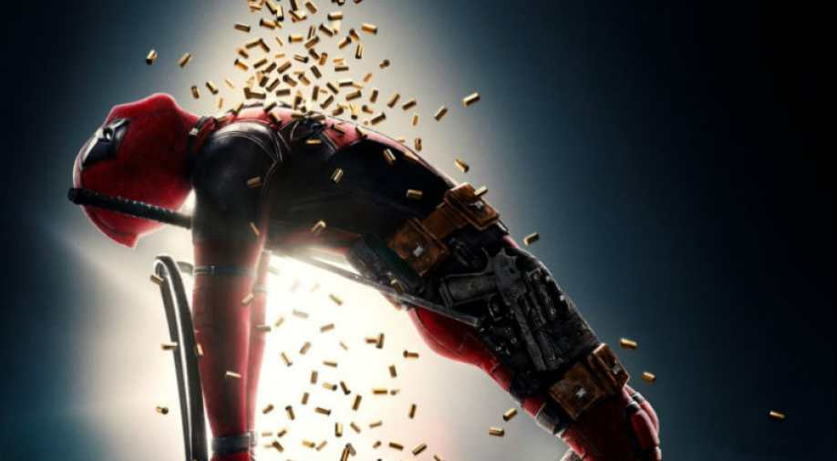
Hypothesis: There is correlation between comic book sales and superhero statistics
Methodology:
We collected data from our class and our social networks on what they thought was the most important statistics of superheroes
Intelligence, Strength, Combat, Durability, Power (non-physical), Speed
We used the API from https://www.superheroapi.com/ and we were able to pull in statistics of superhero’s power rankings
Manually downloaded and cleaned data from https://www.comichron.com/yearlycomicssales/
Normalized statistics to reflect polling data and combined with comicbook sales into a Pandas DataFrame

Slide 4

The Superhero API
Using the API from https://www.superheroapi.com/ we collected data
over 700 superheroes
wide range data like name, group affiliation, and known relatives
ranking from 0 to 100 of their statistics as determined by the superhero database https://www.superherodb.com/
We cleaned the data for the raw statistics and superheroes’ names
Combined duplicated (superheroes with more than one alter ego)
Removed superheroes with NA values
Applied our normalization to their statistics

Slide 5

Comic book Sales
Data was retrieved from https://www.comichron.com/yearlycomicssales/
We were unable to find a database or an API which held individual comic book sales however this site contained the data we needed
After collecting the sales data we converted it into a Data Frame
Issues
The comic book sales only was reliable from 2009 to present
This had the data but was in a non-downloadable list. Jordan had to copy and paste the information by hand to a .csv

Slide 6
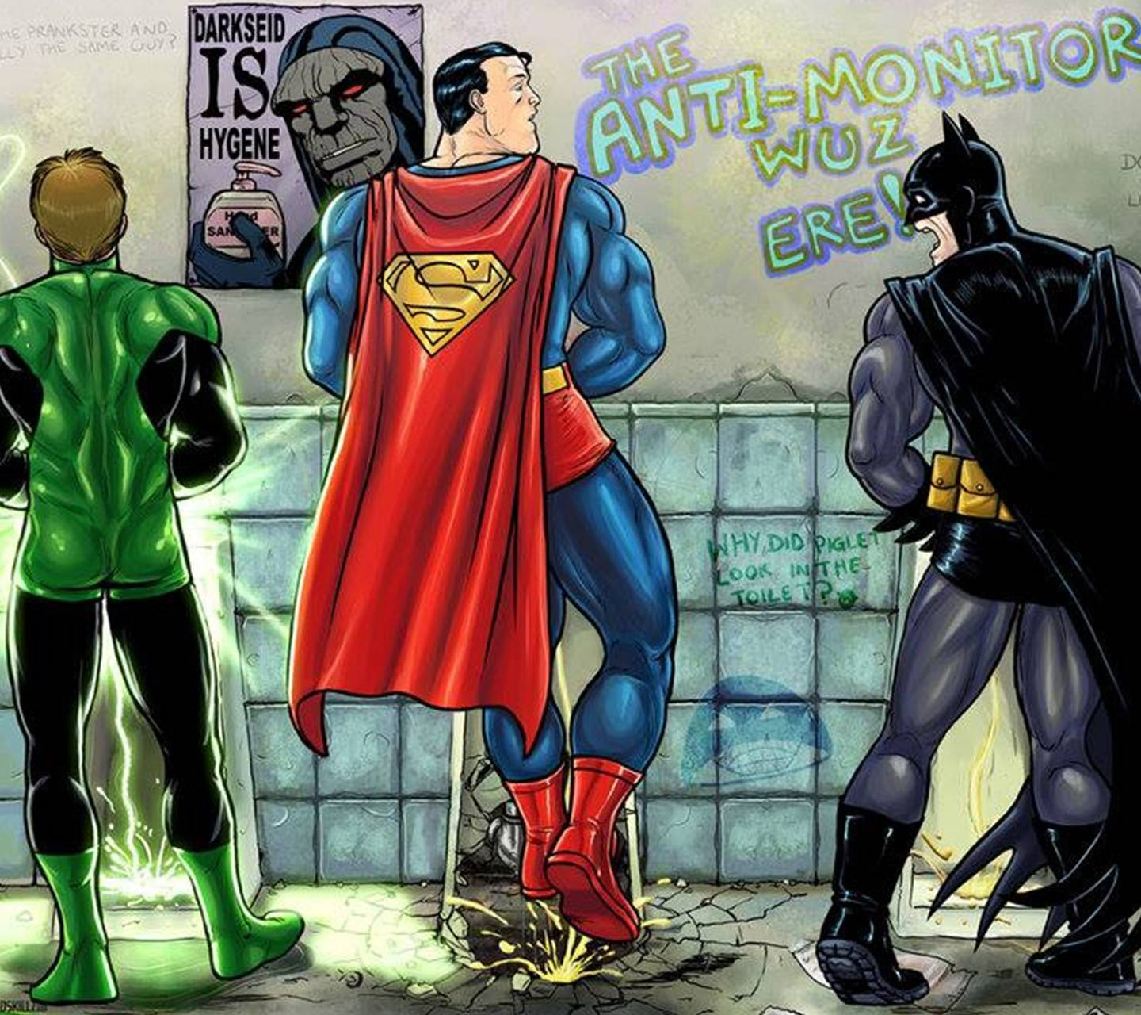
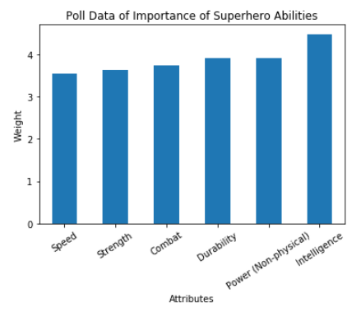
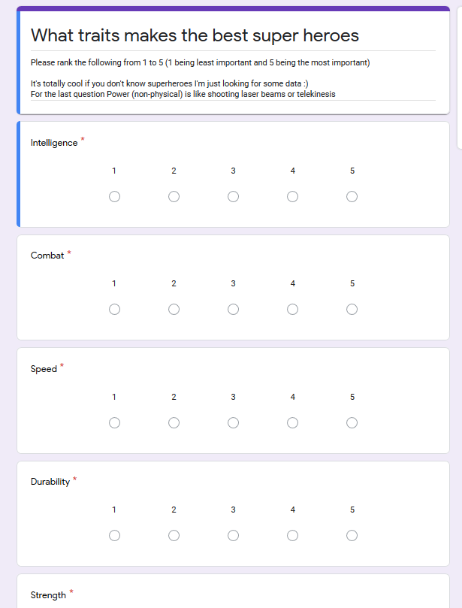
Polling Data
Fig. 1
Each of the team members sent out a poll to determine which statistics of superheroes were the most important to them on a scale of 1 to 5 (Fig. 1)
We download the data as .csv files and combined it into a Pandas Data Frame
We then adjusted the values that were returned to be normalized values
First we got sum of all ranking of each individual stat and then took the mean of it to determine the weighted values of each stat. Each mean we divided by the norm so they would add up to 1 (Fig. 2)
norm = combined_df.mean().sum()
weights_df = combined_df.mean()/norm
Fig. 2

Slide 7
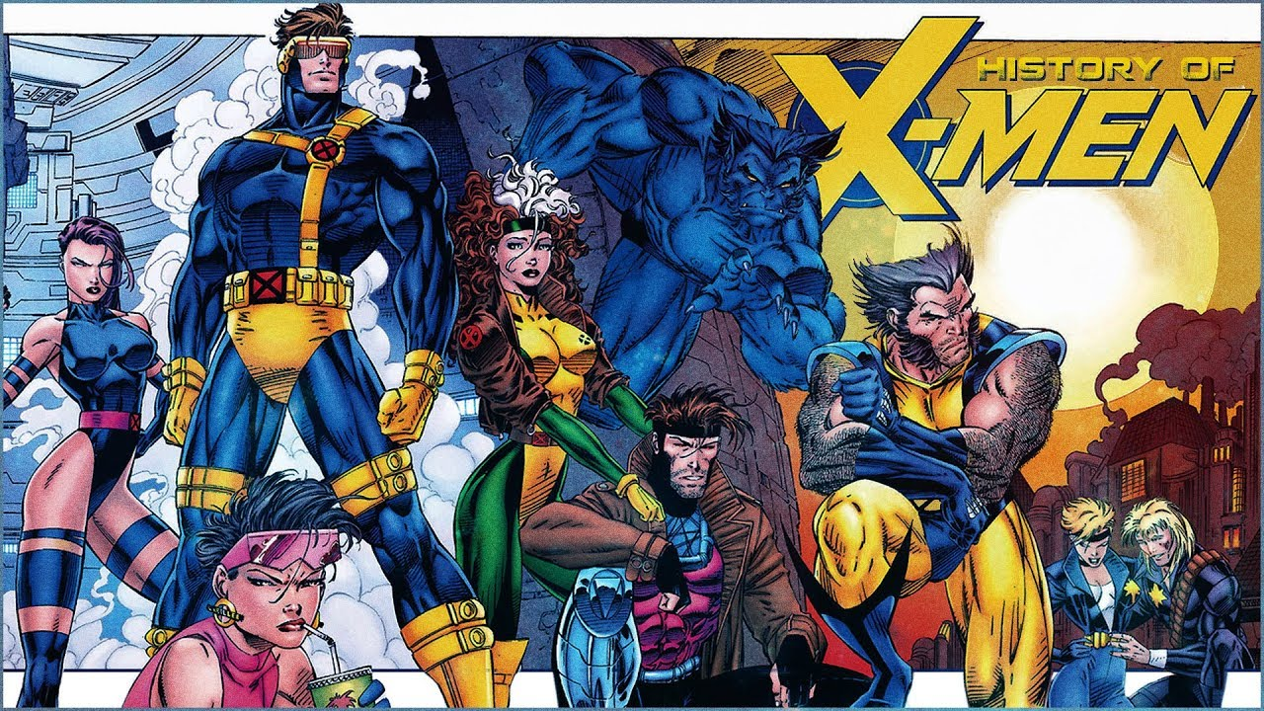
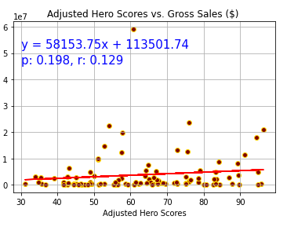
Graphs and Conclusions
Weak correlation
Batman outlier

Slide 8

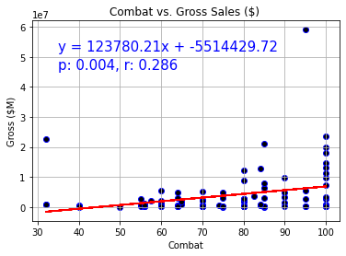
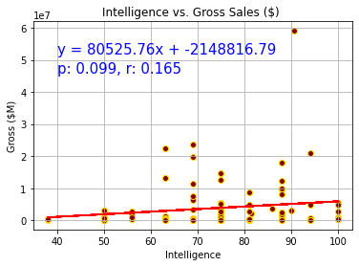
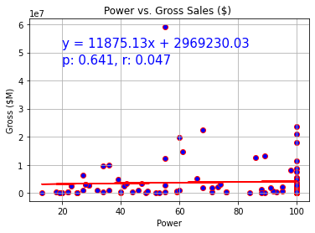
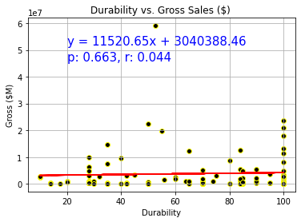
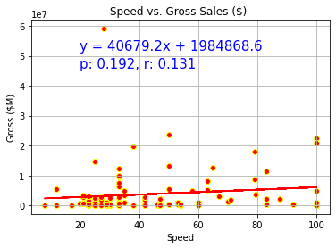
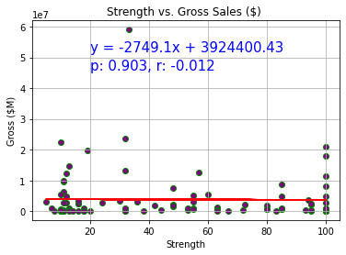

Individual Stats Graphs
Sales not reflecting polling data
Weak positive correlation except for strength
LEAST LIKELY TO SUCCEED
Weakest: Rocket Raccoon
Dumbest: Kick-Ass
Slowest: Man-Thing
Worst Fighter: Ant-Man
Most Fragile: Hawkeye
Most Powerless: Kingpin
THE WINNER AT BEING THE WORST IS…..

Slide 9
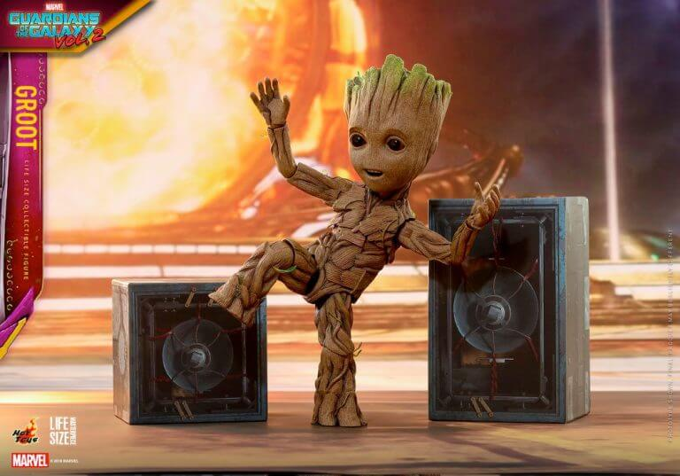
Challenges and Improvements
Challenging data retrieval
Hero to comic book mapping (Darkest Knight title does not map to Batman)
Attribute specific sales
Wider population and more targeted polling pool
Final Thoughts
According to our weighted values Kickass is the worst superhero
The top-ranking superheroes are all part of the Justice League most which also have impressive sales figures
We could not find strong evidence for a correlation between superhero statistics and comic book sales

Slide 10
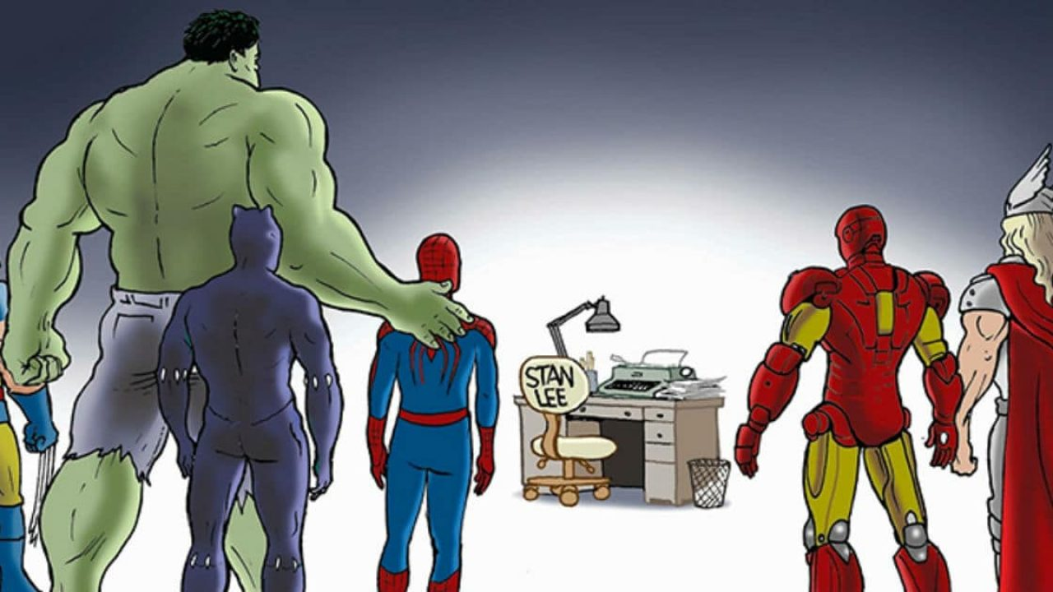
Created by Josh Leibfried Mikhail Kyraha Jordan Thompson

