Slide 1
Weather, Socioeconomic and Air Travel Impact on the Number of COVID-19 Cases
Kyra Duncan
Jade Tao
Cindy Reznikov
Notes:
Research Questions:
What are the current world-wide stats related to COVID-19 for confirmed cases, deaths and recovery?
Do weather conditions such as temperature and humidity impact transmissibility of COVID-19?
What is the socio-economic background of those infected and is there any socio-economic group being infected at a higher rate than others?
Is there a correlation between air travel and the spread of the virus?

Slide 2
Questions
What are the world-wide statistics related to COVID-19 for confirmed cases, deaths and recovery?
Does population density and/or weather conditions such as temperature and humidity have an impact on the number of confirmed cases.
Does temperature and population density have an impact on the transmissibility of COVID-19?
What is the socio-economic background of those infected and is there any socio-economic group being infected at a higher rate than another?
Is there a correlation between air travel and the spread of the virus?
Notes:
Our data comes from the data repository posted on GitHub for the 2019 Novel Coronavirus Visual Dashboard operated by the Johns Hopkins University Center for Systems Science and Engineering, specifically the COVID-19 Daily Report and we have updated with the most recent data from March 20th.

Slide 3
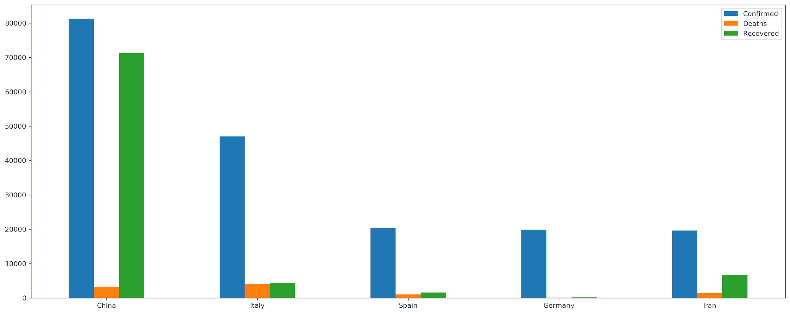
Confirmed Cases, Deaths, and Recovered Cases of Top 5 Countries
Notes:
As of March 20th, the total confirmed cases of COVID 19 world wide stands at 274,180 with 11,375 deaths. After conducting a summary analysis of Johns Hopkins’ data, We pulled the 5 countries with the highest rates of confirmed cases and produced a grouped bar chart to compare them by the confirmed cases as well as their number of deaths and recovered cases. Here, we noticed that Italy’s deaths were higher than China’s and wanted to take a closer look at those 2 countries.

Slide 4
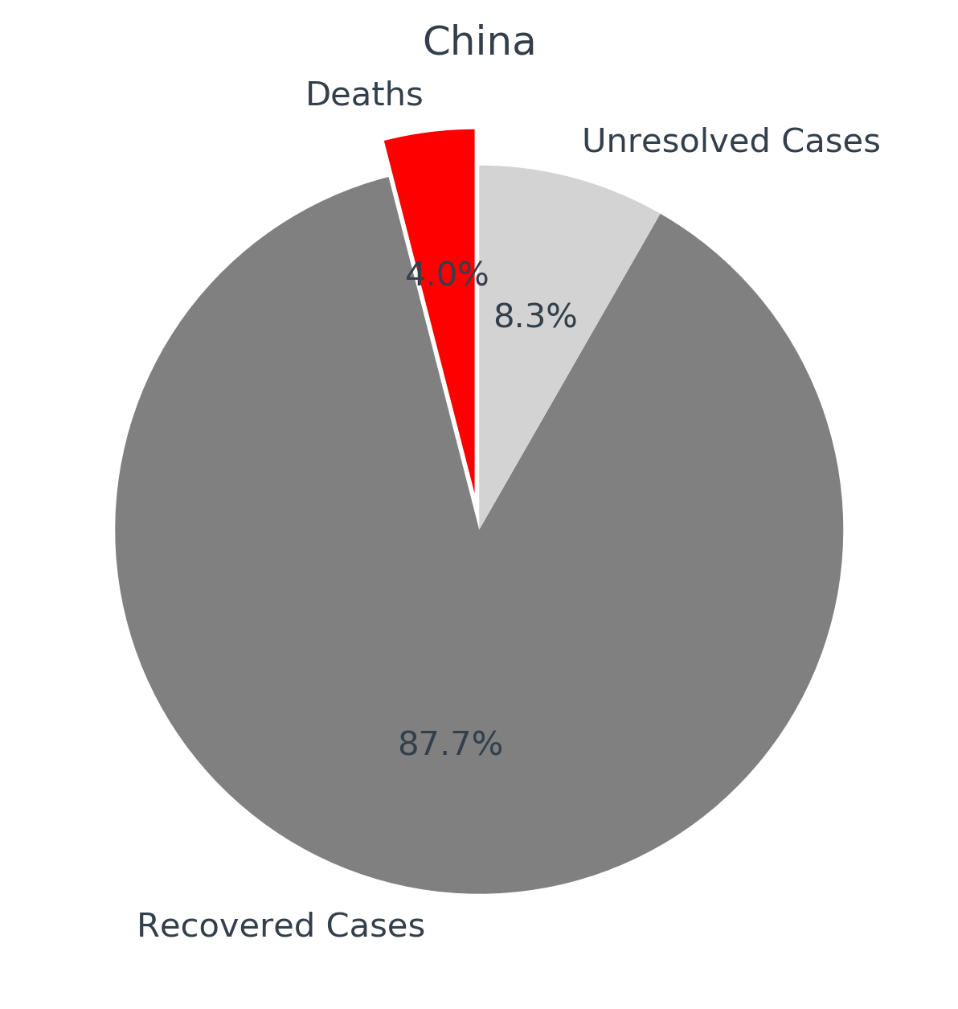
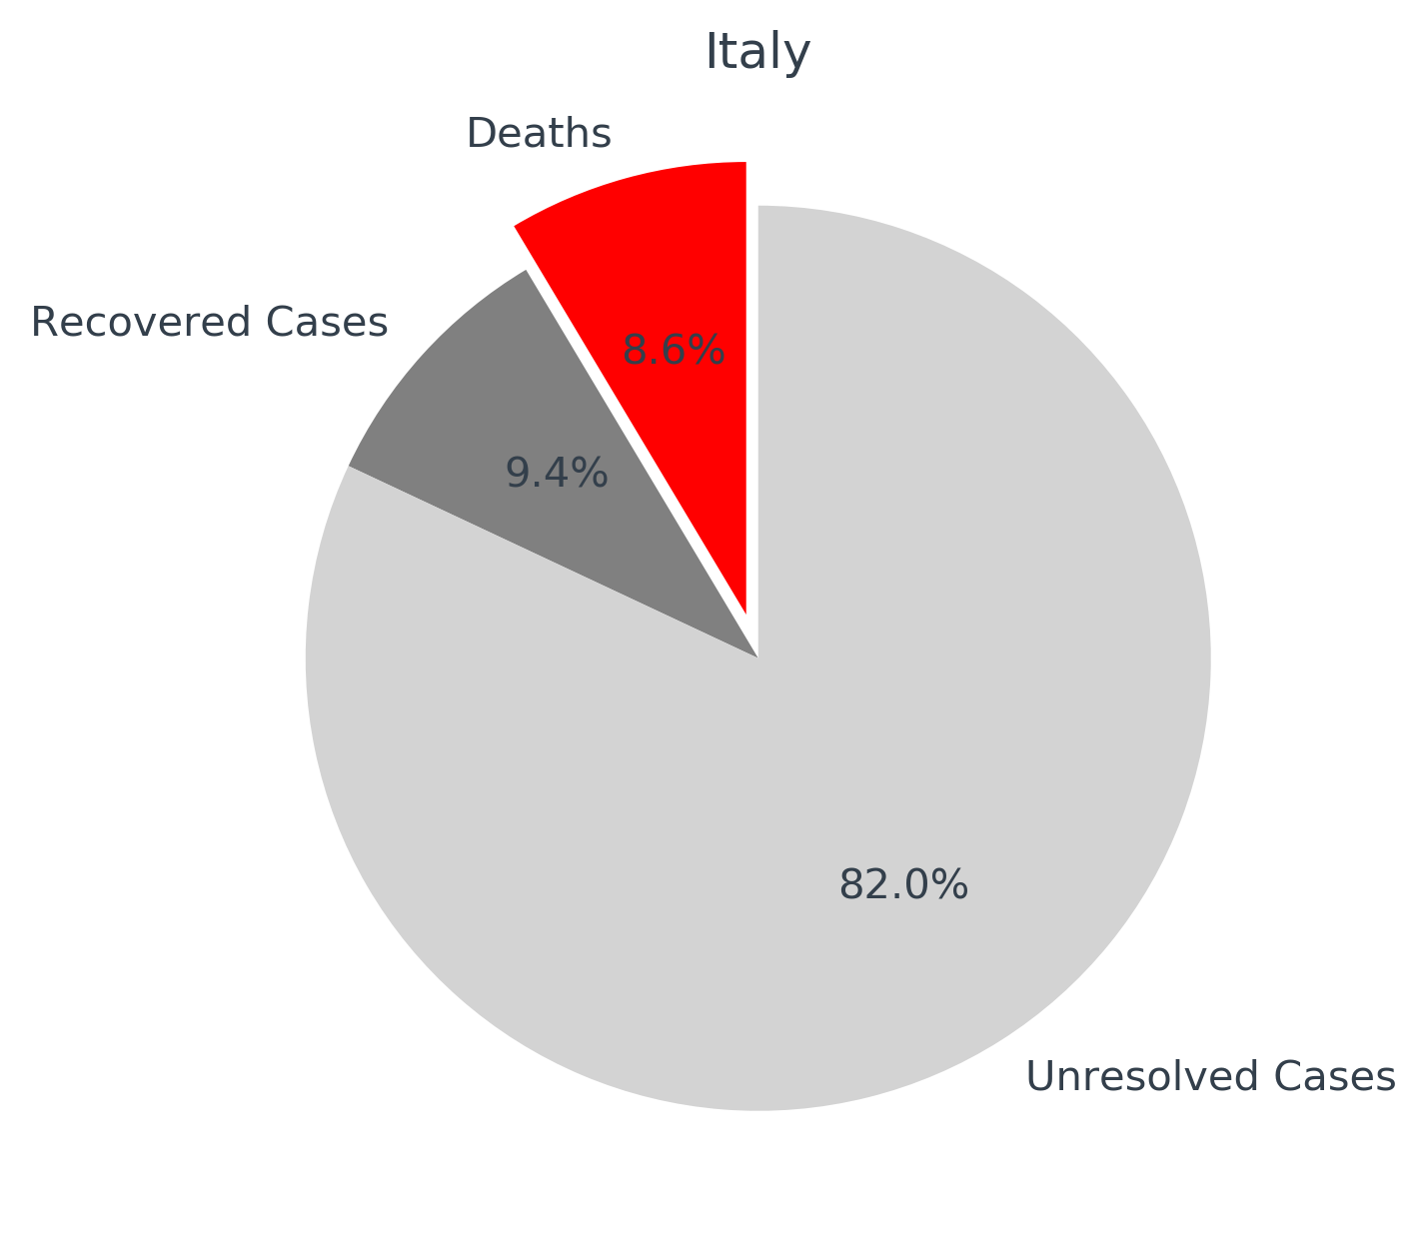
Breakdown of Confirmed Cases for China and Italy
Notes:
This analysis shows the breakdown of confirmed cases for both China and Italy. We found that Italy’s percentage of deaths is more than double China’s. What is most alarming here is that you can see China’s confirmed cases consists mostly of recovered cases with only 8.35% unresolved, while Italy still has 82% of its total cases unresolved, meaning most are still sick and so the death toll has the potential to rise significantly.

Slide 5
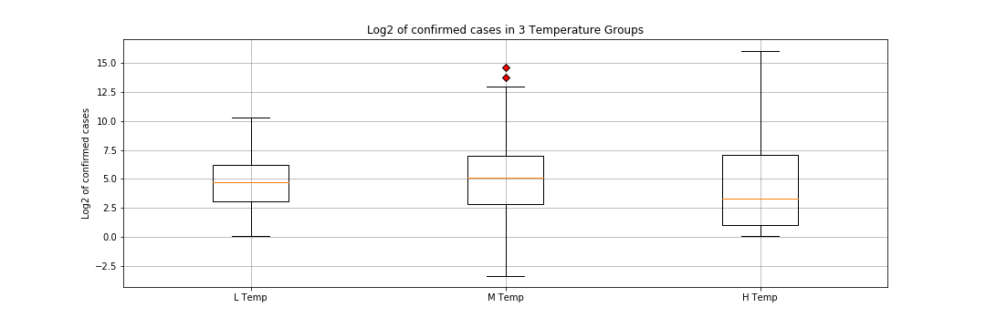
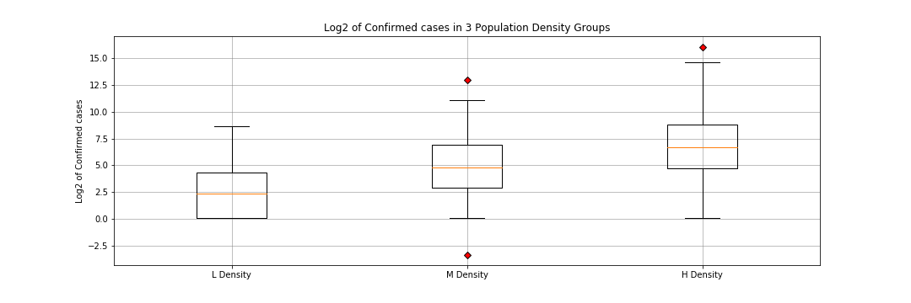
Log2 of confirmed cases differ among different temperature / population density groups
P<0.0001, kruskal wallis test
P<0.0001, kruskal wallis test

Slide 6
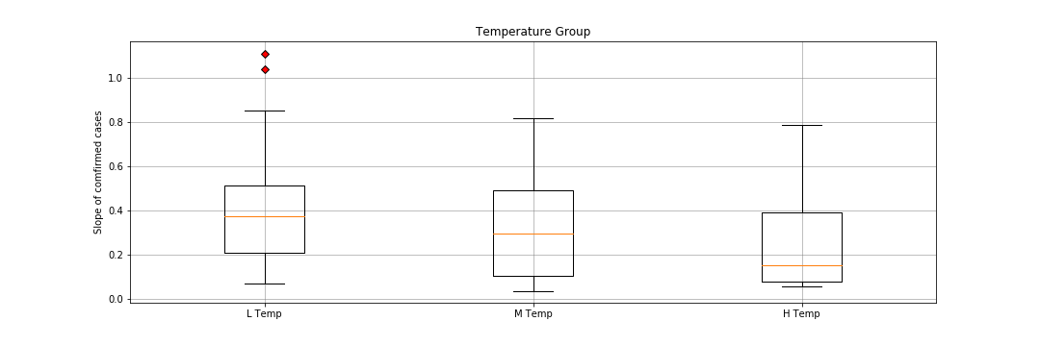
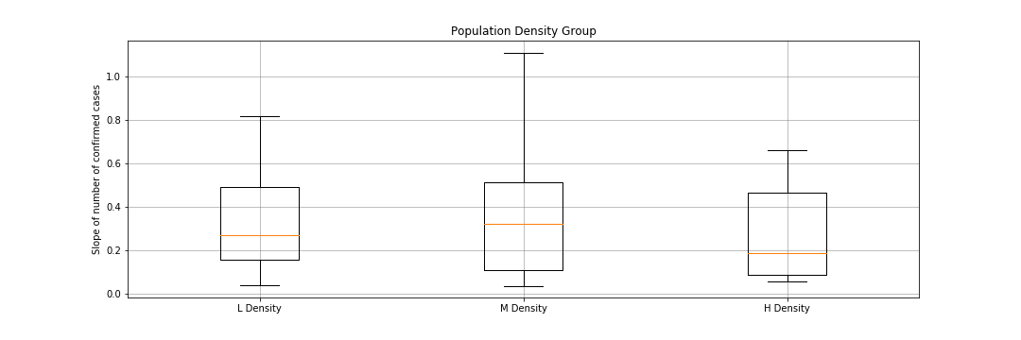
Transmission rate of COVID-19 differ among different temperature /population density groups
P=0.023,, kruskal wallis test
P=0.39, kruskal wallis test

Slide 7
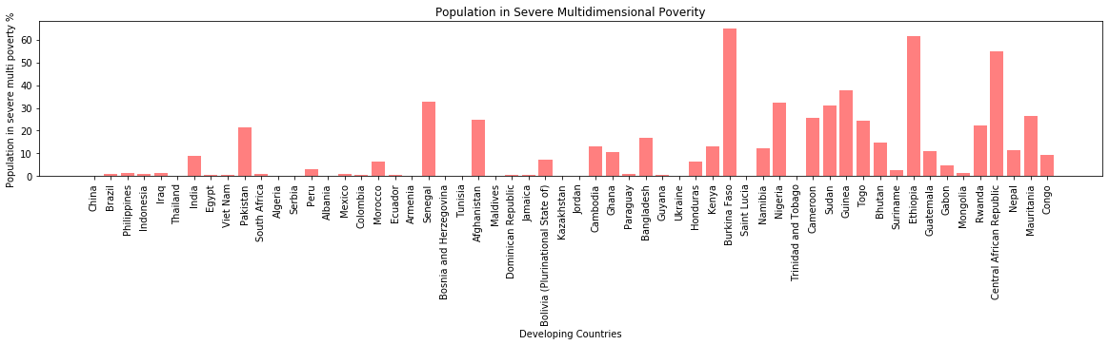
COVID-19 - Affected
Developing Countries - Severe MPI
Notes:
Our research could only find socioeconomic data for developing countries. We looked at the 101 developing countries that were identified in the Multidimentional Poverty Index (MPI) Report produced by United Nations Development Porgramme. 58 of the 101 developing countries in the MPI are reported as having ‘confirmed cases’ of COVID-19. Only 1 (China) is in the top 20 affected countries. (158 countries total in our COVID19 data - means that 43 developing countries do not have any confirmed cases.) This chart shows Intensity of Deprivation - which is the average percentage of deprivation experienced by people in multidimensional poverty. It is calculated based on data on household deprivations 3 categories - education, health and living standards - from various organizational surveys.
This chart shows the 58 developing countries with reported ‘confirmed cases’ of COVID-19 and the percentage of their population that face severe multidimensional poverty - which is defined as the percentage of the population with a deprivation score of 50% or more. There were 158 countries in our original Johns Hopkins University data.

Slide 8
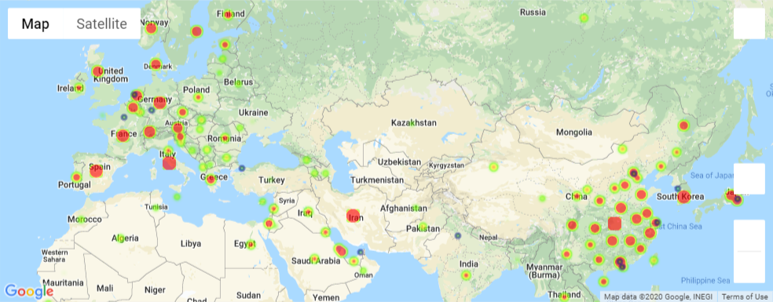
Confirmed Cases and Major Airport Locations
Notes:
This is a heat map showing those areas with confirmed cases of COVID-19 (red dots). The blue dots show where the top 20 airports are located. This graphic seems to indicate that ...

Slide 9
Summary
Since this is a rapid evolving situation, understanding the current world-wide statistics was helpful in guiding our analysis. It was surprising to see that Italy’s death rate has surpassed China’s and still has many unresolved cases.
Locations with > 72 F temperature weather have significantly lower confirmed cases and transmission rate in COVID-19
There is no significant difference in COVID-19 transmission rate found among different population density locations.
Regarding socio economic groups, the developed countries have more confirmed cases than the developing countries.
Our analysis of the top 20 airports showed some correlation to confirmed cases, but not a significant correlation.
If we had more time we would explore potential risk factors and drug developments.
Questions from the class?

