Slide 1

Analysis of Household Income Using Regression Techniques on Synthetic Data
Kyriakos Papadopoulos

Slide 2
Agenda
Project Objectives
Data Overview
Exploratory Data Analysis (EDA)
Modeling Approach
Results and Findings
Model Interpretablitity
Challenges and Limitations
Conclusions

Slide 3
Project objectives
Build regression models to predict annual household income.
Evaluate the performance of various models.
Interpret the models to understand key influencing factors.
Identify challenges in modeling synthetic data.
Provide recommendations based on findings.

Slide 4
Data Overview
Dataset Source:
Kaggle Synthetic Dataset
Numerical Variables:
Age, Number of Dependents, Work Experience, Household Size, Income
Categorical Variables:
Education Level, Occupation, Location, Marital Status, Employment Status, Homeownership Status, Type of Housing, Gender, Primary Mode of Transportation
Target Variable:
Annual Household Income (in USD)

Slide 5
Exploratory data analysis

Slide 6
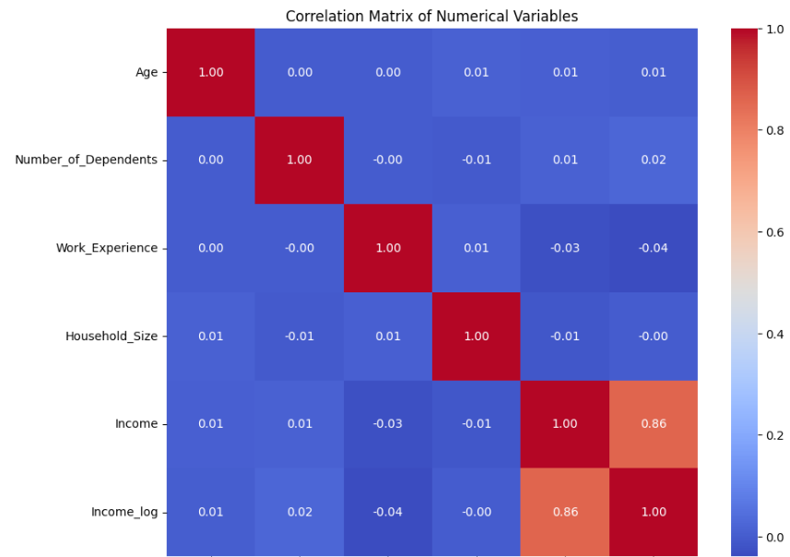
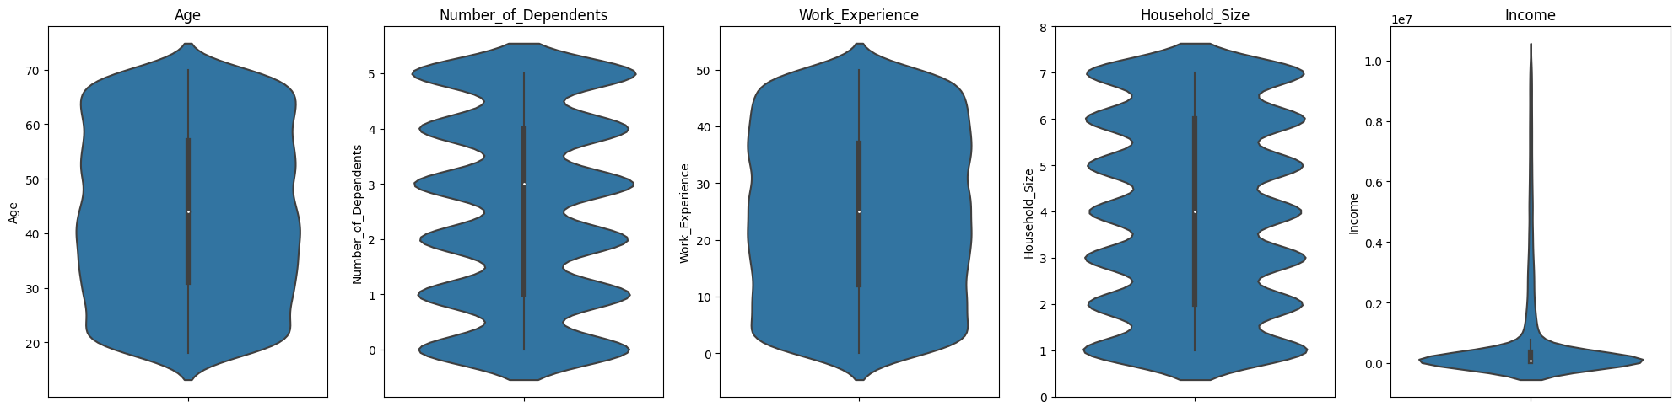
Numerical fEATURES
Income is highly skewed with significant variance
Solution: Applied logarithmic transformation to normalize.
Low correlations and minimal linear relationships with the target variable

Slide 7
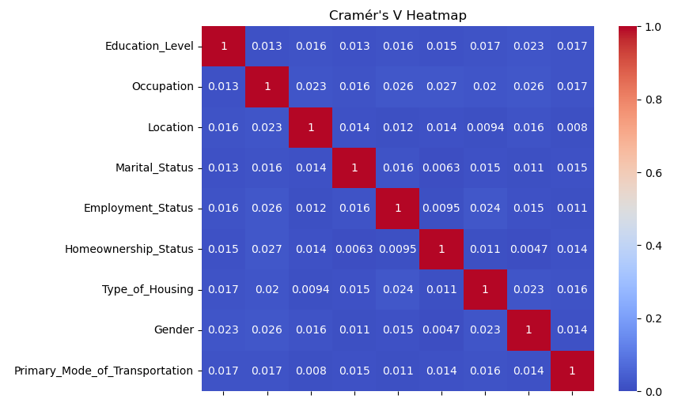
Categorical fEATURES
Distribution: The categorical features in the dataset have moderate cardinality, with the number of unique categories ranging from 2 to 5.
Correlations: Very low correlations between categorical features, indicating that they are mostly independent.

Slide 8
Modeling

Slide 9
Modeling Approach
Data Preprocessing:
One-Hot Encoding for categorical variables.
Manual encoding for ordinal features (Education Level).
Log transformation of the target variable (Income).
Model Selection:
Linear Regression, Lasso, Ridge Regression.
Decision Tree, Random Forest, XGBoost.
Evaluation Metrics:
Mean Squared Error (MSE), Mean Absolute Error (MAE), R-squared ( R² ).

Slide 10
Hyperparameter Tuning and Cross-Validation
Technique:
Grid Search with Cross-Validation (5-fold).
Stratified K-Fold using binned target variable to ensure balanced folds.
Parameters Tuned:
Regularization strengths for Lasso and Ridge.
Tree depths, number of estimators for ensemble models.
Learning rates and max depths for XGBoost.

Slide 11
Results & Findings

Slide 12
Model Results
Model | Best R² | Best MSE | Best MAE
Linear Regression | 0.03 | 2.25 | 1.20
Lasso | 0.03 | 2.25 | 1.21
Ridge | 0.03 | 2.25 | 1.21
Decision Tree | 0.05 | 2.20 | 1.17
Random Forest | 0.08 | 2.13 | 1.12
XGBoost | 0.09 | 2.11 | 1.14
All models have low R² scores (< 0.1), indicating poor predictive power.
Minimal improvement from linear models to advanced ensemble methods.
Models explain less than 10% of the variance in the target variable.*
* the low predictive power is expected due to the use of synthetic data and the limited time for in-depth exploration

Slide 13
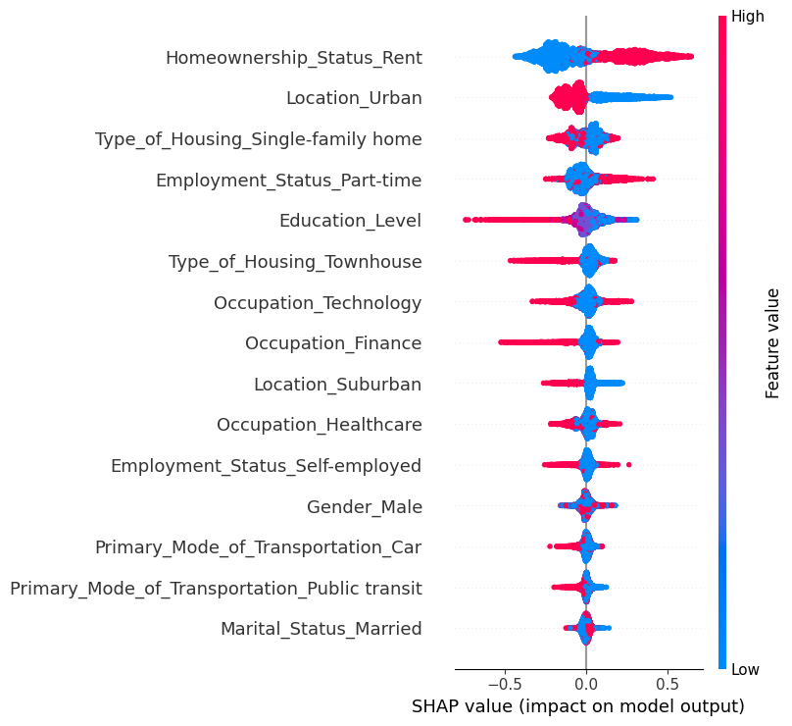
Model Interpretability – Shap Analysis
Counterintuitive Findings:
Renting associated with higher predicted income.
Part-time employment positively impacting income.
Interpretation:
Potential issues with data quality or feature-target relationships.
These could also be artifacts of the synthetic data

Slide 14
Challenges and Limitations
Synthetic Dataset Issues:
Lack of Realistic Relationships: Features may not have meaningful correlations with the target.
Randomness: Possible random assignment of values reducing model effectiveness.
Model Limitations:
Feature Independence: Low correlations make pattern recognition difficult.
Data Quality: Absence of essential predictive features.

Slide 15
Conclusions
Model Performance:
Models could not effectively predict household income using the provided features.
Data Insights:
Low explanatory power due to the nature of the synthetic data.
Interpretability Tools:
SHAP and PDPs highlighted inconsistencies and potential data issues.
Overall Assessment:
For this project, data quality played a larger role than model complexity

Slide 16
Thank you for your time

