Slide 1
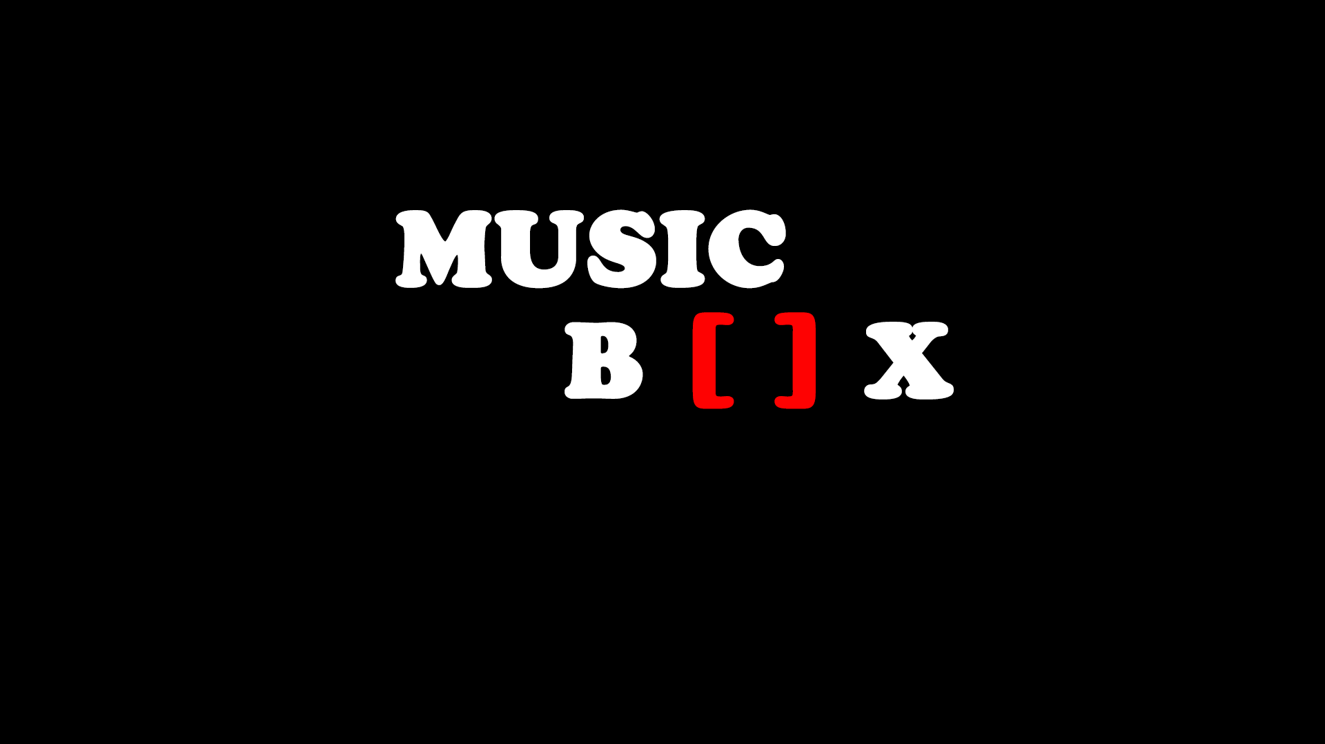

Slide 2
What is MusicBox?
MusicBox is a interactive web application for mixing music

Slide 3
What we have achieved (1)
User friendly interface
5 Sample Categories from which the user can mix music (Drums, Bass, Alarms, Melodies, Vocals)

Slide 4
What we have achieved (2)
Global Stop Button
Play / Pause Buttons that loop music

Slide 5
Problems we encountered
Track Syncing
Loop function not properly implemented in HTML5
Problems with Record / Download / Share Features

Slide 6
What we learned
Hands on experience with Javascript and HTML5
Using developing tools such as git, Atom, Sublime Text, Dreamweaver, Bluefish
Teamwork and co-operation
Time management and co-ordination

Slide 7
Any Question?
Thank you!!

