Slide 1

Data Analysis and Prediction for Prospera Bank
A Comprehensive Data Science Approach
By
Fortune Akpan

Slide 2

Introduction
This project focuses on analysing and predicting credit risk for Prospera Bank. The objective is to build a predictive model that assesses the likelihood of credit default based on customer data.

Slide 3
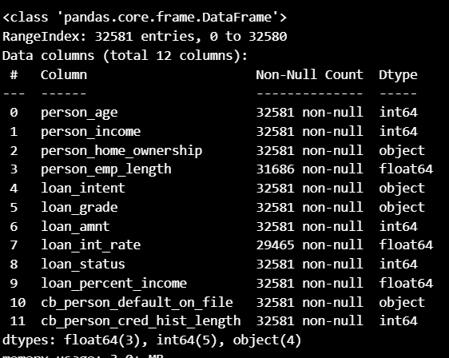
Data Overview
The dataset includes customer information relevant to credit risk analysis. Initial exploration involved viewing the data's structure, identifying missing values, and understanding feature types.

Slide 4

Data Preprocessing
Key preprocessing steps:
- Handling missing values using imputation techniques.
- Encoding categorical variables.
- Scaling numerical features for uniformity.
- Splitting data into training and testing sets.

Slide 5
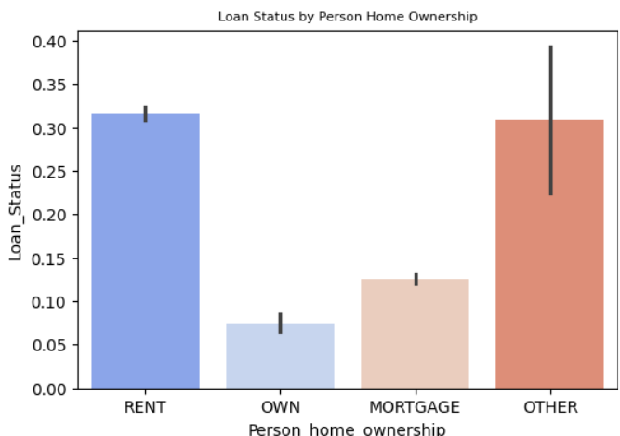
Loan Status by Home Ownership
Shows relationship between loan status and home ownership
30% of loan default are on rented apartment
5% of house owner had more financial stability

Slide 6
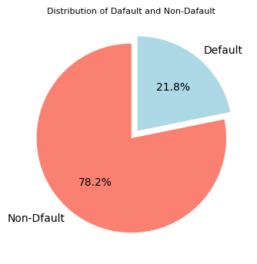
Distribution of loan Status
Encompasses total percentage of borrowers
78.2% of the borrowers repaid their loan
21.8% of the borrowers failed to repay their loan
21.8% of the defaulters need to be monitored
Minimise loan risk and improve loan performance portfolio.

Slide 7
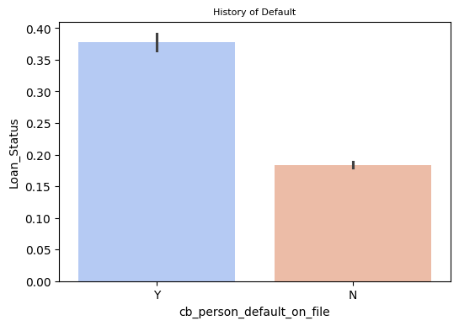
Default History
38% of the borrowers has history of not paying back their loan
20% of the borrowers paid back their loan
Repayment behaviour of an individual will be impacted by their loan history

Slide 8
Modelling
Implemented machine learning algorithms:
- Logistic Regression
- Random Forest Classifier
- XGBoost Classifier
Evaluation metrics include accuracy, ROC-AUC, and classification reports.

Slide 9
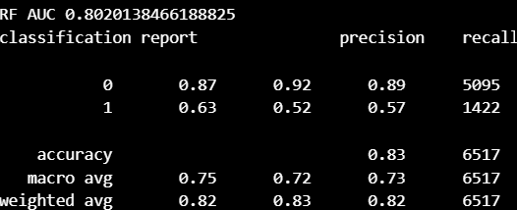
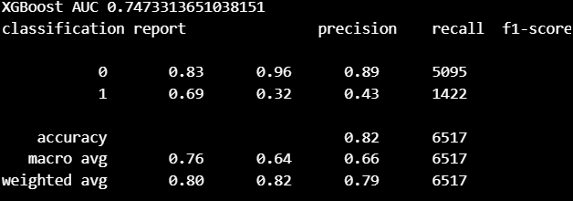
Results
The models demonstrated varying levels of performance. Key highlights:
- Accuracy and ROC-AUC scores.
- Feature importance from Random Forest and XGBoost.
Insights from the analysis can guide credit risk mitigation strategies.

Slide 10

Conclusion
This project showcased a systematic approach to predicting credit risk. The insights derived from the analysis can assist Prospera Bank in making informed decisions regarding loan approvals and risk management.

