Slide 1
EE 551 Python Neural Network on MNIST Dataset
Nan Xu
Falls 2020

Slide 2




Background
Machine/Deep Learning & Python Language
Keras/Tensorflow
Sklearn
Pytorch
Image Processing & Python Language
Matplotlib
Skimage
Opencv

Slide 3
Method

Slide 4
Work Flow
Data Preprocessing
Deep Neural Network
MNIST
Analyze the Results
Evaluation the Results
Prediction Results

Slide 5
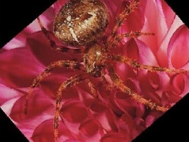

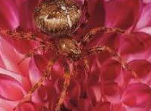
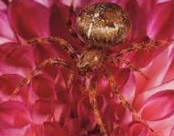
Data Preprocessing
Data Normalization
Scale pixel value to 0-1
Data Augmentation
Shifting
Flipping
Rotation

Slide 6
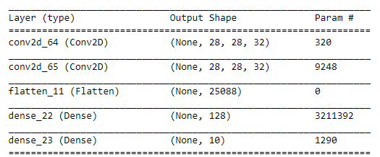
Deep Neural Network
Convolutional Neural Network
A simple 2-layers CNN
Fig. The proposed CNN model

Slide 7
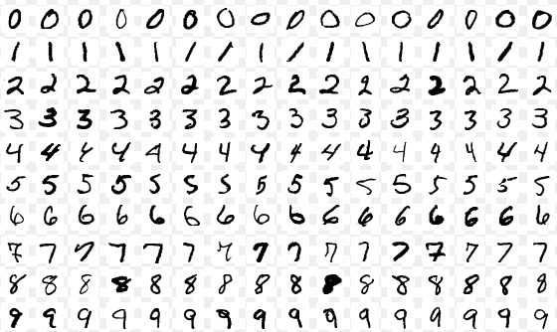
Dataset
MNIST
Train set: 60000 samples
Test set: 10000 samples
Image Size: 28 * 28
Ten Digits: 0-9
Fig. Samples of MNIST dataset [1]

Slide 8
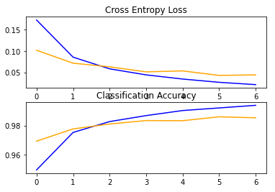
Results
Visualize the training process
Fig. The training & validation loss and accuracy of the proposed model. Blue: Training; orange: validation

Slide 9
Results
Classification results:
Accuracy: 98.57%

Slide 10
Results
Comparing with other ML algorithms
Table. Comparing with ML algorithms
Methods | Accuracy
CNN | 98.57
K-nearest Neighbor
Decision Tree
Linear Regression
Support vector machine
Gaussian Bayes

Slide 11
Discussion
Why CNN: one of the state-of-the-art approaches in solving pattern recognition problems.
Limitation of CNN: black-box algorithms

Slide 12
Reference
[1] Y. LeCun, L. Bottou, Y. Bengio, and P. Haffner. "Gradient-based learning applied to document recognition." Proceedings of the IEEE, 86(11):2278-2324, November 1998

