Slide 1
课程专题一：标签学习

Slide 2
Naïve Bayes
标签学习

Slide 3

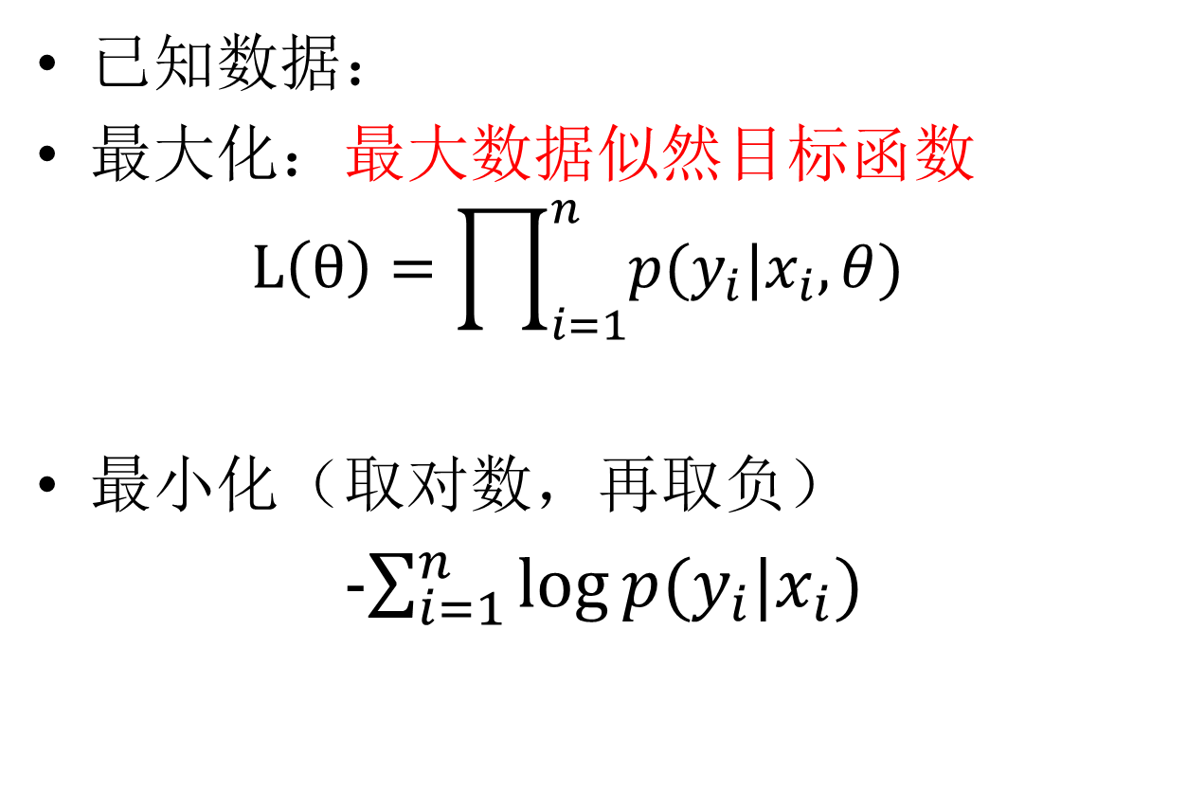
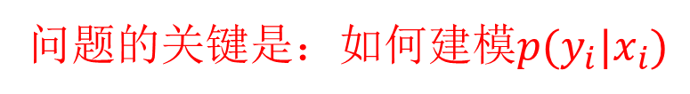
以概率思想建模的监督学习方法
已知数据：
最大化：最大数据似然目标函数
$$L\left(θ\right)=\prod_{i=1}^{n}{p(y_{i}|x_{i},θ)}$$
最小化（取对数，再取负）
-$\sum_{i=1}^{n}{\log{p(y_{i}|x_{i})}}$
问题的关键是：如何建模$p(y_{i}|x_{i})$

Slide 4


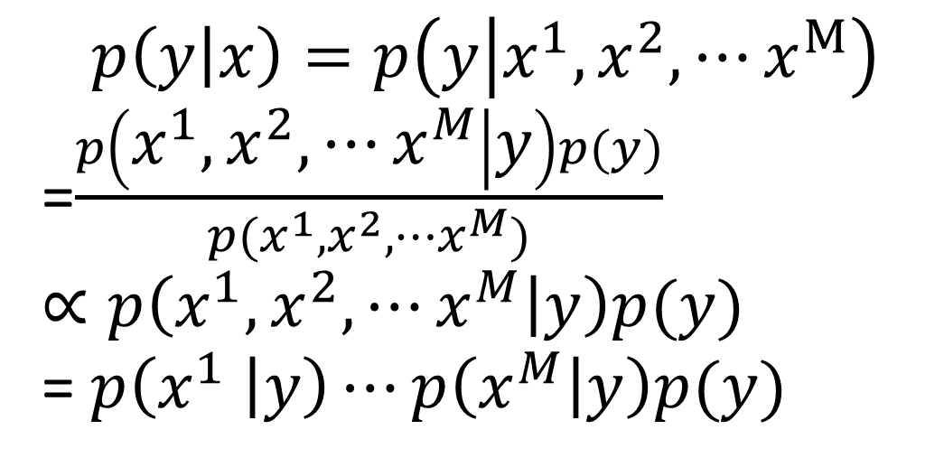
$p(y|x)$的建模
Logistic Regression：假设x的每维为实数
Naïve Bayes
$$p\left(y | x\right)=p\left(y | x^{1},x^{2},⋯x^{M}\right)$$
=$\frac{p\left(x^{1},x^{2},⋯x^{M} | y\right)p(y)}{p(x^{1},x^{2},⋯x^{M})}$
$$∝p\left(x^{1},x^{2},⋯x^{M} | y\right)p(y)$$
= $p\left(x^{1} | y\right)⋯p\left(x^{M} | y\right)p(y)$
条件独立性假设

Slide 5
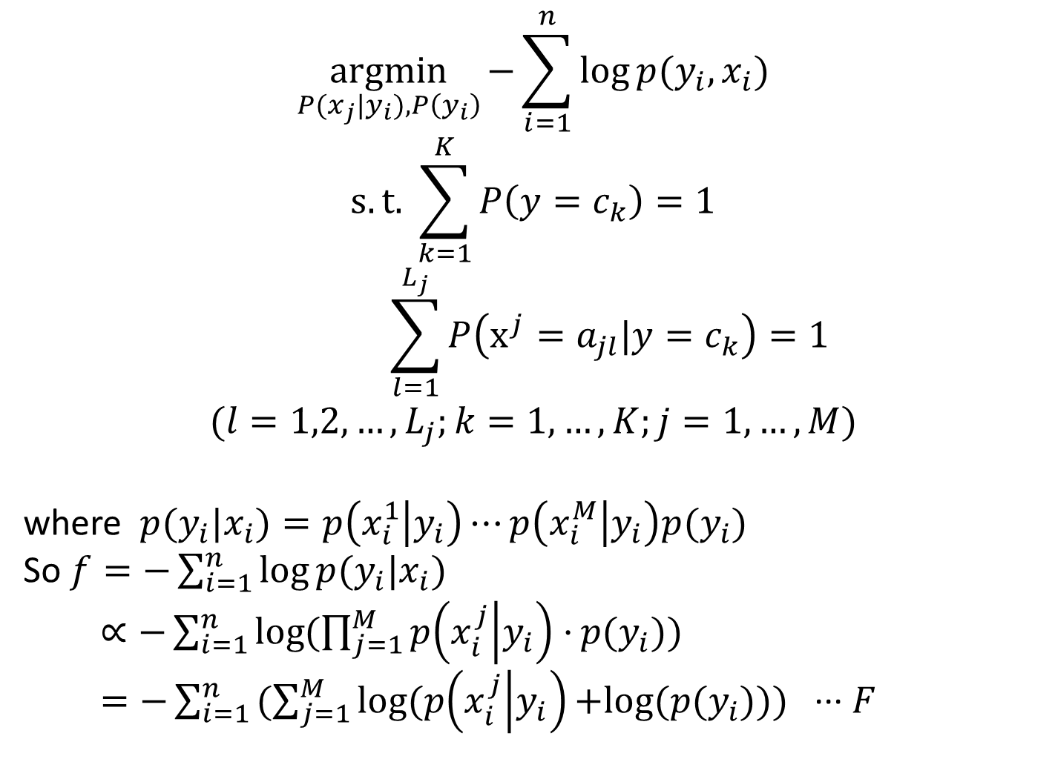
拉格朗日 乘数法
$$\underset{P(x_{j}|y_{i}),P\left(y_{i}\right)}{argmin}{\text{−}\sum_{i=1}^{n}{\log{p(y_{i},x_{i})}}}$$
$$s.t. \sum_{k=1}^{K}{P\left(y=c_{k}\right)}=1$$
$$\sum_{l=1}^{L_{j}}{P\left(x^{j}=a_{jl}|y=c_{k}\right)}=1$$
$$(l=1,2,…,L_{j};k=1,…,K;j=1,…,M)$$
where $p(y_{i}|x_{i})=p\left(x_{i}^{1} | y_{i}\right)⋯p\left(x_{i}^{M} | y_{i}\right)p(y_{i})$
So $f=\text{−}\sum_{i=1}^{n}{\log{p(y_{i}|x_{i})}}$
$∝\text{−}\sum_{i=1}^{n}{\log{(\prod_{j=1}^{M}{p\left(x_{i}^{j} | y_{i}\right)·}p(y_{i}))}}$
$=\text{−}\sum_{i=1}^{n}{(\sum_{j=1}^{M}{log⁡(p\left(x_{i}^{j} | y_{i}\right)}{+log(p(y_{i}))}) }$ ··· $F$
每维的属性均为枚举型数值
Notes:
Try Again for 拉格朗日

Slide 6
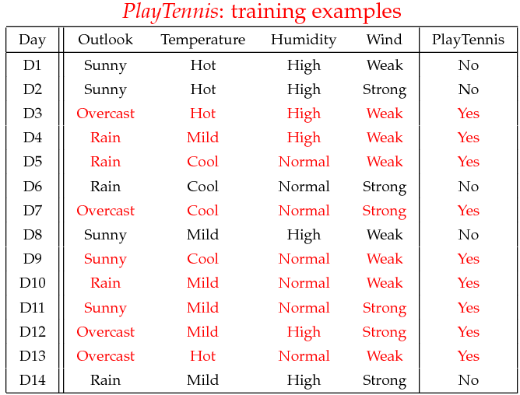
实例：参数学习
Play Tennis：离散型的属性值

Slide 7
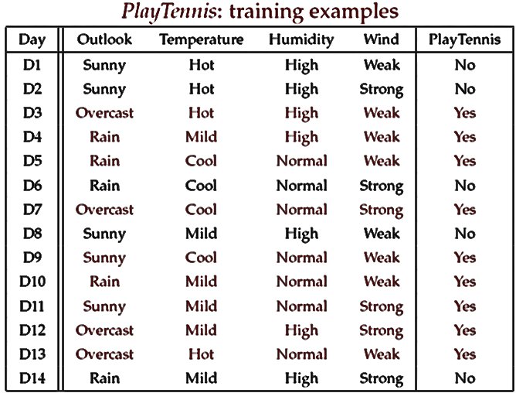

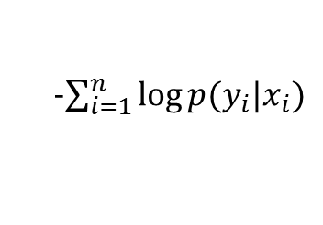
实例：参数学习
参数学习：counting
$$p\left(y=c_{k}\right)=\frac{\sum_{i=1}^{N}{I(y_{i}=c_{k})}}{N}$$
$其中，I(y_{i}=c_{k})\text{为}指示\text{函数}$，即：
$$I\left(x\right)=\left\{\begin{aligned}&1, x成立 \\ &0, x不成立\end{aligned}\right.$$
例如：
$$p\left(play=yes\right)=\frac{\sum_{i=1}^{N}{I(play=yes)}}{N}=\frac{9}{14}$$
-$\sum_{i=1}^{n}{\log{p(y_{i}|x_{i})}}$

Slide 8

实例：参数学习
Humidity | Play=Yes | Play=No
High | ? | 4/5
Normal | 6/9 | 1/5
参数学习：counting
设M维特征的第j维有L个取值，则某维特征的某个取值为$a_{jl}$，
则在给定某分类$c_{k}$下的条件概率$P\left(x^{i} | y=c_{k}\right)$为：
$$p\left(x^{j}=a_{jl}|y=c_{k}\right)=\frac{\sum_{i=1}^{N}{I({x_{i}^{j}=a_{jl},y}_{i}=c_{k})}}{\sum_{i=1}^{N}{I(y_{i}=c_{k})}}$$
例如：
$$p\left(Humidity=High|Play=Yes\right)$$
$$=\frac{\{Humidity=High且Play=Yes\}的个数}{\{Play=Yes\}的个数}=\frac{3}{9}$$

Slide 9
实例：参数学习
参数学习：counting
Outlook | Play=Yes | Play=No
Sunny | 2/9 | 3/5
Overcast | 4/9 | 0/5
Rain | 3/9 | 2/5
Humidity | Play=Yes | Play=No
High | 3/9 | 4/5
Normal | 6/9 | 1/5
Temperature | Play=Yes | Play=No
Hot | 2/9 | 2/5
Mild | 4/9 | 2/5
Cool | 3/9 | 1/5
Wind | Play=Yes | Play=No
Strong | 3/9 | 3/5
Weak | 6/9 | 2/5
P(Play=Yes) = 9/14
P(Play=No) = 5/14
最大化数据似然的解析解！
思考：参数个数？

Slide 10

Naïve Bayes预测
对于给定的x：
$$\hat{y}=\underset{y}{argmax}{p(y|x)}$$
=$\underset{y}{argmax} p\left(x^{1} | y\right)⋯p\left(x^{m} | y\right)p(y)$

Slide 11
实例：预测
预测
给定样本
x’=(Outlook=Sunny, Temperature=Cool, Humidity=High, Wind=Strong)
查表
Outlook | Play=Yes | Play=No
Sunny | 2/9 | 3/5
Overcast | 4/9 | 0/5
Rain | 3/9 | 2/5
Humidity | Play=Yes | Play=No
High | 3/9 | 4/5
Normal | 6/9 | 1/5
Temperature | Play=Yes | Play=No
Hot | 2/9 | 2/5
Mild | 4/9 | 2/5
Cool | 3/9 | 1/5
Wind | Play=Yes | Play=No
Strong | 3/9 | 3/5
Weak | 6/9 | 2/5

Slide 12
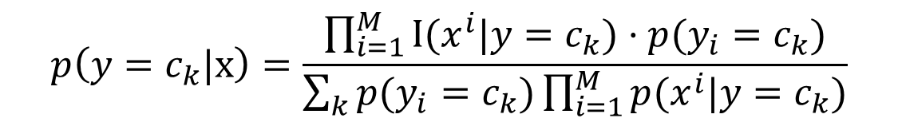
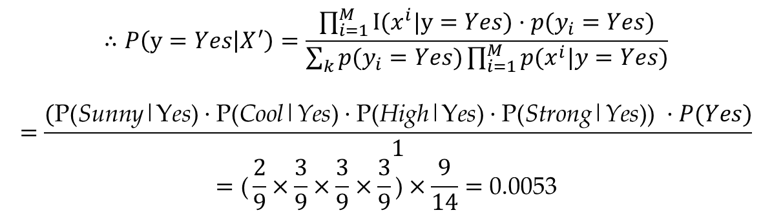
x’=(Outlook=Sunny, Temperature=Cool, Humidity=High, Wind=Strong)
P(Outlook=Sunny|Play=Yes) = 2/9
P(Temperature=Cool|Play=Yes) = 3/9
P(Huminity=High|Play=Yes) = 3/9
P(Wind=Strong|Play=Yes) = 3/9
P(Play=Yes) = 9/14
P(Outlook=Sunny|Play=No) = 3/5
P(Temperature=Cool|Play==No) = 1/5
P(Huminity=High|Play=No) = 4/5
P(Wind=Strong|Play=No) = 3/5
P(Play=No) = 5/14
$$p\left(y=c_{k}|x\right)=\frac{\prod_{i=1}^{M}{I({x^{i}|y=c_{k})·p(y}_{i}=c_{k})}}{\sum_{k}{p(y_{i}=c_{k})\prod_{i=1}^{M}{p(x^{i}|y=c_{k})}}}$$
$$∴P\left(y=Yes | X^{′}\right)=\frac{\prod_{i=1}^{M}{I({x^{i}|y=Yes)·p(y}_{i}=Yes)}}{\sum_{k}{p(y_{i}=Yes)\prod_{i=1}^{M}{p(x^{i}|y=Yes)}}}$$
$$=\frac{(\text{P}\text{(}\text{Sunny}\text{|}\text{Y}\text{es}\text{)}·\text{P}\text{(}\text{Cool}\text{|}\text{Yes}\text{)}·\text{P}\text{(}\text{High}\text{|}\text{Y}\text{es}\text{)}·\text{P}\text{(}\text{Strong}\text{|}\text{Yes}\text{)}\text{) }·P(Yes)}{1}$$
$$=\text{(}\frac{2}{9}×\frac{3}{9}×\frac{3}{9}×\frac{3}{9}\text{)}×\frac{9}{14}=\text{0.0053}$$

Slide 13
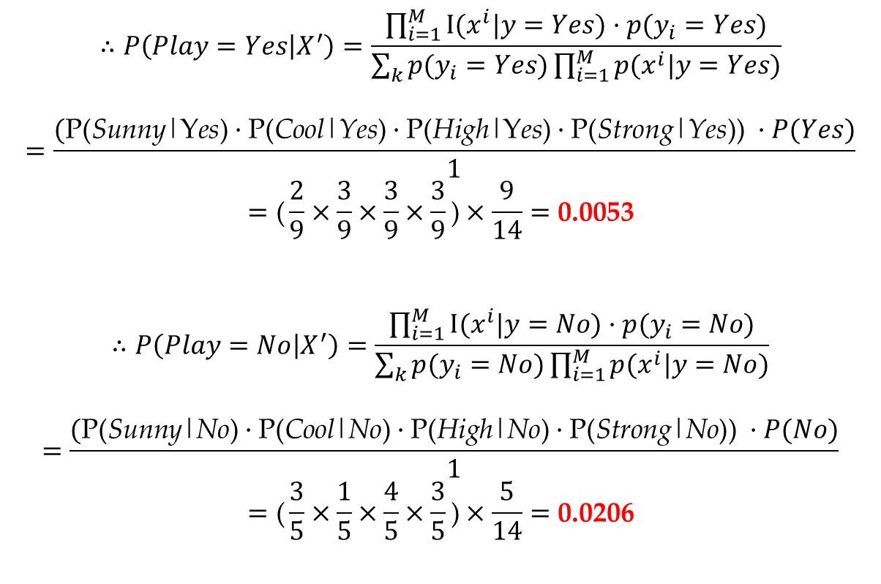
$$∴P\left(Play=Yes | X^{′}\right)=\frac{\prod_{i=1}^{M}{I({x^{i}|y=Yes)·p(y}_{i}=Yes)}}{\sum_{k}{p(y_{i}=Yes)\prod_{i=1}^{M}{p(x^{i}|y=Yes)}}}$$
$$=\frac{(\text{P}\text{(}\text{Sunny}\text{|}\text{Y}\text{es}\text{)}·\text{P}\text{(}\text{Cool}\text{|}\text{Yes}\text{)}·\text{P}\text{(}\text{High}\text{|}\text{Y}\text{es}\text{)}·\text{P}\text{(}\text{Strong}\text{|}\text{Yes}\text{)}\text{) }·P(Yes)}{1}$$
$$=\text{(}\frac{2}{9}×\frac{3}{9}×\frac{3}{9}×\frac{3}{9}\text{)}×\frac{9}{14}=\text{0.0053}$$
$$∴P\left(Play=No | X^{′}\right)=\frac{\prod_{i=1}^{M}{I({x^{i}|y=No)·p(y}_{i}=No)}}{\sum_{k}{p(y_{i}=No)\prod_{i=1}^{M}{p(x^{i}|y=No)}}}$$
$$=\frac{(\text{P}\text{(}\text{Sunny}\text{|}\text{No}\text{)}·\text{P}\text{(}\text{Cool}\text{|}\text{No}\text{)}·\text{P}\text{(}\text{High}\text{|}\text{No}\text{)}·\text{P}\text{(}\text{Strong}\text{|}\text{No}\text{)}\text{) }·P(No)}{1}$$
$$=\text{(}\frac{3}{5}×\frac{1}{5}×\frac{4}{5}×\frac{3}{5}\text{)}×\frac{5}{14}=\text{0.0206}$$
Given the fact P(Yes|x’) < P(No|x’), we label x’ to be “No”.

Slide 14

Naïve Bayes：考虑连续值属性
$建模p\left(x^{j} | y\right)$：$x^{j}$为连续值
通常的方法是：假设$p\left(x^{j} | y\right)$服从正态分布
思考：参数个数？

