Slide 1
课程专题一：单变量学习

Slide 2
Ensemble methods
Notes:
http://ciml.info/

Slide 3
Motivation and Objective
Groups of people can usually make better decisions than individuals, especially group members each have their own biases.
To learn various ways of combining base learners into ensembles
Notes:
分歧终端机

Slide 4
Voting Multiple Classifiers
Majority voting
To obtain multiple different classifiers
Change the learning algorithms
Change the data sets
Basic idea
The main advantage of ensembles of different classifiers is that it is unlikely that all classifiers will make the same mistake. In fact, as long as every error is made by a minority of the classifiers, you will achieve optimal classification!
Unfortunately, the inductive biases of different learning algorithms are highly correlated.
Need a classification algorithm that tends to be very sensitive to small changes in the training data

Slide 5

Change Data Sets
Bagging
Bootstrap resampling: sampling with replacement
没有被采样到的概率
Notes:
分歧终端机

Slide 6
Random Forests
Generates each of the K trees independently, which makes it very easy to parallelize
For each trees, it constructs a full binary tree of depth depth
Features are randomly selected with replacement
Random feature splits
Why it works well (intuitive explanation)
Some of the trees will query on useless features. These trees will essentially make random predictions. But some of the trees will happen to query on good features and will make good predictions. If you have enough trees, the random ones will wash out as noise, and only the good trees will have an effect on the final classification.
Notes:
分歧终端机

Slide 7
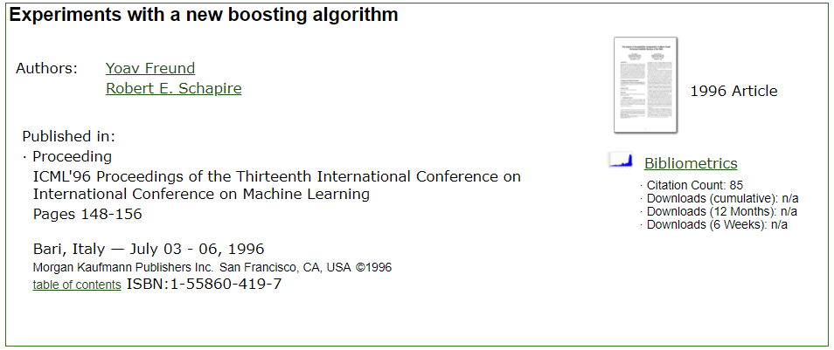
Boosting: AdaBoost

Slide 8
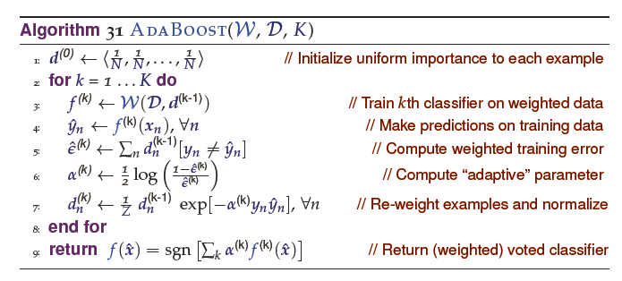

Boosting: AdaBoost

Slide 9
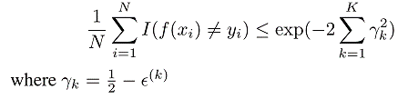
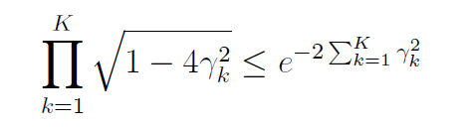
Boosting: AdaBoost重要性质
训练误差的上界
作业：基于如下的引理，证明此结论。

