Slide 1

概率图模型
建模方法
教材第14章

Slide 2
Bayesian networks

Slide 3
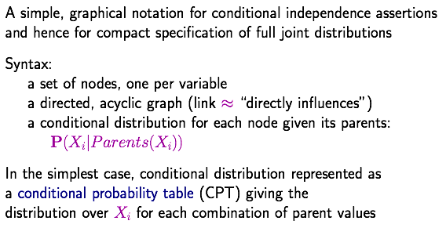
Bayesian networks

Slide 4
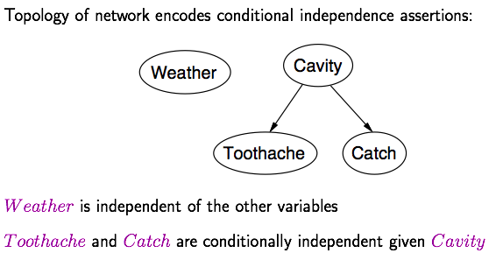
Example

Slide 5
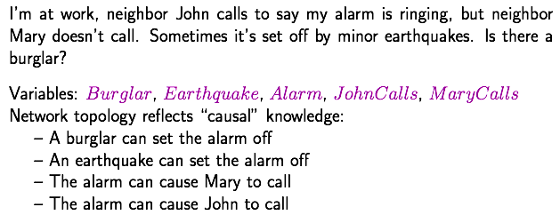
Example

Slide 6
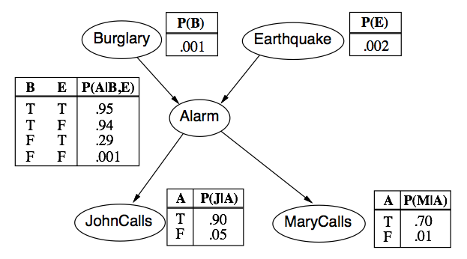
Example

Slide 7
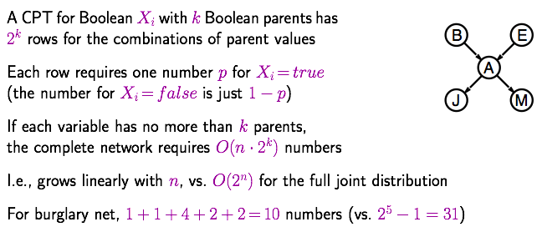
Compactness

Slide 8
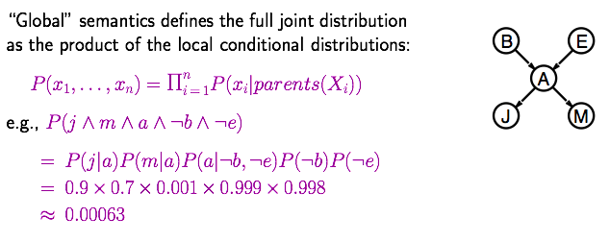
Global semantics

Slide 9
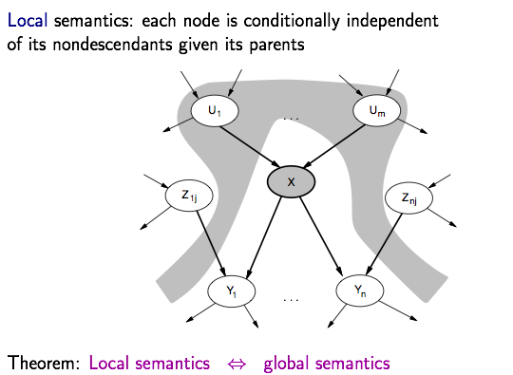
Local semantics

Slide 10
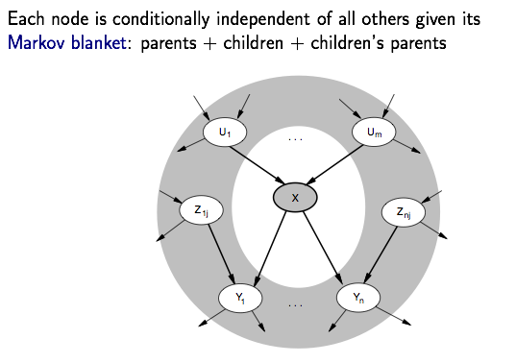
Markov blanket

Slide 11
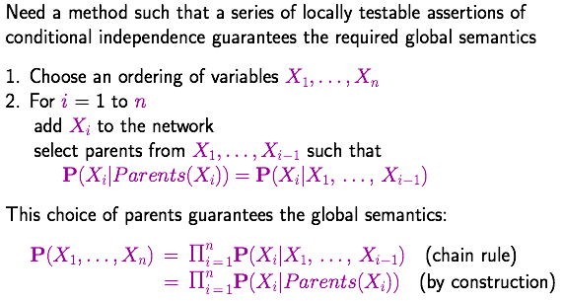
Constructing Bayesian networks
X1…Xn顺序很重要，此处假设已知

Slide 12
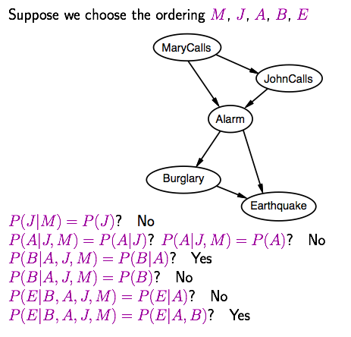
Example

Slide 13
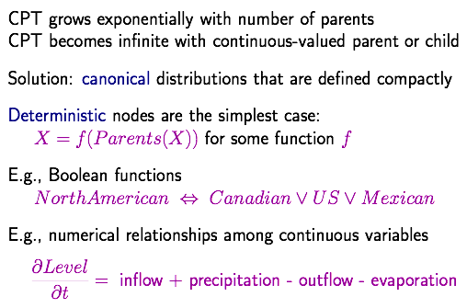
Compact conditional distributions
确定性关系 大大简化

Slide 14
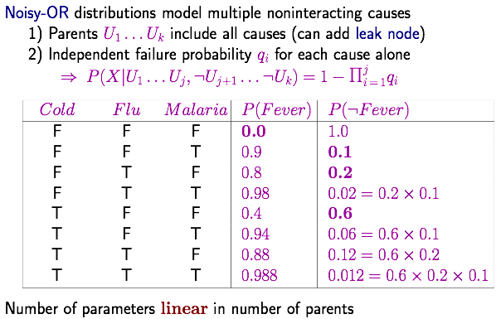
Compact conditional distributions contd.

Slide 15
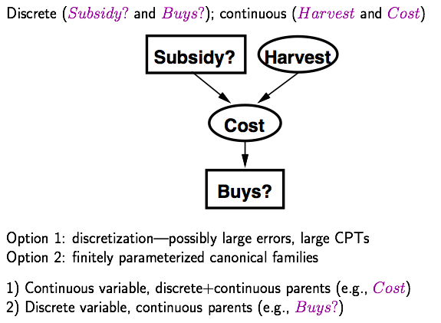
Hybrid (discrete+continuous) networks
把连续性变量切分成几个区域，变成离散型

Slide 16
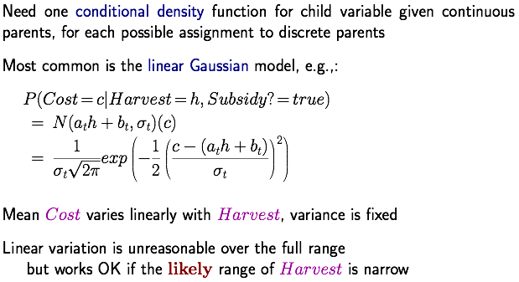
Continuous child variables
连续性parent给了，对离散型parent的每一个取值，都要建立概率密度函数
at<0, 产量越大，价格越低

Slide 17
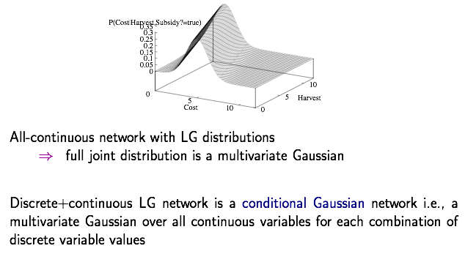
Continuous china variables

Slide 18
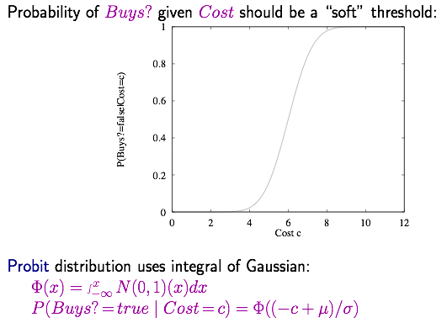
Discrete variable w/ continuous parents

Slide 19
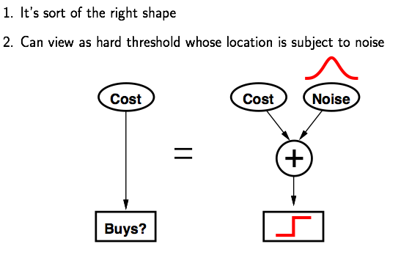
Why the probit?

Slide 20
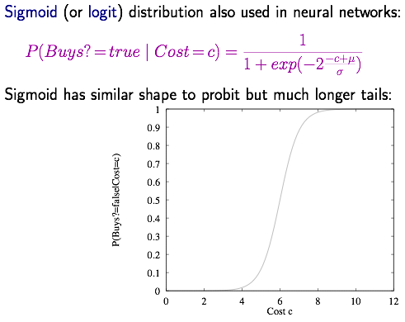
Discrete variable contd.

