Slide 1

有向概率图模型
推理
教材第14章

Slide 2
Inference in Bayesian networks

Slide 3
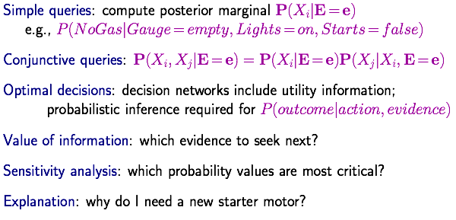
Inference tasks

Slide 4
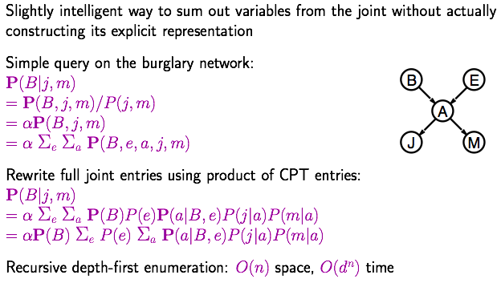
Exact inference
Inference by enumeration

Slide 5
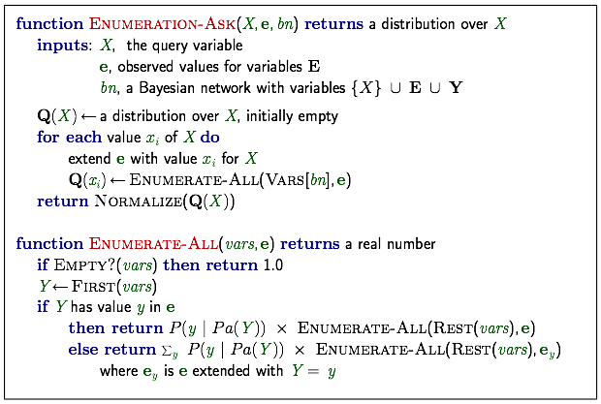
Enumeration algorithm

Slide 6
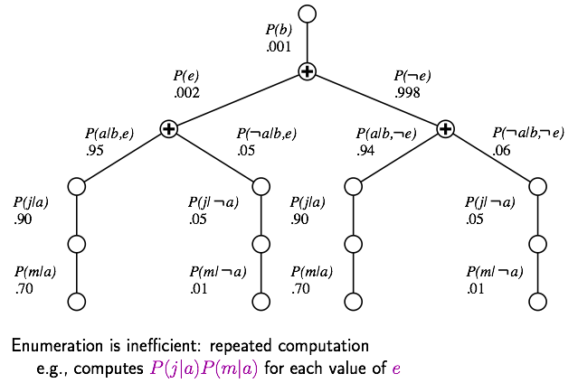
Evaluation tree

Slide 7
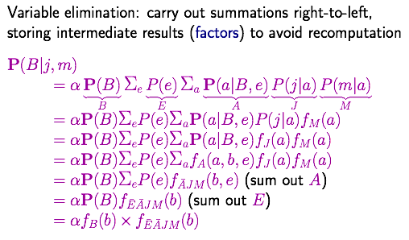
Inference by variable elimination

Slide 8
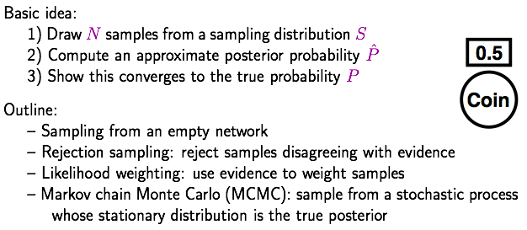
Approximate inference
Inference by stochastic simulation

Slide 9
About random number generation
How to generate a discrete distribution from the uniform distribution?
given U[0,1]
generate A 30%, B 60%, C 10%

Slide 10
About random number generation
How to generate a continuous distribution from the uniform distribution?
given U[0,1]
generate N(0,1)

Slide 11
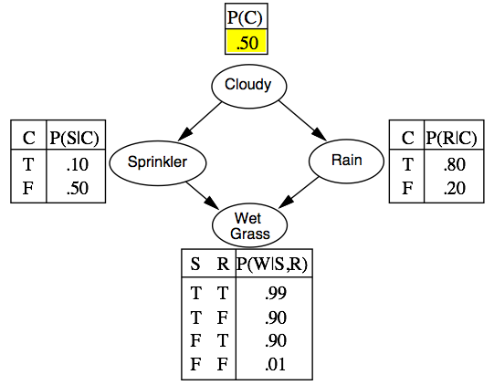
Sampling from an empty network

Slide 12
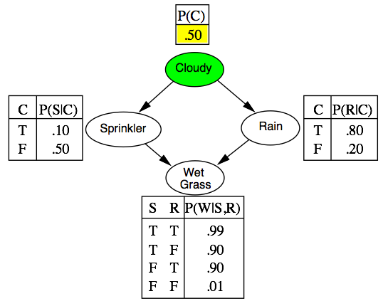
Sampling from an empty network

Slide 13
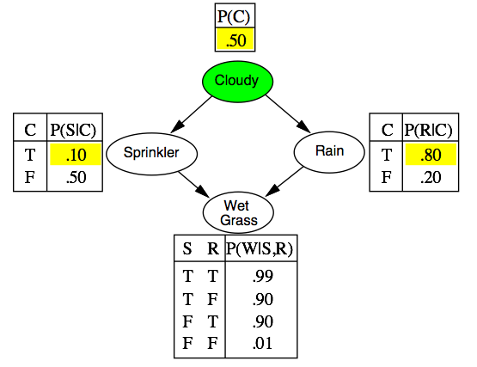
Sampling from an empty network

Slide 14
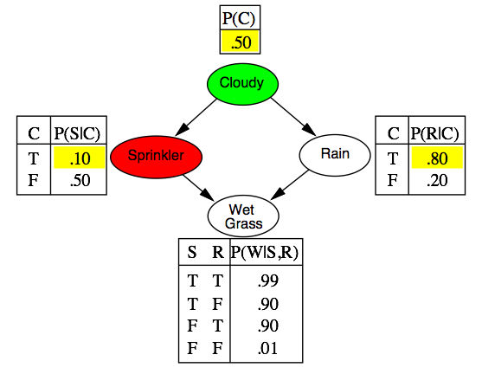
Sampling from an empty network

Slide 15
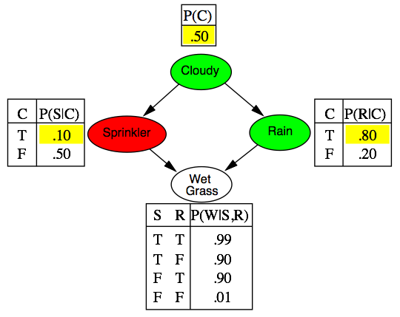
Sampling from an empty network

Slide 16
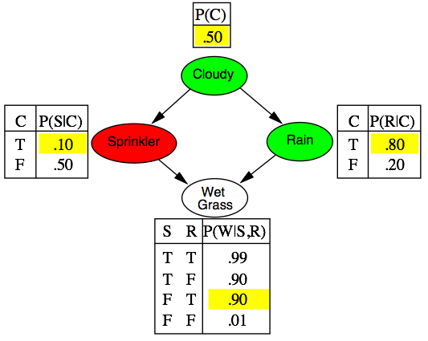
Sampling from an empty network

Slide 17
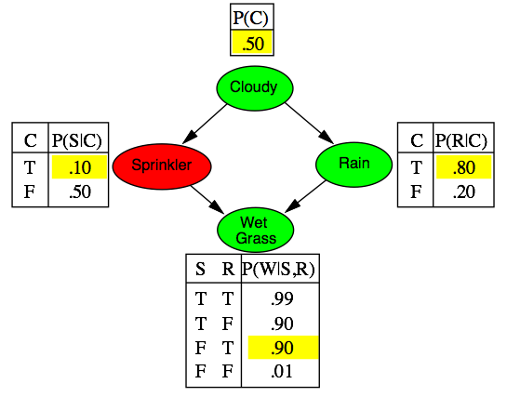
Sampling from an empty network

Slide 18
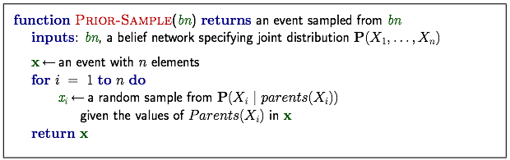
Sampling from an empty network

Slide 19
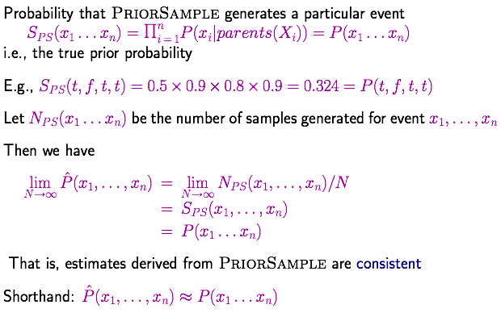
Sampling from an empty network contd.

Slide 20
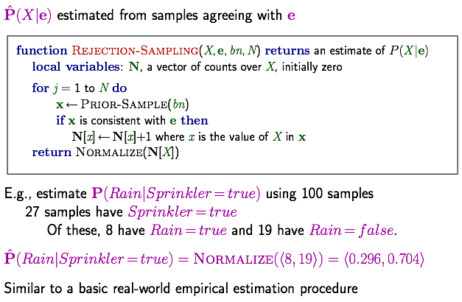
Conditional Probability: Rejection sampling

Slide 21
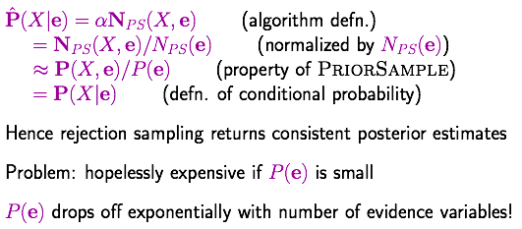
Analysis of rejection sampling

