Slide 1
Back Propagation Algorithm

Slide 2


求导基本法则
链式法则
多元复合函数求导法则
$$z=f\left(y_{1},y_{2},⋯,y_{k}\right)$$
$y_{1}$= $g_{1}\left(x\right),y_{2}\text{= }g_{2}\left(x\right),⋯,$ $y_{k}\text{= }g_{k}\left(x\right)$
$$\frac{∂z}{∂x}=\sum_{i=1}^{k}{\frac{∂z}{∂y_{i}}\frac{∂y_{i}}{∂x}}$$

Slide 3
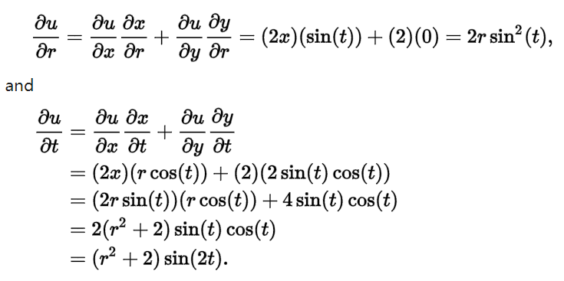
求导：例子
Given u(x, y) = x² + 2y where x(r, t) = r sin(t) and y(r,t) = sin²(t), determine the value of ∂u / ∂r and ∂u / ∂t using the chain rule.

Slide 4
计算图
a
入边
节点
出边
节点
c = a+b 的计算图
b
+
c
节点
操作
节点
y = sigmoid(x) 的计算图
父亲
节点
操作
孩子
节点
节点
x
sigmoid
y

Slide 5
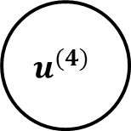
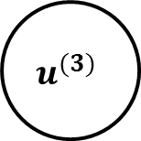
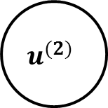
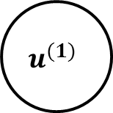
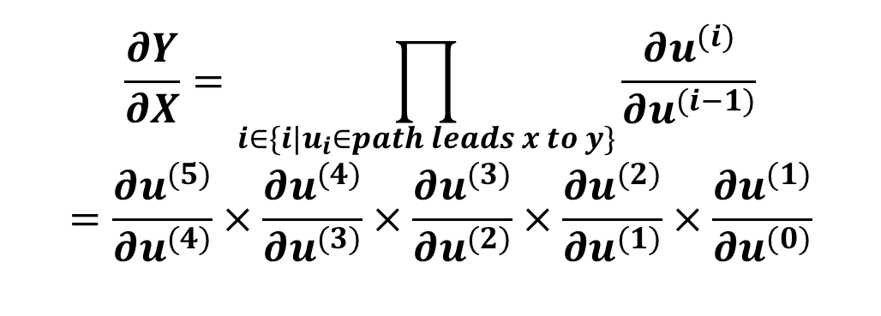
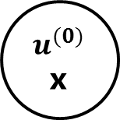
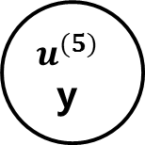
Calculate gradient with path（Chain Rule）
$$u^{(0)}$$ x
$$u^{(1)}$$
$$\frac{∂Y}{∂X}=\prod_{i∈\{i|u_{i}∈path leads x to y\}}{\frac{∂u^{(i)}}{∂u^{(i−1)}}}$$
$$=\frac{∂u^{(5)}}{∂u^{(4)}}×\frac{∂u^{(4)}}{∂u^{(3)}}×\frac{∂u^{(3)}}{∂u^{(2)}}×\frac{∂u^{(2)}}{∂u^{(1)}}×\frac{∂u^{(1)}}{∂u^{(0)}}$$
$$u^{(3)}$$
$$u^{(2)}$$
$$u^{(4)}$$
$$u^{(5)}$$
y

Slide 6
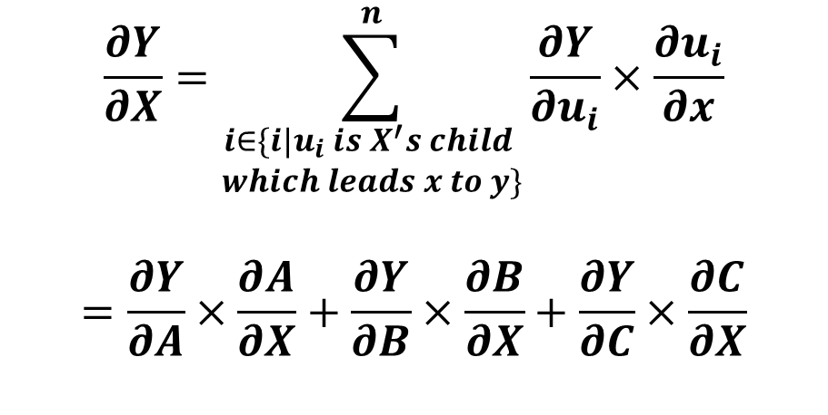
Calculate gradient with multiple children
子节点A
···
操作a
$$\frac{∂Y}{∂X}=\sum_{\begin{aligned}i∈\{i|u_{i} is X^{′}s child \\ which leads x to y\}\end{aligned}}^{n}{\frac{∂Y}{∂u_{i}}×\frac{∂u_{i}}{∂x}}$$
$$=\frac{∂Y}{∂A}×\frac{∂A}{∂X}+\frac{∂Y}{∂B}×\frac{∂B}{∂X}+\frac{∂Y}{∂C}×\frac{∂C}{∂X}$$
节点X
操作b
子节点B
节点Y
···
操作d
子节点D
操作c
子节点C
···

Slide 7
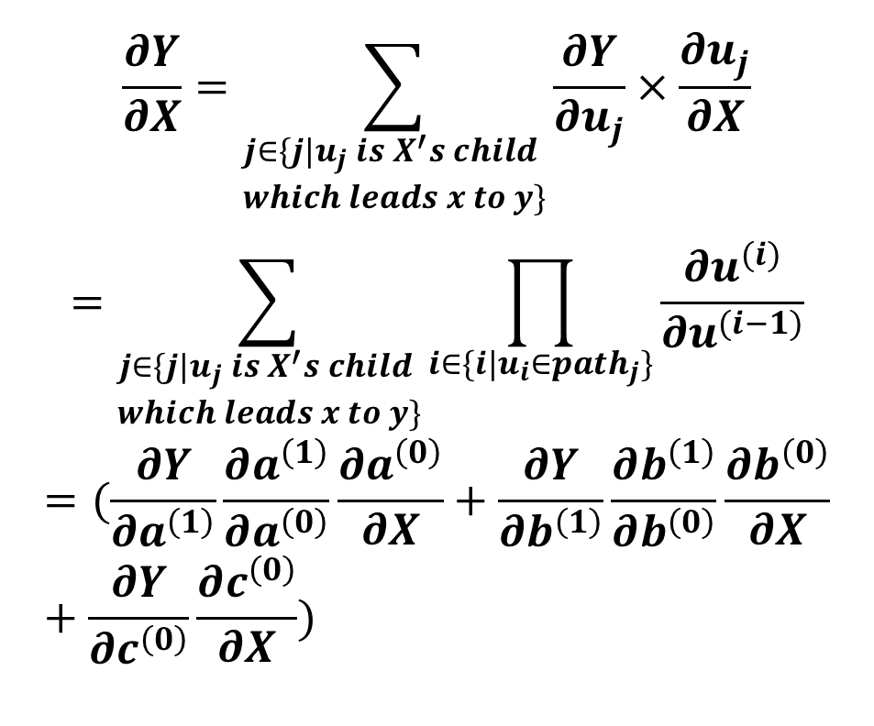
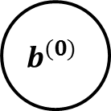
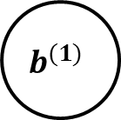
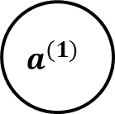
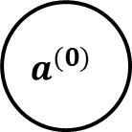

Sum up
$$\frac{∂Y}{∂X}=\sum_{\begin{aligned}j∈\{j|u_{j} is X^{′}s child \\ which leads x to y\}\end{aligned}}{\frac{∂Y}{∂u_{j}}×\frac{∂u_{j}}{∂X}}$$
$$=\sum_{\begin{aligned}j∈\{j|u_{j} is X^{′}s child \\ which leads x to y\}\end{aligned}}{\prod_{i∈\{i|u_{i}∈{path}_{j}\}}{\frac{∂u^{(i)}}{∂u^{(i−1)}}}}$$
$$=(\frac{∂Y}{∂a^{\left(1\right)}}\frac{∂a^{\left(1\right)}}{∂a^{\left(0\right)}}\frac{∂a^{\left(0\right)}}{∂X}+\frac{∂Y}{∂b^{\left(1\right)}}\frac{∂b^{\left(1\right)}}{∂b^{\left(0\right)}}\frac{∂b^{\left(0\right)}}{∂X}+\frac{∂Y}{∂c^{\left(0\right)}}\frac{∂c^{\left(0\right)}}{∂X})$$
$$a^{(0)}$$
$$a^{(1)}$$
X
$$b^{(0)}$$
$$b^{(1)}$$
Y
$$c^{(0)}$$
其中，${path}_{j}$是以节点$u_{j}为$起点，最终可以到达Y节点的一条路径
Notes:
通过非递归地扩展和重写递归链式法则得出的：路径求和法

Slide 8
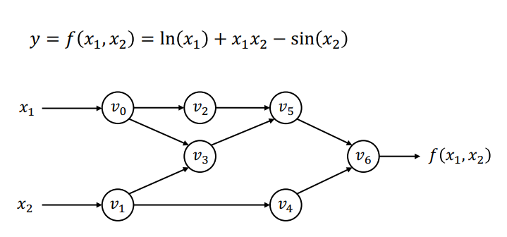
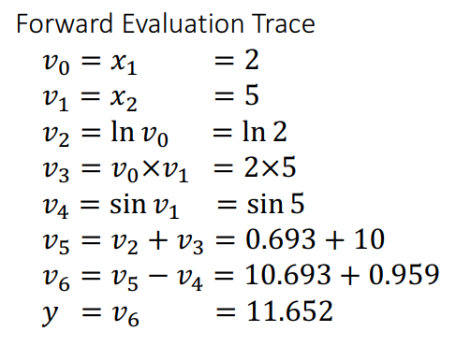





通用计算图网络（举例）
$$ln$$
$+$
$×$
$−$
$$sin$$
Reference: http://dlsys.cs.washington.edu

Slide 9
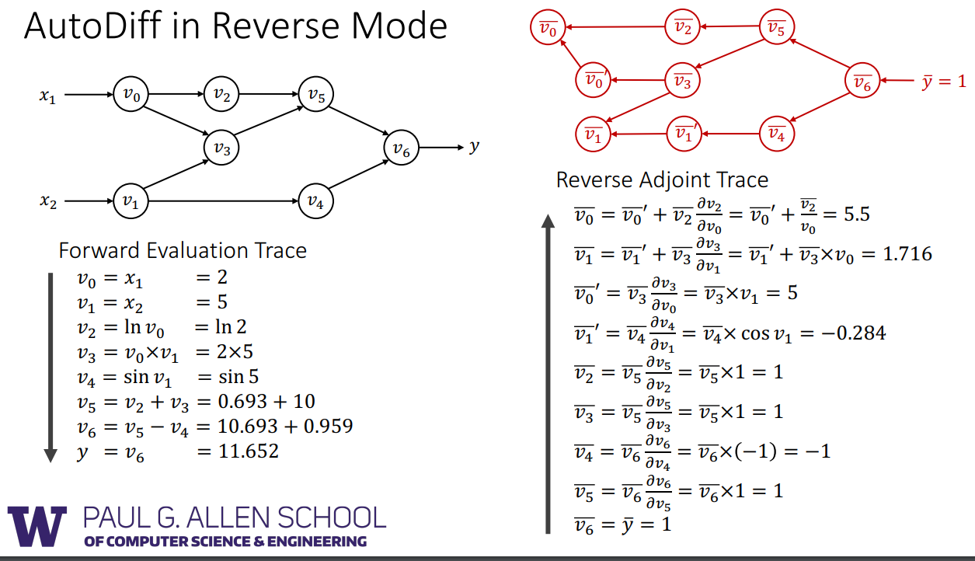

通用计算图网络（举例）
$\overline{v}$:= ∂y/∂v
Reference: http://dlsys.cs.washington.edu

Slide 10
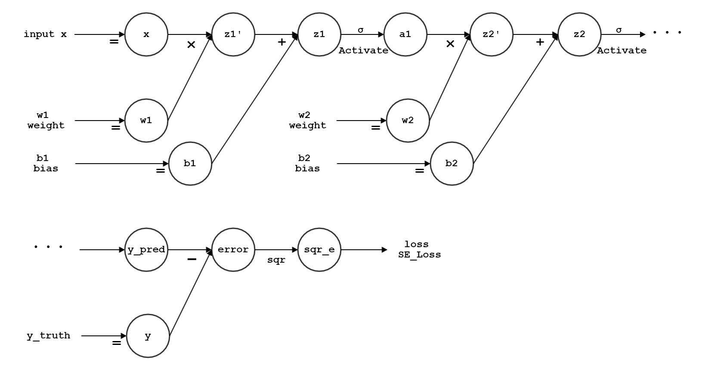
前馈神经网络
输入 x
激活函数 σ
激活函数 σ：常见的如 relu, sigmoid, tanh等
系数矩阵W：神经网络中需要学习的部分，权重(weight)矩阵W与向量 x 相乘，
再加上偏移(bias)矩阵 b，以获得新的向量

Slide 11

前馈神经网络
输出 y
Loss Function:
SE_Loss = (y - y_pred)²
Learning: $W_{k}=W_{k} −α∙∂loss/∂W_{k}$

Slide 12
1.0
0.5
1.0
0.73
0.73
1.0
0.5
1.0
0.5
v
1.0
grad: ∂y/ ∂v
vertical_name
value: forward
0.5
0.27
=
0.73
0.5
0.25
0.25
（前向过程）
sqr_e = error² = 0.5 * 0.5 = 0.25
error = y_pred - y = 0.73 – 0.23 = 0.5
Now Calculating:
y_pred = sigmoid(z2) = 1/(1+exp(-1)) ≈ 0.73
z1’ = w1 * x = 1.0 * 0.5 = 0.5
a1 = sigmoid(z1) = 1/(1+exp(-1)) ≈ 0.73
z1 = z1’ + b1 = 0.5 + 0.5 = 1.0
z2 = z2’ + b2 = 0.73 + 0.27 = 1.0
z2’ = w2 * a1 = 1.0 * 0.73 = 0.73
0.23

Slide 13
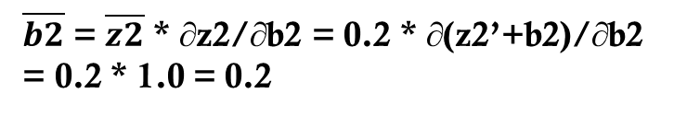
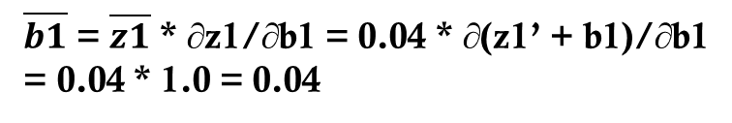
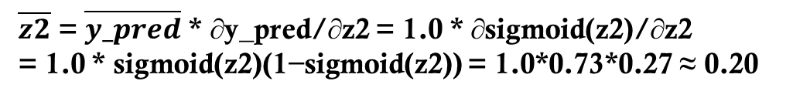
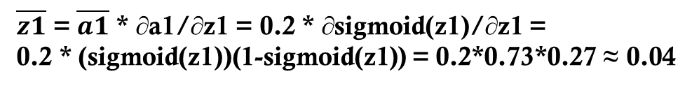
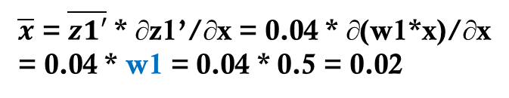
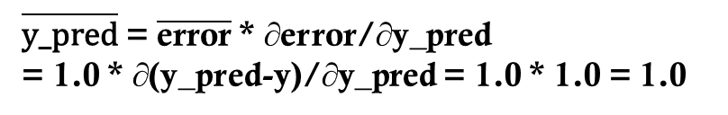
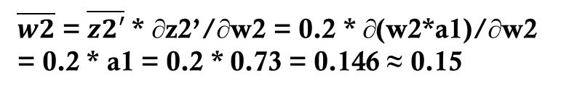
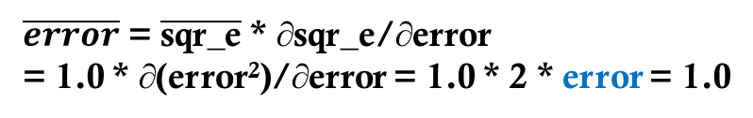
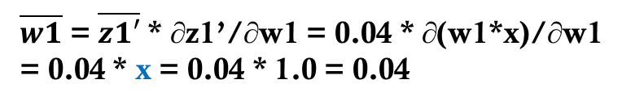

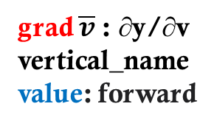
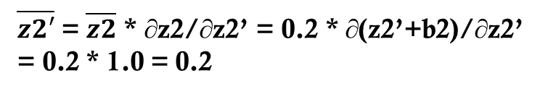
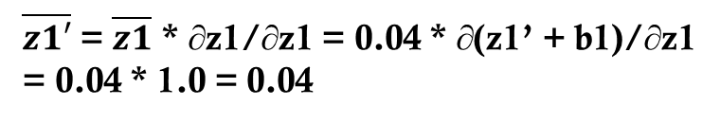
0.02
0.04
0.04
0.20
0.20
0.20
1.0
0.5
1.0
0.73
0.73
1.0
0.04
0.15
0.5
1.0
0.04
0.20
0.5
v
1.0
grad $\overline{v}$: ∂y/∂v
vertical_name
value: forward
0.5
0.27
1.0
1.0
1.0
1.0
=
0.73
0.5
0.25
=
0.25
（反向求导）
$\overline{x}$ = $\overline{z1′}$ * ∂z1’/∂x = 0.04 * ∂(w1*x)/∂x
= 0.04 * w1 = 0.04 * 0.5 = 0.02
$\overline{w1}$ = $\overline{z1′}$ * ∂z1’/∂w1 = 0.04 * ∂(w1*x)/∂w1
= 0.04 * x = 0.04 * 1.0 = 0.04
$\overline{z2′}$ = $\overline{z2}$ * ∂z2/∂z2’ = 0.2 * ∂(z2’+b2)/∂z2’
= 0.2 * 1.0 = 0.2
$\overline{a1}$ = $\overline{z2′}$ * ∂z2’/∂a1 = 0.2 * ∂(w2*a1)/∂a1
= 0.2 * w2 = 0.2 * 1.0 = 0.2
$\overline{w2}$ = $\overline{z2′}$ * ∂z2’/∂w2 = 0.2 * ∂(w2*a1)/∂w2
= 0.2 * a1 = 0.2 * 0.73 = 0.146 ≈ 0.15
$\overline{z2}$ = $\overline{y_pred}$ * ∂y_pred/∂z2 = 1.0 * ∂sigmoid(z2)/∂z2
= 1.0 * sigmoid(z2)(1−sigmoid(z2)) = 1.0*0.73*0.27 ≈ 0.20
$\overline{b2}$ = $\overline{z2}$ * ∂z2/∂b2 = 0.2 * ∂(z2’+b2)/∂b2
= 0.2 * 1.0 = 0.2
$\overline{z1′}$ = $\overline{z1}$ * ∂z1/∂z1 = 0.04 * ∂(z1’ + b1)/∂z1
= 0.04 * 1.0 = 0.04
$\overline{b1}$ = $\overline{z1}$ * ∂z1/∂b1 = 0.04 * ∂(z1’ + b1)/∂b1
= 0.04 * 1.0 = 0.04
$\overline{\text{y}\text{_}\text{pred}}$ = $\overline{\text{e}\text{rror}}$ * ∂error/∂y_pred
= 1.0 * ∂(y_pred-y)/∂y_pred = 1.0 * 1.0 = 1.0
$\overline{z1}$ = $\overline{a1}$ * ∂a1/∂z1 = 0.2 * ∂sigmoid(z1)/∂z1 =
0.2 * (sigmoid(z1))(1-sigmoid(z1)) = 0.2*0.73*0.27 ≈ 0.04
$\overline{error}$ = $\overline{\text{sqr}\text{_}\text{e}}$ * ∂sqr_e/∂error
= 1.0 * ∂(error²)/∂error = 1.0 * 2 * error = 1.0
Now Calculating:
∂loss/ ∂loss = 1.0 = ∂loss/ ∂sqr_e
0.23

Slide 14

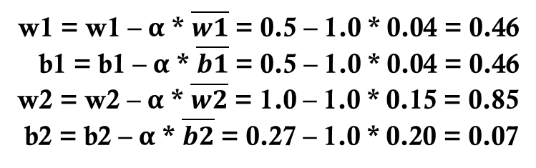
0.02
0.04
0.04
0.20
0.20
0.20
1.0
0.5
1.0
0.73
0.73
1.0
0.04
0.15
0.5
1.0
0.04
0.20
0.5
v
1.0
grad $\overline{v}$: ∂y/∂v
vertical_name
value: forward
0.5
0.27
1.0
1.0
1.0
1.0
=
0.73
0.5
0.25
=
0.25
Learning: $W_{k}=W_{k} −α∙∂loss/∂W_{k}$
w1 = w1 – α * $\overline{w1}$ = 0.5 – 1.0 * 0.04 = 0.46
b1 = b1 – α * $\overline{b1}$ = 0.5 – 1.0 * 0.04 = 0.46
w2 = w2 – α * $\overline{w2}$ = 1.0 – 1.0 * 0.15 = 0.85
b2 = b2 – α * $\overline{b2}$ = 0.27 – 1.0 * 0.20 = 0.07
0.23

