Slide 1
Exploring the Trends in the Suicide Rate of Demographic Groups in the United States
Presented by:
Christopher Kalfas
Daniel Bowen
Jason Chicatelli
Kyriaki Karalis

Slide 2
Trends in Suicide Rates
How does proximity to gun retailers effect the suicide rate? Additionally, how do suicide rate vary across demographic groups.
How does poverty rate in a state relate to the suicide rate in that state?
The majority of gun-related deaths are self-inflicted. This project hoped to find a correlation between the number of gun-related suicides and the number of gun dealers in a county.
Suicide rates, especially among white males, is are closely grouped in areas with an abundance of gun stores.
Notes:
Determine suicide rates for different demographic groups in the US and what percentage of the suicides are by gun. Then compare the suicides to proximity to a gun dealer. (you’ll find more suicides where you’ll find more gun retailers) additional
What are the suicide rates for different demographic groups in select US counties (separated by men and women)?
Of those suicides found, what percentage are committed using guns?
Finally, in those counties, are there an abundance of gun dealers?
3..

Slide 3
Trends in Suicide Rates
Data was gathered from the following sources
Bureau of Alcohol, Tobacco, and Firearms (atf.gov)
Centers for Disease Control and Prevention (cdc.gov)
Wikipedia for location based information
Google for mapping information
Notes:
This slide is also looking for us to elaborate on the questions we asked, I feel that’s redundant from the previous slide.
Fun note: (Google does not include guns shops as a searchable field)

Slide 4
Trends in Suicide Rates
Exploration and cleanup process
Data cleanup issues:
Converting county/city names into numerical data
Correcting errors from sloppy data (i.e., typos in data create search errors)
Limiting the scope of the investigation
Notes:
Problems in data gathering:
Converting county/city names into numerical data
Correcting errors from sloppy data (i.e, typos in data create search errors)
Limiting the scope of the investigation

Slide 5
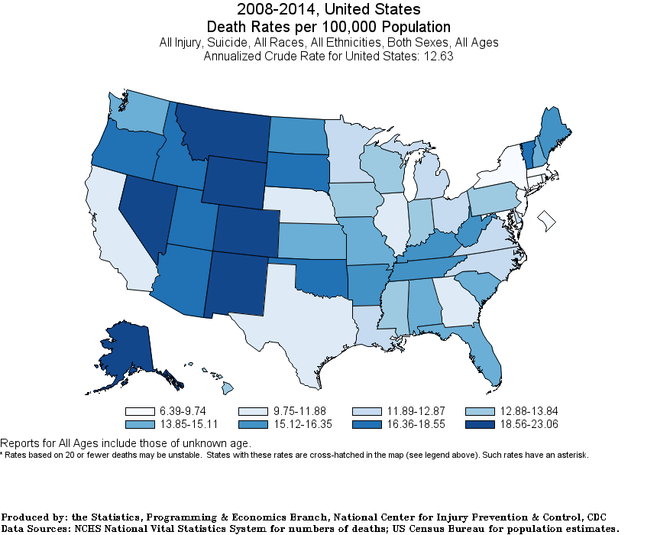
Trends in Suicide Rates

Slide 6
Trends in Suicide Rates

Slide 7
Trends in Suicide Rates
Discuss the steps you took to analyze the data and answer each question you asked in your proposal
Present and discuss interesting figures developed during analysis, ideally with the help of Jupyter Notebook

Slide 8
Trends in Suicide Rates
Difficulties
Additional areas for exploration
Effect of access to mental health services
Effect of social stigmas regarding discussion about suicide

Slide 10
Trends in Suicide Rates
QUESTIONS?

Slide 11
Trends in Suicide Rates
Extra Stuff

