Slide 1

FORMULA 1 api
A RESTful Web Service for Formula 1 Data

Slide 2

Project Overview
Dataset: Ergast Motor Racing – Kaggle
Data Ranges from 1950-2024
Includes 900+ Drivers, 300+ Teams, and 1100+ Races
24 RESTful endpoints for CRUD and Analytical Queries
Championship Standings, Leaderboards, Career Summaries
API Key authentication on all write operations
Live Deployment with Swagger UI

Slide 3
Technology Stack
FastAPI
Built-in Swagger UI at /docs (Primary manual testing tool)
Pydantic validation removes manual input checking
Widely adopted, well-documented and maintained
SQLite
Serverless single-file, easy to deploy alongside app
API is read-heavy (single-writer limit not a major concern)
No separate Server Process (via PostgreSQL)
SQLAlchemy ORM
Manages relationships between tables in Python
Raw SQL across 6 related tables becomes unsustainable
Future scope: PostgreSQL migration requires minimal code change

Slide 4
Architecture and Design decisions
No Service Layer:
CRUD on static data has no business logic
Extra layers add no value
Utils.py:
Single resolve_driver() / resolve_team() used across all routers
Auth.py:
Secrets.compare_digest() for constant-time comparison
Helps against timing attack resistance
Pydantic Schemas:
Centralise validation and response shaping automatically
HTTP Request
Router (auth check)
SQLAlchemy Query
Pydantic (response)
Utils.py
Resolve ID / Code / Name
JSON Response
Pydantic (request validation)
For flexible ref endpoint

Slide 5
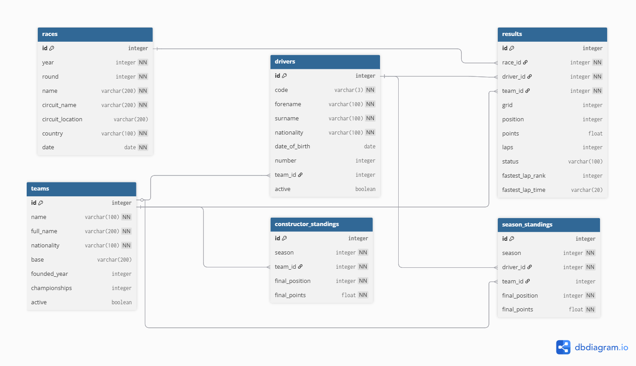
Database Design

Slide 6
Testing
Test Setup:
Pytest + FastAPI TestClient
No live server required
Fast and self-contained
Fresh in-memory SQLite database per session
Tests do not touch the production database
Conftest.py: Shared DB setup and test client
Coverage
41 Tests across 5 files
GET list endpoints with query filters
GET by ID, driver code, and name
POST creation with response validation
Duplicate rejection (409)
Foreign key violations (404/422)
PATCH partial updates
DELETE operations
Analysis: standings, leaderboard, career

Slide 7
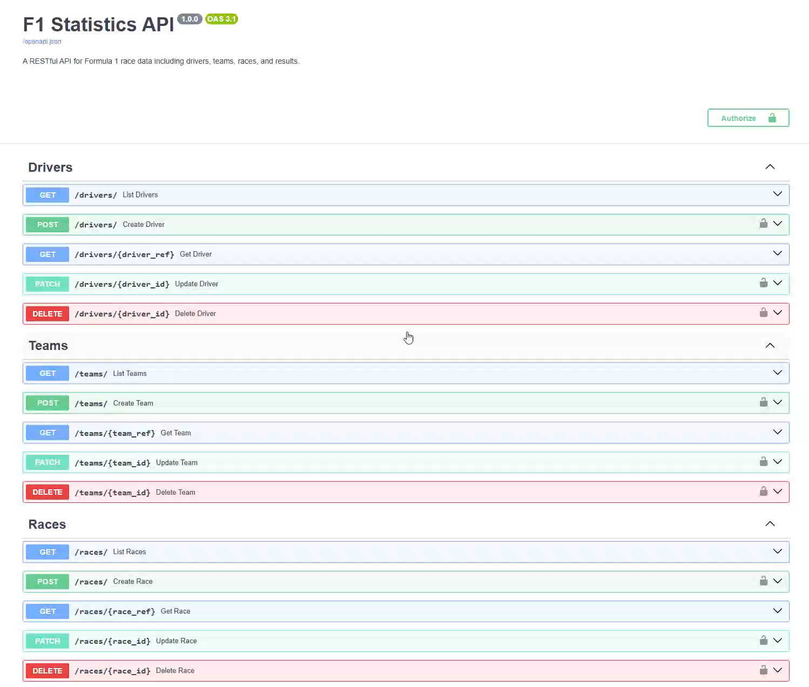
API Documentation
Swagger UI
Auto generated by FastAPI
5 Resource Groups – 24 Endpoints
Drivers, Teams, Races, Results
Full CRUD (GET, POST, PATCH, DELETE)
Analysis (Standings, All-time leaderboard, career summaries)
Flexible Identifiers (/drivers/HAM, /drivers/Hamilton, /drivers/1)
Authentication
GET endpoints open, no key required
For POST / PATCH / DELETE: API Key Required

Slide 8
Version control & deployment
Commit History
25 Overall Commits
Deployment
Init
Project Structure, Libraries
PythonAnywhere – Free Python Hosting
Issue 1: SQLite path broke in production
Fix: Absolute path derived from __file__
Issue 2: WSGI wrapper caused uWSGI hang
Fix: Deploy via pa website create with Uvicorn Directly
Workflow after deployment: -> Develop Locally
-> Git Push -> Git Pull on PythonAnywhere terminal
-> pa website reload
Models
ORM Models: Teams, Drivers, Races, Results
Routers
CRUD Routers: Teams, Drivers, Races, Results
Analysis
Analysis Router: Standings, Leaderboard, Career
Seed
Seed.py - Ergast Dataset Import
Tests
41 Pytest tests with in-memory database
Auth
API Key Authentication for write operations
Utils
Multi-Identifier Resolution via utils.py
Deploy
PythonAnywhere
Docs
README + API Documentation

Slide 9
Reflections & Lessons Learned
Domain Knowledge Importance
Assumed Unique Driver Numbers
Not the case pre-2014
Aggregated Point totals ≠ Official Standings
Dropped scores, countbacks
Led to separate SeasonStanding/ConstructorStanding models
Results model Complexity
Position Nullable
Retired drivers have no finishing position
Points as float
Half-points in shortened races
Duplicate Check in router
Same driver cannot appear twice in a race
AI-Assisted Development
Heavily used to explore alternatives
Consistently used to identify weaknesses and correct flaws
Troubleshooting throughout
(e.g. Deployment)

Slide 10
Deliverables
GitHub Repository
github.com/kyrikonis/F1_API
Public repo with full commit history
README with setup instructions
API documentation PDF included
Live Deployment
kyrik2005.pythonanywhere.com
Swagger UI available at /docs
All endpoints accessible
API key required for write operations
Technical Report
Submitted via Minerva
Tech Stack Justification
Design & Architecture
Reflections
Limitations
GenAI Declaration with full chat logs

Slide 11

Thank you

