Slide 1
Machine Learning and Content Analytics
Argumentation Mining Project

Slide 2
Argumentation Mining
What is argumentation mining?
The process by which the machine learns to recognize argumentative statements
Interpreted by the machine with an acceptable degree of accuracy
Applied to several sectors (e.g., NLP, social and philosophical science)

Slide 3
Project – Business Goals
Our project
Scientific articles related to medical science sector
Annotation process to form datasets
Classification via ML techniques
Clustering via ML techniques
Business Goals
Support sense-making (Data driven decisions)
Argument retrieval (Support future work for writing scientific articles)

Slide 4
Methodology - Data Collection
Annotation Process
Abstracts’ distribution to teams
Arguments (claim, evidence)
Structure (background, aim, results, etc.)
Citations (positive, negative, etc.)
Team’s pairwise agreement
Corrections on annotation process
Forming final datasets through all teams’ agreement

Slide 5
Methodology – Data Overview
Final datasets
Arguments
Structure

Slide 6
Methodology – Data Processing
Text cleansing (Nltk library)
Punctuation removal, lowercase transformation
Stopwords, Common words removal
Split dataset (train, validation, test)
Text transformation for classification process
Fasttext’s algorithm specific input format

Slide 7
Methodology – Classification
Intuitive Baseline model
Argument labeling using lexicons
Extra labeling based on empirical rules
Sentences between Evidence - Claim ----------> Evidence
Sentence exists after first Claim ----------> Claim
Fasttext algorithm
Open-source library by the Facebook AI Research lab
Advanced technique for text classification
Specific input format : ‘__label__’ prefix + label + text
Model training on train dataset
Hyperparameter tuning on validation dataset:
Epochs (number of times the model sees an input)
Learning rate (how much the model changes after each sentence is processed)
Loss functions (computation time speed up)
Word n-gramms (different sequences of n items)

Slide 8
Methodology – Clustering
Graph method (NetworkX library)
Sentence embeddings extraction
Embeddings’ normalization
Similarity matrix creation (1 – distance)
Normalization of similarity matrix
Similarity threshold for strong relationships
Graph creation
Setting similarity scores as edges’ weights
Communities' identification for different k-cliques
Threshold tunning for stronger communities’ identification

Slide 9
Experiments / Results - Classification
Fasttext’s model for arguments:
Loss function = hierarchical Softmax
Learning Rate = 0.7
Epochs=18
Word N-Grams = 2
Fasttext’s model for structure:
Loss function = ‘one vs all’
Learning Rate = 0.1
Epochs=18
ARGUMENT CLASSIFICATION |  | precision | recall | f1-score
Intuitive baseline model | claim | 0.35 | 0.36 | 0.35
 | evidence | 0.43 | 0.45 | 0.44
Fasttext model | claim | 0.52 | 0.32 | 0.4
 | evidence | 0.62 | 0.54 | 0.58
Fasttext model tuned | claim | 0.49 | 0.41 | 0.45
 | evidence | 0.56 | 0.61 | 0.58
STRUCTURE CLASSIFICATION |  | precision | recall | f1-score
Fasttext model | result | 0.46 | 0.76 | 0.57
 | background | 0.4 | 0.48 | 0.44
 | objective | 0.43 | 0.61 | 0.5
 | conclusion | 0.49 | 0.2 | 0.28
 | method | 1 | 0 | 0.01
Fasttext model tuned | result | 0.59 | 0.64 | 0.61
 | background | 0.59 | 0.6 | 0.6
 | objective | 0.52 | 0.55 | 0.54
 | conclusion | 0.47 | 0.35 | 0.4
 | method | 0.44 | 0.55 | 0.49

Slide 10
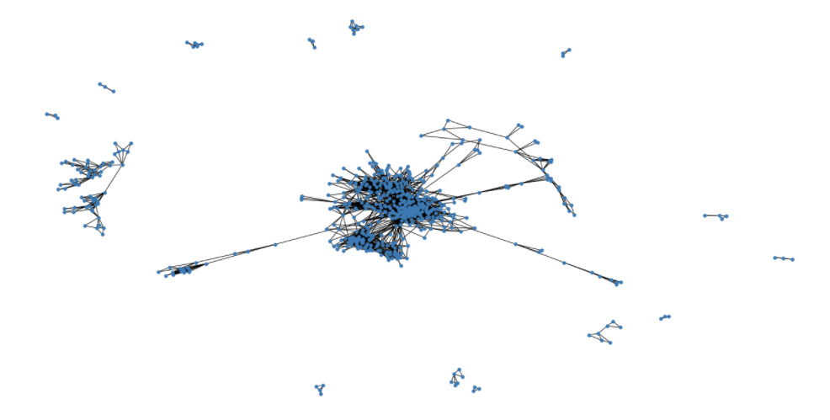
Experiments / Results - Clustering
Number of observations | Similarity range
23315511 | 0 – 0.1
2044619 | 0.1 – 0.2
9443238 | 0.2 – 0.3
9397561 | 0.3 – 0.4
2049584 | 0.4 – 0.5
100369 | 0.5 – 0.6
2912 | 0.6 – 0.7
163 | 0.7 – 0.8
18 | 0.8 – 0.9
4843 | 0.9 – 1
Starting threshold = 0.6
Communities with k=3 cliques

Slide 11
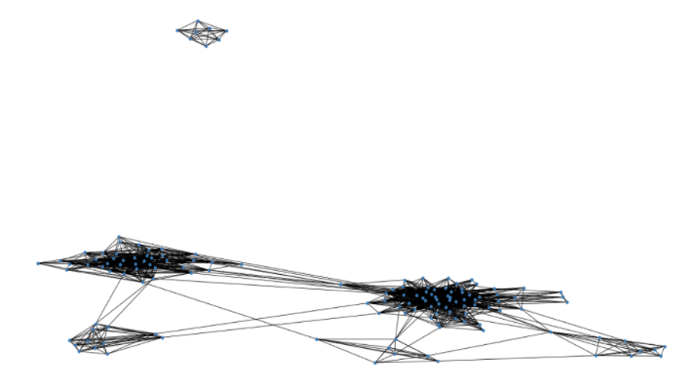
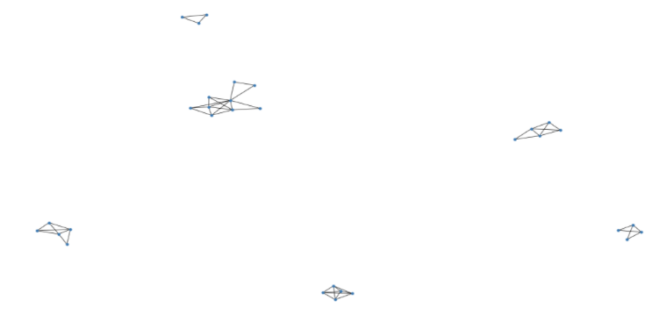
Experiments / Results - Clustering
Similarity > 0.6
Communities of k = 7 cliques
Removing edges
Similarity > 0.7
Communities of k = 3 cliques

Slide 12
Error Analysis - Comments
Good clustering :
IDs: [2132 , 2031]
Topic: ‘elderly patients treatments’
Poor clustering:
IDs: [796 , 2002]
'Electronic supplementary material The online version of this article contains supplementary material, which is available to authorized users.’
Problematic annotation process
Graph using only “Claim arguments”
Weaker clustering
Comments:
Better text pre-processing
Different ML model for embeddings extraction

Slide 13
Team members
Kyriakakis
Nikolaos
Papadomarkakis
Georgios
Thank you for your attention!

