Slide 1
Internship Projects
Kaveh Shahabi
Application Prototype Lab, ESRI
May 18 through August 9, 2011

Slide 2
Projects
Temporal Data Reader
ArcSDE
OpenGL
ArcCASPER
Network Analyst Extension
Evacuation Routing

Slide 3
1. Temporal Data Reader

Slide 4


Problem
Temporal data -> Animation
Japan Honda Car locations:
1 Day capture every 30 sec: ~8.5 million points
Real-time animation
Minimal start time
Maximal animation speed
C++ library
We need a 60 FPS animation !

Slide 5


Solution
Multiple Databases
A multithreaded program to minimize I/O blocks
ArcSDE API to stream the data
Transparent and asynchronous garbage collection

Slide 6
Demo

Slide 7

System Components
Thread 1
Thread 2
Manager
Client
Thread 3
OpenGL
Thread 4
GC
Temporal Data Reader Library

Slide 8
Performance

Slide 9
2. ArcCASPER

Slide 10
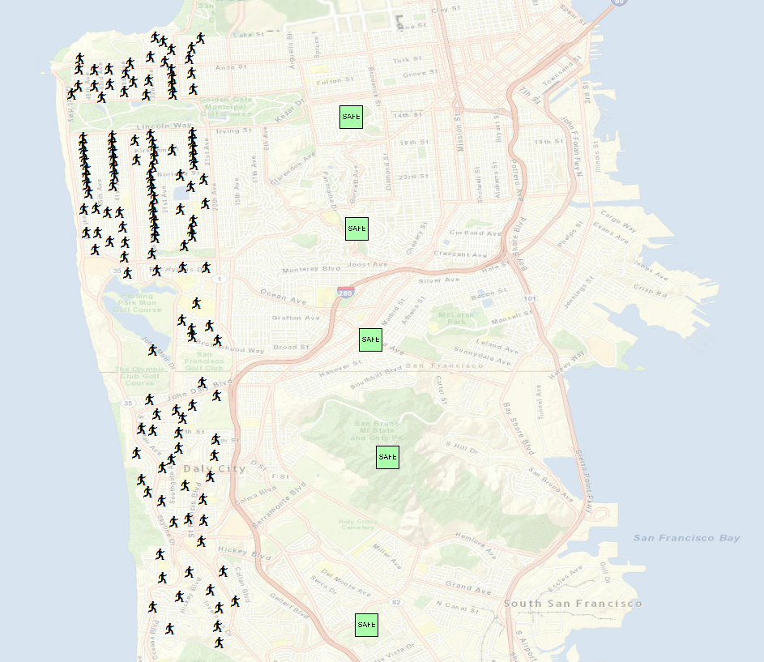

Motivation
A Routing algorithm designed for evacuation
Macro view instead of micro view
Considers network capacity, traversal speed, and population density
Scalable to urban evacuation
Fuzzy road saturation calculation
CASPER:
Capacity Aware Shortest Path Evacuation Routing

Slide 11



System Design
Sort
Evacuees
Evacuees
Safe Zones
Capacity-Aware
Dijkstra
CASPER
Junction
Heuristic
Segment
Reservation
Evacuation
Routes
Road
Usage
Final Route
Calculation
Network Tree

Slide 12

Steps
Evacuation
Routes
Road
Usage
Network Dataset
Evacuees
Safe Zones
CASPER
ArcObject API
Network Analyst

Slide 13
Demo

