Slide 1

Python for Data Science and AI Level 1
Project made by
RACHDAOUI Sofiane
SARHIRI Nabil

Slide 2

Contents
Definition of subject
Objectives
Development environment
Designing the Convolutional Neural Network
Model Training
Model Evaluation

Slide 3
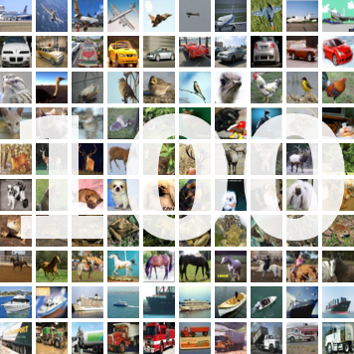
Definition of subject
CIFAR10 and CIFAR100 are some of the famous benchmark datasets which are used to train convolutional networks for the computer vision task.
The goal of this project is to design, train, and evaluate a convolutional networks on the CIFAR-100 image classification dataset.

Slide 4

Objectives
The objectives of the project are to adjust the architecture, hyperparameters, and data augmentation parameters in order to obtain the best accuracy.

Slide 5



Development environment
In order to develop, train and analyze our model we will use the python backend environment offered by Google through Colab, its hosted Jupyter Notebook which includes all the necessary tools and libraries such as Tensorflow and Keras.

Slide 6
Designing the Convolutional Neural Network
First of all we had to load the data which was shuffled and slip it between data which was used for the training and data used for testing
(x_train, y_train), (x_test, y_test) = cifar100.load_data()
print('x_train shape:', x_train.shape)
print(x_train.shape[0], 'train samples')
print('y_train shape:', y_train.shape)
print(x_test.shape[0], 'test samples')

Slide 7
Designing the Convolutional Neural Network
Then we had to encode the data transforming categorical data to numerical value for classes. Each class is represented by an array of 100 values, 99 values set to 0 and one set to 1
num_classes = 100
y_train = keras.utils.to_categorical(y_train, num_classes)
y_test = keras.utils.to_categorical(y_test, num_classes)

Slide 8
Designing the Convolutional Neural Network
In Order to manipulate the data easily, we had to normalize it by making it float and scaling it
x_train = x_train.astype('float32')
x_test = x_test.astype('float32')
x_train /= 255
x_test /= 255

Slide 9
Designing the Convolutional Neural Network
Our model uses the architecture of VGGNET composed of a sequence of convolutional layers and pool layers.
After each convolutional layer, we applied a ReLU function activation with three different number of filters.
Each ReLU function is followed by a BatchNormalzation to normalize each layer's activations by centering and scaling them down, which helps the model learn more quickly and stably.
We also added Dropout functions to prevent overfitting.
Data is flattened thanks to a Flatten function before entering the fully connected layer.
The Dense function allows us to add fully connected layers to all activations of the previous layer
A Softmax activation function is applied at the end of the model to classify each data.

Slide 10
Designing the Convolutional Neural Network
from keras.models import Sequential
from keras.layers import Conv2D, MaxPooling2D, Flatten, Dense, Activation, Dropout, BatchNormalization
model_2 = Sequential()
model_2.add(Conv2D(128,(3, 3), padding='same', input_shape=x_train.shape[1:]))
model_2.add(Activation('relu'))
model_2.add(BatchNormalization())
model_2.add(Conv2D(128, (3, 3)))
model_2.add(Activation('relu'))
model_2.add(BatchNormalization())
model_2.add(MaxPooling2D(pool_size=(2, 2)))
model_2.add(Dropout(0.5))
model_2.add(Conv2D(256, (3, 3), padding='same'))
model_2.add(Activation('relu'))
model_2.add(BatchNormalization())
model_2.add(Conv2D(256, (3, 3)))
model_2.add(Activation('relu'))
model_2.add(BatchNormalization())
model_2.add(MaxPooling2D(pool_size=(2, 2)))
model_2.add(Dropout(0.5))
model_2.add(Conv2D(512, (3, 3), padding='same'))
model_2.add(Activation('relu'))
model_2.add(BatchNormalization())
model_2.add(Conv2D(512, (3, 3), padding='same'))
model_2.add(Activation('relu'))
model_2.add(BatchNormalization())
model_2.add(MaxPooling2D(pool_size=(2, 2)))
model_2.add(Dropout(0.5))
model_2.add(Flatten())
model_2.add(Dense(512))
model_2.add(Activation('relu'))
model_2.add(BatchNormalization())
model_2.add(Dropout(0.5))
model_2.add(Dense(num_classes))
model_2.add(Activation('softmax’))

Slide 11
Model Training
To help the model train, we have integrated a data augmentation via the ImageDataGenerator class provided by Keras. This allows the model to reduce the risk of overfitting, resist image variations such as rotations or zooms, and make efficient use of the data since it is generated on the fly

Slide 12
Model Training
The training of our model is boosted by an optimizer that helps reduce loss and increase accuracy. We have chosen the Adam optimizer that combines the advantages of SGD and RMSProp optimizers. In addition, it requires few hyperparametric settings and it is possible to adjust the learning rate.

Slide 13
Model Training
from keras.preprocessing.image import ImageDataGenerator
datagen = ImageDataGenerator(
rotation_range=20,
width_shift_range=0.2,
height_shift_range=0.2,
shear_range=0.2,
zoom_range=0.2,
horizontal_flip=True,
fill_mode='nearest'
)
batch_size = 64
opt = tf.keras.optimizers.legacy.Adam(learning_rate=0.008, decay=1e-6)
model_2.compile(loss='categorical_crossentropy',
optimizer=opt,
metrics=['accuracy'])
model_2.fit(
datagen.flow(x_train, y_train, batch_size=batch_size),
steps_per_epoch=len(x_train) // batch_size,
epochs=70,
validation_data=(x_test, y_test)
)

Slide 14
Model Evaluation
During and at the end of the training, the model is evaluated with test data to check the accuracy of the model. The accuracy of the training is different from the accuracy of the test, and it is this last which is considered.
score, acc = model_2.evaluate(x_test, y_test,
batch_size=batch_size)
print('Test score:', score)
print('Test accuracy:', acc)
print('Test accuracy:', (acc * 100.0))

Slide 15

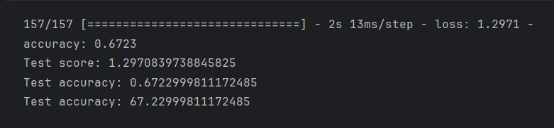
Model Evaluation
After training, our model allows us to achieve an accuracy of 67%. Although there is room for improvement, this value is quite satisfactory given the volume of data in the CIFAR-100 dataset.

Slide 16
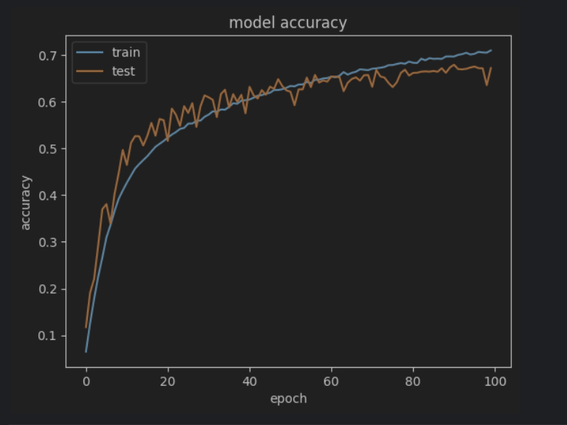
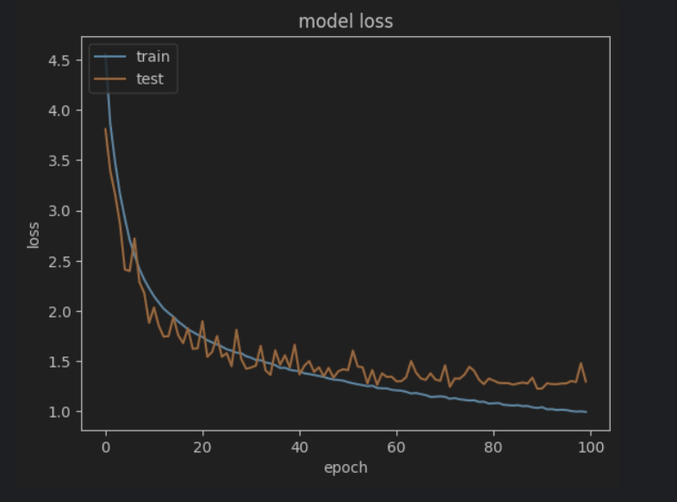
Model Evaluation
As you can see on the following curves the precision and loss curves obtained from the training data are very close to those obtained for the test data. This shows that our model generalizes quite well and that it does not do much overfitting.

