Slide 1

Chladni Figure Simulator
Kyle Smith, Andrew Elko, Evan Magill
April 27, 2026
CMSC 476

Slide 2

Outline
Background
Chladni's Law
Parallel Structure
Example Images
Live Demo

Slide 3
Background

Slide 4

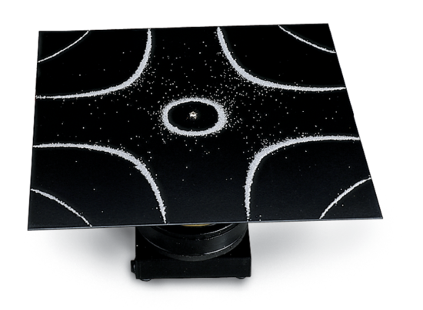
Background
Chladni plates help visualize sound into geometric patterns

Slide 5

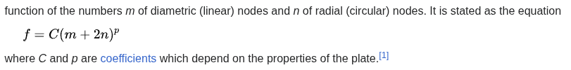
Chladni's Law

Slide 6


Slide 7
Code Architecture

Slide 8

Parallel Systems
Using MPI to separate the image into # processes sections

Slide 9

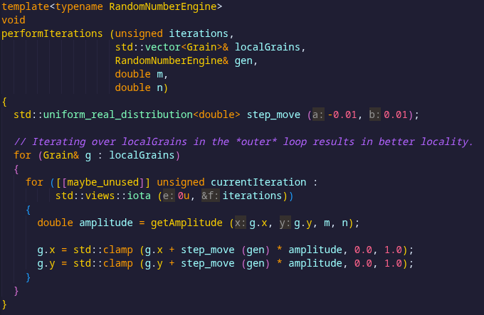

Slide 10
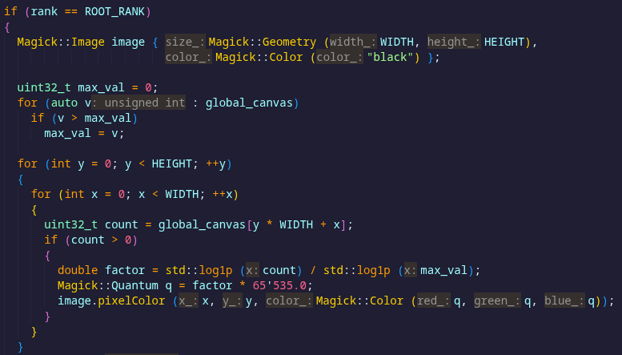

Slide 11
RESULTS!!!!!

Slide 12

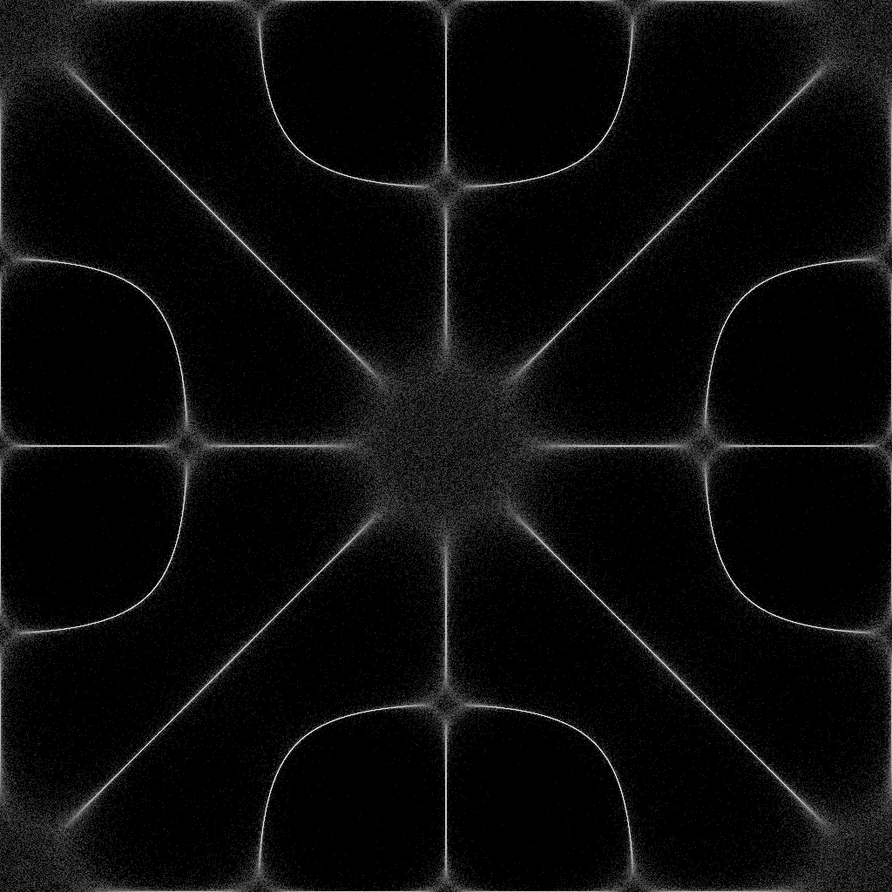
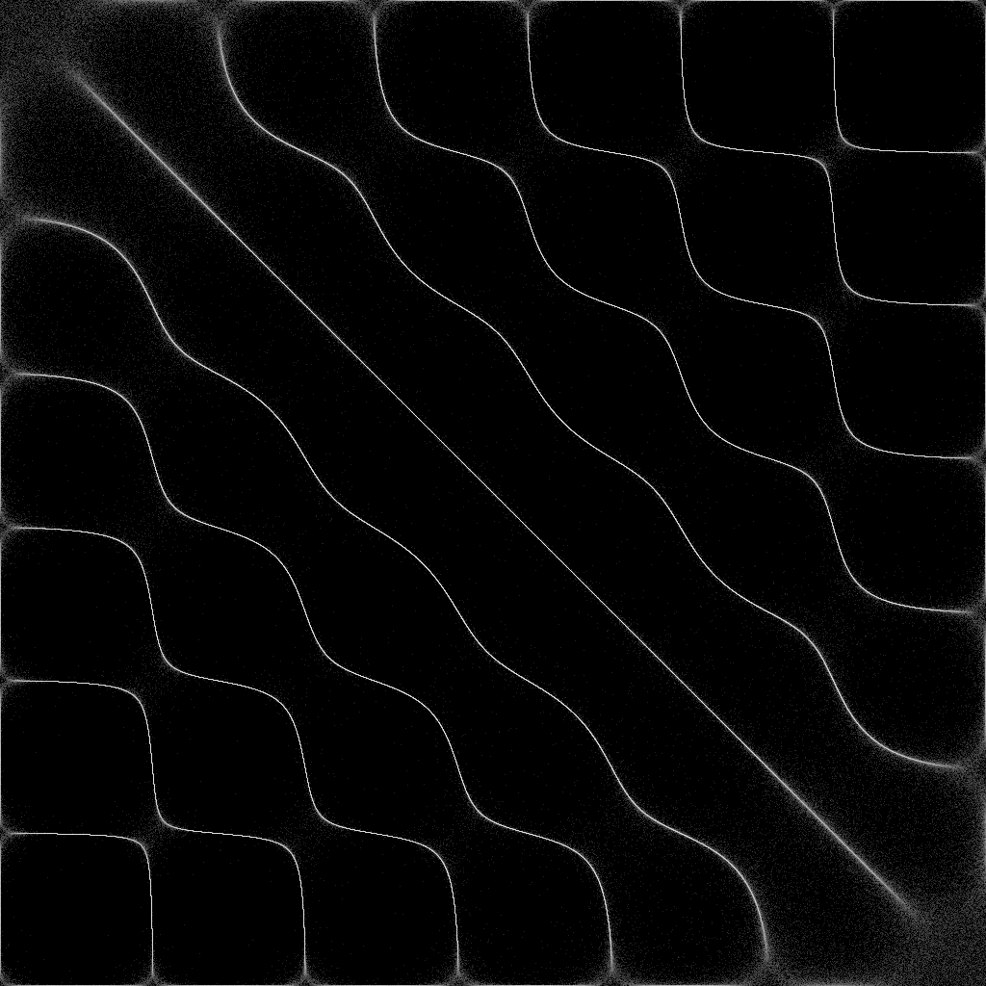
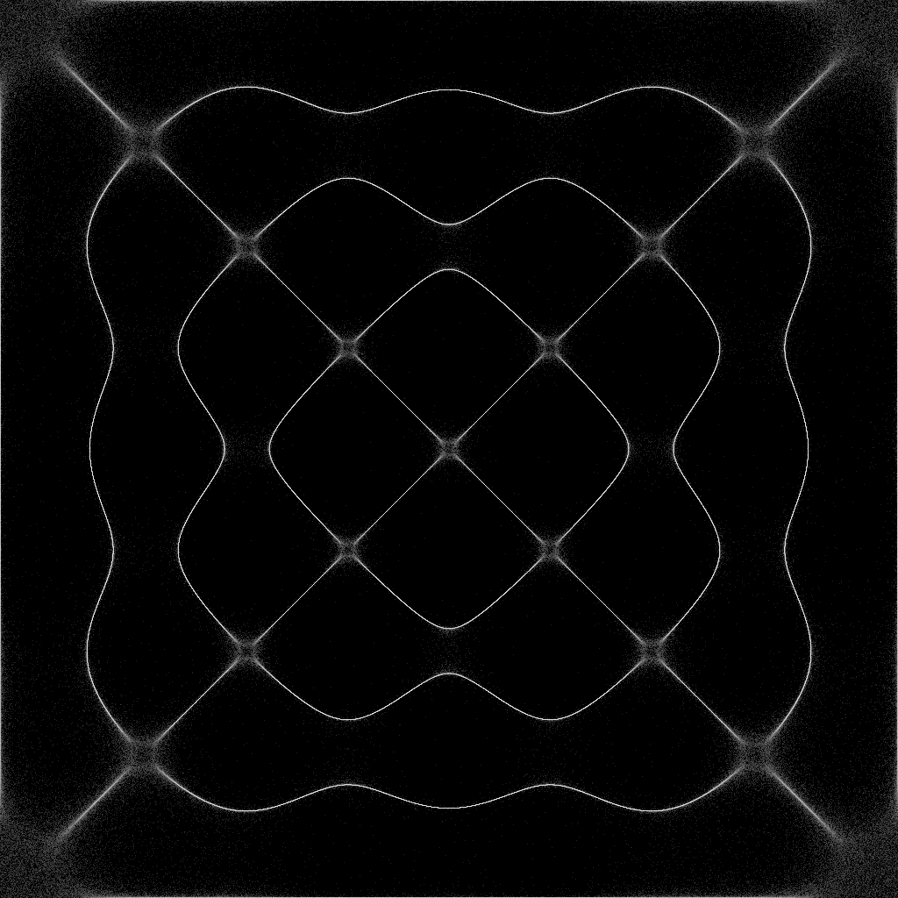
Some Generated Images
Grains = 1'000'000 Iterations = 1'000
All background images on the slides were generated images
m = 4 n = 6
m = 6 n = 7
m = 1 n = 9

Slide 13

Future Improvements
Possibly changing the IPC to Puts/Gets

