Slide 1
New security flaw discovered in Wi-Fi routers
Yining Wang

Slide 2
Some Background knowledge
Tcp Basics
unidirectional nature of half-duplex wireless

Slide 3
Tcp: transmission control protocol
TCP breaks information into manageable chunks
Each chunk, known as a “packet,” receives a number within a sequence unique to that particular communication
The first number of the initial sequence is randomly chosen, but the next numbers will increase predictably, so the receiving computer can arrange them properly if they arrive out of order.
vulnerability

Slide 4
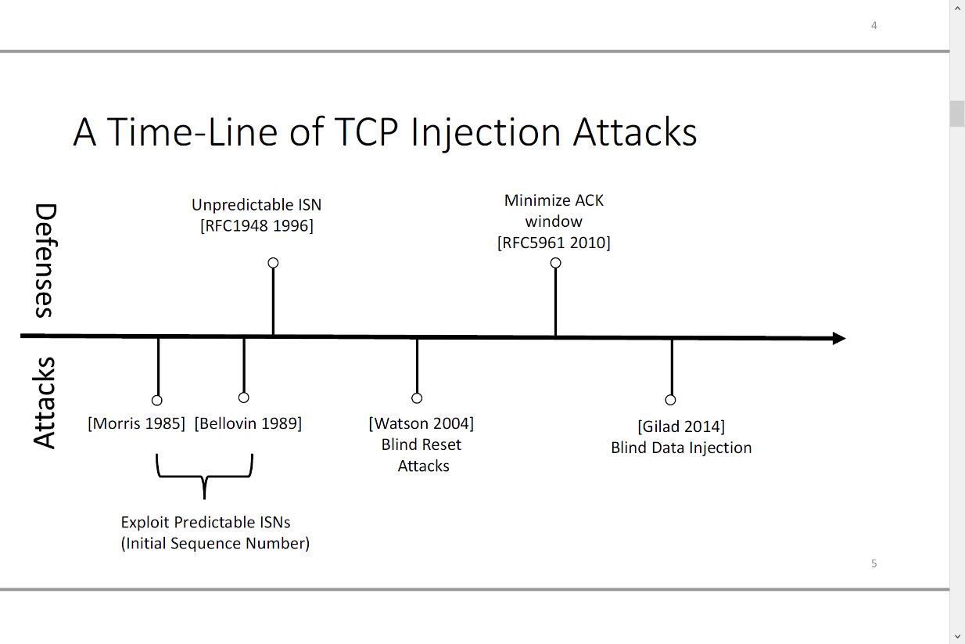

Slide 5
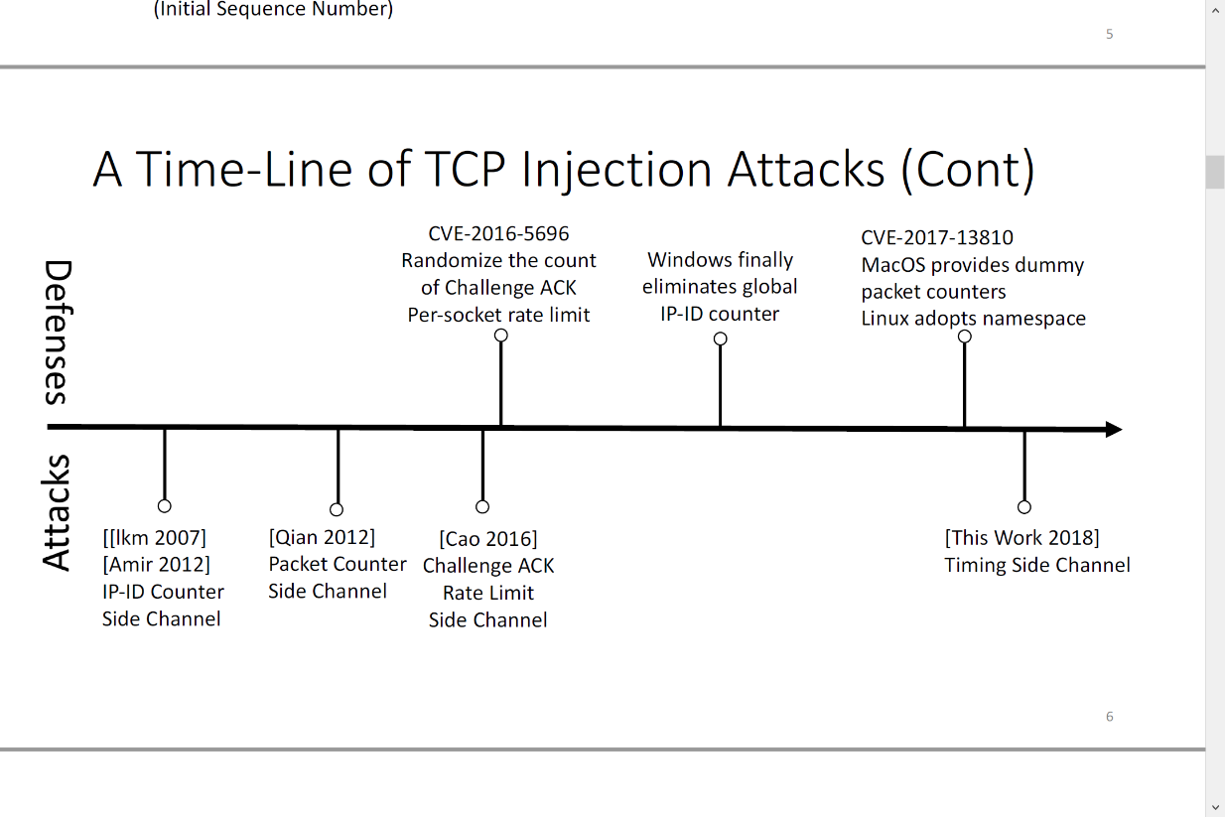

Slide 6
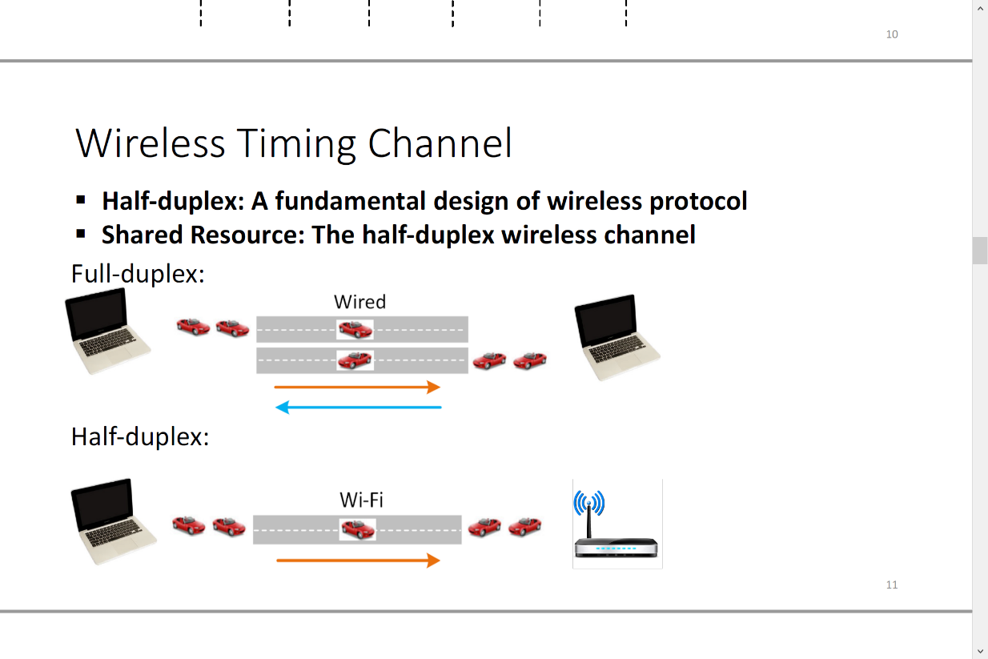
unidirectional nature of half-duplex wireless

Slide 7
How does those two things work together?
Computer would give a response after receiving a TCP trunk
Time relevant to if it is ‘good’ because of the half-duplex nature of the wife router

Slide 8
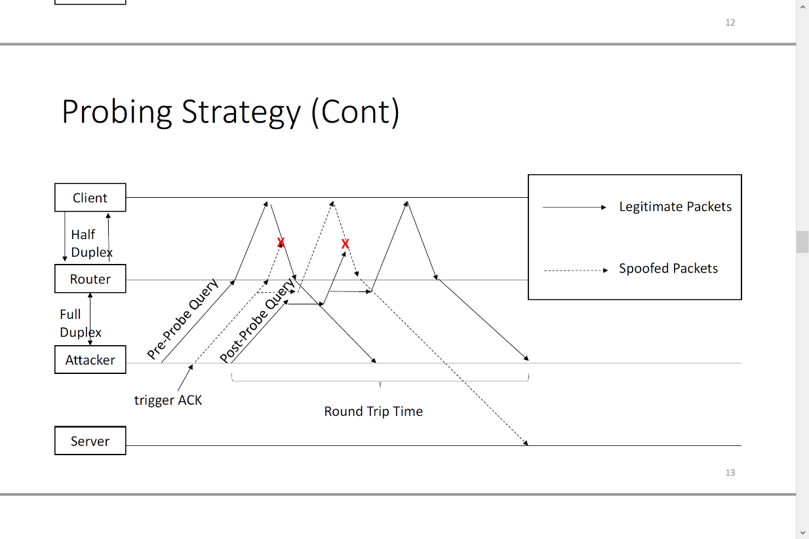

Slide 9
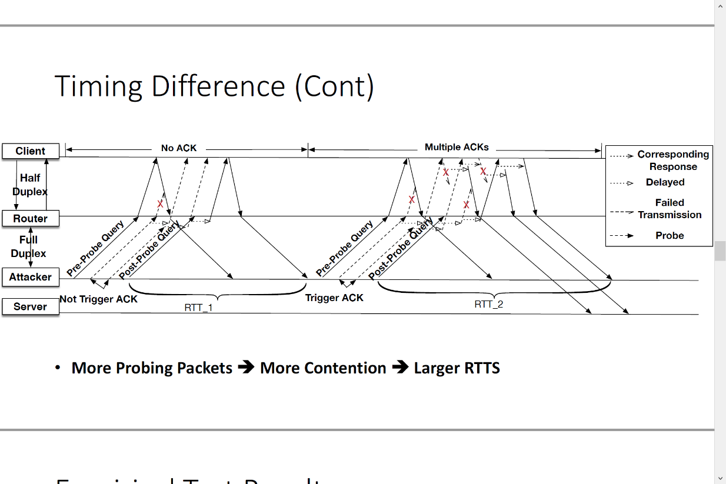

Slide 10
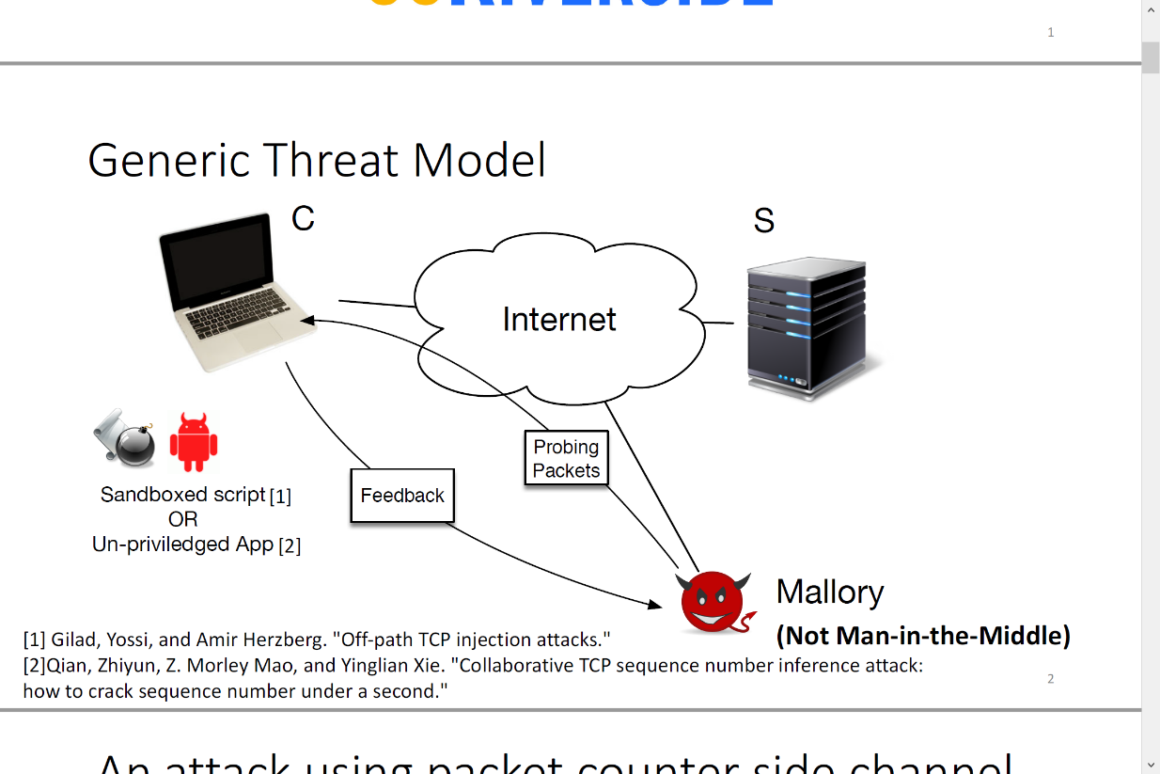
How does the attack work?
inject their own copy of the banking webpage into the browser cache: Web cache poisoning

Slide 11
https://www.youtube.com/watch?time_continue=76&v=xT8NYXGzTuw

Slide 12
Something we could do
Application Layer: HTTPS and HSTS
Wireless Layer: Full-duplex Wi-Fi Technology
Don’t click on suspicious links !

Slide 13
The end
Off-Path TCP Exploit: How Wireless Routers Can Jeopardize Your Secrets, Weiteng Chen and Zhiyun Qian, University of California, Riverside (https://www.usenix.org/conference/usenixsecurity18/presentation/chen-weiteng)

