Slide 1
MOBA多人对战游戏
服务端数据
wait client
act,user_role
wait client
act,user_role
wait client
act,user_role
wait client
act,user_role
wait client
game,move,hero,0,321,316
game,move,hero,0,380,231
game,move,hero,0,386,132
game,move,hero,0,402,219
game,move,hero,0,443,218
game,move,hero,0,392,242
game,skill,key,q,hero,0,500,150
game,skill,key,q,hero,0,500,150
game,skill,key,q,hero,0,500,150
game,skill,key,q,hero,0,500,150
game,skill,key,q,hero,0,500,150
服务端
多个客户端
双方阵营：各个4个英雄，1个塔
移动，画面同步
Q攻击，W回血
tel: 18234498304
qq: 379766697

Slide 2
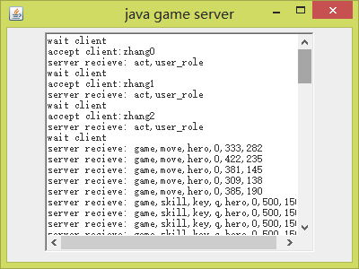
服务端

Slide 3
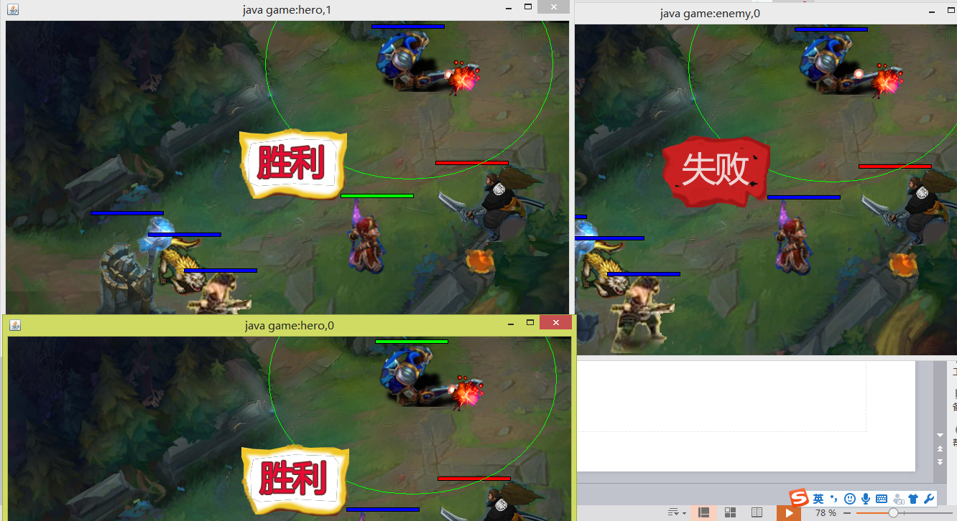
运行效果

Slide 4
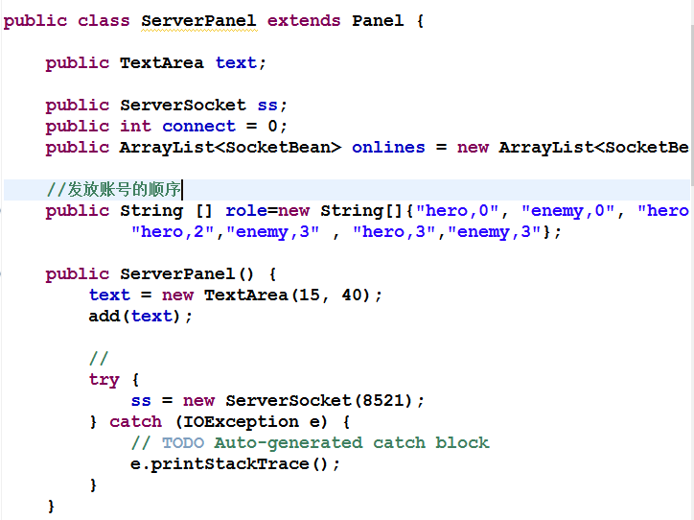
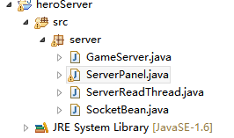
服务端
多个客户端的socket连接

Slide 5
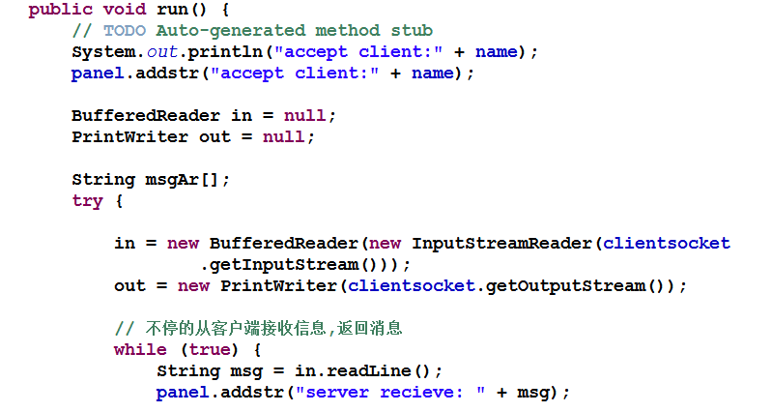
服务端：创建线程，接收客户端消息

Slide 6
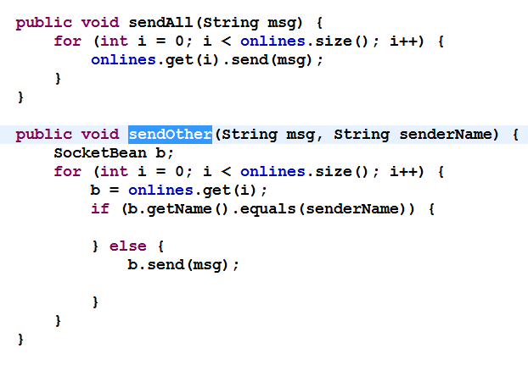
服务端，转发消息

Slide 7
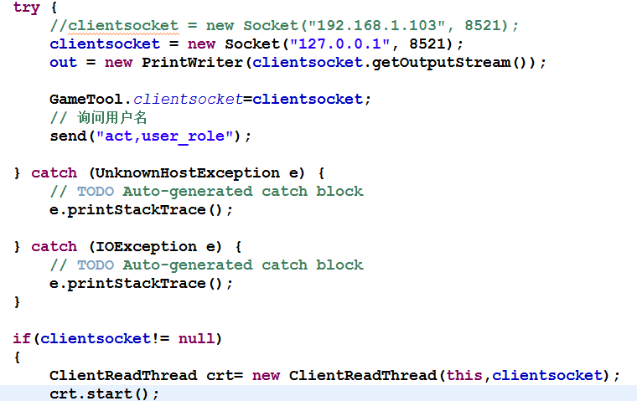
客户端
连接服务端
创建线程，接收消息

Slide 8
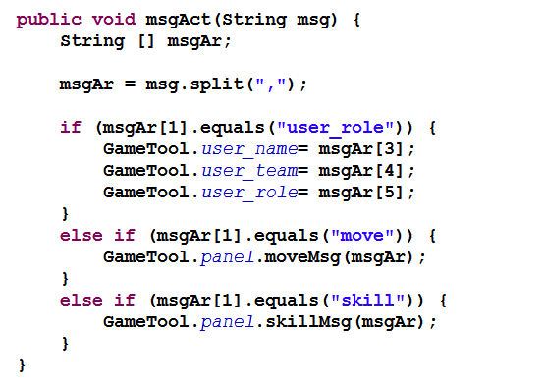
客户端，解析消息：移动，技能

Slide 9
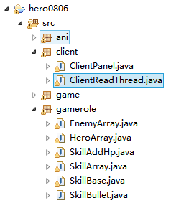
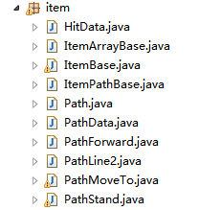
客户端：移动，技能

