Slide 1
Olist analysis
Sokol Oleksandra, 24.04

Slide 2
Scope:
Revenue and seller presence in 5 key regions in Brazil. Seller presence across top product categories.
Seller-customer relationship. Monogamous and non-monogamous transactions for Olist.
Operational efficiency. TTA - time to approve the order from seller side.

Slide 3
General context
In our dataset, we have transactional data from November 2016 till November 2018 (2 years).
Throughout this time we had 99441 customers and 3095 sellers.
For geo analysis we bucket 23 states into 5 key regions in Brazil: NorthEast, North, South, SouthEast, Central-West

Slide 4
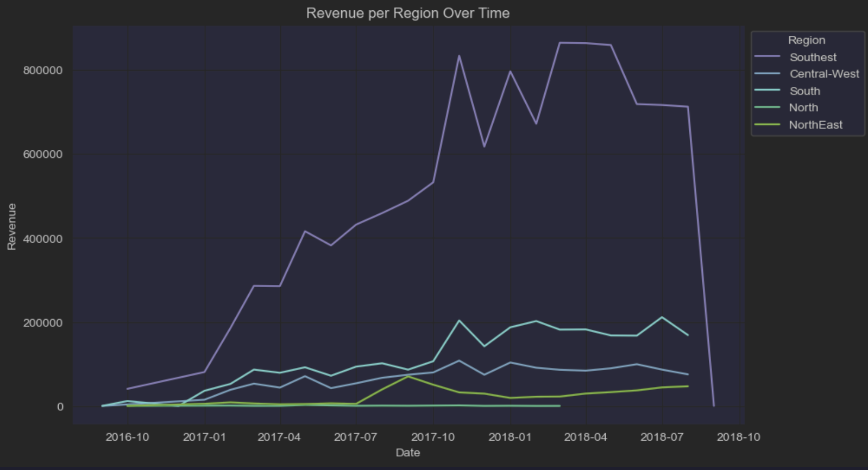
Regions Performance
SouthEast has strongest revenue.
South has biggest potential of all mediocre r.
North has the lowest revenue.

Slide 5
Sellers vs customers
As we are dealing with marketplace, it is important to monitor both sides and keep this seller to customer dynamic healthy. Current customer to seller ration is 32.
When it comes to seller density, we see strong signal that it is the highest for our top-revenue product categories. When we compare our top 20% (=16) categories in terms of revenue and seller count, they are almost identical.
It is a good sign when a customer doesn’t shop exclusively with one seller. 1.3% of customers shop with more than one seller (“non-monogamous transactions”).

Slide 6
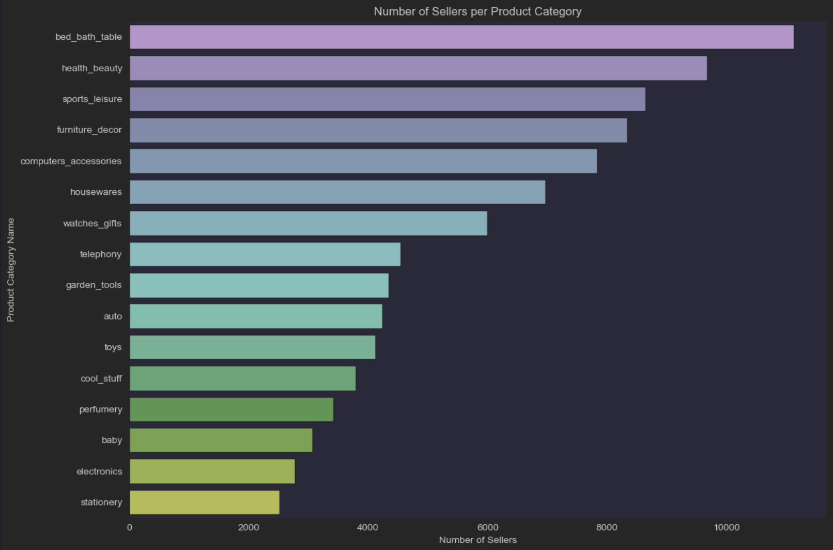
Seller presence for top product categories
For all of these top-revenue product categories, we have more than 2000 sellers.

Slide 7
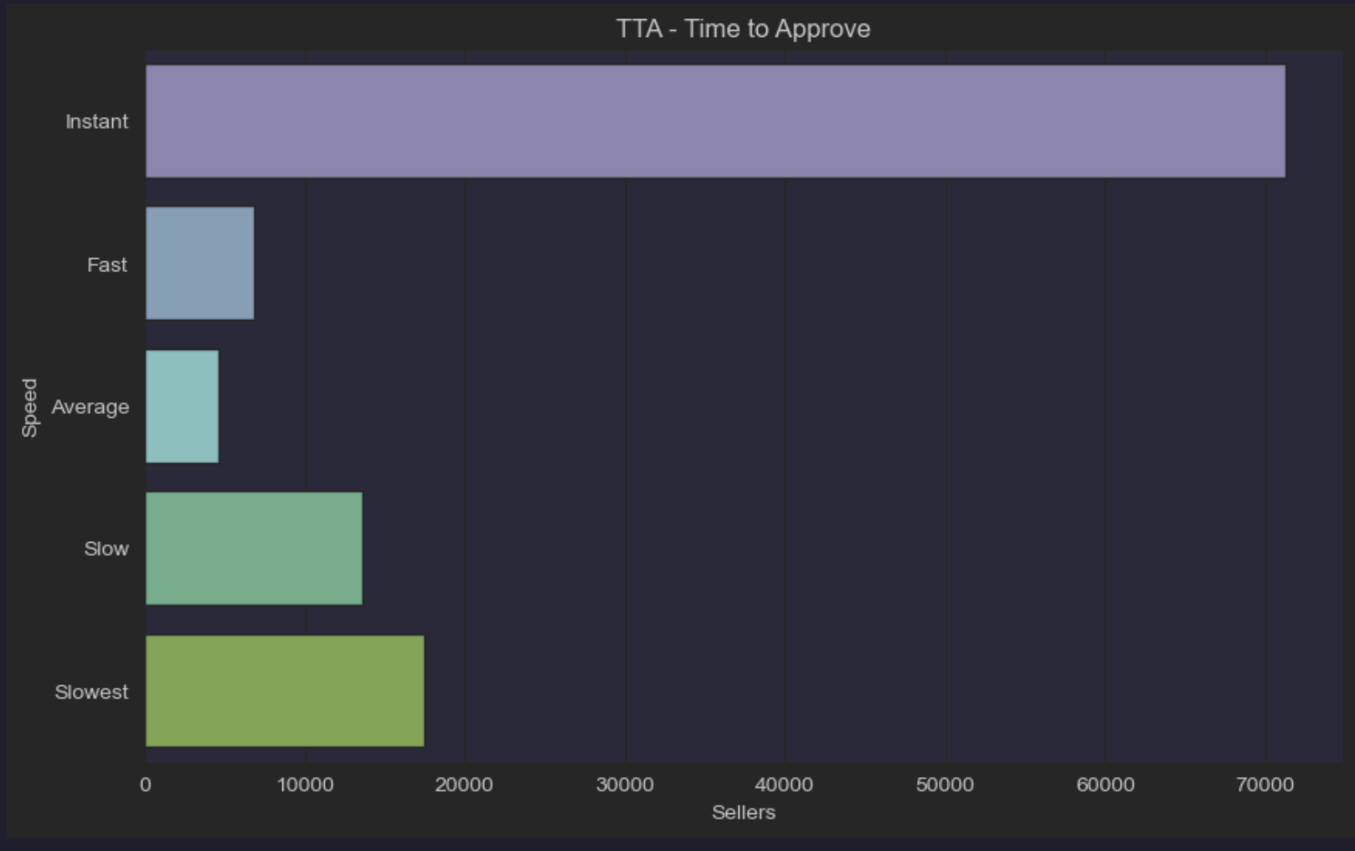
Operational excellence - TTA for orders at Olist
Segmentation goes as following:
Instant < 1 hour
Fast 1-5 hours
Average 5-12 hours
Slow 12-24 hours
Slowest > 24 hrs

Slide 8
Summary
TTA is healthy with the majority of orders being approved Instant. Introducing SLA with 12 hour processing window can help with decreasing Slowest and Slow categories.
Overall, economical disposition of regions is reflected in revenue they bring on Olist with Southeast being Strongest. Second most important region for investment can be South.
When it comes to supply-demand balance, further segmentation should be provided in order to increase seller presence in top 16 product categories.
We see that almost all top-revenue product categories have high seller presence. In a similar way, products with lowest revenue have limited seller representation.

