Slide 1
기계학습
The delta rule & Back-propagation
정보시스템공학과
안규황

Slide 2
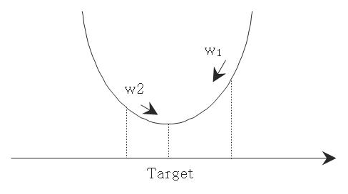

The delta rule
Input02
Input01

Slide 3
Wi = Â alpha * s'(a(p,n)) * (t(p,n) - y(p,n)) * X(p,i,n)
The delta rule

Slide 4
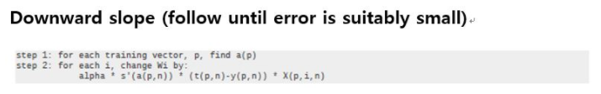
The delta rule

Slide 5
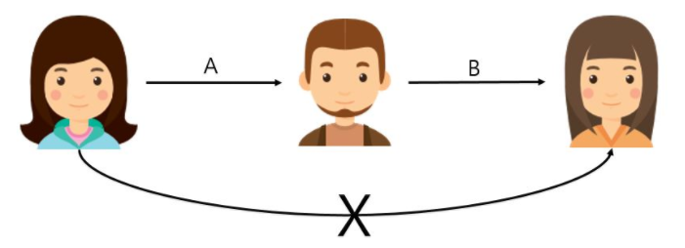
Back-propagation

Slide 6
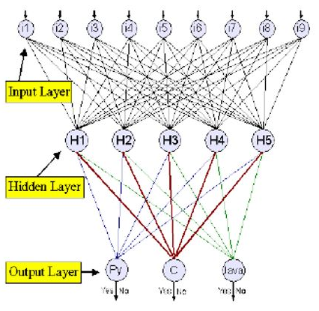
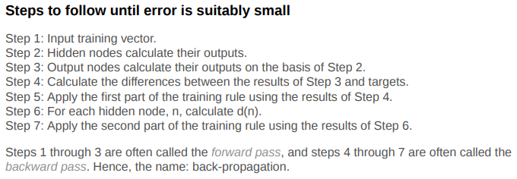


Back-propagation
First part :
Second part :

