Slide 1
CNN Benchmark Models

Slide 2
Nonlinear stiffness
Parameters used:
P.kl = 2e4; P.kn = 5e12;
P.cl = 50; P.cn = 0;
T = 200; dt = 2^-12;
Input:
F = 10 * randn(length(taxis), 1);
Total 20 datasets

Slide 3
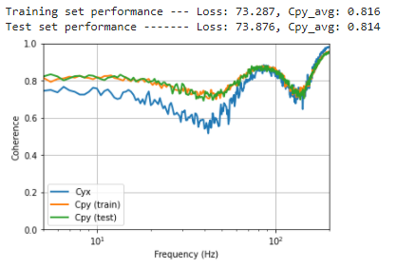
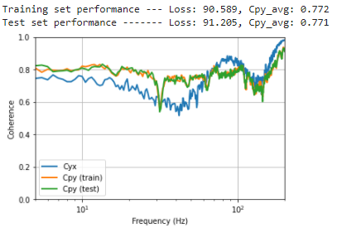
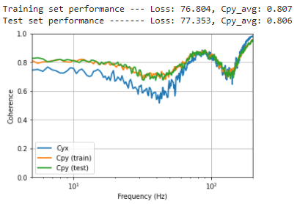
CNN, layers:11, skip:1, kernel width:2, relu, no validation set, epochs:50, (layers in factors of 4)
Run 1: Loss: 90.589, Cpy_avg: 0.772
Run 2: Loss: 76.610, Cpy_avg: 0.808
Run 3: Loss: 73.285, Cpy_avg: 0.816

Slide 4
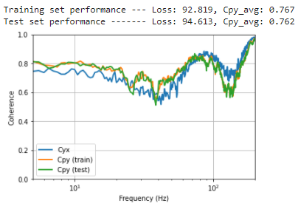
CNN, layers:11, skip:1, kernel width:2, relu, validation set, epochs:50, (layers in factors of 4)
Run 1: Loss: 92.819, Cpy_avg: 0.767
Run 2: Loss: 79.832, Cpy_avg: 0.799
Run 3: Loss: 82.190, Cpy_avg: 0.793

Slide 5
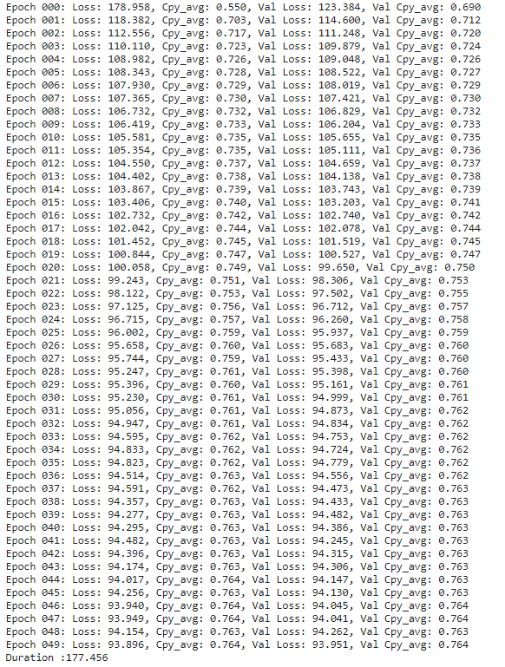

Slide 6
First model notes:
Relu activation function converges very quickly (normally gets to within 0.02 of final Cpy value in 25 epochs)
Would mean that model is converging quickly towards a local minima
Can notice some dips in coherence
Performance on training, validation, and testing sets essential identical

Slide 7
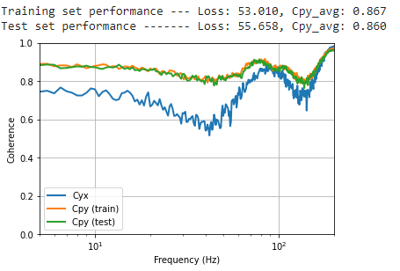
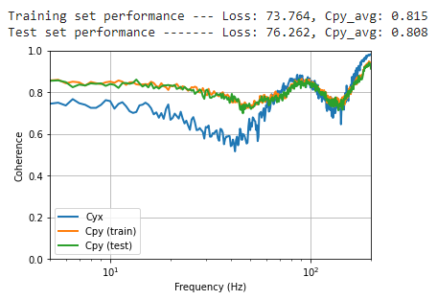
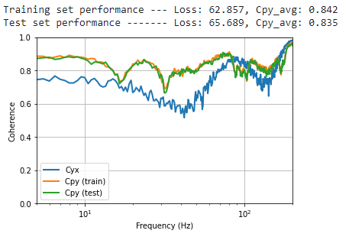
CNN, layers:11, skip:1, kernel width:2, tanh, validation set, (layers in factors of 4)
Number of parameters: 21101
Run 1: 80 epochs
Run 2: 100 epochs
Run 3: 100 epochs

Slide 8
tanh model notes
Identical structure with tanh activation outperforms model with relu
Converges a lot slower, needs more epochs to converge 80 – 100
Also seems to get stuck in local minima?
Run 1 with 0.86 had not fully converged yet

Slide 9
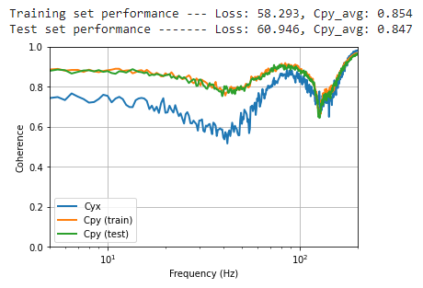
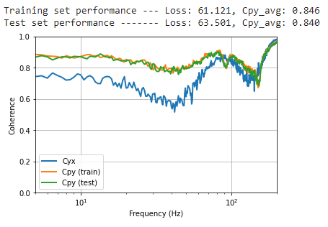
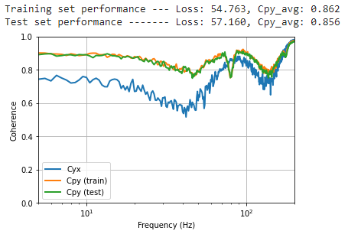
CNN, layers:7, skip:1, kernel width:3, tanh, validation set, (layers in factors of 4)
Number of parameters: 8161
Run 1: 100 epochs
Run 2: 100 epochs
Run 3: 100 epochs

Slide 10
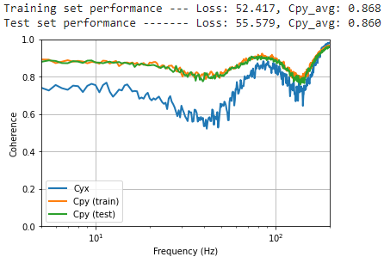
Notes
Issues with training model with even number of layers – probably issue in the last layer in CNN functions
Tested model with 9 layers:
Receptive field quite large (1.6s)
Training time slightly longer but similar
Good performance

Slide 11
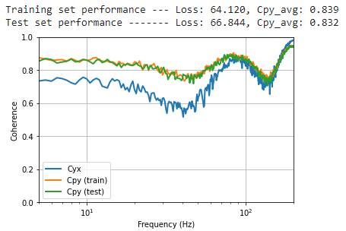
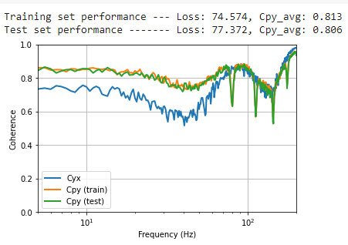
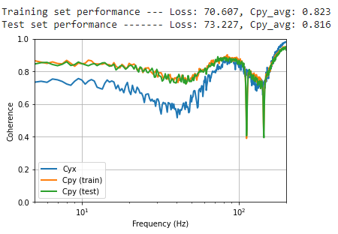
CNN, layers:7, skip:1, kernel width:4, tanh, validation set, 100 epochs
Number of parameters: 12925

Slide 12
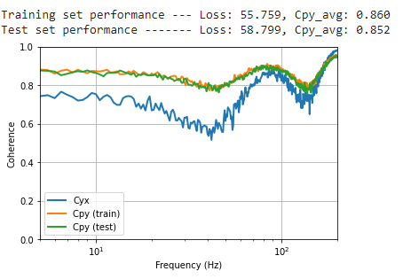
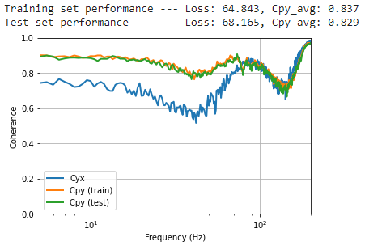
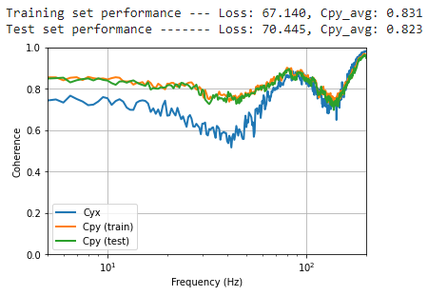
CNN, layers:7, skip:1, kernel width:3, tanh, validation set, 100 epochs (layers in factors of 6)
Number of parameters: 18217

Slide 14
Nonlinear Damping
Parameters used:
P.kl = 2e4; P.kn = 0*5e12;
P.cl = 50; P.cn = 1e7;
P.cn2 = 1.3e5; % Square term for non-linear damping
T = 200; dt = 2^-12;
Input:
F = 10 * randn(length(taxis), 1);
Total 20 datasets

Slide 15
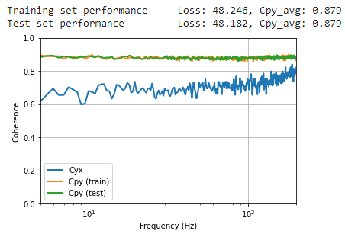
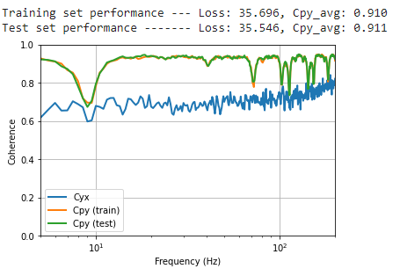
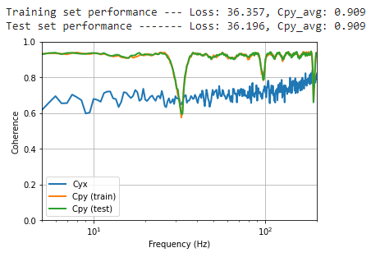
CNN, layers:11, skip:1, kernel width:2, tanh, validation set, epochs:100, (layers in factors of 4)

Slide 16
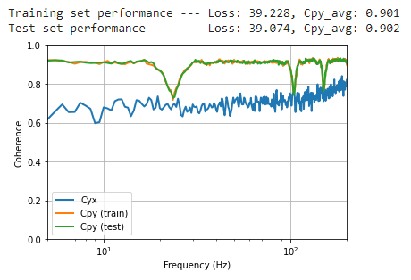
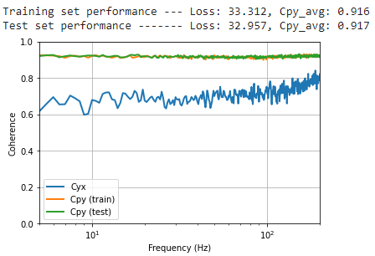
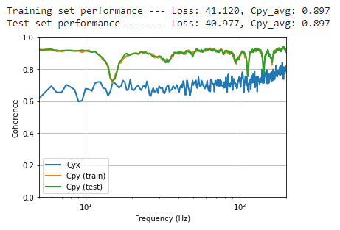
CNN, layers:11, skip:1, kernel width:2, relu, validation set, epochs:100, (layers in factors of 4)

Slide 17
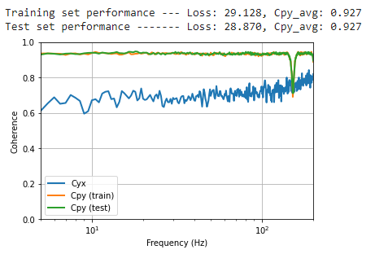
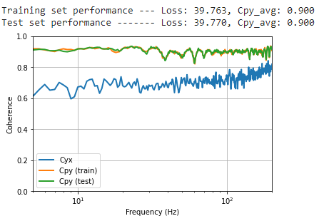
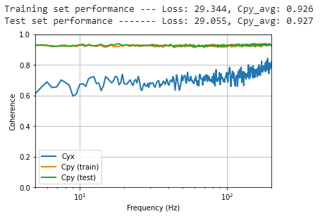
CNN, layers:7, skip:1, kernel width:3, tanh, validation set, (layers in factors of 4)
Number of parameters: 8161

Slide 18
Notes
Decreasing layers and increasing kernel width reduces training time!

Slide 19
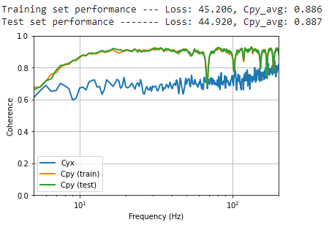
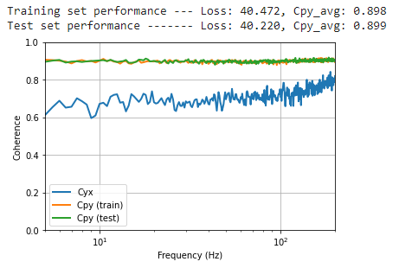
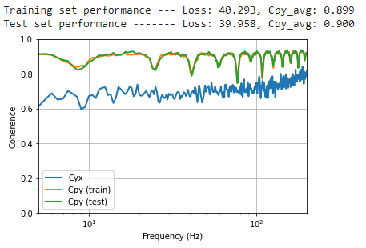
CNN, layers:7, skip:1, kernel width:3, relu, validation set, 100 epochs, (layers in factors of 4)

Slide 20
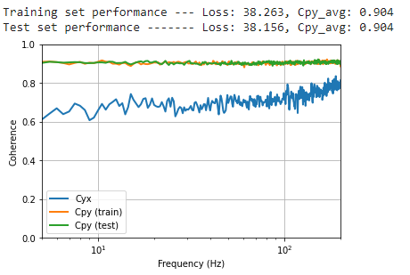
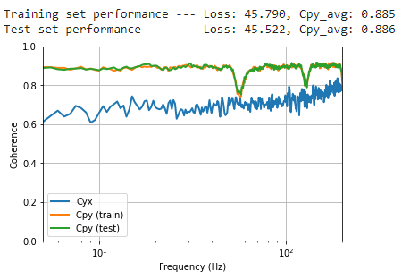
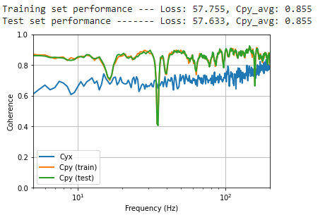
CNN, layers:7, skip:1, kernel width:4, tanh, validation set, (layers in factors of 4)

Slide 21
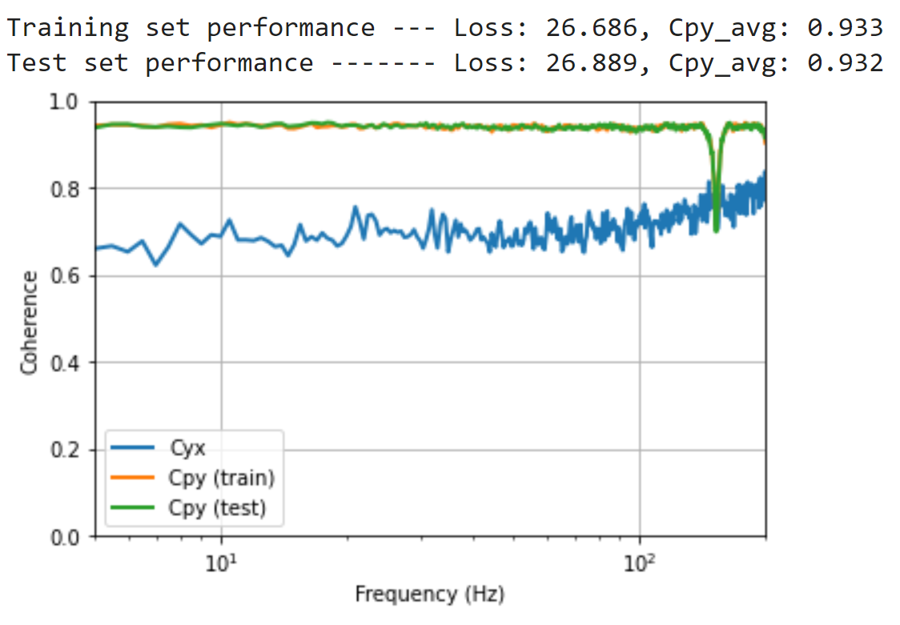
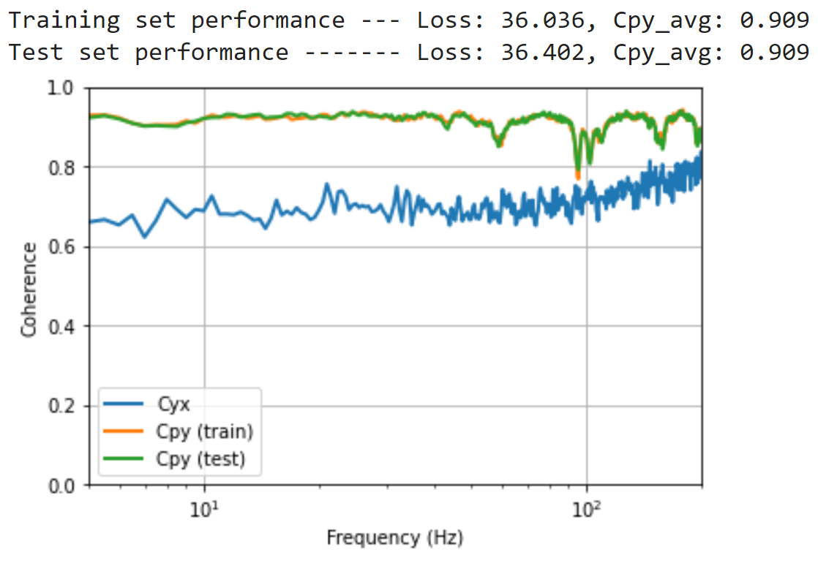
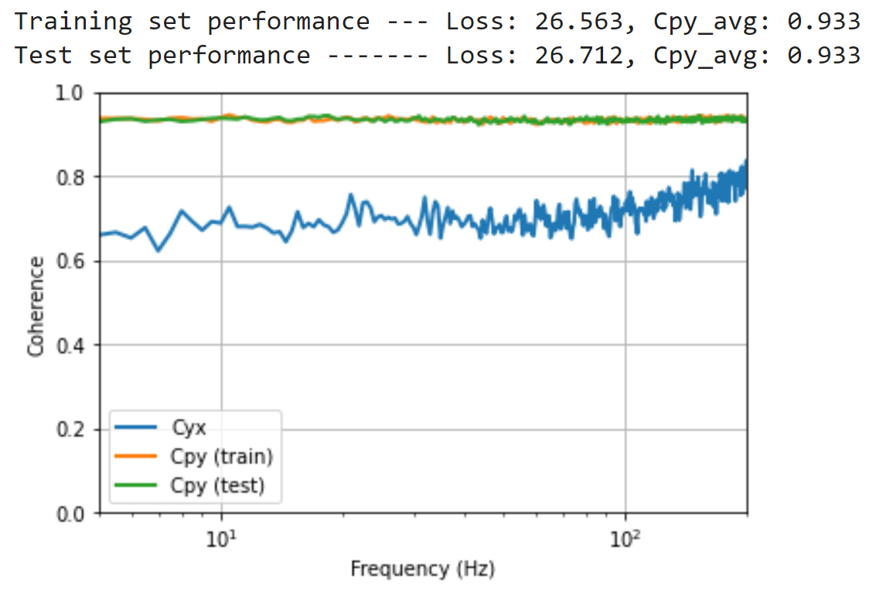
CNN, layers:7, skip:1, kernel width:4, tanh, validation set, (layers in factors of 6)

