Slide 1
Studying Intermediate layers

Slide 2
model1
Original Loss function (summing up losses at individual frequencies)
Hyperparameters:
Hpar = {'layers' : 11,
'skips' : 1,
'activation' : 'tanh',
'kernel_width’ :2}
Channels in factors of 4
21101 total parameters
Nonlinear stiffness

Slide 3
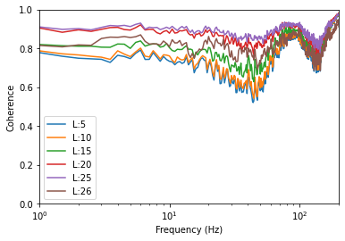
Plotting multiple coherence output after each skip connection (after the activation)
Most of the work done between 3rd and 4th skip connection (15th and 20th layer), between green and red.
Final output (L:26, brown) lower coherence than multiple coherence of the penultimate output layer.

Slide 4
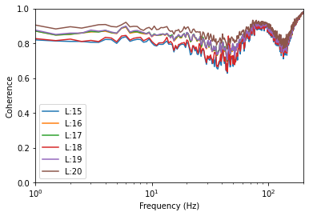
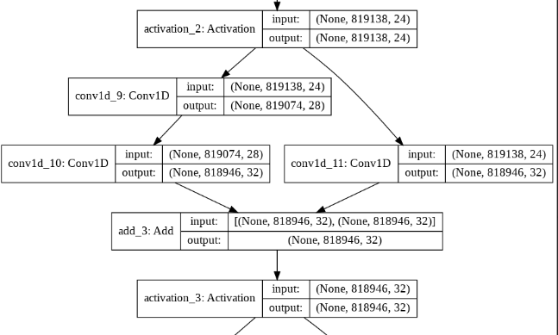
17 and 18 (layers being added) have a linear activation. No increase in coherence from 15 to 18 and 16 to 17.

Slide 5
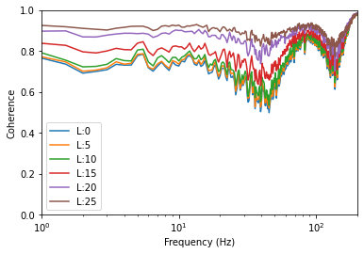
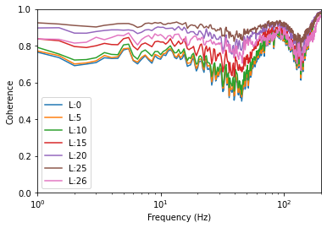
With different training set (model1_s_2)
Average mcoherence:
25: 0.8978
26: 0.832

Slide 6
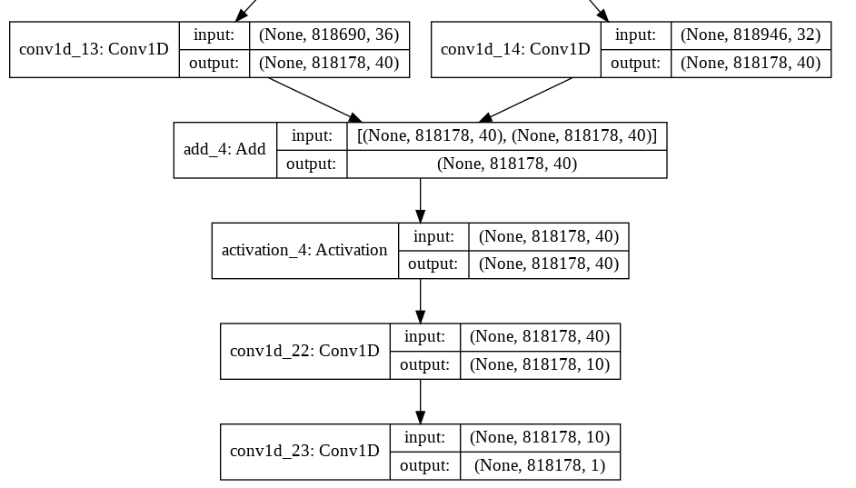
model1_s_3
Instead of the original output, has the following output
Number of trainable parameters increased to 21481

Slide 7
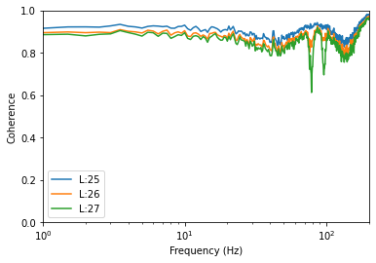
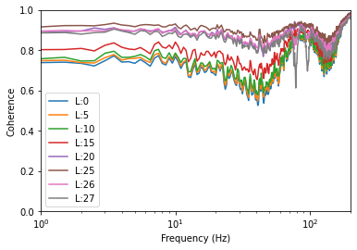
Decrease in coherence in final layer not as significant but major drops in coherence.
Average mcoherence:
25: 0.8982
26: 0.8592
27: 0.8398

Slide 8
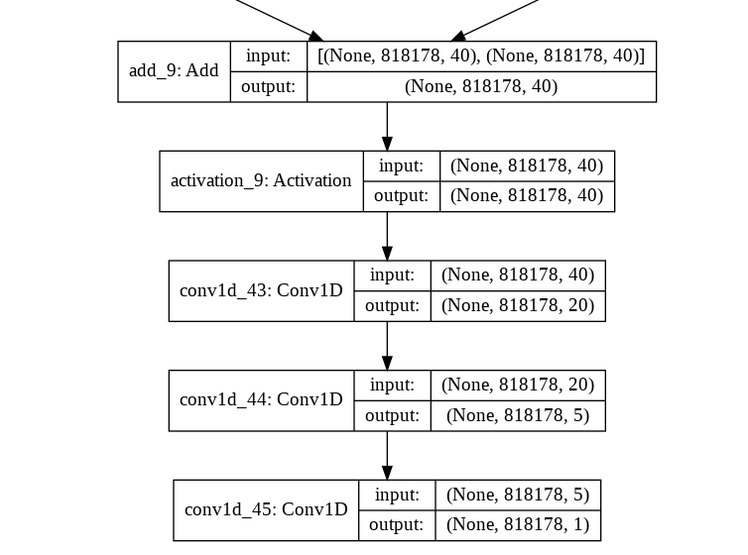
model1_s_4
Instead of the original output, has the following output
Number of trainable parameters increased to 21991

Slide 9
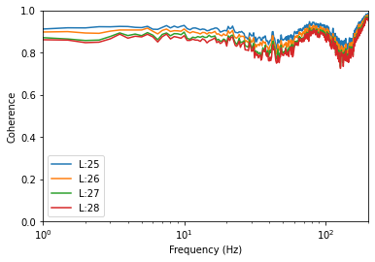
Multiple coherence averages
25: 0.8976
26: 0.8764
27: 0.8550
28: 0.8460

Slide 10
Nonlinear Damping

Slide 11
model1_d
Hpar = {'layers' : 11,
'skips' : 1,
'activation' : 'tanh',
'kernel_width' :2}
Channels in factors of 4
Nonlinear damping

Slide 13
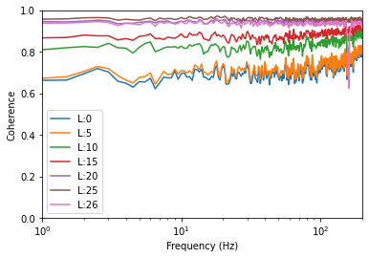
Coherence of final layer still lower than multiple coherence of penultimate layer.
Not much done during first skip layer
The large dip in coherence at ~150Hz only seen in final output layer, not within the network.

Slide 14
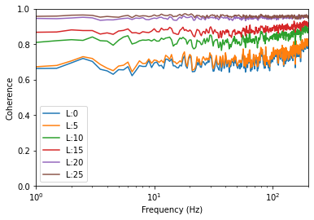

Slide 15
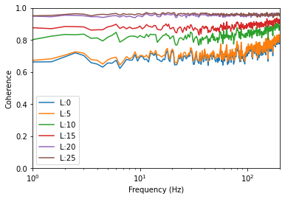
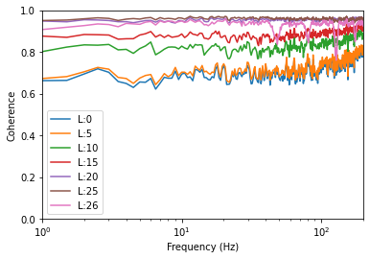

Slide 16
model2_s
Hpar = {'layers' : 7,
'skips' : 1,
'activation' : 'tanh',
'kernel_width' :3}
Channels in factors of 4
Nonlinear stiffnesss
8161 total parameters

Slide 17
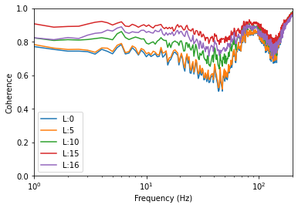
Plotting multiple coherence output after each skip connection (after the activation)
Almost no difference after first skip connection, but even increase after 2nd and 3rd skip connection
Again, final output coherence lower than multiple coherence of penultimate layer
Same results when repeated with a different test set

Slide 18
model2_d_1
Hpar = {'layers' : 11,
'skips' : 1,
'activation' : 'tanh',
'kernel_width' :2}
Channels in factors of 4

Slide 19
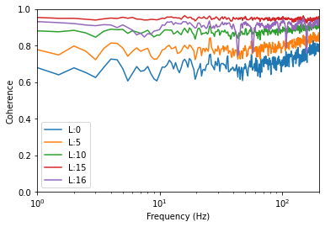
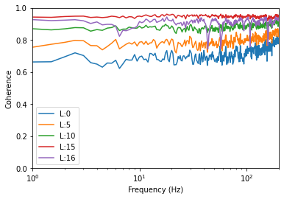

Slide 20
model3_s_1
Hpar = {'layers' : 11,
'skips' : 1,
'activation' : 'tanh',
'kernel_width' :2}
Channels manually defined
array([ 6, 12, 18, 24, 30, 36, 42, 30, 18, 6])
21817 parameters

Slide 21
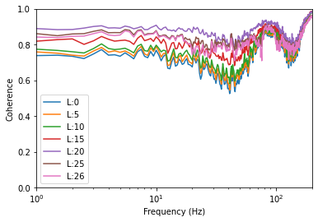
Decrease from 20 to 25, and 25 to 26 slightly
Coherence values:
20: 0.8798
25: 0.8422
26: 0.8301

Slide 22
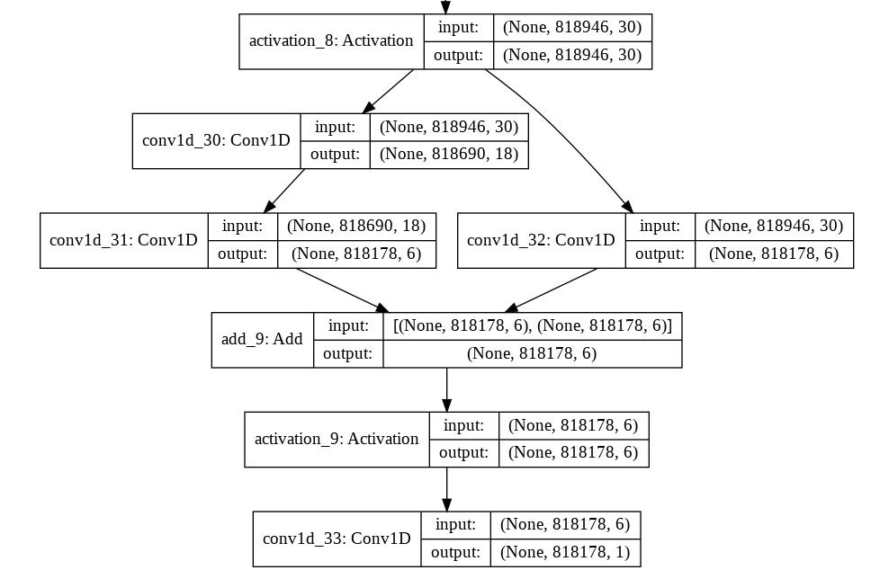
Jumps from 30 to 6 in 1 skip connection

Slide 23
model3_s_2
Hpar = {'layers' : 11,
'skips' : 1,
'activation' : 'tanh',
'kernel_width' :2}
Hpar['channels'] = np.array([6, 12, 18, 24, 30, 36, 30, 24, 18, 12])
19435 parameters

Slide 24
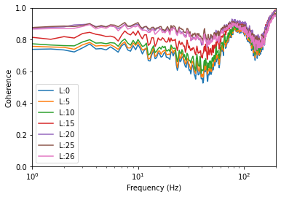
Performance drop not as large
But overall performance not as good
Coherence averages:
20: 0.8677
25: 0.8599
26: 0.8446

Slide 25
model3_s_3
Hpar = {'layers' : 11,
'skips' : 1,
'activation' : 'tanh',
'kernel_width' :2}
Channels: Hpar['channels'] = np.array([8, 16, 24, 32, 40, 24, 32, 16, 24, 8])

Slide 26
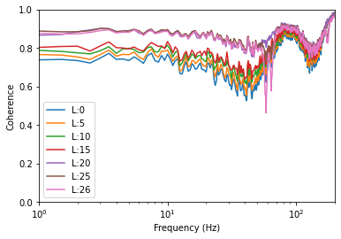
All of the work done in the increasing layers, but with this skip structure the coherence doesn’t drop when the channels decrease
Downspikes in coherence (mainly in the last layer)
Average multiple coherence
20: 0.8681
25: 0.8606
26: 0.8454

Slide 27
model4_s_1
Hpar = {'layers' : 7,
'skips' : 1,
'activation' : 'tanh',
'kernel_width' :3}
Channels in factors of 6

Slide 28


