Slide 1
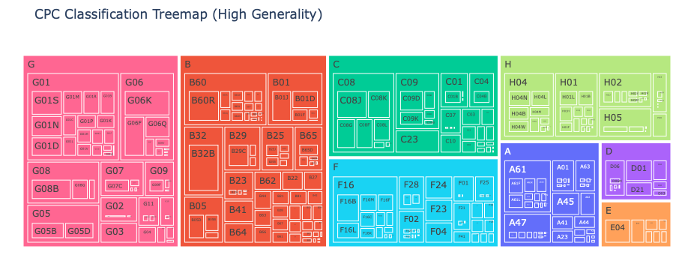
B32B:LAYERED PRODUCTS
G08B:SIGNALLING OR CALLING SYSTEMS; ORDER TELEGRAPHS; ALARM SYSTEMS
B06R:VEHICLES, VEHICLE FITTINGS, OR VEHICLE PARTS, NOT OTHERWISE PROVIDED FOR
G06K:GRAPHICAL DATA READING; PRESENTATION OF DATA; RECORD CARRIERS; HANDLING RECORD CARRIERS
C08J:WORKING-UP; GENERAL PROCESSES OF COMPOUNDING; AFTER-TREATMENT NOT COVERED BY SUBCLASSES C08B, C08C, C08F, C08G C08H
G05B:CONTROL OR REGULATING SYSTEMS IN GENERAL; FUNCTIONAL ELEMENTS OF SUCH SYSTEMS; MONITORING OR TESTING ARRANGEMENTS FOR SUCH SYSTEMS OR ELEMENTS
G06F:ELECTRIC DIGITAL DATA PROCESSING
F16B:DEVICES FOR FASTENING OR SECURING CONSTRUCTIONAL ELEMENTS OR MACHINE PARTS TOGETHER, e.g. NAILS, BOLTS, CIRCLIPS, CLAMPS, CLIPS OR WEDGES; JOINTS OR JOINTING
G05D:SYSTEMS FOR CONTROLLING OR REGULATING NON-ELECTRIC VARIABLES
B01J:CHEMICAL OR PHYSICAL PROCESSES, e.g. CATALYSIS OR COLLOID CHEMISTRY; THEIR RELEVANT APPARATUS

Slide 2
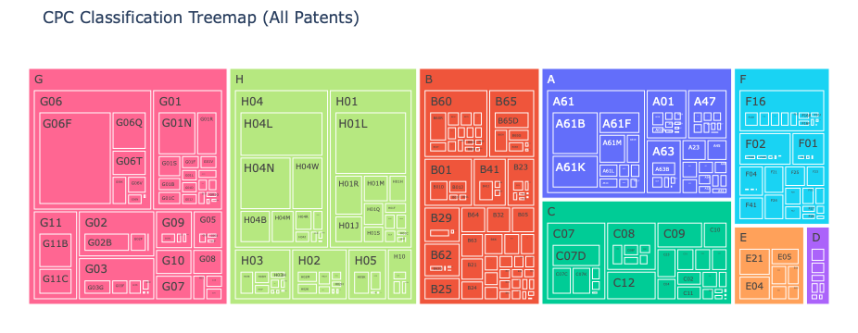
G06F: ELECTRIC DIGITAL DATA PROCESSING
H01L: SEMICONDUCTOR DEVICES NOT COVERED BY CLASS H10
H04L: TRANSMISSION OF DIGITAL INFORMATION
H04N: PICTORIAL COMMUNICATION
A61B: DIAGNOSIS; SURGERY; IDENTIFICATION
A61K: PREPARATIONS FOR MEDICAL, DENTAL OR TOILETRY PURPOSES
G01N: INVESTIGATING OR ANALYSING MATERIALS BY DETERMINING THEIR CHEMICAL OR PHYSICAL PROPERTIES
C07D: HETEROCYCLIC COMPOUNDS
G02B: OPTICAL ELEMENTS, SYSTEMS OR APPARATUS
H04W: WIRELESS COMMUNICATION NETWORKS

Slide 3
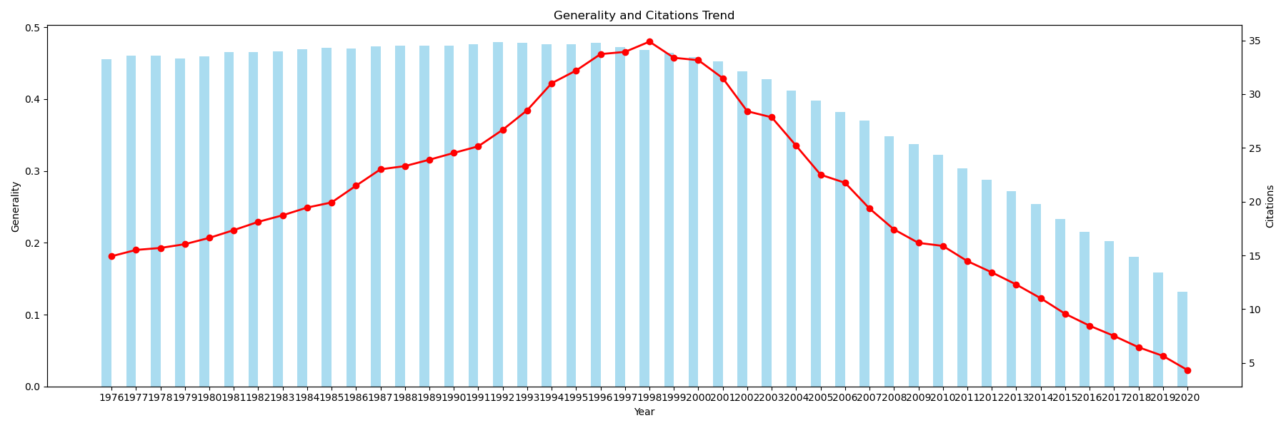
Patents are becoming less general
Mean generality and citations, for patents with at least 1 citation
Bar: average generality
Line: average citations

Slide 4
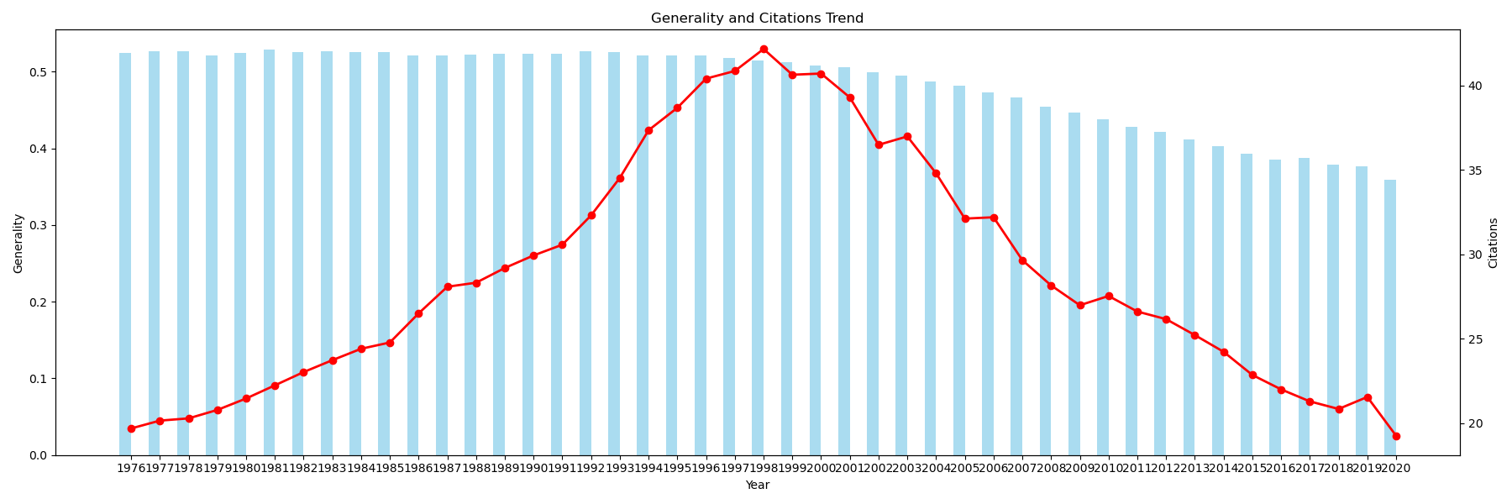
Patents are becoming less general
Mean generality and citations, for patents with at least 5 citation
Bar: average generality
Line: average citations

Slide 5
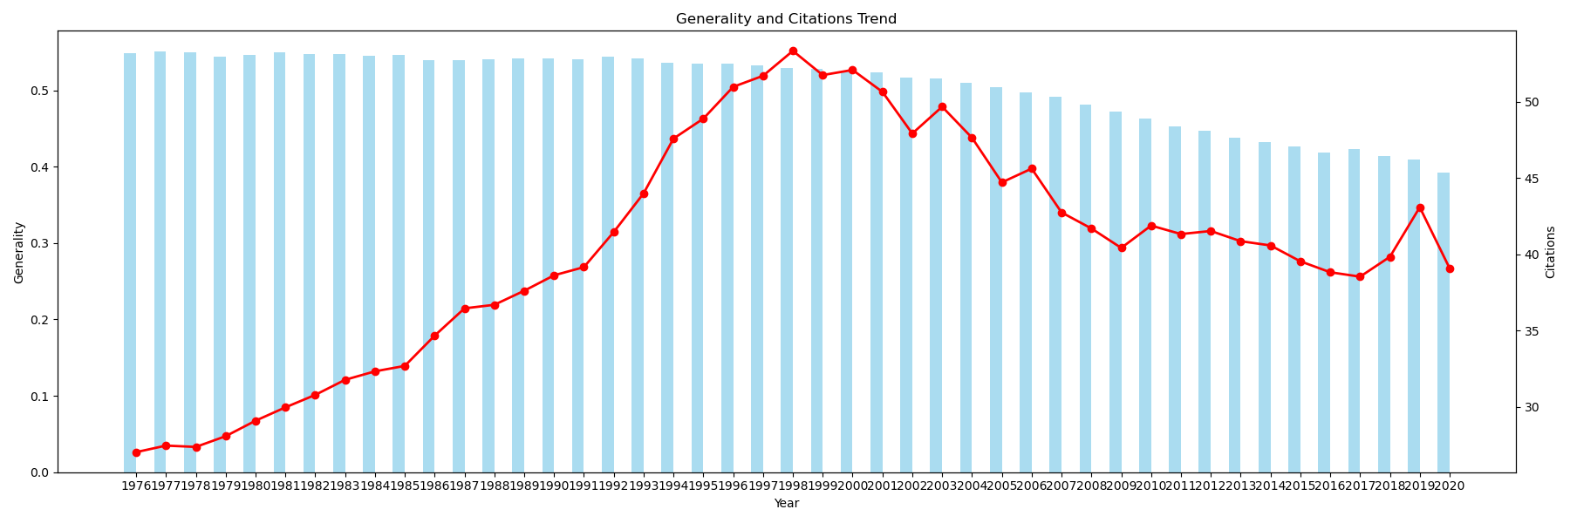
Patents are becoming less general
Mean generality and citations, for patents with at least 10 citation
Bar: average generality
Line: average citations

Slide 6
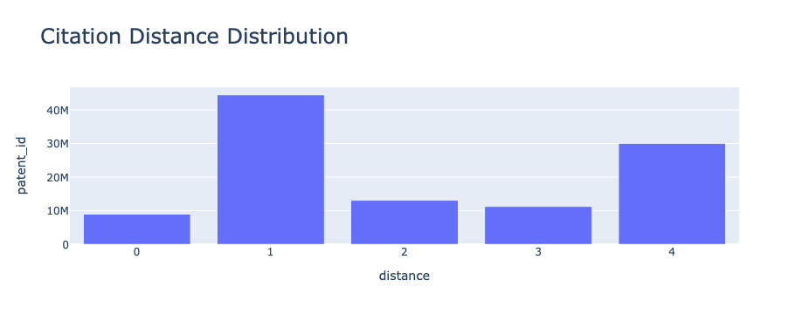
Distance: 0 if exactly same CPC 1 if same subclass, different CPC 2 if same class, different subclass 3 if same section, different class
4 if different section

Slide 7
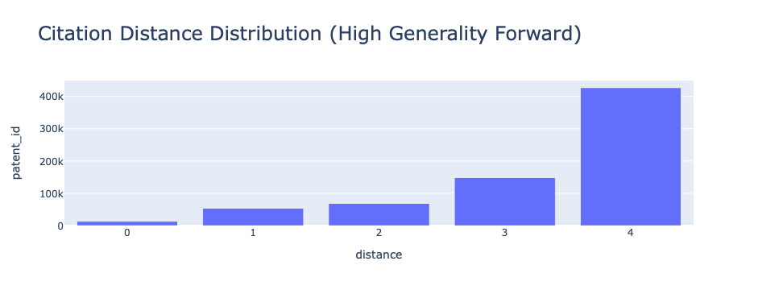
Distance: 0 if exactly same CPC 1 if same subclass, different CPC 2 if same class, different subclass 3 if same section, different class
4 if different section
High generality (>=0.9)

Slide 8
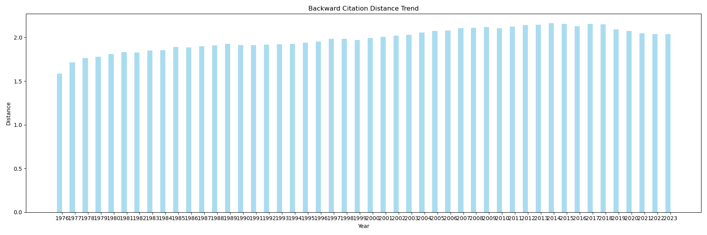
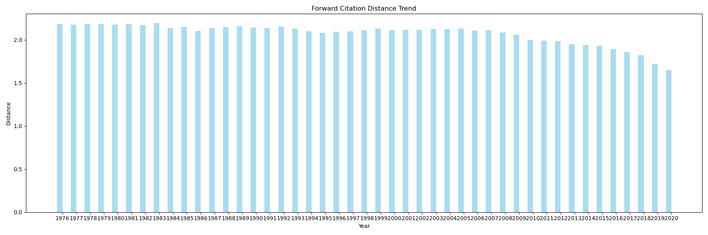

Slide 9
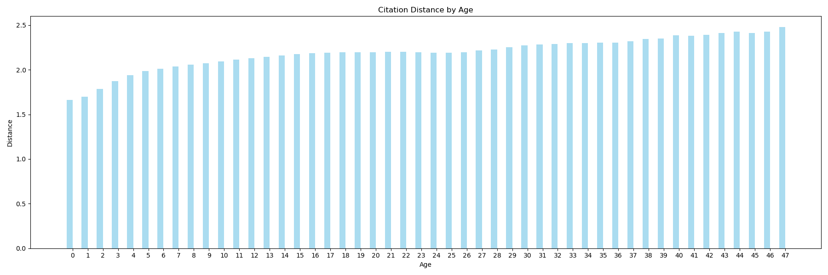

Slide 10
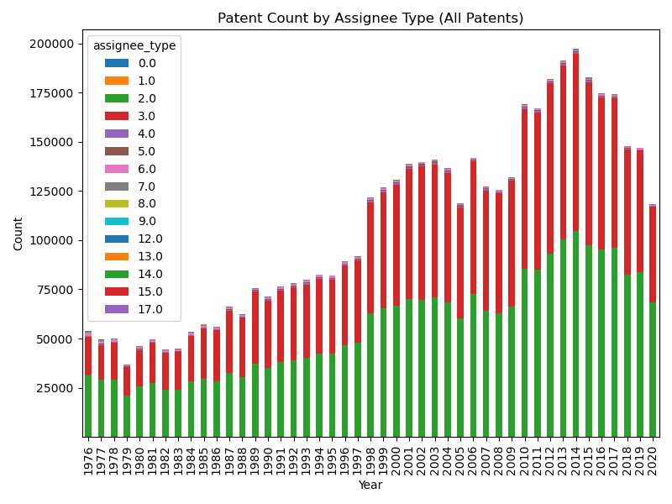

Slide 11
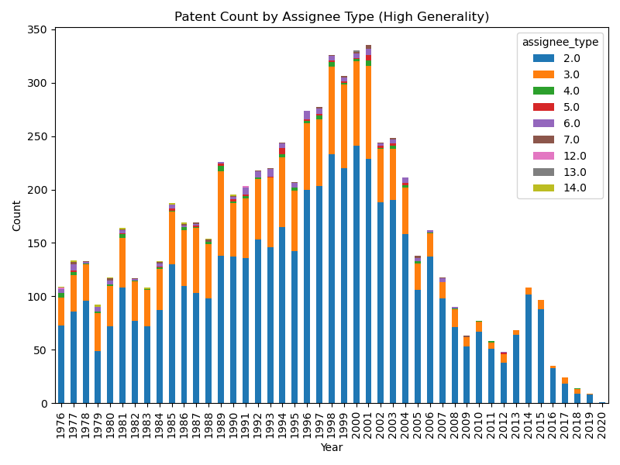

Slide 12
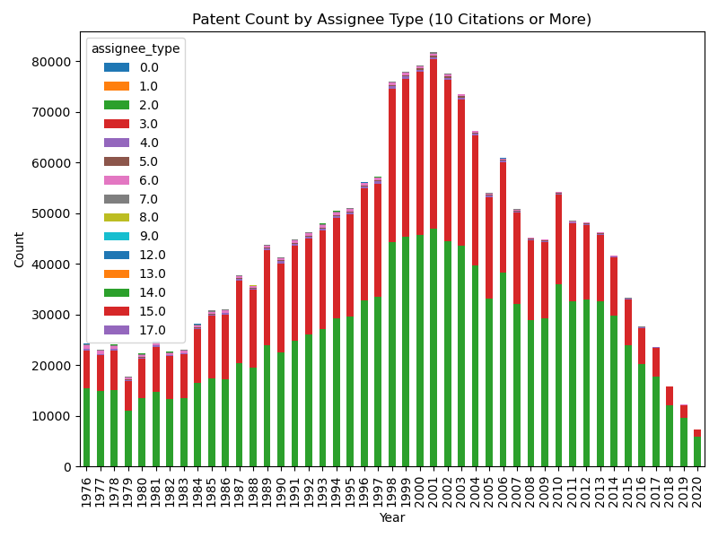

Slide 13
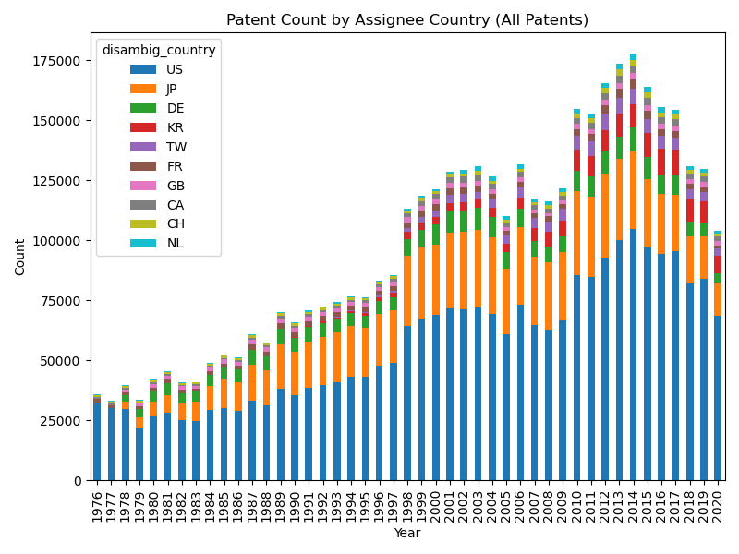

Slide 14
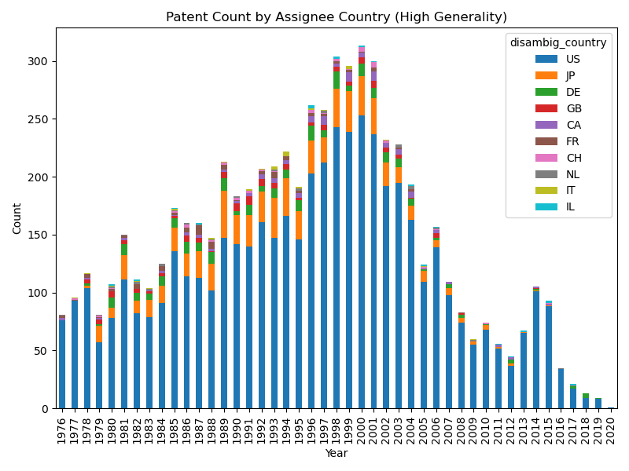

Slide 15
