Slide 1
Vanguard Digital Experience
A/B Test Results — New UI vs. Legacy Process
Kseniia, Nadiya, Carla
1 / 9
Notes:
Good morning. Let me introduce our team — my name is Kseniia, and together with Nadia and Carla, we've prepared something interesting to discuss with you today. In the next ten minutes we'll walk through Vanguard's digital experience A/B test — the new step-by-step process versus the old one. I'll open with whether this experiment was set up fairly. Nadia will then cover completion and speed, and Carla will show where customers drop off and whether the new design fixed that. And I'll come back at the very end with one thing that's still a problem, before we wrap up.

Slide 2
The Digital Challenge
The idea: a more intuitive UI, paired with in-context prompts — cues, hints, and instructions delivered right when a client needs them — could make the online process easier to complete.
The question: would this actually get more clients to finish the process, not just feel nicer to use?
The Experiment Conducted
A live A/B test — real clients, randomly split:
Control
the existing process
Test
redesigned UI + in-context prompts
Everything that follows is us checking whether that idea held up.
2 / 9
Notes:
Here's the idea behind this project. Vanguard believed that a more intuitive interface, combined with in-context prompts — small cues and hints delivered right when a client needs them — could make the online process easier to get through. But the real question wasn't whether it would feel nicer to use, it was whether it would actually get more clients to finish. To test that, Vanguard ran a live A/B experiment — real clients, randomly split between the existing process, our Control group, and the redesigned UI with in-context prompts, our Test group. Everything we're about to walk you through is us checking whether that idea actually held up.

Slide 3
Is the experiment valid?
Checking Test vs. Control before trusting any result
50,500 clients in the experiment — 53% Test / 47% Control
 | Control | Test
Avg. balance | $150,147 | $148,963 | not significant
Avg. age | 47.5 yrs | 47.2 yrs | significant, but tiny
Avg. tenure | 12.1 yrs | 12.0 yrs | not significant
Calls / logons (6mo) | slightly higher | slightly lower | significant, but tiny
All effect sizes: Cohen's d < 0.04 — negligible
Groups are well balanced. What follows is attributable to the UI, not to who ended up in which group.
3 / 9
Notes:
Before trusting any result, we checked whether Test and Control were actually comparable — balance, age, tenure, engagement. A few metrics come out as statistically significant, but only because the sample is huge; with over 50,000 clients, even a fraction-of-a-unit difference clears that bar. What matters more is effect size, and every single one is under 0.04 on Cohen's d — negligible. So the randomization worked, and everything we show you next can be attributed to the new UI, not to lopsided groups. I'll hand it to Nadia now, and I'll come back at the end with one thing that's still unresolved.

Slide 4
Do customers complete the journey faster?
Completion rate and completion time, Test vs. Control
Completion rate
Reaching confirm at all
Completion time (median)
Control → Test
Control → Test
Control → Test
35.2% → 36.6%
47.7% → 57.7%
4.07 → 3.33 min
+1.5 pts · significant, small effect
+10 pts · clearest behavioral difference
significant · Cohen's d = 0.13
Test converts more people to confirm, and does it faster.
4 / 9
Notes:
So does the new design actually work? Two things get better in Test. First, more people reach confirmation at all — 57.7% versus 47.7% in Control, a ten-point jump, and that's the single clearest behavioral difference we found. Second, among people who succeed, they get there faster — median completion time drops from about four minutes to three and a third. Both differences are statistically significant. The effect size on speed is small, so don't expect anyone to feel a dramatic difference — but directionally, and at scale, this is a real win for Test.

Slide 5
What else can we say about the success path?
Stress-testing the result, not just reporting it
Not driven by outliers
Excluding unusually long journeys, Test is still faster: 3.80 min vs. 4.34 min (full data: 3.33 vs. 4.07)
The gap is real, not noise
95% CI on the completion-rate difference: +0.69 to +2.12 points — entirely positive, never crosses zero
Assumptions checked, not assumed
Levene's test confirmed unequal variance (p = 0.0001) → Welch's t-test was the right call, not just a default
This holds up under scrutiny — the effect is real, even if it's modest in size.
5 / 9
Notes:
Before we move on, a quick word on how solid this result actually is. It's not a couple of outliers dragging the average — if we strip out unusually long journeys, Test is still faster than Control. It's not noise either — the confidence interval on the completion-rate gap is entirely positive, it never crosses zero. And we didn't just default to a standard test — we checked the variance between groups first, confirmed it was unequal, and used the right statistical test for that. So: real, if modest.

Slide 6
Where and why do customers abandon?
Abandoned = reached start, never reached confirm
Furthest step reached before giving up (all abandoned journeys, 67,770 total)
Start only
39.7%
Step 1
22.6%
Step 2
15.2%
Step 3
22.5%
Nearly 1 in 4 abandoners made it all the way to Step 3 — right before confirmation — and still walked away.
6 / 9
Notes:
So who exactly are we losing? We defined abandonment simply: a journey that starts but never reaches confirmation. About 40% of those people never get past the start screen at all — that's a first-impression problem. But look at the other end: almost a quarter of all abandoners make it all the way to Step 3, the very last step before confirming, and still don't finish. That's not disinterest — that's friction right at the finish line, and it tells us this isn't just one problem, it's at least two different ones.

Slide 7
Did we fix the problem with abandonment?
Abandonment rate improved — but that's not the whole story
Abandonment rate
Time before giving up (median)
Control → Test
Control → Test
49.7% → 41.0%
0.52 → 1.43 min
−8.7 points
~3x longer, not sooner
Fewer people abandon in Test — but the ones who still do stick around much longer before quitting. That's not pure good news; it could mean the new flow is more engaging, or that it strings people along further before they give up.
7 / 9
Notes:
So, did the redesign fix abandonment? Partly. The abandonment rate drops meaningfully — from about 50% down to 41%. That's a real win. But look at how long people wait before giving up: in Control, the typical abandoner leaves in about half a minute. In Test, it's a minute and a half — almost three times longer. That's not necessarily bad, it could mean people are more engaged and trying harder before quitting. But it could also mean the new flow pulls people further in before it fails them. Either way, we shouldn't call this fully solved.

Slide 8
What problems do we still have?
Looking at journeys that reached confirmation
Error rate
Backward navigation
confirmed journeys that weren't a clean path
any journey, whole population
Control → Test
Control → Test
48.2% → 54.6%
34.4% → 37.8%
More than half of confirmed journeys in Test still show errors — the redesign hasn't closed this gap, it's grown slightly wider.
8 / 9
Notes:
I want to come back to something now that Carla's shown you the full picture on abandonment. Even among people who successfully confirmed, we looked at whether they got there cleanly or with errors — repeated steps, backtracking, that kind of thing. In Control, 48% of confirmed journeys had errors. In Test, that's 55%. And this lines up with a second, independent measure — how often people navigate backward at all — which shows the same gap, 34% versus 38%. So before we wrap up: this is a real, corroborated pattern, and the new UI hasn't fixed it — by this measure, it's slightly worse.

Slide 9
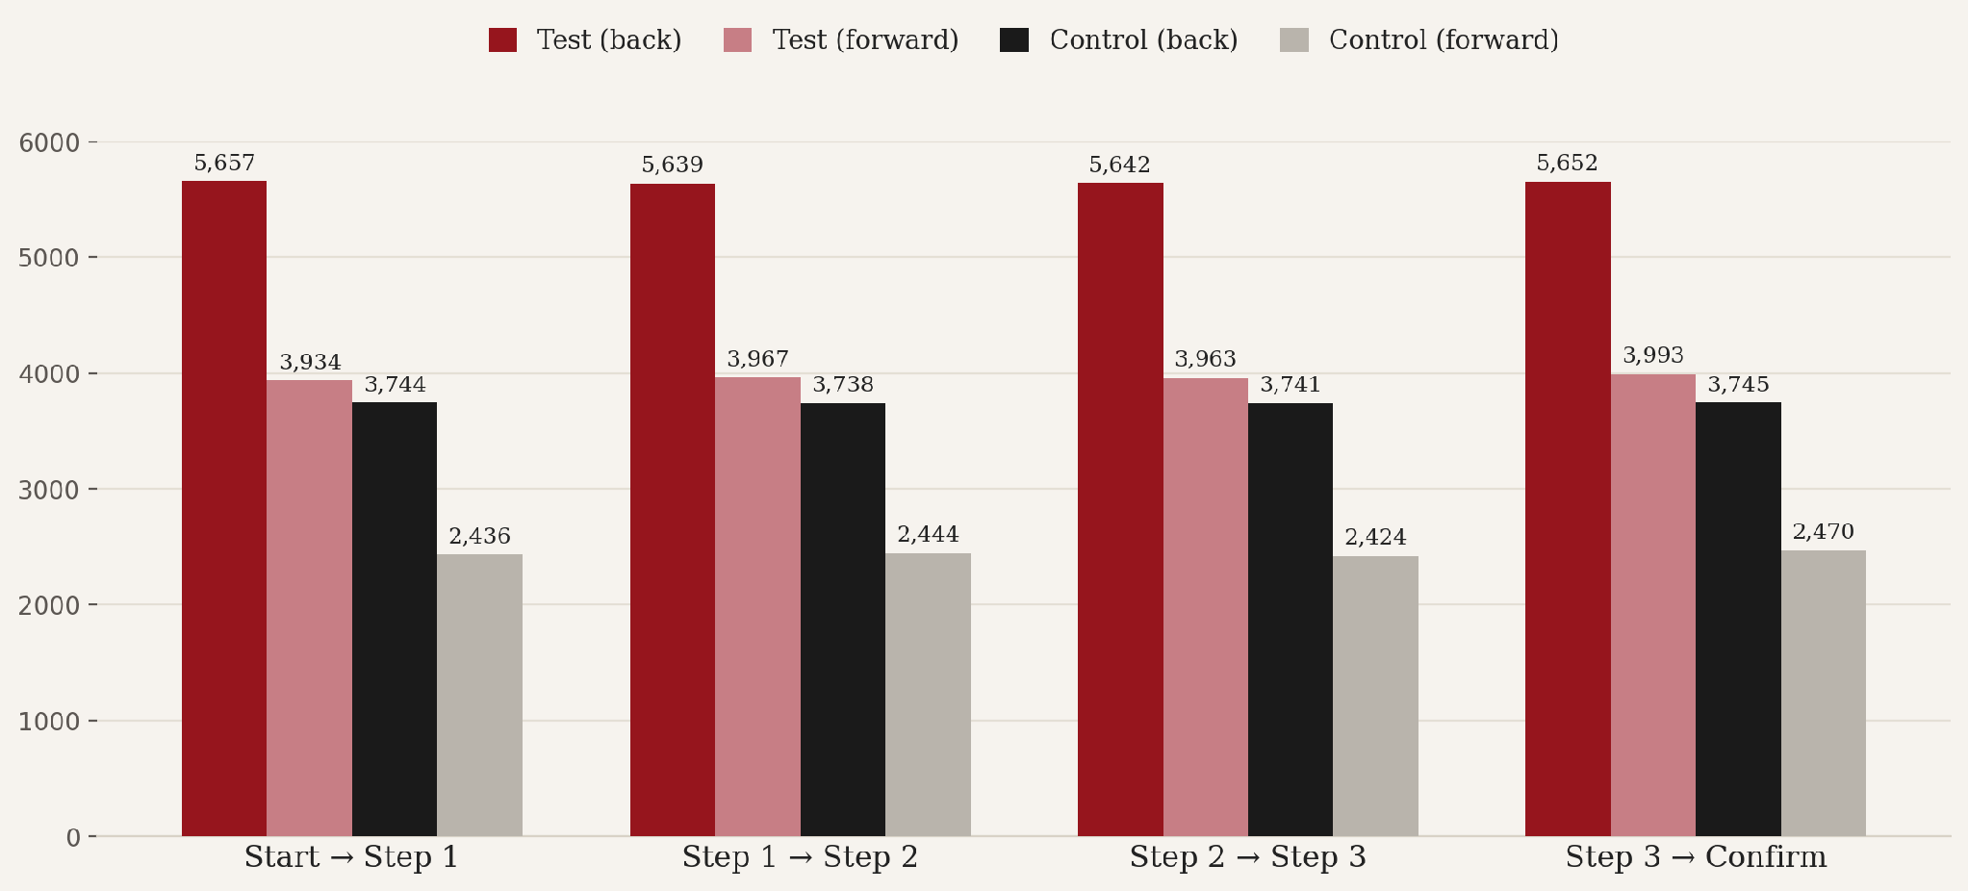
Backward vs. forward navigation, by step
9 / 9

Slide 10
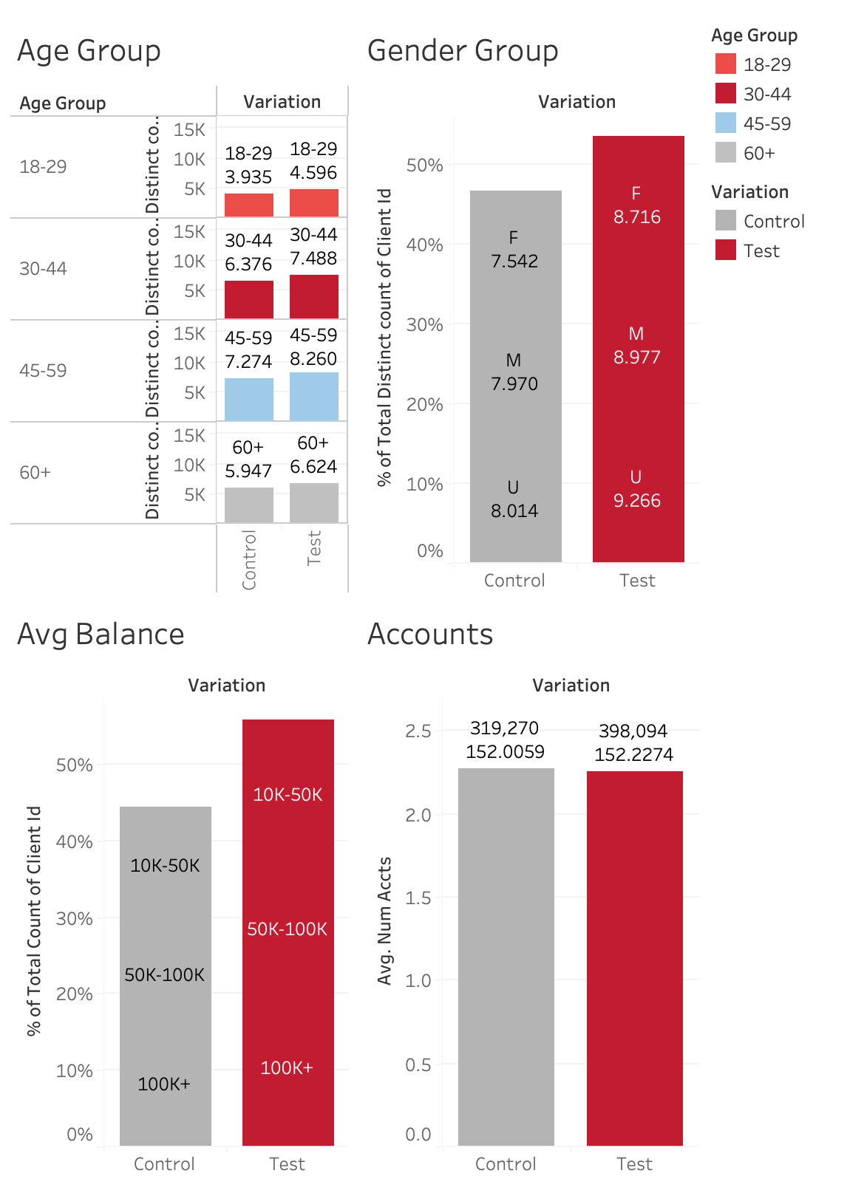
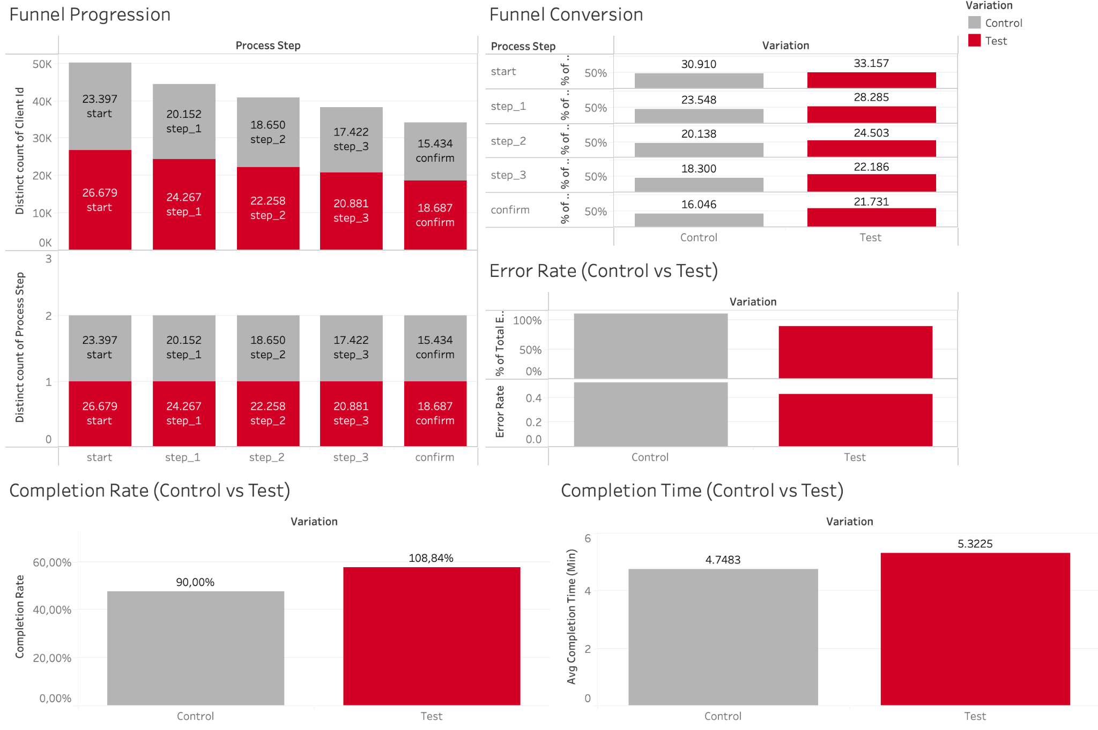
Dashboard. Customer Journey and Customer Demographic
9 / 9

