Slide 1
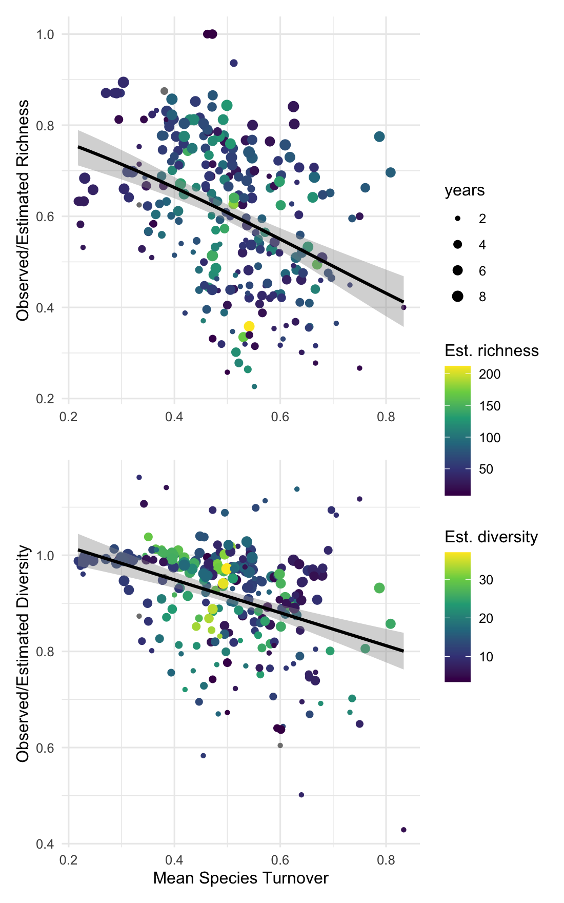
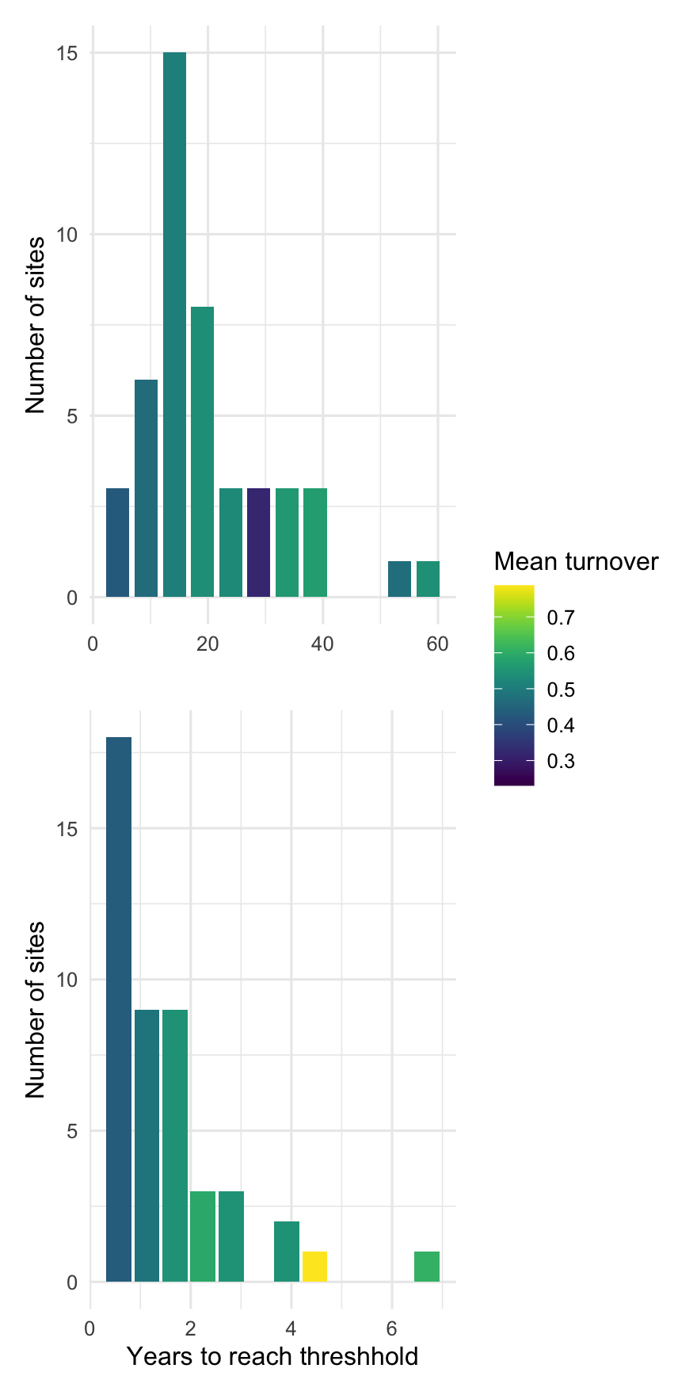
(a)
(c)
a/b is exported as 500 x 800 pixels;
c/d as 400 x 800
(b)
(d)

