Slide 1
BROWN UNIVERSITY INVESTMENT OFFICE
Private Fund Holdings
Data-State Analysis
Objective 1 — completeness and cleanliness scorecard across field, fund and manager
DSI Capstone · Phase 1 deliverable
52,048
385
101
8,633
329
HOLDINGS
FUNDS
MANAGERS
COMPANIES
FIELDS
Data period: December 2024 – March 2026 · Confidential

Slide 2
SCOPE
What we were asked to deliver
The Investment Office receives 400+ fund reports as non-standard PDFs. A third-party vendor flattens them into one CSV. Before that CSV can support any analysis, its trustworthiness has to be measured.
MANDATE (PROJECT BRIEF)
THIS DELIVERABLE (OBJECTIVE 1)
Identify missing data and its cause
Completeness scored by field, by fund, by manager
Catch the same company reported under different names
Gap concentration quantified and ranked
Flag fields that should always be populated but are not
Flagged-record extract for GP follow-up
Design repeatable procedures Operations can run
Entity-resolution scope sized for Phase 2
Success test from the brief: every major field assessed, and findings clear enough for Operations to prioritise remediation without a data scientist in the room.
Source: Private Fund Holdings — Project Detail, Brown University Investment Office
1

Slide 3
APPROACH
Method
01
Load and inspect
837 columns profiled; zero-information attributes dropped
SCORING RULE
Exclude non-investments
Completeness of a fund =
non-null mandatory cells
———————————————
real rows × 7 fields
02
Cash, other assets and liability lines removed from scoring
03
Score by field
Fill rates overall and by functional category
04
Score by fund
Seven mandatory fields:
Deal Status · Current Cost ·
Unrealized Value · Capital Invested
Sector · Geographic Focus · Total Value
385 vehicles ranked; outliers isolated at ±2σ
05
Score by manager
101 GPs ranked; within-GP fund variance measured
06
Size entity resolution
Companies appearing under more than one fund counted
GUARDRAIL
Managers with fewer than 20 rows are reported separately. Three holdings and one blank Sector should not read as a reporting failure.
07
Export
Flagged records and scorecards written for Operations
Scoring is computed on real investment rows only
2

Slide 4
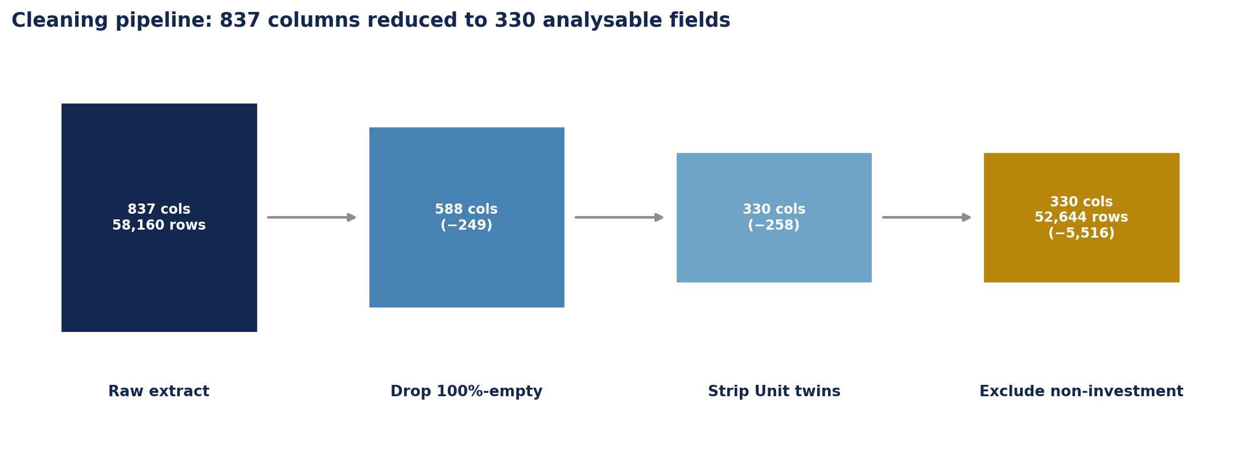
STEP 1 — LOAD AND INSPECT
From 837 columns to 330 analysable fields
COLUMNS 100% EMPTY
"UNIT" METADATA TWINS
COLUMNS FULLY POPULATED
DUPLICATE ROWS
249
258
8
0
carry no information at all
label columns, not data
of 330 survivors
extract is clean on this axis
Two-thirds of the schema is noise. The vendor emits a fixed superset of columns for every fund regardless of strategy, so sparsity here is a schema artefact, not a GP failure — which is why fill rates must be computed after this reduction, not before.
58,160 rows × 837 columns raw extract
3

Slide 5
STEP 2 — CLASSIFY SOURCE ASSET
One column, three different kinds of thing
The vendor puts every line of a GP schedule into Source Asset. Scoring and entity resolution need different subsets of it.
Class
Example
Rows
Score it
Resolve it
holding
Stripe · Valar Co-Invest 13 LP (Qonto)
51,770
Yes
Yes
unnamed_aggregate
Other Investments · Seed Investments
278
Yes
No
balance_sheet
Non-Investment Assets — Cash
5,518
No
No
accounting_entry
Quarterly Unrealized Gain/Loss
577
No
No
subtotal
Subtotal Private Investments
17
No
No
WHAT THE OLD FILTER MISSED
It matched only the Non-Investment prefix. 594 rows of journal entries arriving without that prefix stayed in the population — including a singular "Non-Investment Asset - Cash" the regex did not cover.
WHY AGGREGATES ARE SPLIT OUT
"Other Investments" is real exposure and belongs in a score, but it is not an entity. Counting it as a company puts work in the resolution queue that can never be completed.
Matching is anchored to the whole string, not substrings: the book contains real companies called Itz Cash, Keeper Tax Inc. and Gamma Labs (dba Column Tax). SPV and co-invest vehicles are kept as holdings.
57 regression tests lock this behaviour
4

Slide 6
FINDINGS
Headline results
PORTFOLIO COMPLETENESS
FUNDS AT 100%
FUNDS BELOW −2Σ
90.6%
118
19
mean across 385 funds
30.6% of the book
none above +2σ
MANAGERS BELOW 85%
CROSS-FUND COMPANIES
FLAGGED RECORDS
14
1,107
13,176
of 87 scored
entity-resolution scope
ready for GP follow-up
One number hides the story. 90.6% average completeness looks healthy, but the distribution is one-tailed and the variance sits inside managers, not between them — the next eleven slides take that apart.
All figures computed on 52,048 scorable rows
5

Slide 7
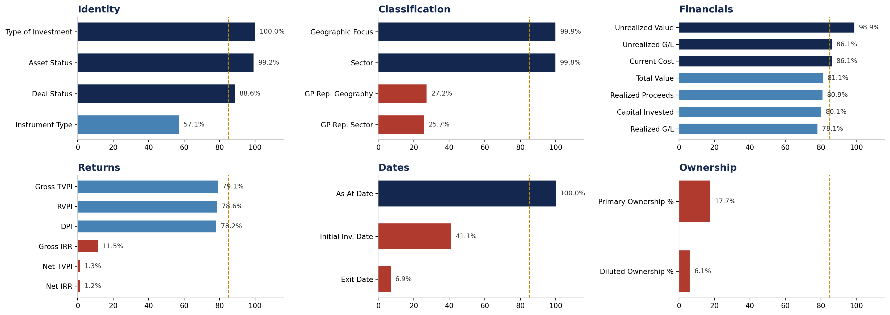
STEP 3 — SCORE BY FIELD
Completeness is not uniform across field families
Identity and classification fields are effectively complete. Financial fields cluster in the low-80s. Returns and ownership fields collapse — and that collapse is the single largest analytical constraint in the dataset.
Gold line = 85% threshold · red bars below 50%
6

Slide 8
FINDING 1
The returns cliff
Gross-level return metrics are broadly reported. Net-level metrics are effectively absent.
Return metric
Fill rate
Usable?
WHY THE GAP IS STRUCTURAL
Net returns are fund-level figures net of fees, carry and expenses. They belong on the capital account statement, not the schedule of investments the vendor parses.
This is an extraction-scope gap, not a GP reporting failure.
Gross TVPI
79.1%
Yes
RVPI
78.6%
Yes
DPI
78.2%
Yes
Gross IRR
11.5%
No
Net TVPI
1.3%
No
Net IRR
1.2%
No
CONSEQUENCE FOR THE INVESTMENT OFFICE
Any net-of-fee performance analysis cannot be sourced from this extract at holding level. Either the capital account reports enter the extraction scope in Phase 2, or net performance stays a fund-accounting output and the holdings CSV is used strictly for gross, position-level work. This should be an explicit decision, not a discovery made mid-analysis.
Recommendation: confirm with the vendor whether capital account statements are in extraction scope before any net-return workstream is committed.
Dates are similarly thin: Exit Date 6.9%, Initial Investment Date 41.1%
7

Slide 9
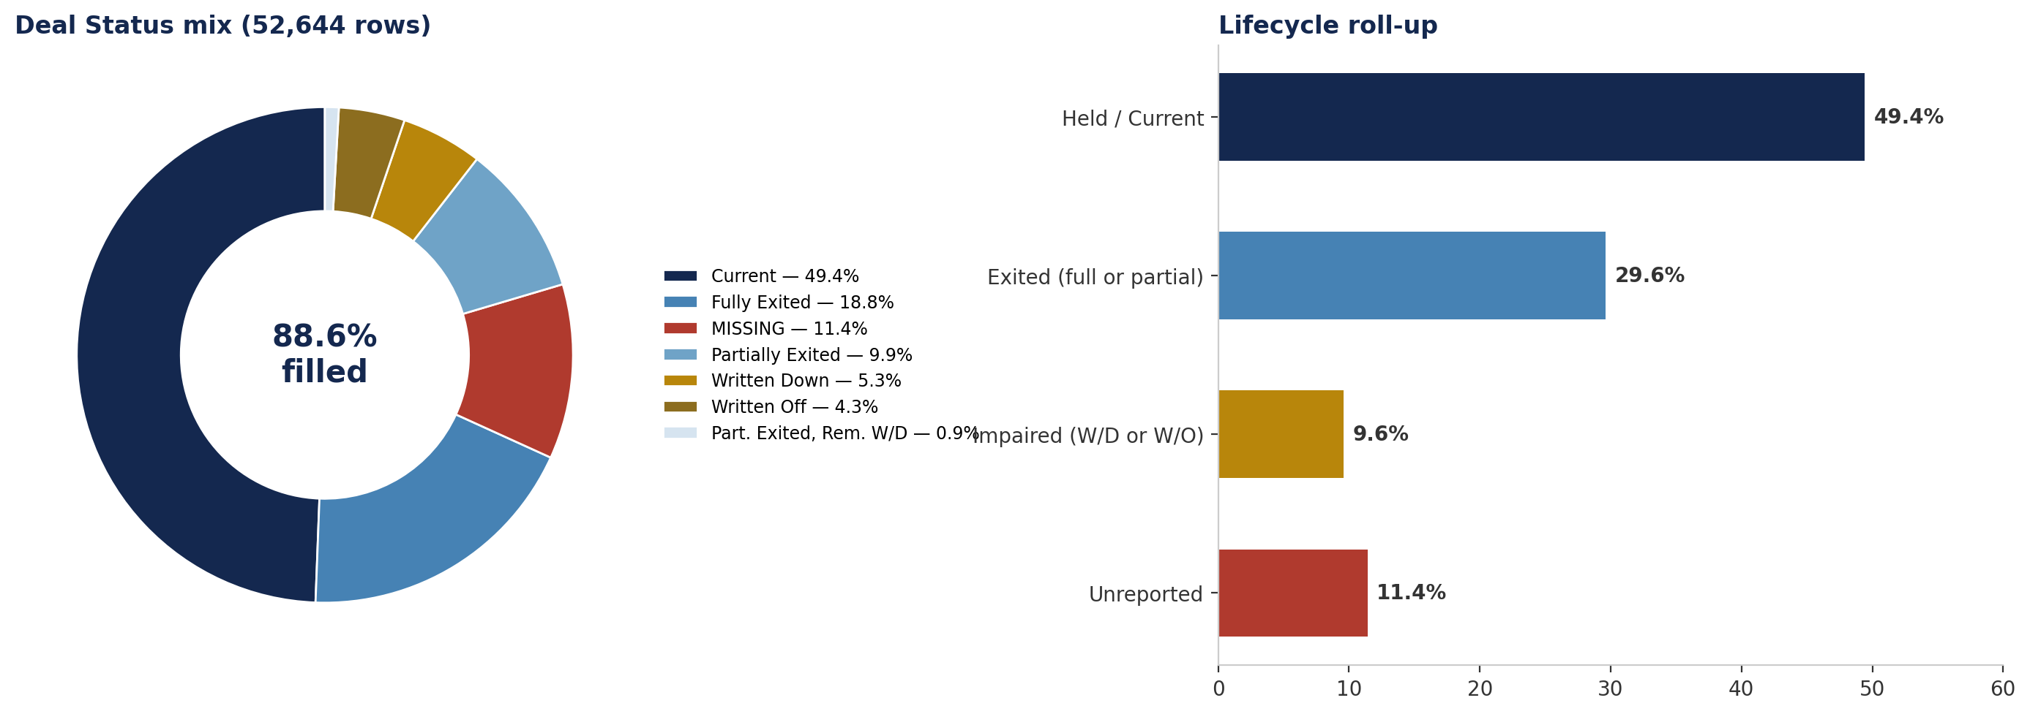
FINDING 2
Deal Status — the field the brief singles out
The brief flags Deal Status as a field that should always carry a value. It is 88.6% filled: 6,639 rows carry no lifecycle marker at all. Those rows cannot be routed to either the current-portfolio view or the realisations view, so they drop silently out of both.
Vocabulary is clean — no typos or inconsistent labels across 52,048 rows
8

Slide 10
STEP 3 — FIELD-LEVEL DISTRIBUTION
Systematic gaps versus scattered gaps
A field 90% complete everywhere is a data problem. A field 100% complete in some funds and 0% in others is a policy choice. Counting funds at zero separates the two.
Mandatory field
Funds at 0% fill
Reading
Sector
0
Universal — no fund omits it
Geographic Focus
0
Universal
Unrealized Value
0
Universal
Deal Status
3
Near-universal; 3 funds opt out entirely
Current Cost
17
Small opt-out cohort
Total Value
58
Structural — 15% of funds never report it
Capital Invested
67
Structural — 17% of funds never report it
Capital Invested and Total Value are not degraded fields — they are absent-by-design for a sixth of the book. Chasing individual blank cells here would waste Operations time; the question is which fund types systematically exclude them and whether that is contractually expected.
Zero-fill counts computed across 385 funds
9

Slide 11
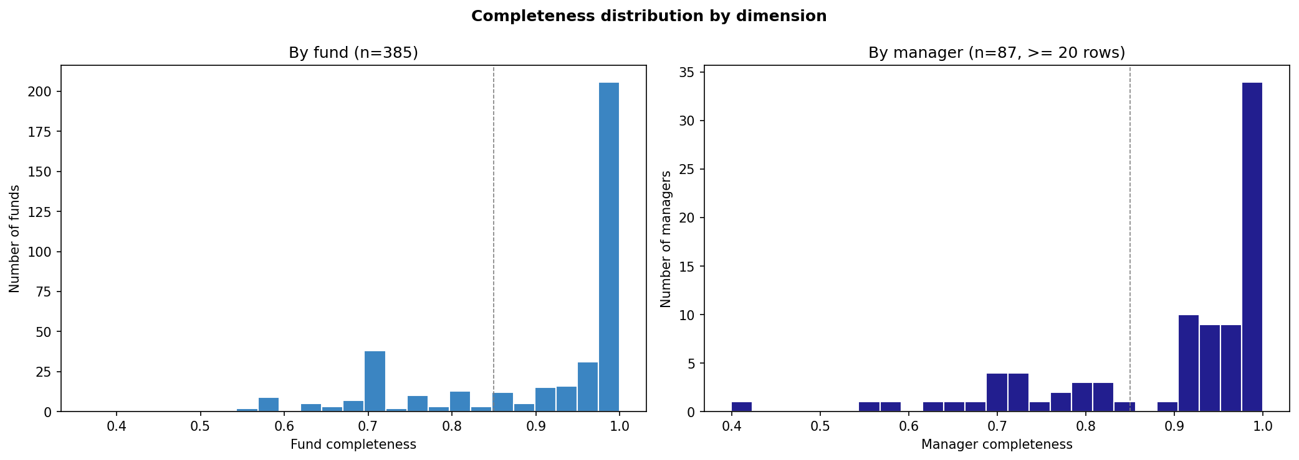
STEP 4 — SCORE BY FUND
Fund and manager completeness distributions
Both distributions are left-skewed against a hard ceiling at 100%. The mass sits above the 85% line, which means remediation is a tail problem — a small number of named vehicles, not a portfolio-wide programme.
Left: 385 funds · Right: 87 managers with at least 20 rows
10

Slide 12
STEP 4 — SCORE BY FUND
Where the funds sit
Completeness band
Funds
Share
Action
THE THREE WORST VEHICLES
100%
118
30.6%
None
95–99%
92
23.9%
None
Ab3ea87 — 36.5% (z = −4.05)
Ae7bb35 — 42.3% (z = −3.62)
A80d406 — 47.6% (z = −3.22)
Each sits more than three standard deviations below the mean.
85–94%
74
19.2%
Monitor
75–84%
63
16.4%
Review
50–74%
35
9.1%
Escalate
Below 50%
3
0.8%
Escalate
73% of funds already clear the 85% bar. The remediation target is the 38 funds below 75% — a list short enough to work through by name in a single quarter.
Framing for Operations: this is not a data-quality crisis. It is a concentrated tail of 38 named vehicles, of which 3 are severe.
Bands computed on mandatory-field completeness
11

Slide 13
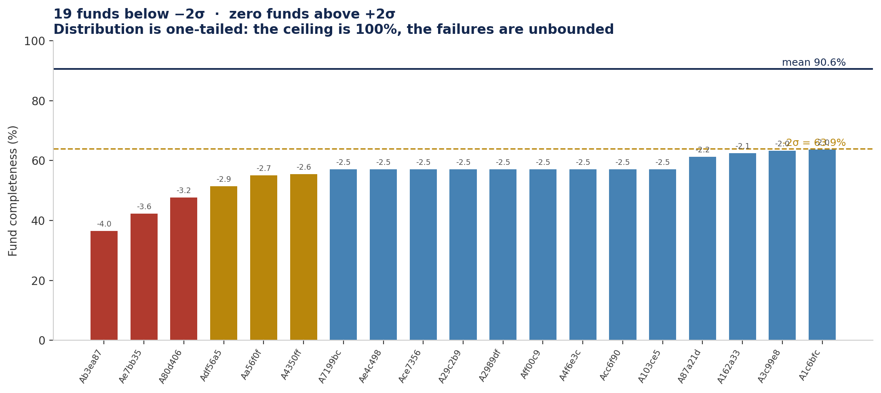
STEP 4 — OUTLIER DETECTION
The distribution is one-tailed
Nineteen funds fall below minus two sigma; none rise above plus two. That asymmetry is mechanical — completeness is capped at 100%, so excellence cannot be an outlier while failure is unbounded. Nine funds cluster at exactly 57.1%, which is 4 of 7 mandatory fields: the same four, suggesting a shared template rather than nine independent lapses.
Mean 90.6% · sigma 13.3%
12

Slide 14
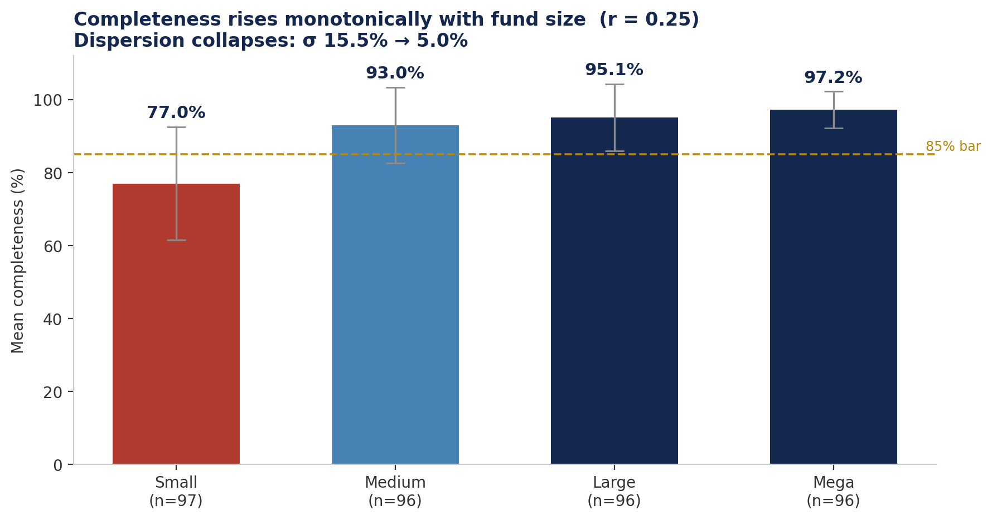
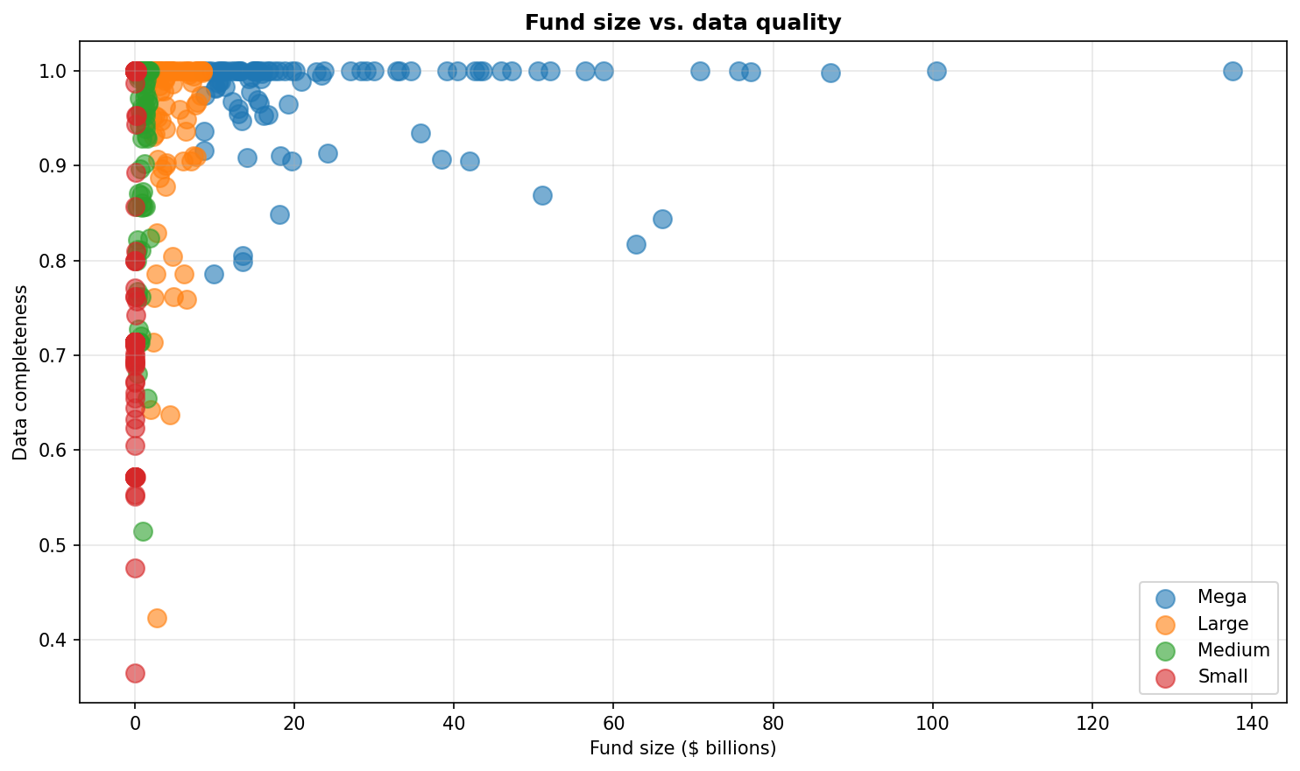
STEP 4 — SIZE VERSUS QUALITY
Larger funds report better — but size is not the mechanism
Mean completeness climbs monotonically from 77.0% to 97.2% across size quartiles, and dispersion collapses from σ 15.5% to 5.0%. But correlation is only 0.25 and small funds span the full range — several report at 100%. Size proxies for back-office maturity; it does not determine outcomes, so it cannot be used to excuse a small manager.
Quartiles by summed Total Value · n = 385
13

Slide 15
STEP 5 — SCORE BY MANAGER
Manager scorecard
MANAGERS SCORED
MEAN
MEDIAN
87
89.8%
95.1%
≥20 rows
well above mean
AT 100%
BELOW 85%
WORST
10
14
39.9%
16.1% of GPs
manager A5d1a01
Least complete managers
Rows
Funds
Completeness
Worst field
A5d1a01
169
2
39.9%
Deal Status 18.9%
A99a662
54
3
56.3%
Current Cost 0%
Aed3782
226
1
57.1%
Current Cost 0%
A9fbabf
173
3
62.3%
Capital Invested 0%
Median far above mean confirms a small tail dragging the average. Seven of the bottom ten share the same worst field: Capital Invested.
14 managers with fewer than 20 rows excluded as low-evidence
14

Slide 16
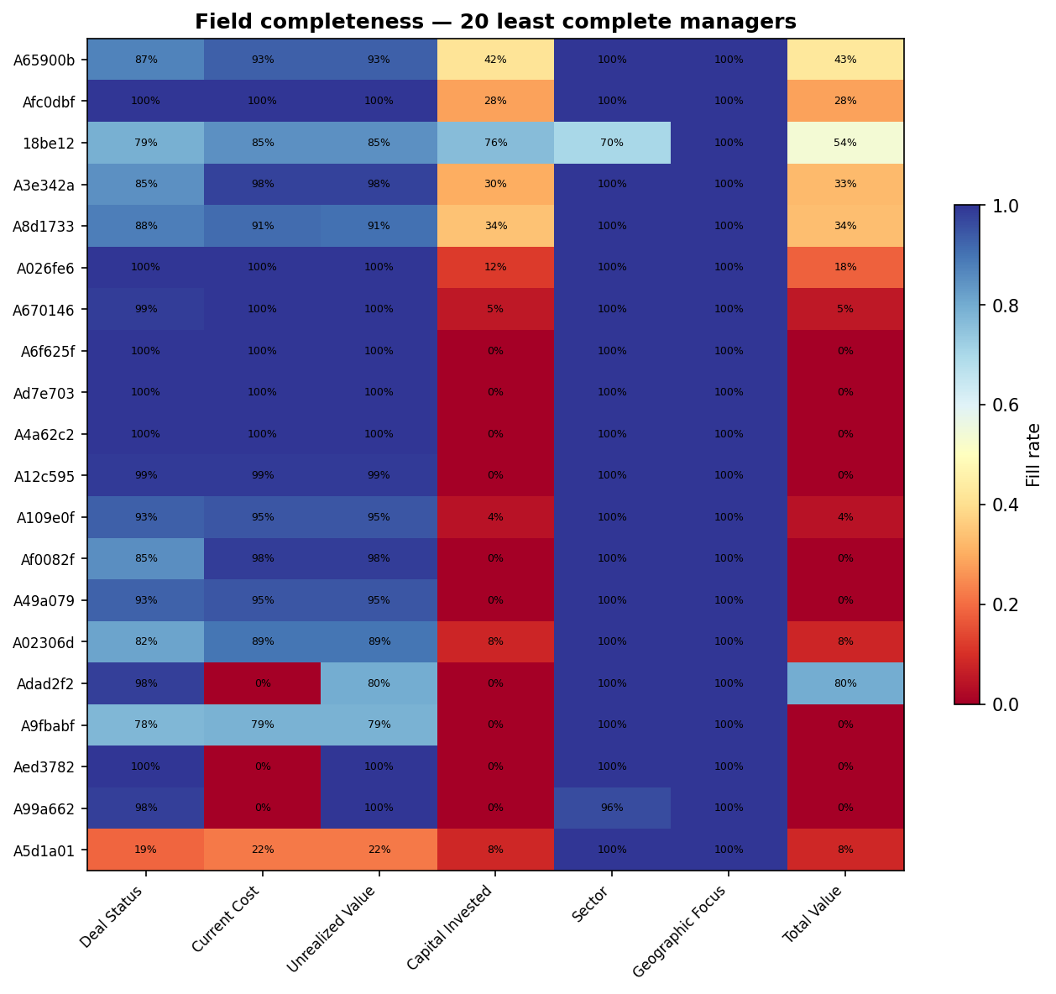
STEP 5 — MANAGER X FIELD
Which field does each weak manager omit?
The gaps are vertical, not diffuse. Sector and Geographic Focus stay green across every weak manager; Capital Invested is red almost everywhere. A manager at 60% overall is not sloppy across the board — they are missing one or two specific fields, which makes the follow-up request a single sentence rather than a data-quality lecture.
20 least complete managers · red = low fill
15

Slide 17
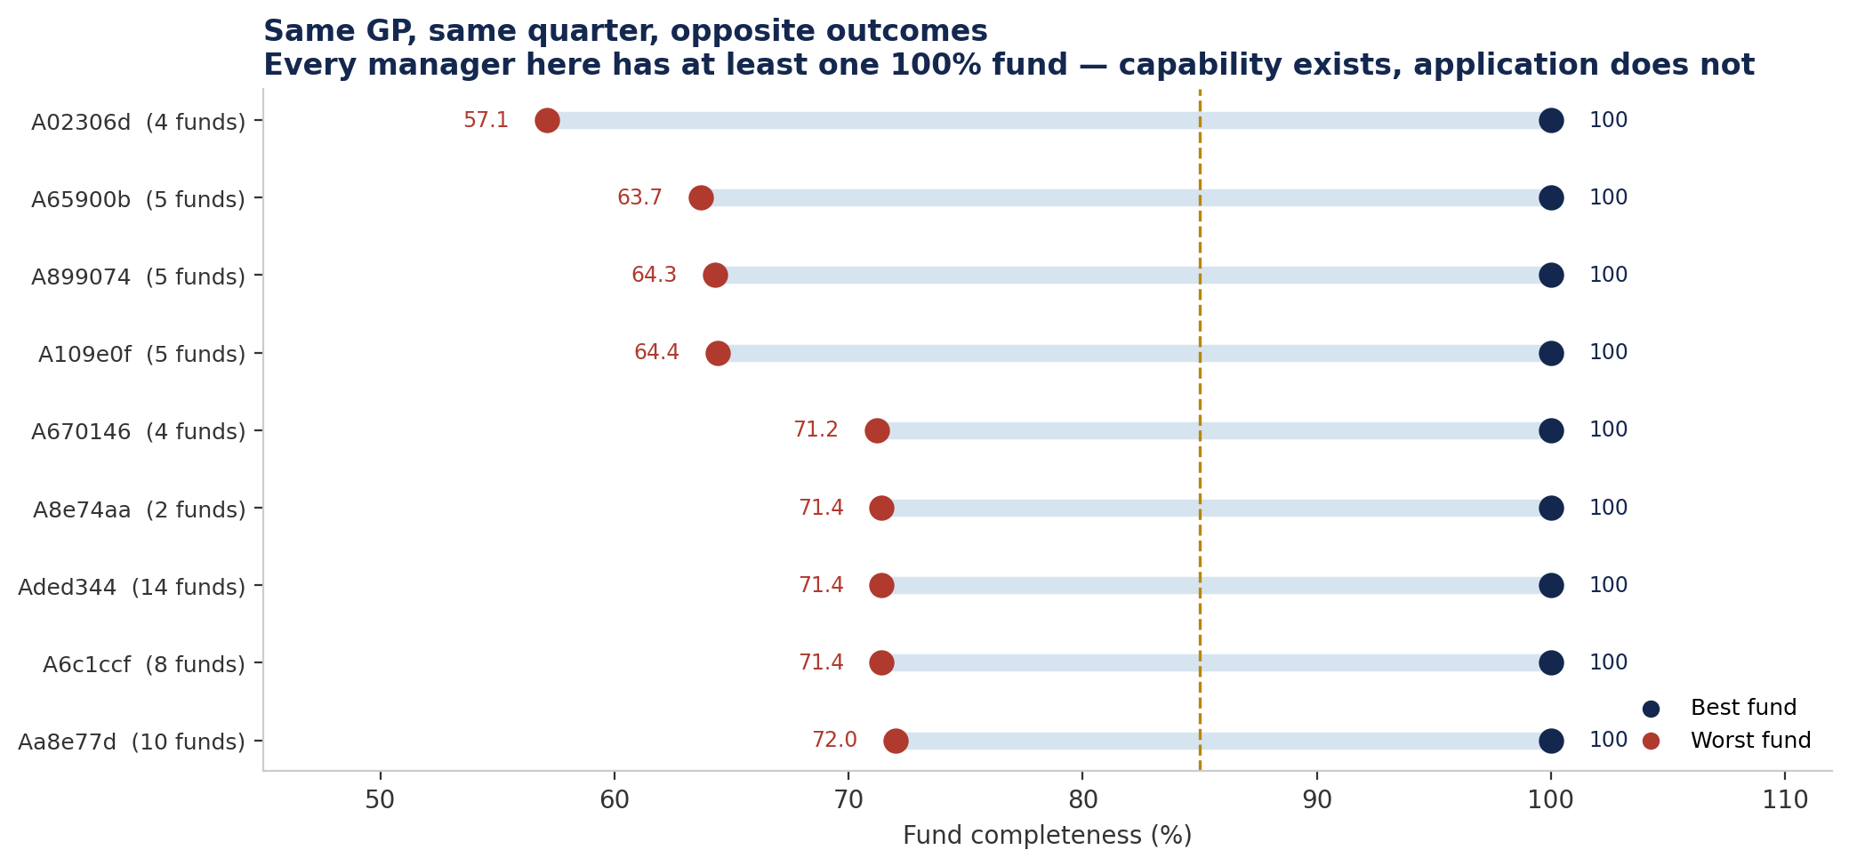
STEP 5 — WITHIN-MANAGER VARIANCE
The most actionable cut in the analysis
Every manager shown has at least one fund at 100% and another below 72%. Same GP, same reporting quarter, opposite results. The capability plainly exists, so these are fund-level breakdowns to raise about a named vehicle — not manager-level policy conversations. Managers with near-zero spread are the opposite case and need the policy conversation instead.
Managers with more than one fund · ranked by spread
16

Slide 18
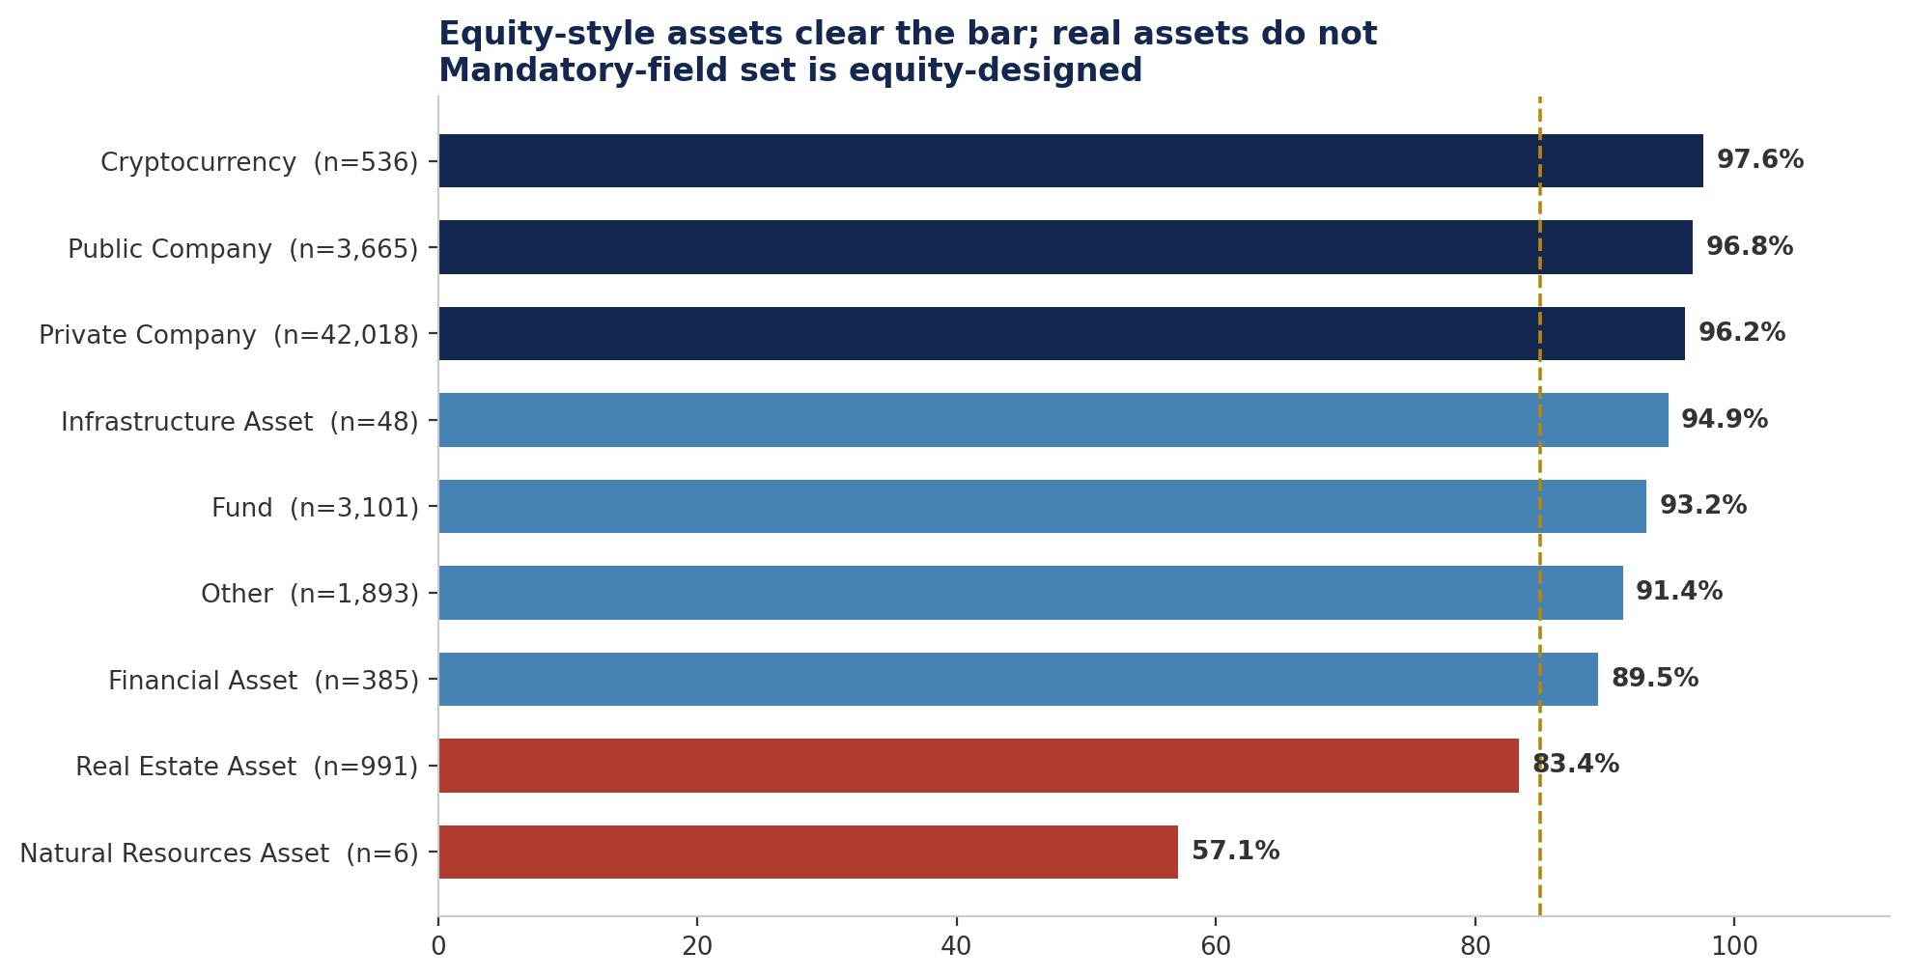
STEP 3 — CROSS-CUT
Quality by investment type
Equity-style holdings clear the bar comfortably. Real Estate at 83.4% and Natural Resources at 57.1% sit below it — and both are being measured against a mandatory field set built for equity.
n shown per type · gold line = 85%
17

Slide 19
FINDING 3
Real assets fail an equity-shaped test
Mandatory field
Equity meaning
Real-asset reality
Deal Status
Current / Exited / Written off
A property is held, leased or listed for sale — no exit event
Current Cost
Entry cost of the position
Book value plus capitalised improvements
Unrealized Value
Mark versus cost
Third-party appraisal on its own cycle
Capital Invested
Staged rounds
One purchase, then ongoing capex
Sector
GICS-style classification
Office / retail / industrial taxonomy
NATURAL RESOURCES — 6 ROWS
Lifecycle is exploration → development → production → decline. None of it maps to exit or write-down. Sample is too small to score meaningfully in any case.
WHAT THIS IS NOT
This is not evidence that real-asset GPs report poorly. It is evidence that the yardstick was built for a different asset class.
Recommendation: define an asset-class-specific mandatory set before these managers appear on any remediation list. Scoring them against the current set produces a false positive.
Real Estate 991 rows · Natural Resources 6 rows
18

Slide 20
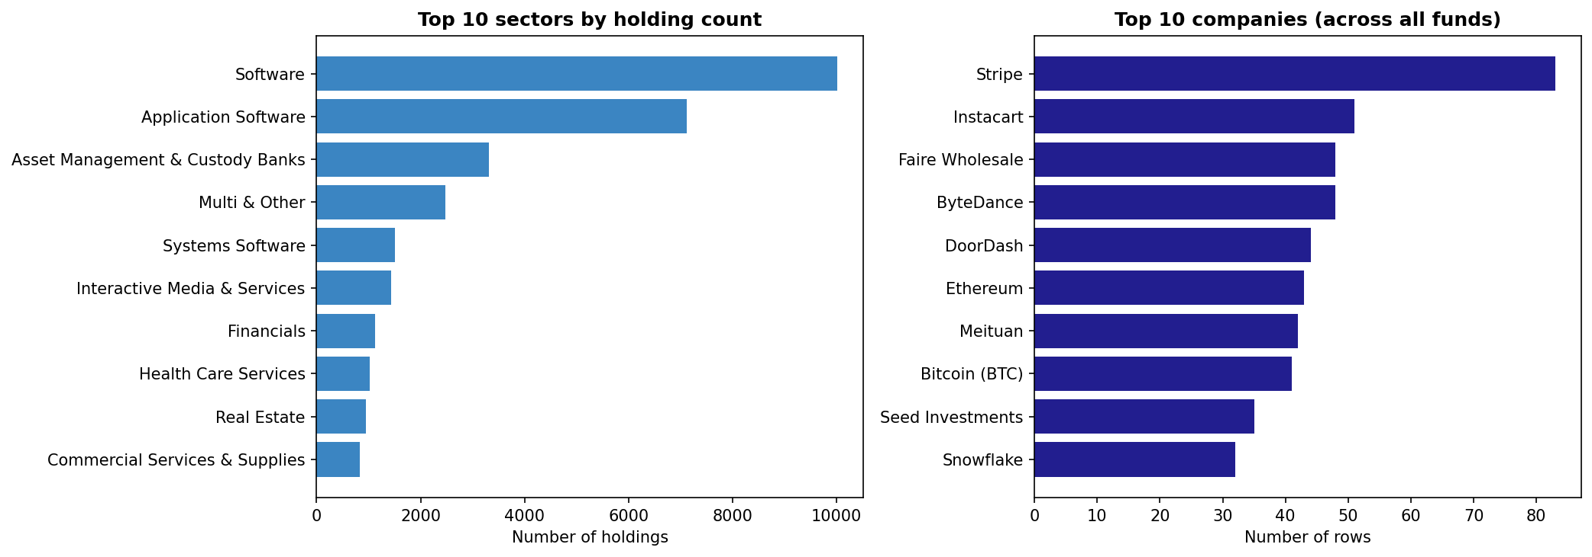
STEP 6 — CROSS-CUT
Portfolio concentration
Software and Application Software alone account for 32.5% of holdings; the top five sectors reach 44.6%. Concentration this high means a single sector-taxonomy error propagates across a third of the book.
Top 15 sectors · top 10 companies by row count
19

Slide 21
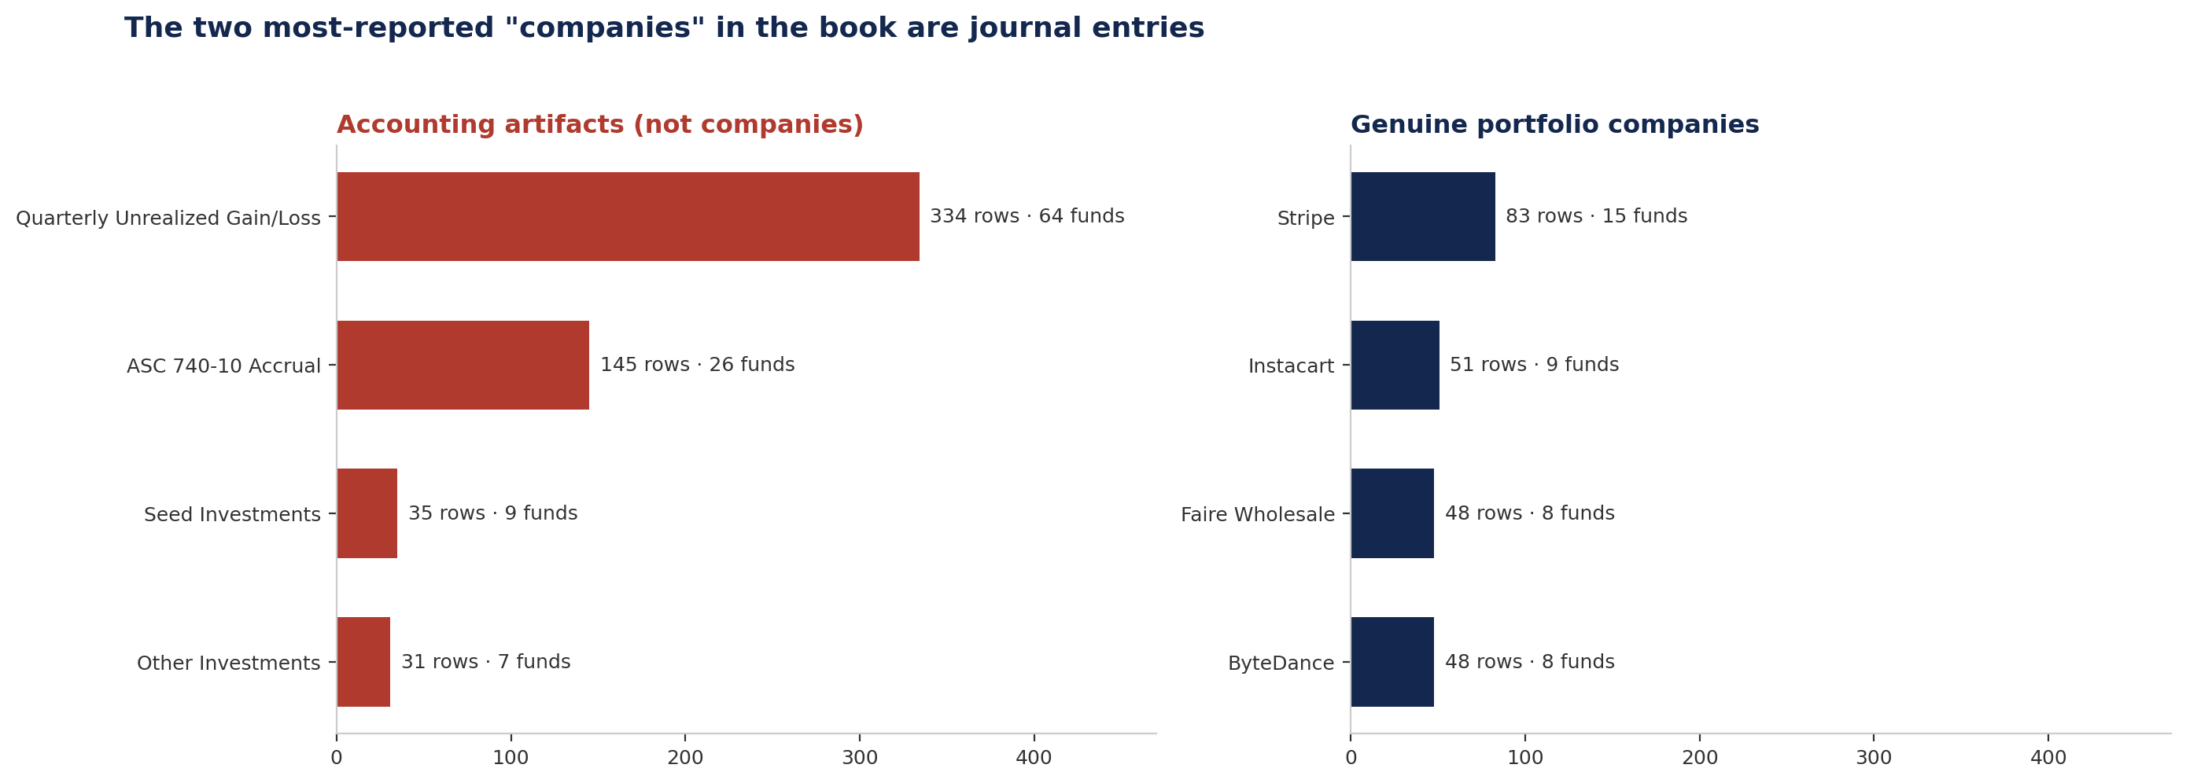
FINDING 4 — RESOLVED
The two most-reported "companies" were journal entries
"Quarterly Unrealized Gain/Loss" appeared 334 times across 64 funds and "ASC 740-10 Accrual" 145 times across 26, both sitting in Source Asset as though they were portfolio companies. The classifier now removes 594 such rows, and both entries drop out of the entity resolution queue where they had been the two largest items.
Detected in the top-20 company frequency table · now excluded
20

Slide 22
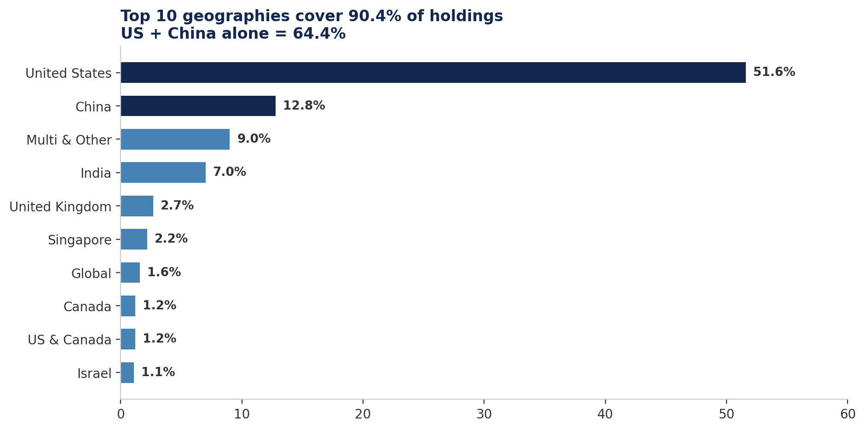
STEP 6 — CROSS-CUT
Geographic distribution
Reported completeness reaches 100% in Africa, Peru, Estonia and Nigeria — but each rests on a handful of rows. Small-n geographies should be read as noise, not as reporting excellence.
Top 10 cover 90.4% of holdings
21

Slide 23
STEP 6
Entity resolution — sizing the Phase 2 problem
RESOLVABLE NAMES
HELD BY MORE THAN ONE FUND
MEAN APPEARANCES PER NAME
8,633
1,107
6.0
after classification
12.8% of names
across quarters and funds
WHY THE COUNT OVERSTATES THE COMPANY UNIVERSE
Two funds holding the same business can write it two ways. "Oomnitz" on one schedule of realised gains and "Oomnitza, Inc." on another schedule of investments are the same company — the extract treats them as two.
The 1,107 multi-fund names are the working set: these are the only ones where a naming mismatch can split a single company into several, and the only ones where cross-fund valuation comparison is possible at all. Twenty-seven names were removed from this queue by the classifier, led by the two journal entries on the previous slide.
Phase 2 dependency: deal-status inference cross-references the schedule of investments against the schedule of realised gains. That join is by company name, so canonical mapping has to land before inference can run. Fuzzy matching may propose candidates; it may not decide them.
Explicit aliases, not automatic fuzzy acceptance
22

Slide 24
SYNTHESIS
Findings ranked
#
Finding
Scale
Severity
Owner
1
Capital Invested absent by design
67 funds (17.4%)
High
Vendor + GP
2
Net-return metrics unusable
Net IRR 1.2%
High
Vendor scope
3
Managers below 85%
14 of 87
High
Operations
4
Entity resolution unresolved
1,107 names
Medium
Phase 2
5
Accounting entries as companies
594 rows
Resolved
Fixed
6
Deal Status blank
6,639 rows
Medium
GP follow-up
7
Real assets mis-scored
997 rows
Low
Redefine metric
8
Severe fund outliers
3 funds below 48%
High
Operations
Two of the top three findings are not GP failures — they are extraction-scope and field-definition questions that belong with the vendor. Sequencing those first avoids sending Operations to chase data the GPs already sent.
Severity weighted by rows affected and analytical impact
23

Slide 25
ACTIONS
Recommendations
01
Resolve Capital Invested and Total Value with the vendor
Vendor
Immediate
Confirm whether the 67 and 58 zero-fill funds are contractual exclusions or extraction misses. Nothing else should be chased until this is settled.
02
Decide the net-return question explicitly
Vendor
Immediate
Bring capital account statements into scope, or record that net performance is out of scope for this extract.
03
Tier manager outreach
Operations
Q1
Tier 1: 3 GPs below 60%. Tier 2: 11 GPs at 60–85%. Tier 3: high-spread GPs, raised per fund rather than per relationship.
04
Define an asset-class mandatory set
Analytics
Q1
Real Estate and Natural Resources scored against their own field list before either appears on a remediation list.
05
Extend the non-investment filter ✓ DONE
Analytics
Complete
Three-way classifier shipped with 57 regression tests. 594 rows reclassified; 27 names left the resolution queue.
06
Stand up canonical naming
Analytics
Q1–Q2
Begin with the 1,107 multi-fund names. Explicit aliases, reviewed, not auto-accepted.
07
Re-run quarterly
Operations
Ongoing
The notebook is parameterised. Track band migration rather than the headline average.
Sequenced so vendor questions resolve before GP outreach begins
24

Slide 26
ROADMAP
Phase 1 closes, Phase 2 opens
PHASE 1 — DESCRIPTIVE ✓ COMPLETE
PHASE 2 — VALIDATIVE NEXT
"What state is the data in?"
"Is the data correct?"
Completeness scored on three axes
Parse schedule of investments from source PDFs
Gap concentration quantified
Reconcile cost and fair value to fund totals
13,176 records flagged
Infer Deal Status across schedules
Entity-resolution scope sized
Compare vendor CSV against statements
Eight exports written for Operations
Attach page and bounding box to every value
Cannot answer: is the data correct?
Blocked on: canonical entity naming
The two phases answer different questions. Completeness says a value is present; validation says it is right. A fund at 100% completeness carrying wrong numbers still scores 100% here — which is precisely why Phase 2 exists.
Sample statement parsed and reconciled to the dollar
25

Slide 27
APPENDIX
Exports and validation
File
Contents
ASSERTIONS PASSED
data_state_by_field.csv
Fill rate, all 329 value columns
Fund completeness within [0,1]
data_state_by_fund.csv
Completeness, all 385 funds
data_state_by_manager.csv
Completeness, rows, funds — 101 GPs
Manager completeness within [0,1]
data_state_by_manager_field.csv
Field-level fill per manager
No duplicate rows
flagged_missing_fields.csv
13,176 records for GP follow-up
Unit columns stripped
source_asset_classification.csv
Row and name counts per class
Flagged ⊆ all rows
excluded_non_investment_rows.csv
6,112 rows removed, with reason
REPRODUCIBILITY
The notebook runs end to end from the raw extract with no manual steps. Thresholds — the 85% bar, the 20-row manager floor, the mandatory field list — are parameters at the top of the file, so a change in Investment Office policy is a one-line edit and a re-run, not a rewrite.
source_asset_review_queue.csv
4 names held for human decision
Open question for the Investment Office: is 85% the right bar, and should Sector carry equal weight to Current Cost in the mandatory set? Both are currently assumptions.
Notebook: (phase1)holdings_data_state_analysis.ipynb · 62 cells
26

Slide 28
Questions
Phase 1 data-state analysis complete.
Phase 2 validation blocked only on canonical entity naming.
Brown University Investment Office · Confidential

